Slide 1


Flight Booking Prediction — Model Performance Report
Predicting whether a customer will book a flight
By Srinivasan Sankaralingam

Slide 2

Problem Statement
Objective
Data
Predict flight booking likelihood per customer
Features from customer behavior and historical data
Goal
Build effective classification model

Slide 3

Model Used
Model Type
Dataset
RandomForest
10,000 test samples for evaluation
Training
Trained on historical flight booking data

Slide 4
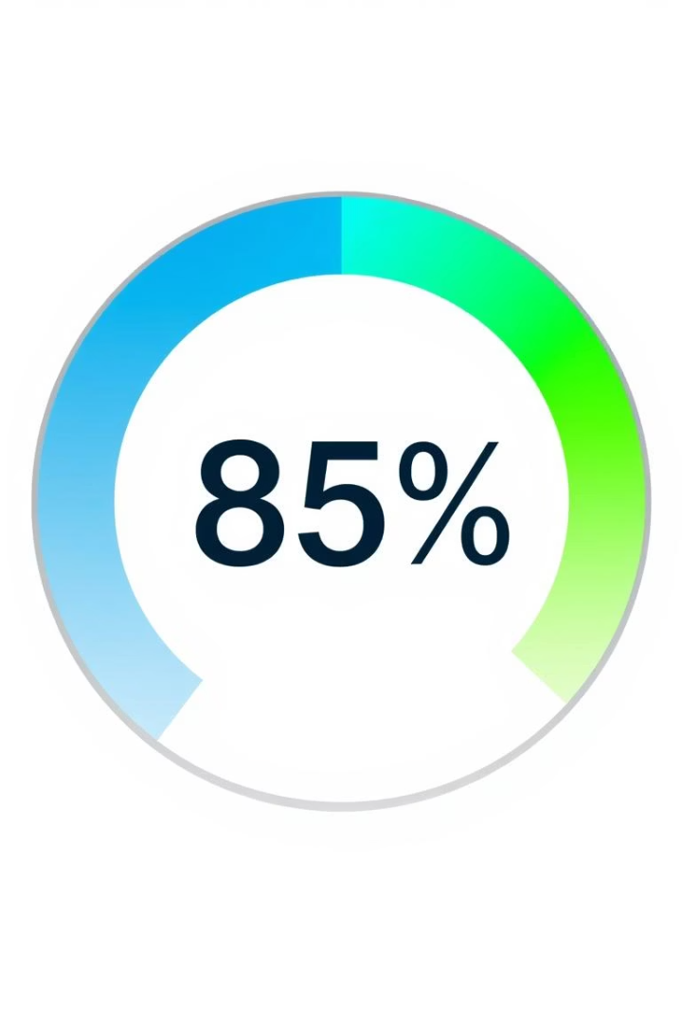
Overall Accuracy
Accuracy = 85.41%
Strong overall classification performance
Accuracy reflects correct predictions over total samples

Slide 5
Classification Report
Class
Precision
Recall
F1-Score
Support
No booking (0)
0.86
0.98
0.92
8520
Booking (1)
0.54
0.11
0.18
1480
Macro Avg
0.70
0.55
0.55
10000
Weighted Avg
0.82
0.85
0.81
10000

Slide 6





Interpretation
High Class 0 accuracy
Precision 0.86, recall 0.98 for no bookings
Low Class 1 recall
Only 11% of actual bookings detected
Weighted F1-Score: 0.81
Good overall model balance
Majority class advantage
Better prediction for non-bookers

Slide 7

Conclusion & Next Steps
Achievements
85% accuracy, strong non-booking predictions
Limitations
Low recall on booking class needs attention
Recommendations
Apply SMOTE, cost-sensitive learning, and tuning
Future Focus
Enhance minority class detection

