Slide 1
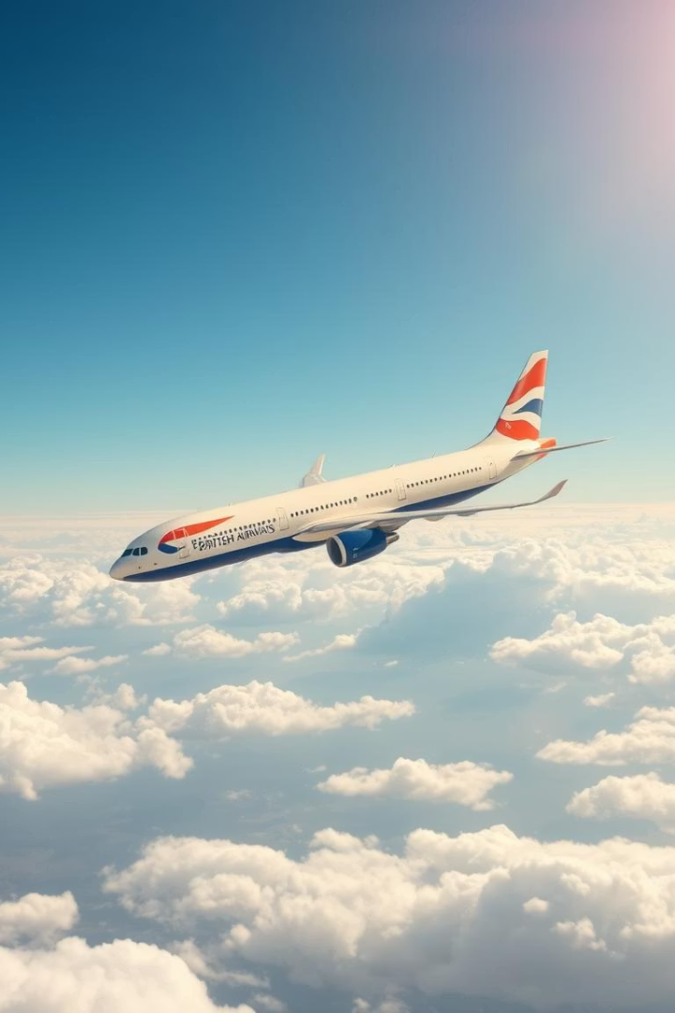

Sentiment Analysis of British Airways Reviews
This presentation delivers key insights from customer reviews of British Airways.
by Srinivasan Sankaralingam

Slide 2
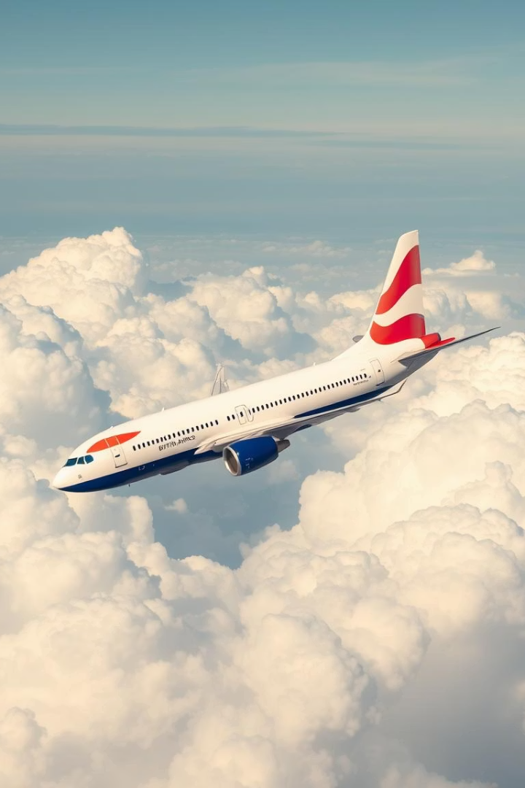
Deep Dive: British Airways Customer Sentiment
Title
Deep Dive: British Airways Customer Sentiment
Subtitle
Key Insights from Text Analytics & Review Trends

Slide 3

Project Objective
Quantify sentiment distribution
Identify pain points & strengths
Measure positive, negative, and neutral review amounts.
Find frequent words revealing key customer themes.
Correlate review length & sentiment
Analyse how length relates to sentiment intensity.

Slide 4
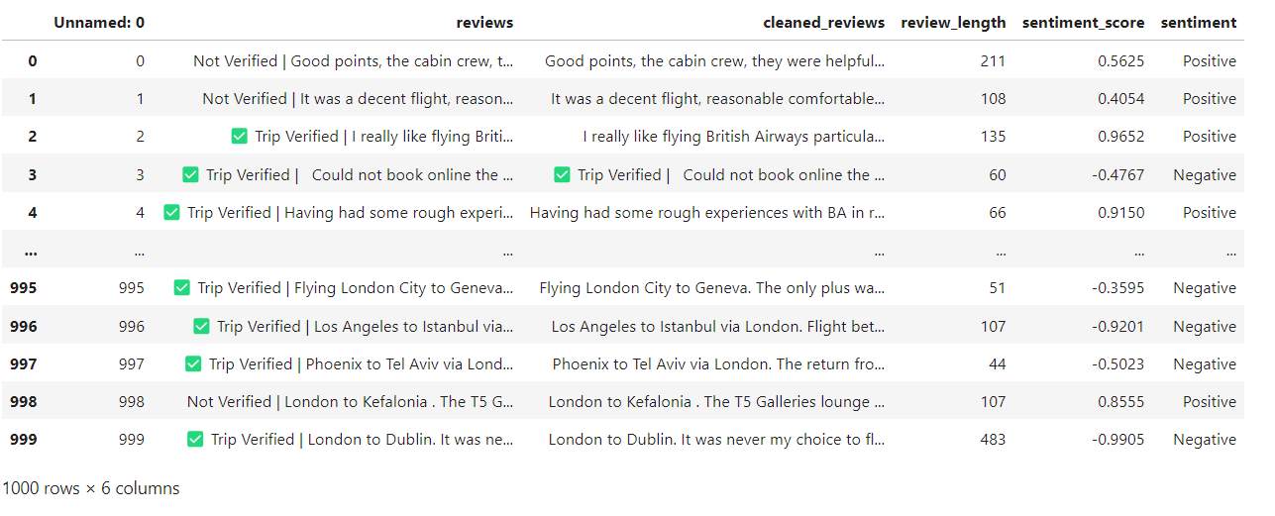
Dataset Overview
Total reviews exceed 1,500, capturing diverse customer voices. Columns: sentiment (Positive, Negative, Neutral), review_length, cleaned_reviews. Most reviews are under 200 words; longer ones >300 words indicate detailed complaints.

Slide 5
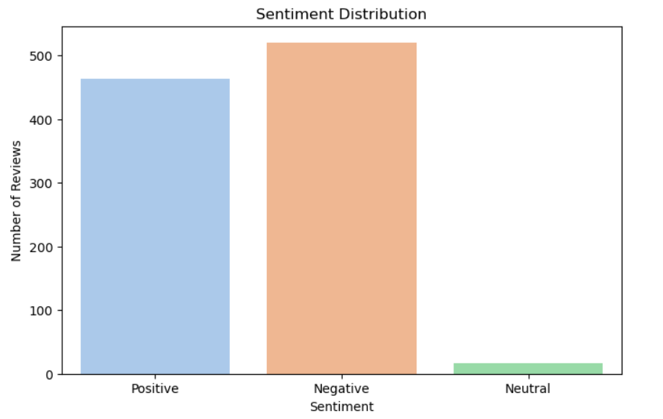
Sentiment Distribution
Majority lean negative, overtaking positive just by a 50-60 reviews out of the 1000 with neutrals highlighting nuanced feedback.

Slide 6
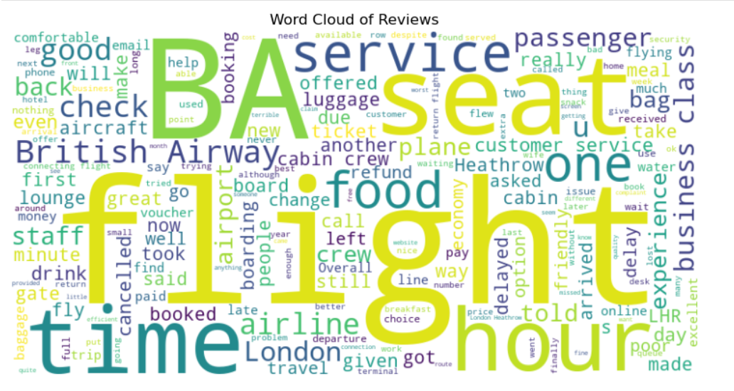
Top 20 Frequent Words
Brand Mentions
"British Airways" and "BA" show strong brand identity connection.
Operational Terms
Words like flight, time, food, and seat dominate discussions.

Slide 7
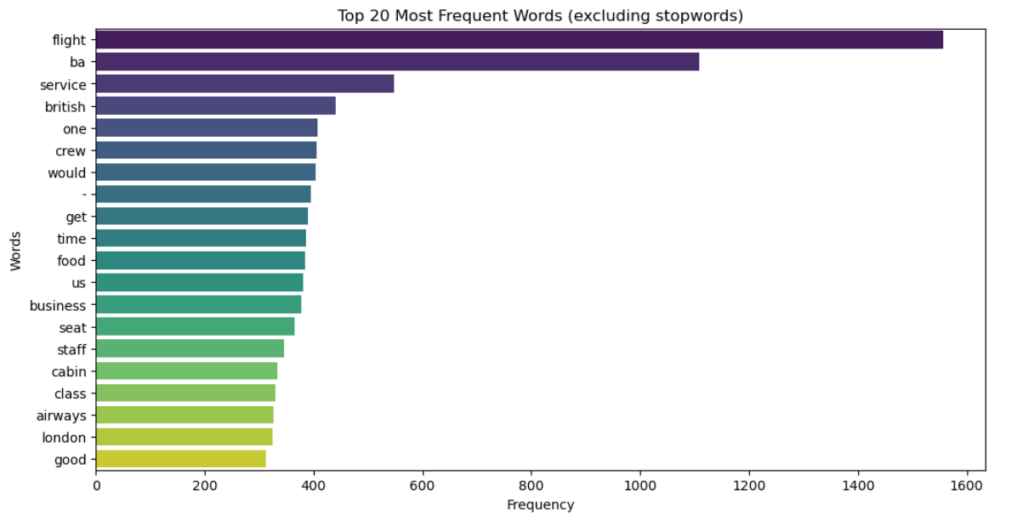
20 most frequently used Words

Slide 8
Sentiment-Length Correlation
Average Word Counts
Positive: 130 words | Negative: 180 words | Neutral: 110 words.
Insight
Negative reviews are about 38% longer, indicating detailed complaints.

Slide 9
Positive Themes
Top Words
Sample quote: ‘Crew was exceptionally helpful during delay.’
crew
service
good
comfortable

Slide 10
Negative Themes
Top Words
Quote: ‘Flight delayed 6 hours with no compensation.’
time
Action: Address delays and refund transparency to reduce negativity.
delayed
refund
food

Slide 11
Thank you.

