Slide 1
Django Framework
Django is High-Level Python web Framework
Presented by :Anchan
Date: 02/08/2021

Slide 2
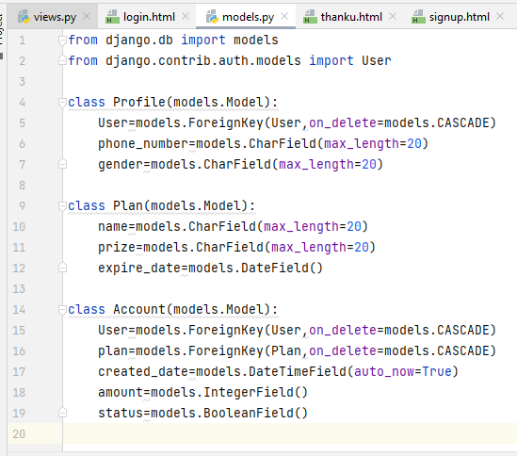
User Authentication in Django

Slide 3
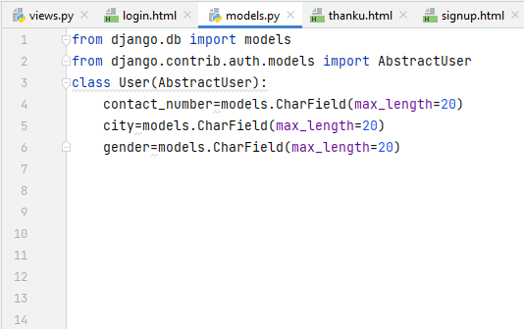
AbstractUser

Slide 4
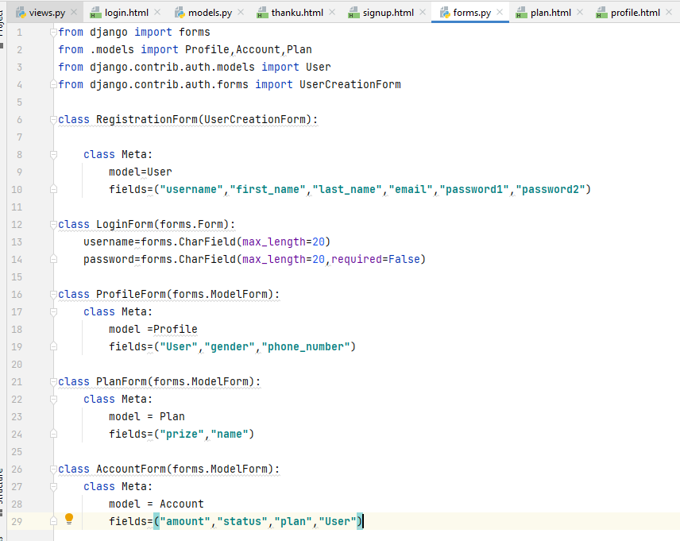
UserCreationForm (Forms.py)

Slide 5
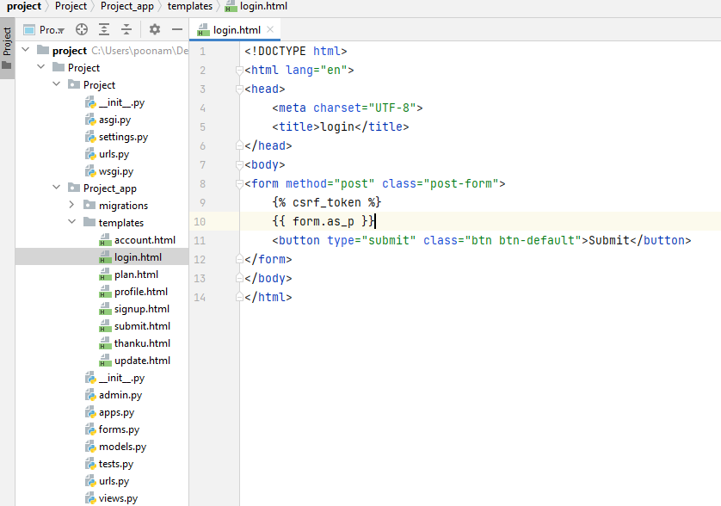
Templates

Slide 6
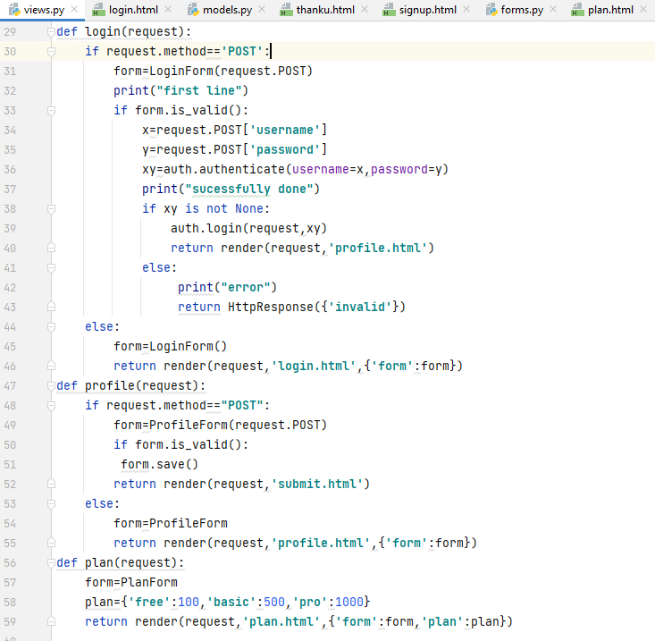
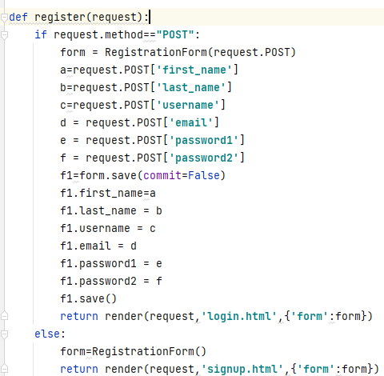
View.py

Slide 7
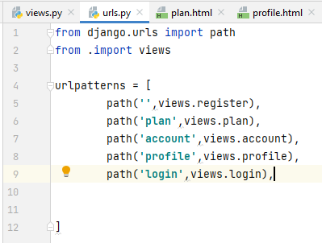
Urls.py

Slide 8
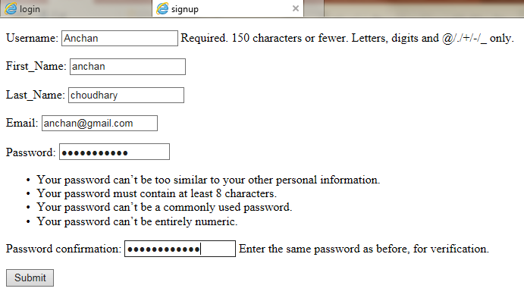
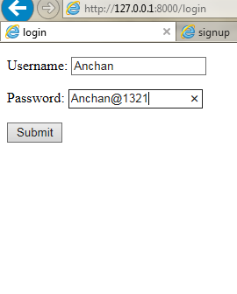
Signup/Login

Slide 9
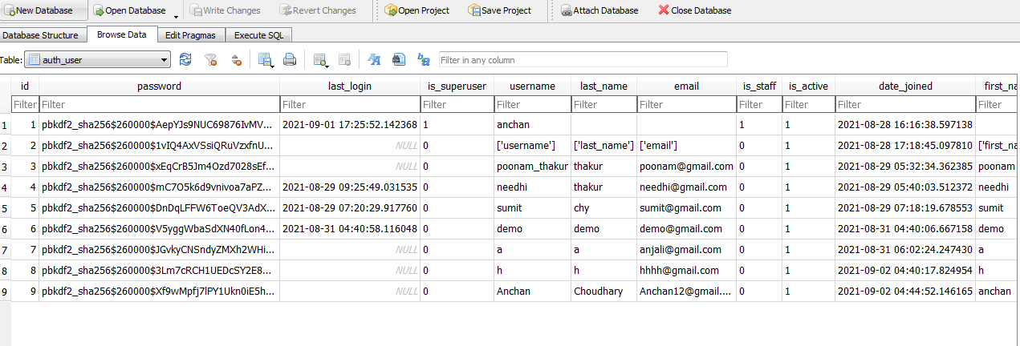
DbSqlLite

Slide 10
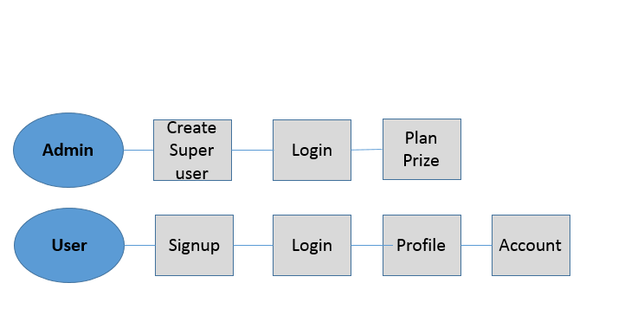

Slide 11
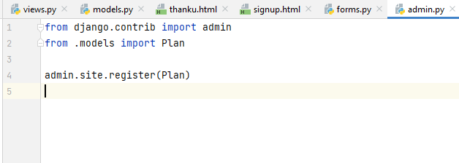
Admin.py

Slide 12
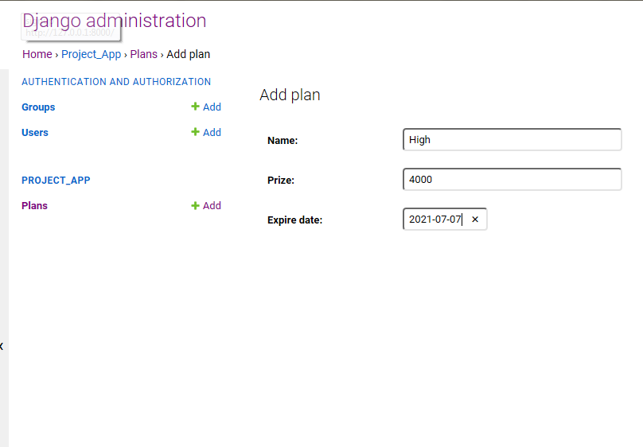

Slide 13
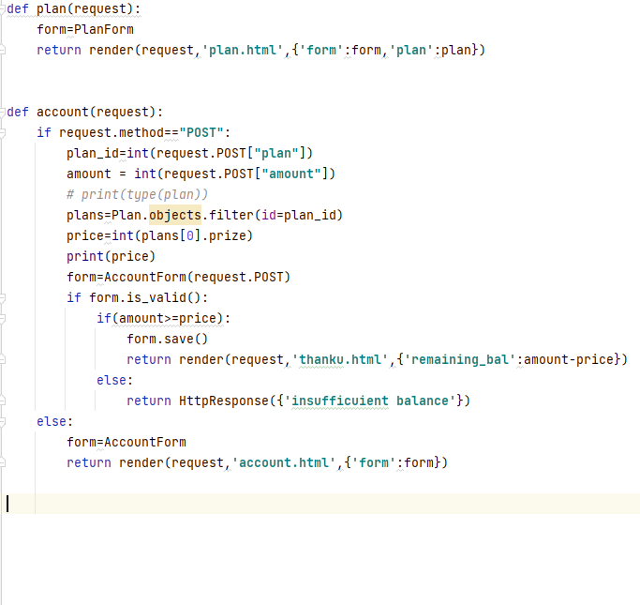

Slide 14
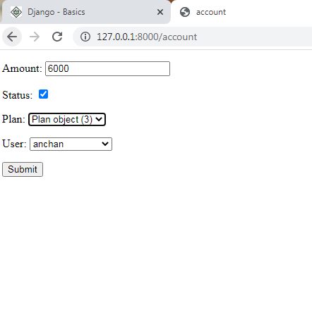

Slide 15
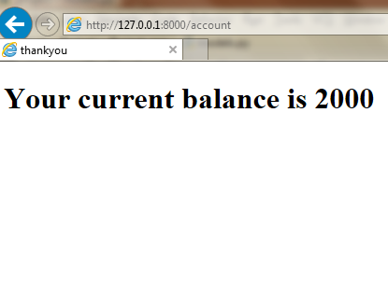

Slide 16
Thankyou

Slide 17
Query & Model Relationship . Many-to-many relationships . Many-to-one relationships . One-to-one relationships
Presented by :Anchan
Date: 15/09/2021

Slide 18
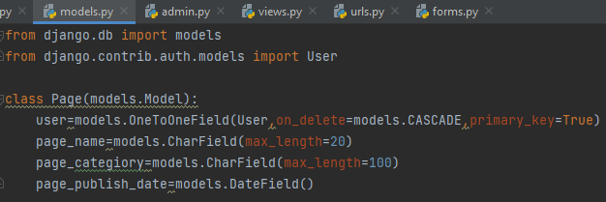
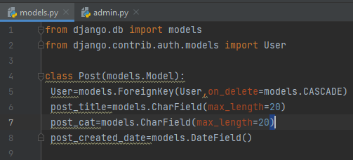
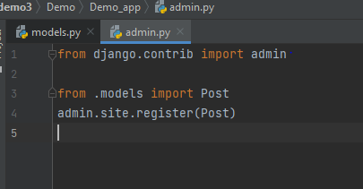
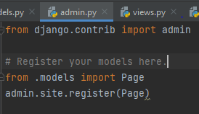
Model.py

Slide 19
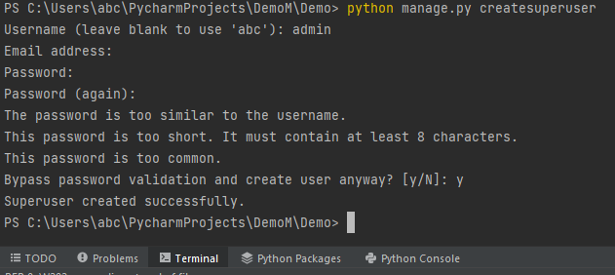
Superuser

Slide 20
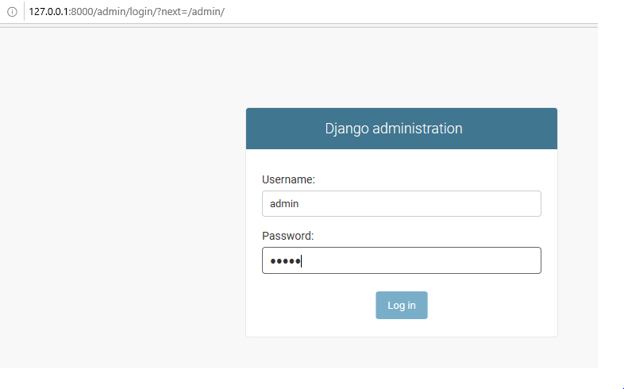
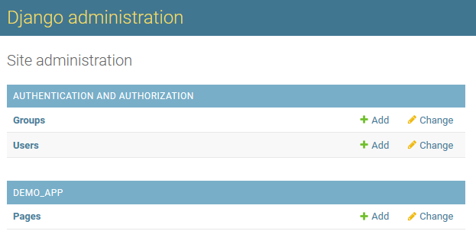
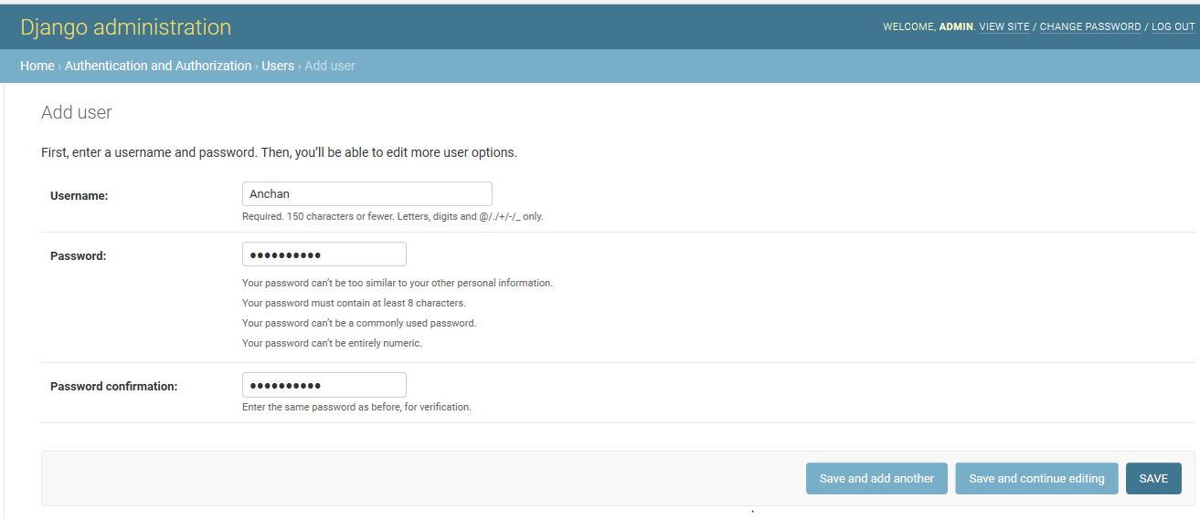
Django adminstration

Slide 21
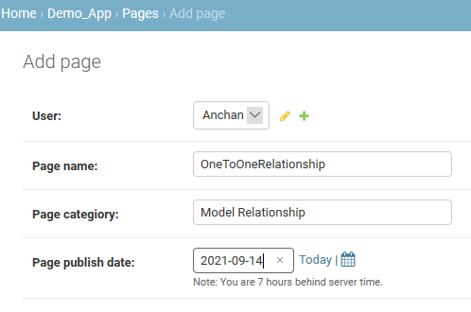
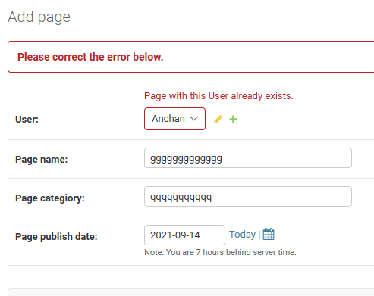
OneToOne Relationship

Slide 22
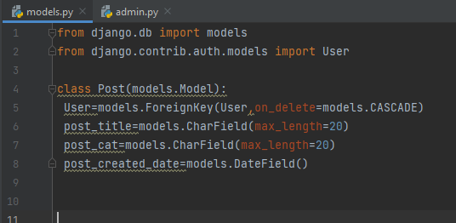
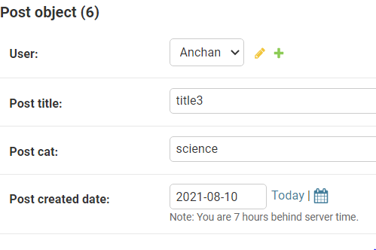
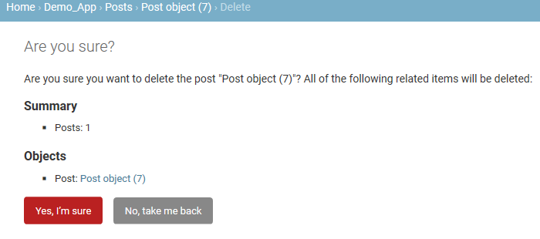
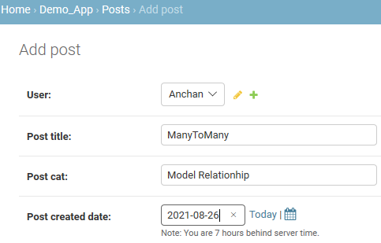
ManyToOneRelationship

Slide 23
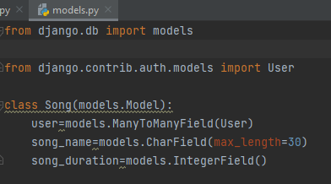
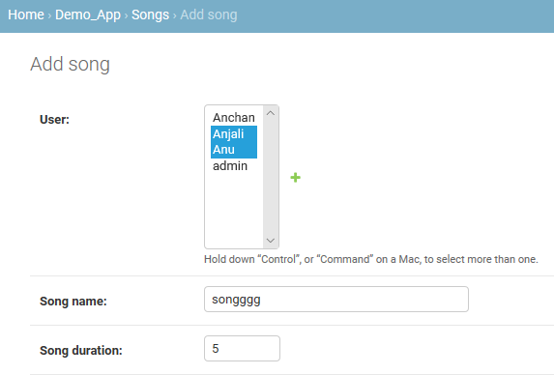
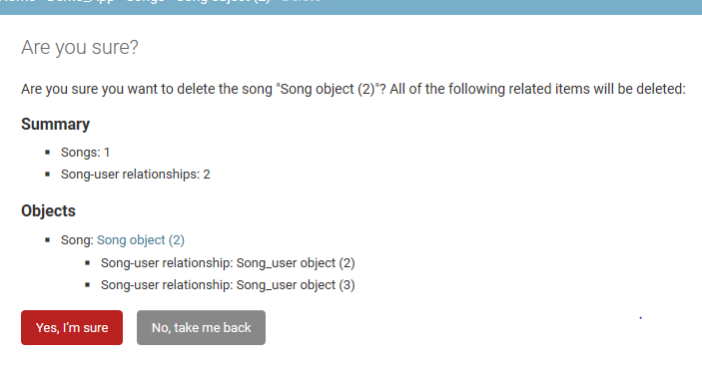
ManyToManyRelationship

Slide 24
User
Sign-up
Log-in
Student
Teacher
Update
Delete
Student Registration
College
Course
College

Slide 25
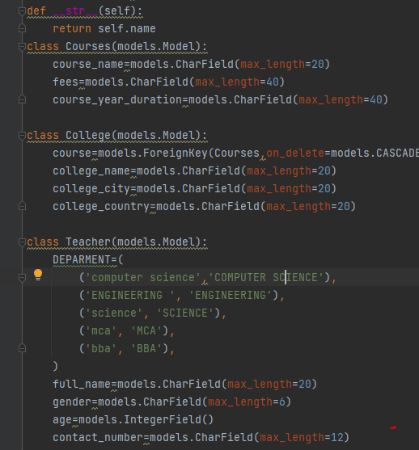
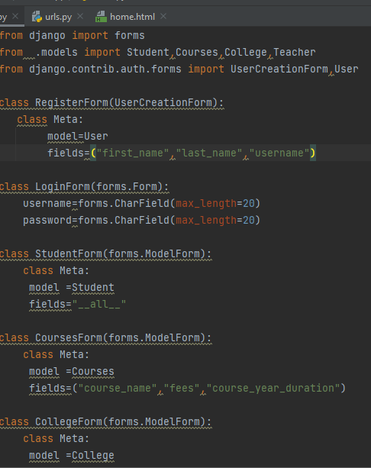
Model.py &Forms.py

Slide 26
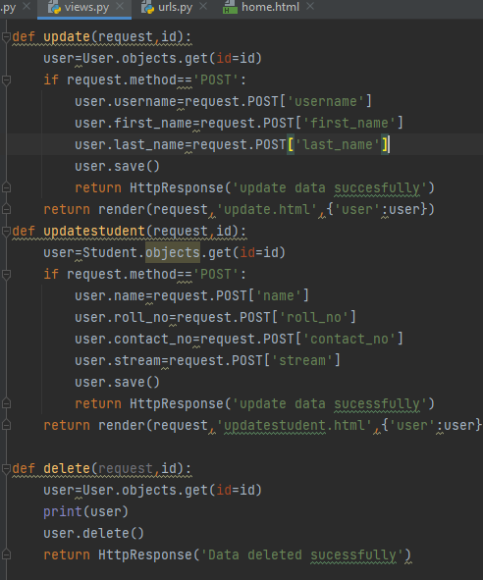
View.py

Slide 27
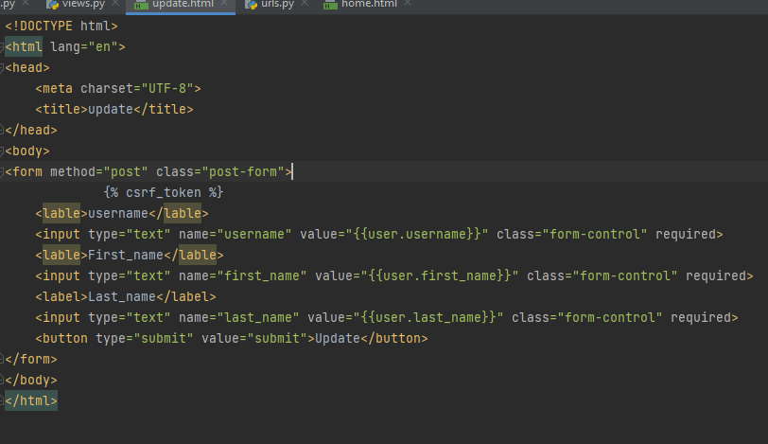
Update.html

Slide 28
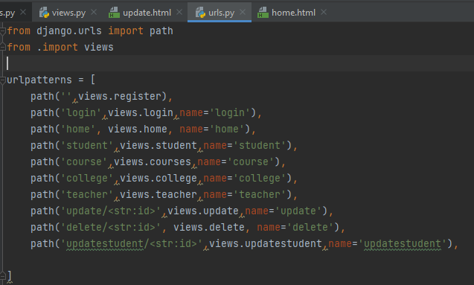
Urls.py

Slide 29
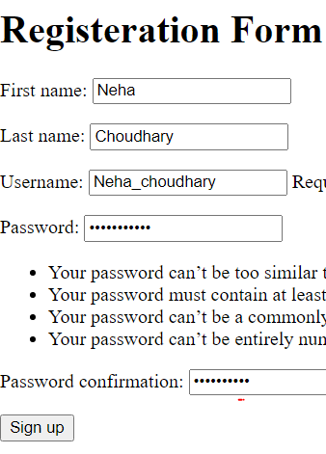
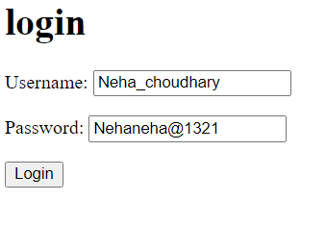
Signup and Login

Slide 30
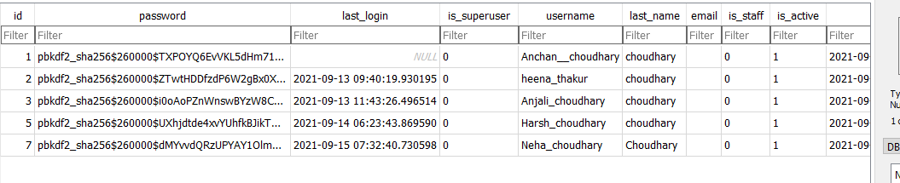
Database

Slide 31
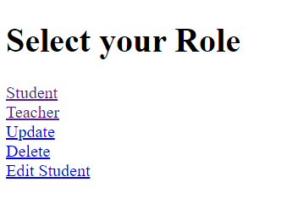
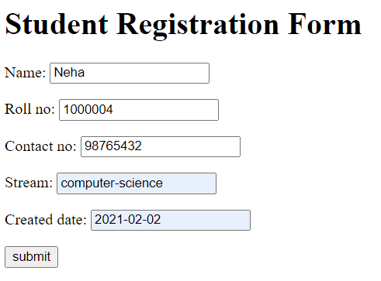
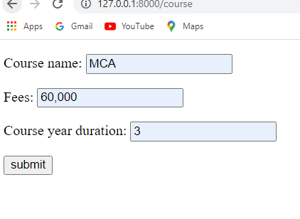
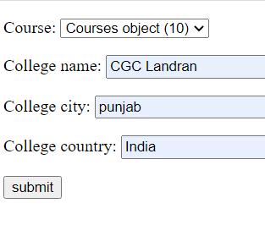

Slide 32
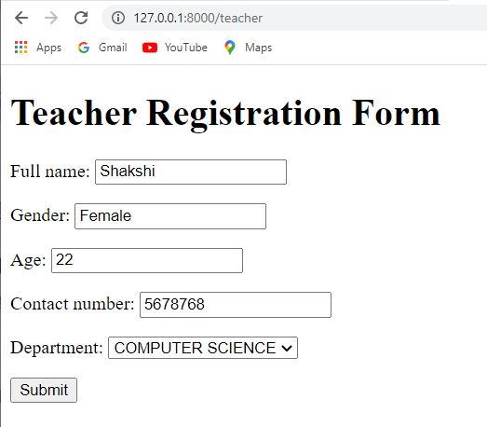
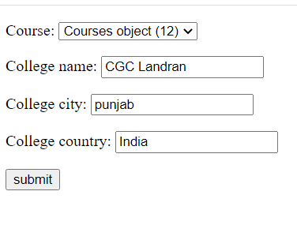
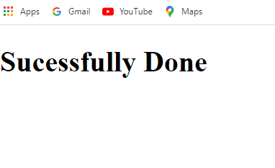

Slide 33
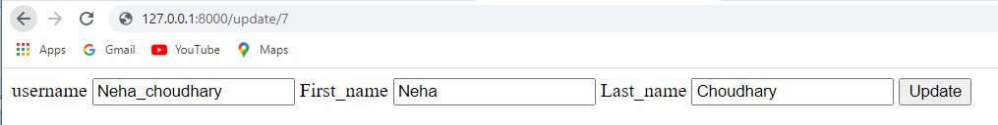
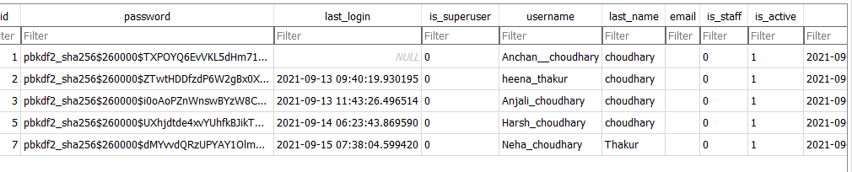


Update & Delete

Slide 34
Thank you

Slide 35
Django Rest Framework
Django Rest Framework is Powerful and flexible
toolkit for building Web APIs.
Presented by :Anchan
Date: 01/10/2021

Slide 36

models.py

Slide 37

serializers.py

Slide 38

Views.py(SchoolView)

Slide 39

Views.py

Slide 40


Slide 41

Views.py(ClassView)

Slide 42

Views.py(SectionView)

Slide 43

Urls.py

Slide 44

Post . adding school

Slide 45

Get getting all school list

Slide 46

Getting school with section & classes

Slide 47



PUT
get id create id

Slide 48


Update exiting data

Slide 49



Deleting data

Slide 50


Creating CLASS

Slide 51



Patch updating exiting data

Slide 52


Delete

Slide 53

View.py(SectionView)

Slide 54


POST adding section

Slide 55


Delete

