Slide 1
Beyond WhatsApp: An Improved Real-Time Messaging Solution
Presented By Akash Yadav M Ananda Krishnan Aji Lohith K Mohammad Abith
SlideMake.com

Slide 2
CONTENTS :-
INTRODUCTION.
HARDWARE/SOFTWARE REQUIRMENTS
APPLICATION ARCHITECTURE
BACKEND DEVELOPMENT
FRONTEND DEVELOPMENT
SECURITY AND AUTHENTICATION
DEPLOYMENT
CONCLUSION
FUTURE IMPROVEMENTS/REFERNCE
Notes:
Image source: https://www.slidemake.com

Slide 3
INTRODUCTION:
What is a Web-Based Chat Application? A platform for real-time communication with features like instant messaging and media sharing.Purpose Facilitate user interaction in real-time.. Handle media uploads seamlessly. Provide a scalable, modern communication tool. Technologies Used: React: Frontend framework for building an interactive UI. Node.js: Backend server. MongoDB: Database for data storage. Cloudinary: Media upload and optimization. Socket.IO: Real-time messaging support.
Notes:
Image source: https://www.slidemake.com

Slide 4
HARDWARE/SOFTWARE REQUIRMENTS :-
Hardware Requirements
Client System:
4GB RAM (8GB recommended), Intel Core i3 or higher, 20GB storage.
Server System:
8GB RAM, Quad-core CPU, 100GB SSD, High-speed internet.
Software Requirements
Frontend: React.
Backend: Node.js, Express.js, Socket.IO.
Database: MongoDB.
Media Management: Cloudinary SDK.
Tools: VS Code, Git/GitHub.
OS: Windows, macOS, or Linux
Notes:
Image source: https://www.slidemake.com

Slide 5
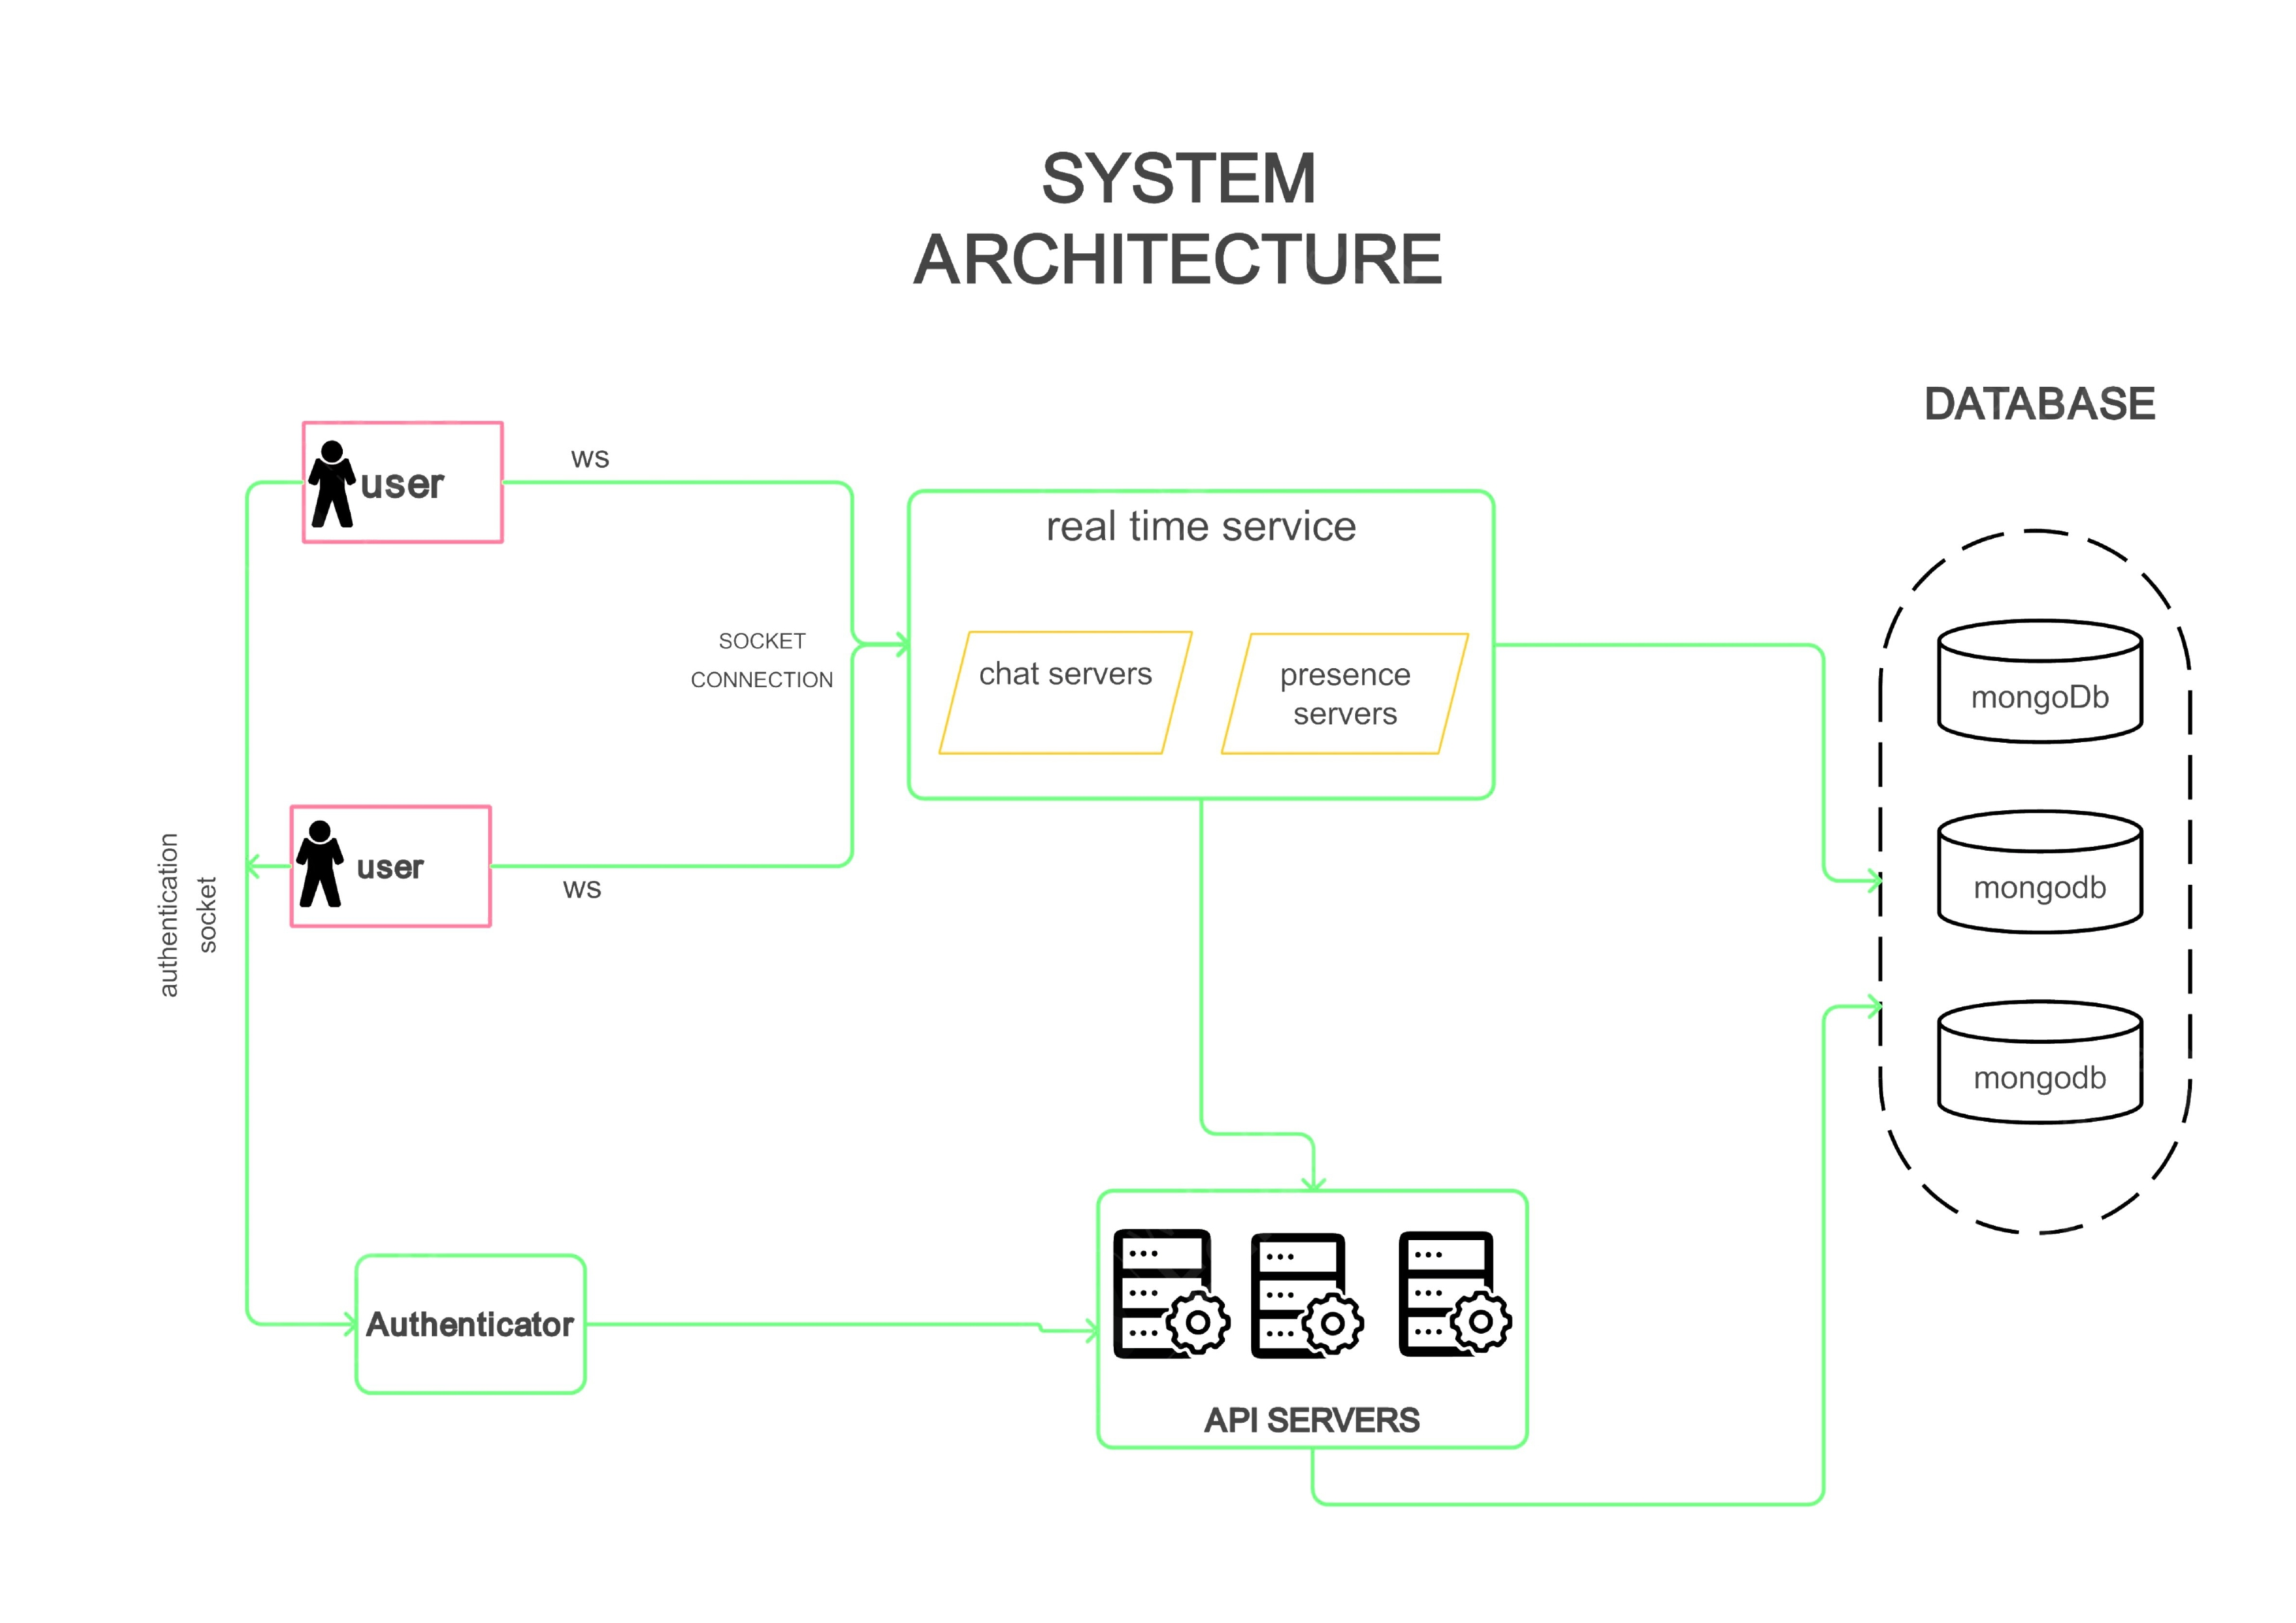
APPLICATION ARCHITECTURE :-
Notes:
Image source: https://www.slidemake.com

Slide 6
Users connect via WebSockets for real-time messaging, authenticated by the Authenticator.
Real-Time Service manages chat through Chat Servers and user status via Presence Servers.
API Servers handle authentication, data requests, and media uploads.
MongoDB stores user data, messages, and chat history, while Cloudinary handles media storage and delivery.
Notes:
Image source: https://www.slidemake.com

Slide 7
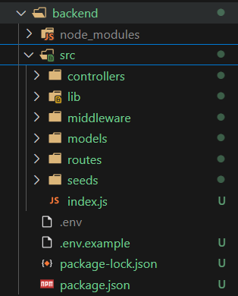
BACKEND DEVELOPMENT :-
controllers: Contains functions to handle API requests (e.g., create, update, delete).
seeds: Scripts to populate the database with initial or sample data.
libs: Utility functions and helpers used throughout the app.
routes: Defines API endpoints and links them to controller functions.
middleware: Functions that run before request handlers, like authentication or validation.
models: Defines database schemas and how data is structured.
index.js: Main file to set up the server, connect to the database, and initialize routes.
.env file: Stores sensitive environment variables (e.g., API keys, database URLs).
Package.json: Manages project dependencies and scripts
Notes:
Image source: https://www.slidemake.com

Slide 8
CONNECTING DATABASE TO BACKEND
Install Mongoose: Use npm install mongoose to add it to your backend.
Set Up MongoDB: Use MongoDB Atlas (cloud) or a local MongoDB instance.
Connect to MongoDB: In your backend, use Mongoose to connect with the MongoDB URI.
Define Schema: Create a Mongoose schema to structure your data (e.g., for users or messages).
Create API Routes: Define routes to perform CRUD operations using Mongoose methods.
Store Data: Use Mongoose to save and retrieve data from MongoDB.
Environment Variables: Store sensitive info (like the MongoDB URI) in .env files.

Slide 9
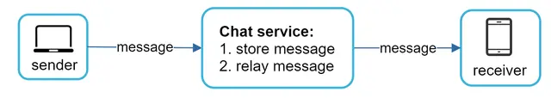
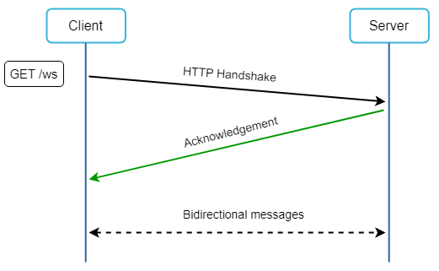
WORK FLOW DIAGRAMS
websockets:

Slide 10
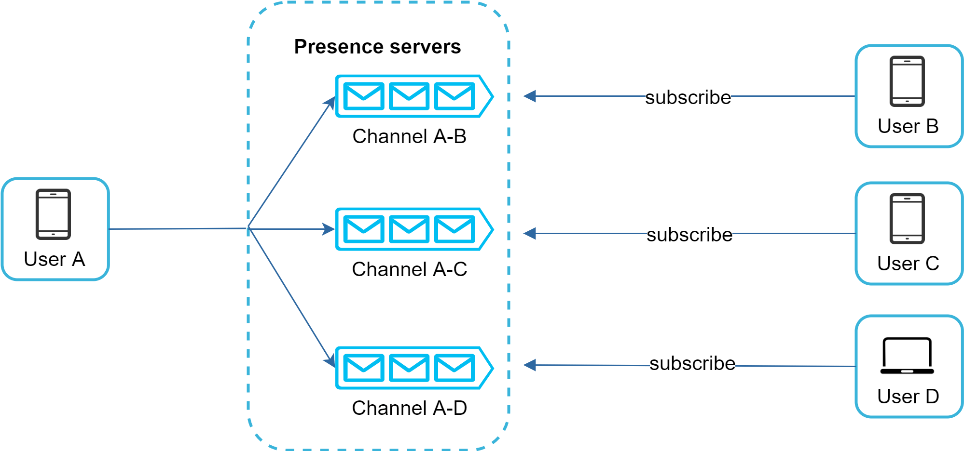
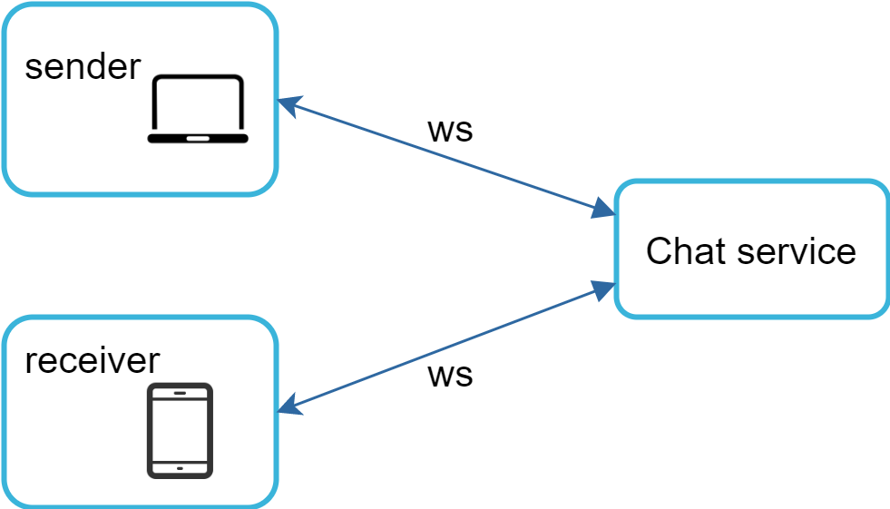
ONLINE/OFFLINE SERVICE FLOW
Chat service b/w sender and receiver

Slide 11
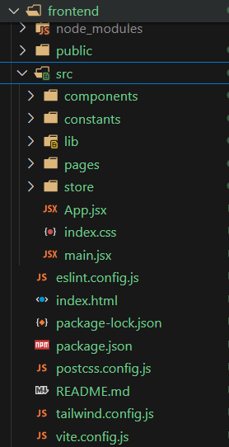
FRONT-END DEVELOPMENT
Project Folders:
public: Holds static files (e.g., index.html, images) that are publicly accessible.
src:
components: Reusable UI elements like buttons, headers, etc.
pages: Main app pages (e.g., chat, login).
constants: Stores constant values like API URLs or action types.
lib: Utility functions, custom hooks, and helper logic.
store: Manages app state with tools like Redux or Context API’
Key Files:
app.jsx: Main entry point, defines layout, routing, and global components.
main.jsx: Boots up the app and connects it to the DOM.
app.css: Global or component-specific styles for consistent design.
package.json: Manages dependencies, scripts, and project metadata.
Notes:
Image source: https://www.slidemake.com

Slide 12
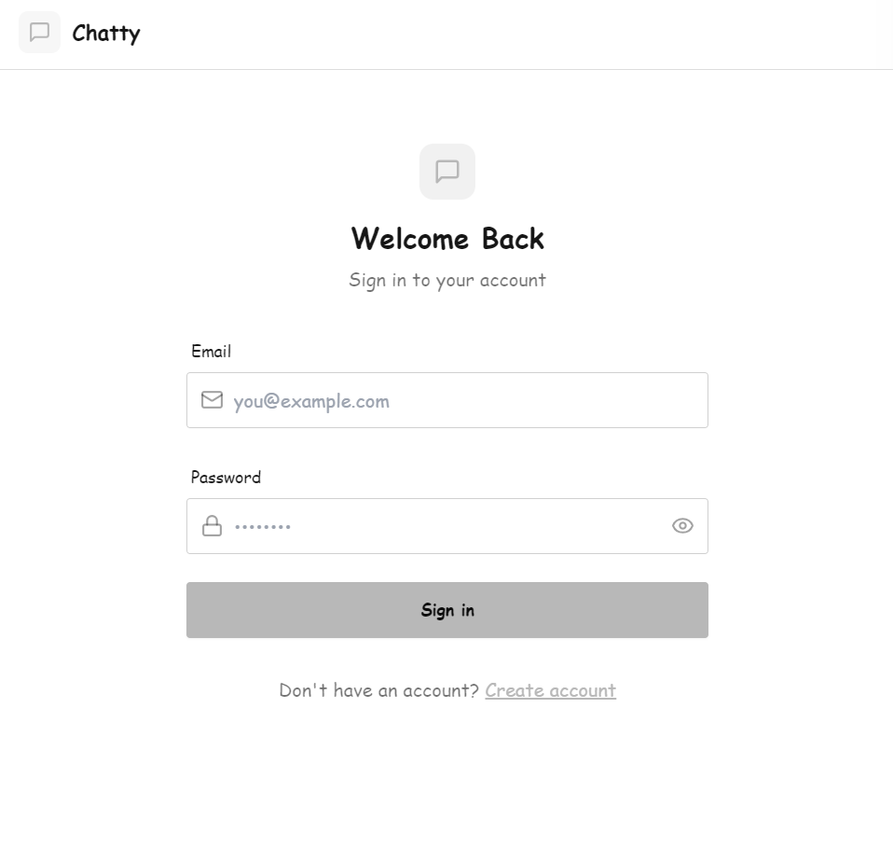
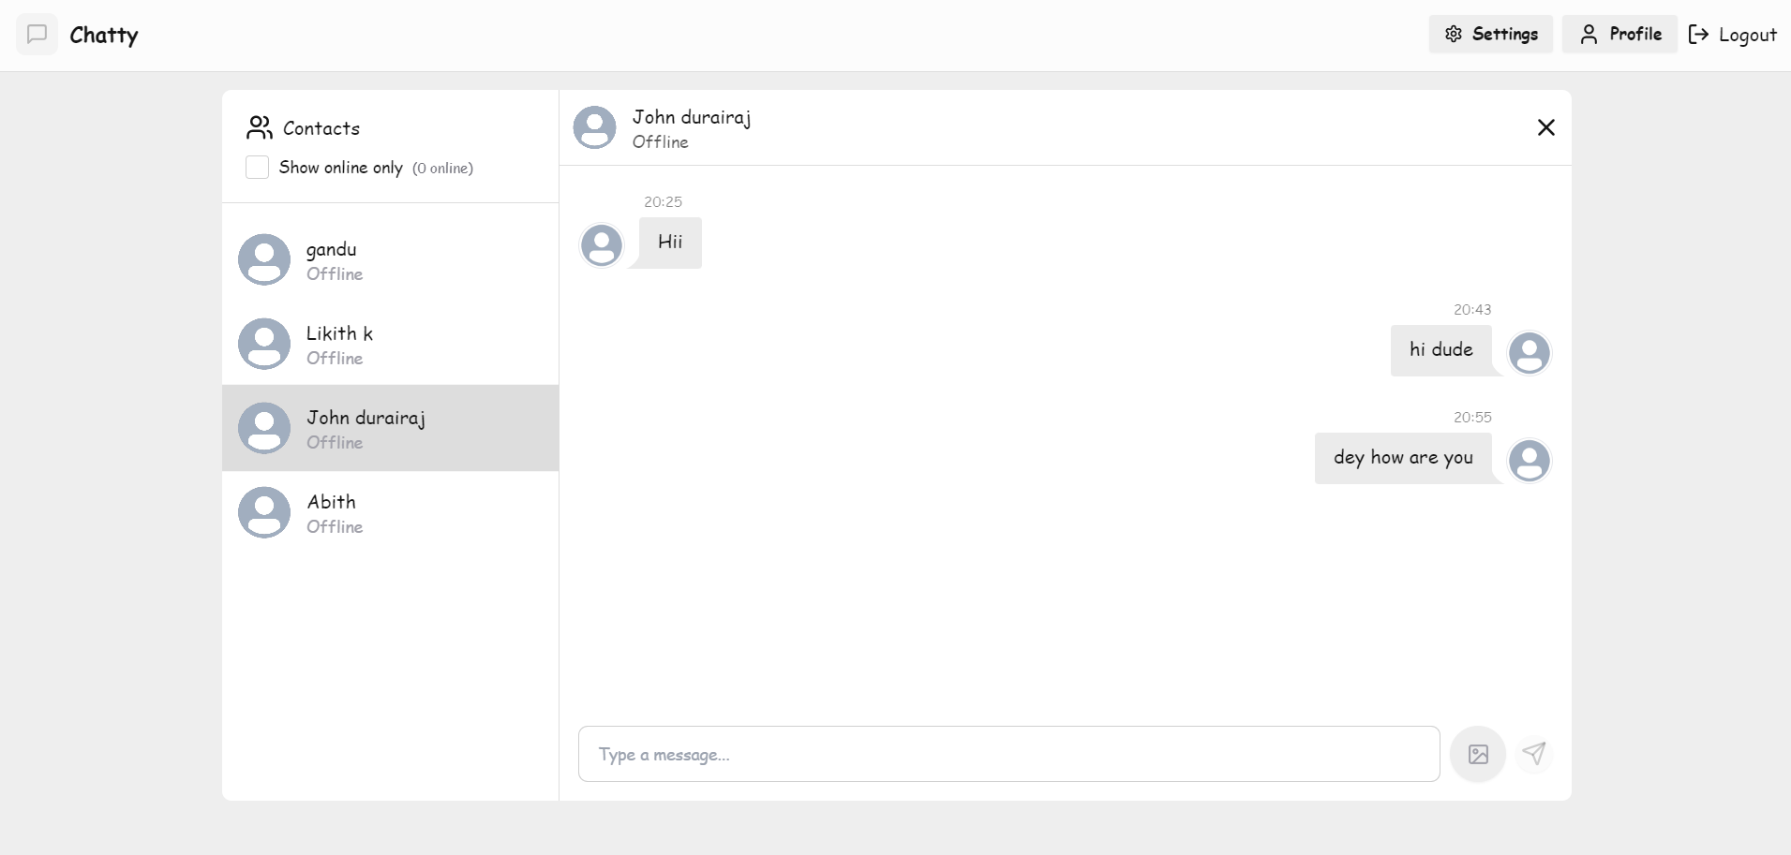
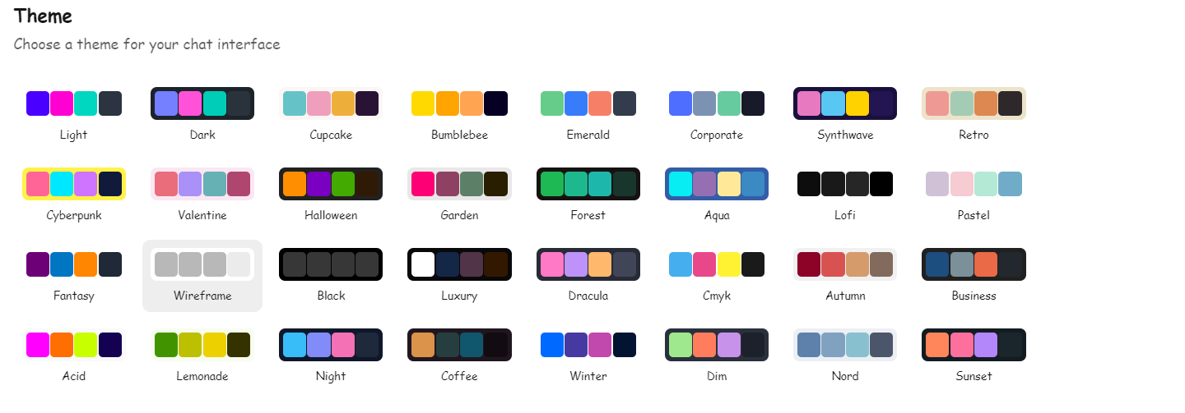
FRONT-END SNAPSHOTS

Slide 13
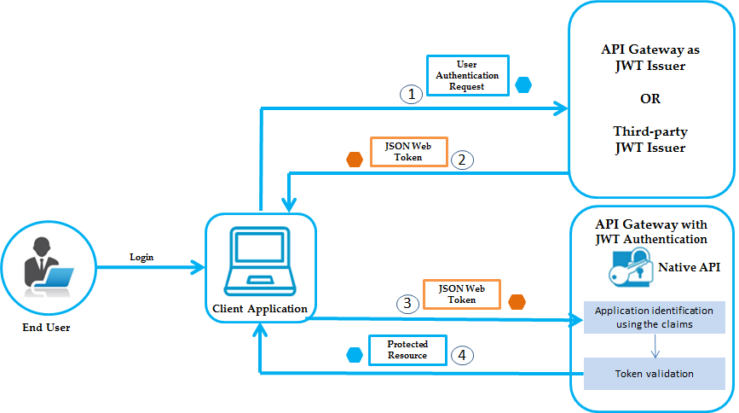
SECURITY AND AUTHENTICATION :-
Using json web token for security and authentication
Notes:
Image source: https://www.slidemake.com

Slide 14
JWT Authentication Flow:
User Logs In: User sends credentials (username/password) to the server.
Server Validates: Server checks credentials and generates a JWT.
User Stores JWT: User stores the JWT (in local Storage or cookies).
User Makes Authenticated Request: User sends JWT in the Authorization header (Bearer <token>).
Server Verifies JWT: Server checks JWT validity. If valid, processes the request; otherwise, prompts for login again.
Notes:
Image source: https://www.slidemake.com

Slide 15
DEPLOYMENT
Frontend Deployment:
Build React app: Run npm run build to create production-ready files.
Serve React app: Use Express in the backend to serve the React build/ folder.
Deploy: Push to Heroku (or another platform like DigitalOcean) using Git.
Backend Deployment:
Start server: Run npm run start to start the backend server.
Deploy: Push the backend to Heroku (or another platform) using Git.
Environment Variables:
Set environment variables (e.g., JWT secret, database URL) on the hosting platform.
After deploying, your app should be live at the provided URL.

Slide 16
CONCLUSION
As a team, we successfully developed a real-time chat web app with a focus on key features like real-time messaging, user authentication, and media sharing. Each member contributed to the frontend and backend aspects, ensuring that the app functions smoothly from both a user interface and server perspective. We integrated React for the frontend, Node.js with Socket.IO for real-time communication, and MongoDB for database management.
Key Accomplishments:
Real-time Messaging: Our team integrated Socket.IO to provide seamless real-time communication between users.
User Authentication: We implemented JWT to ensure secure and reliable user login and session management.
Media Sharing: Through Cloudinary, users can easily upload and share images and videos.
Deployment: We successfully deployed the app on Heroku or DigitalOcean, making it live and accessible to users.

Slide 17
FUTURE IMPROVEMNTS
Future enhancements may include:
• Voice and video calling features with multiple users sharing screen
• AI-driven content moderation to ensure community standards.
• Integration with third-party services for extended functionality.
• Add bot detection or spam detection in chat

Slide 18
REFERENCES
React Documentation: https://reactjs.org/docs/getting-started.html
Socket.IO Documentation: https://socket.io/docs/
JWT Authentication: https://jwt.io/introduction/
MongoDB Atlas:https://www.mongodb.com/cloud/atlas
Cloudinary Documentation:https://cloudinary.com/documentation
ChatGPT from OpenAI
GitHub repositories and educational videos on MERN stack and WebSockets
YouTube Videos on the ChatApp Development
Google Search

Slide 19
THANK YOU

