Slide 1
NOAO
Science Data Processing
Science Data Management (SDM)
Francisco Valdes
January 25, 2010
Science Data Processing Workshop

Slide 2
Outline
SDM program perspective from non-manager
Science Data Processing at NOAO (SDM)
Pipeline Framework and Applications
January 25, 2010
Science Data Processing Workshop

Slide 3
SDM Program
Key areas in next few years
  Dark Energy Camera
    Data transport
    Data management
    Community pipeline support and operation
  One Degree Imager
  US VO Facility Collaborator
    User support
  Maintaining current “E2E” system
    Archive, Pipelines, Portal
January 25, 2010
Science Data Processing Workshop

Slide 4
SDM Program
Smaller Group
  program manger and program scientist
  ~6 developers
  ~4 operations
January 25, 2010
Science Data Processing Workshop

Slide 5
SDP @ NOAO/SDM
IRAF
Science Pipelines
Telescope Quick Look & Reduction
VO Technologies
Science Portal
Data Management
January 25, 2010
Science Data Processing Workshop

Slide 6
IRAF
Capabilities
  instrument calibration packages
  image characterization and display
  science analysis
  scripting capabilities (users & pipelines)
New Developments
  Packages: nfextern (ace, msctools, newfirm, …)
  Core of science pipelines (#!cl modules)
  64-bit port
  VO-CL
  Web Services
January 25, 2010
Science Data Processing Workshop

Slide 7
Science Pipelines
NHPPS Middleware
Applications
  MOSAIC
  NEWFIRM
Exploring application port to OGCE/Teragrid
January 25, 2010
Science Data Processing Workshop

Slide 8
Science Pipelines
Dark Energy Camera Community Pipeline
  Developed externally
  Operated and supported by NOAO for community
One Degree Imager Pipeline
January 25, 2010
Science Data Processing Workshop

Slide 9
Quick Look/Reduce
IRAF at all telescopes
Display tools
Evaluation tools
NEWFIRM NHPPS pipeline
MOSAIC NHPPS pipeline (proposed)
January 25, 2010
Science Data Processing Workshop

Slide 10
VO Technologies
VO command line tools
VO-CL
Leader in VOEvent
VO enabled archive/portal
Partner in US VO project
  Tasked with user support
January 25, 2010
Science Data Processing Workshop

Slide 11
Science Portal
Advance portal technology
  Spatial and time display and discovery
  VO enabled discovery and retrieval
  Ruby on rails
  ADQL
PI access
Community access
January 25, 2010
Science Data Processing Workshop

Slide 12
Data Management
Data transport technologies
  FITS evolution
  Compression
Archive technologies
  Service oriented architecture
  JAVA
January 25, 2010
Science Data Processing Workshop

Slide 13
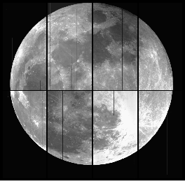

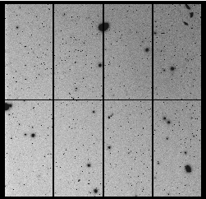
NOAO
Pipelines
Francisco Valdes
Rob Swaters, Mark Dickinson
January 25, 2010
Science Data Processing Workshop

Slide 14
Current and
Past Contributors
Francisco Valdes (NOAO)
Mark Dickinson (NOAO)
Robert Swaters (NOAO)
F. Pierfederici (CFA)
D. Scott (NOAO)
B. Thomas (NOAO)
Tracy Huard (UMd)
D. Shaw (LSST)
C. Smith (NOAO)
S. Vielleux (UMd)
N. Zarate (Gemini)
M. Miller (LSST)
D. Gasson (UVic)
January 25, 2010
Science Data Processing Workshop

Slide 15
Outline
Pipeline Framework (NHPPS)
Pipeline Applications
Pipeline Modules
January 25, 2010
Science Data Processing Workshop

Slide 16
Pipeline Framework
NOAO High Performance Pipeline System
Parallel and Distributed
Multiple Pipeline Applications
Event Driven
Programmable
Context Configurable
Open (any language)
Written in Python
Node Manager
Data Manager
Pipeline Scheduling Agent
Pipeline Manager
Calibration Manager
See: Valdes, et al, 2006,
The NOAO High-Performance Pipeline System
(http://chive.tuc.noao.edu/noaodpp/pipeline.shtml)
January 25, 2010
Science Data Processing Workshop

Slide 17
Pipeline Outline
Sequence of stages
  Sequential or parallel
Stage triggered by event(s)
  File, Status, …
Preproc, Proc, Postproc actions
Proc module returns status
January 25, 2010
Science Data Processing Workshop

Slide 18
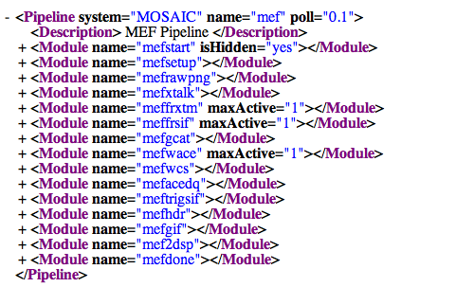
Pipeline
Description Language
January 25, 2010
Science Data Processing Workshop

Slide 19
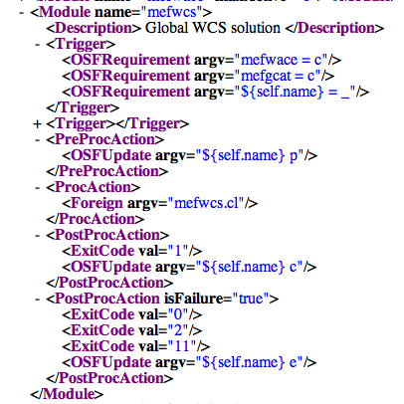
Pipeline
Description Language
January 25, 2010
Science Data Processing Workshop

Slide 20
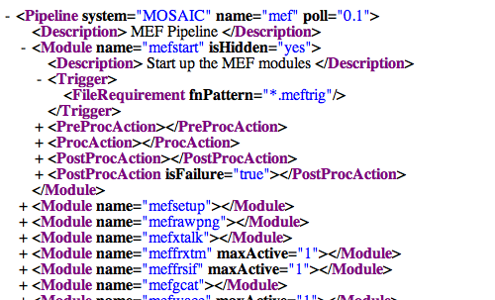
Pipeline
Description Language
January 25, 2010
Science Data Processing Workshop

Slide 21
Pipeline Applications
Applications
  MOSAIC SPL
  NEWFIRM QRP
  NEWFIRM SPL
  DEC DC0
  ODI
January 25, 2010
Science Data Processing Workshop

Slide 22
Pipeline Applications
Current
  NOAO CCD Mosaic Imagers
    2 cameras, 8 x 2K x 4K SITe CCDs (64 Mpix)
    36 x 36 arcmin FOV @ 4m PF
  NOAO Extremely Wide-Field IR Mosaic
    4 x 2K x 2K Orion InSb Arrays (32 Mpix)
    27.6 x 27.6 arcmin FOV @ 4m CF
Future
  Enhancements: Stacking, Catalogs, Transients
  WIYN One Degree Imager (1 Gpix)
January 25, 2010
Science Data Processing Workshop

Slide 23


Mosaic and NEWFIRM
January 25, 2010
Science Data Processing Workshop

Slide 24
Pipeline
Applications Structure
Source and Sink
Pipelines/Services
  Mosaic: 26 pipelines, 195 stages
  NEWFIRM: 25 pipelines, 168 stages
Servers
  Data Mgr, Node Mgr, Directory, Name, …
Configuration
  Any, self, …
Node Utilization
Monitors
Parallelization
January 25, 2010
Science Data Processing Workshop

Slide 25
Mosaic Parallelization
Block of Nights
1..*
1 Night /1 Filter
Basic Cal
Sky Cals
…
Resample
Data Products
January 25, 2010
Science Data Processing Workshop

Slide 26
Mosaic Parallelization
Basic Calibration
1 Night /1 Filter
1..*
1 Mosaic
crosstalk
WCS
1..*
1 CCD
mask
overscan
bias
dome flat
merge
January 25, 2010
Science Data Processing Workshop

Slide 27
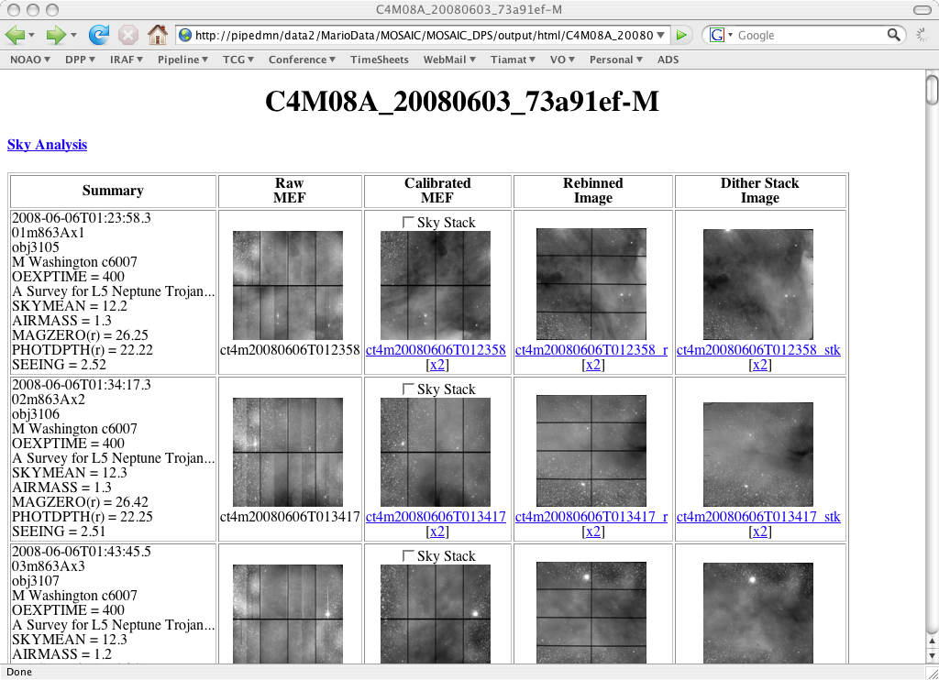
January 25, 2010
Science Data Processing Workshop

Slide 28
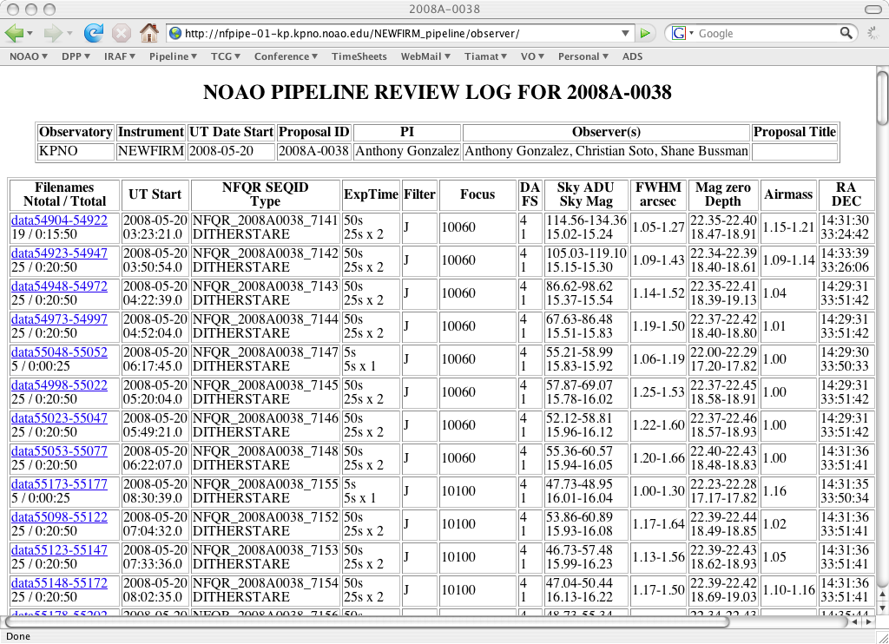
January 25, 2010
Science Data Processing Workshop

Slide 29
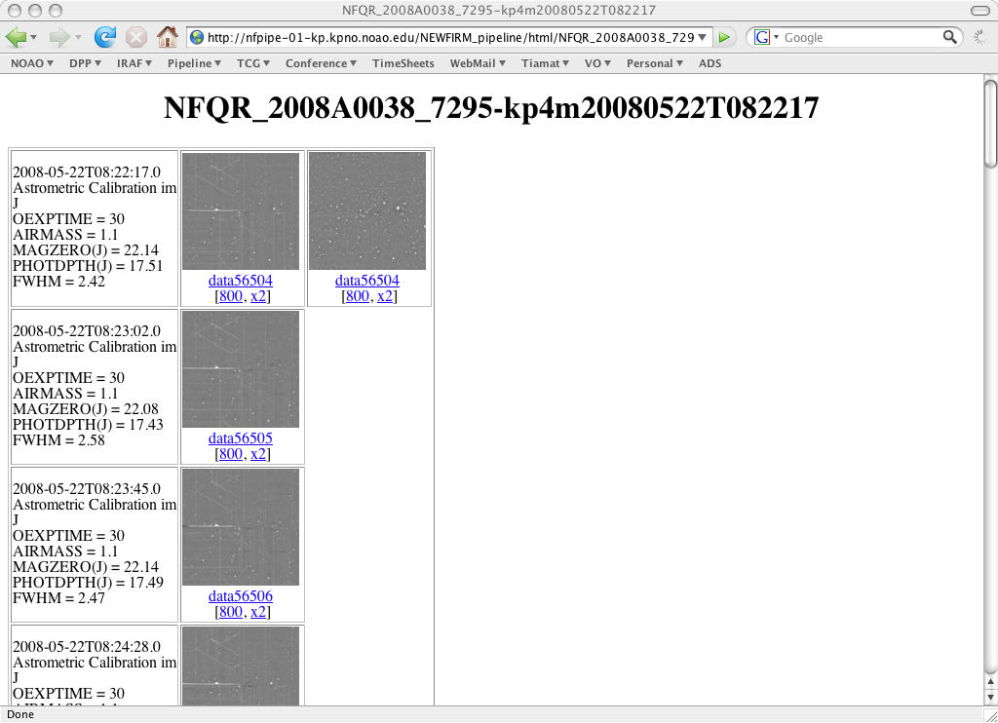
January 25, 2010
Science Data Processing Workshop

Slide 30
Pipeline Modules
IRAF/ECL and Python
#!/bin/env pipecl
IRAF networking
January 25, 2010
Science Data Processing Workshop

