Slide 1
OPUS Data Processing
Jan 2010
Pipeline Coordination Meeting

Slide 2

OPUS 1.0
Key features
Original design by JRose, et al.
Deployed at STScI in 1995
Key features
  Blackboard model for IPC
    No single controller has complete system knowledge
    Blackboard implemented in the host file system
      BB entries are empty files – state described in the filename itself
      Each poller does a file system listing with wildcards to find appropriate events to work on
      Uses atomic file system renames to signal event capture and completion

Slide 3
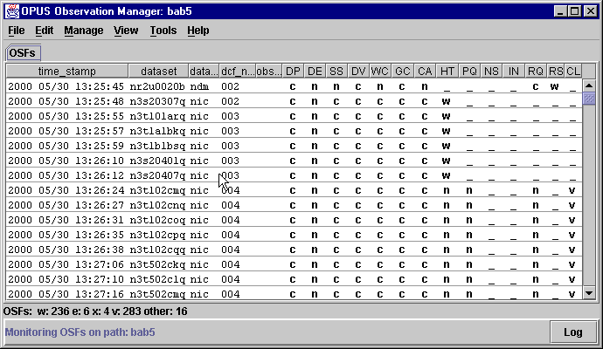
OPUS 1.0
Key features - Blackboards

Slide 4
OPUS 1.0
Key features - Blackboards
426e996b-cccw____.p391442_________________________-cdb-000-____
Each dataset has an entry on the Observation blackboard. An entry consists of multiple fields, separated by dashes, showing:
  a coded timestamp indicating when the entry was created (426e996b)‏
  single character codes providing the status of each pipeline stage (cccw__)‏
  the dataset name (p391442)‏
  some categorical fields that allow filtering of blackboard entries (cdb, 000)‏
  a command field that allows control directives to be issued for this dataset (____)‏

Slide 5
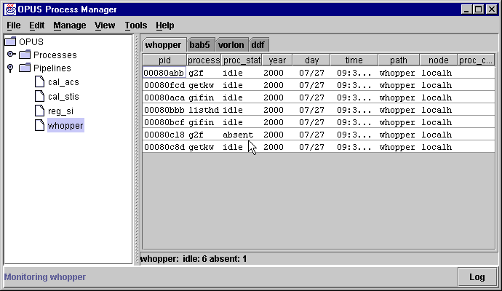
OPUS 1.0
Key features - Blackboards

Slide 6
OPUS 1.0
Key features - Blackboards
00004570-cdbpol___-idle______________.4304ee0c-cdbs__-tufnel_____-____
Each process has an entry on the Process blackboard. An entry again consists of multiple fields separated by dashes showing:
a coded process ID (00004570)‏
the process name (cdbpol)‏
the process status (idle)‏
a coded timestamp indicating when the entry was created (4304ee0c)‏
the name of the path the process is running in (cdbs)‏
the node on which the process is running (tufnel)‏
a command field that allows control directives to be issued for this process (____)‏

Slide 7
OPUS 1.0
Key features (cont.)‏
“Internal/External poller” models
  Internal poller tasks
    Make OPUS lib calls to capture/close blackboard events
    Can perform initialization overhead once and keep in memory between events
    Can implement complex event close-out schemes
  External poller tasks
    Have no knowledge they are running in an OPUS pipeline
    Obtain inputs via env vars and communicate exit status via exit codes
    Each instance has a companion process that takes care of the BB interface (event notification, etc.)‏
    Start fresh with each new triggering event (no saved memory between events)‏

Slide 8
OPUS 1.0
Key features (cont.)‏
X/Windows GUIs for monitoring and control
  Read and write file system blackboard entries directly
Entire system written in ANSI C

Slide 9
OPUS 1.0
Advantages
  Simple operation - file renames can be used to make pipeline behavior corrections
  Easy to integrate 3rd-party tasks as external pollers - just wrap in a script that sets env vars and returns exit codes
  Simple multiprocessing model- operators interactively add more instances of processes where bottlenecks are seen
  Saves system state in the file system, which supports controlled shutdown and restart right where things left off

Slide 10
OPUS 1.0
Disadvantages
  GUI had to run on machines with direct access to the file system blackboard (NFS or VAX clustered file system)‏
  Scalability issues as file system blackboard has more pipeline processes and/or operators added
Used for about 5 years, with mods/enhancements until...

Slide 11
OPUS 3.2
Major object-oriented redesign and re-implementation in 2000 by WMiller, et al.
Written in C++/Java
Key features
  Caching in-memory blackboard model w/file system “backing store”
  CORBA communication between blackboard servers and applications/GUIs
    Reduces file system interaction/load
    File system backing store still supports BB persistence after controlled system shutdown (can resume when restarted)‏

Slide 12
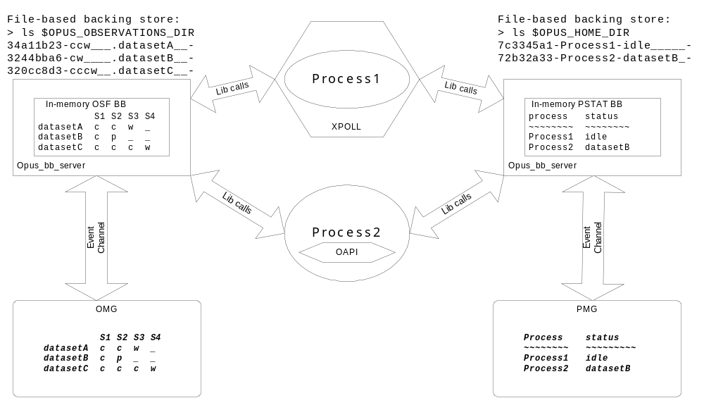
OPUS 3.2

Slide 13
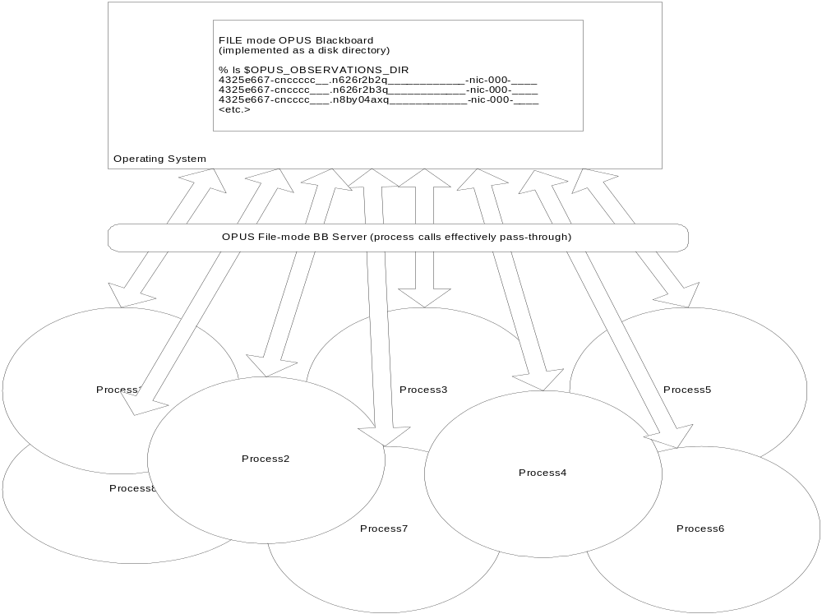
OPUS 1.0
Key features - Blackboards
‏

Slide 14
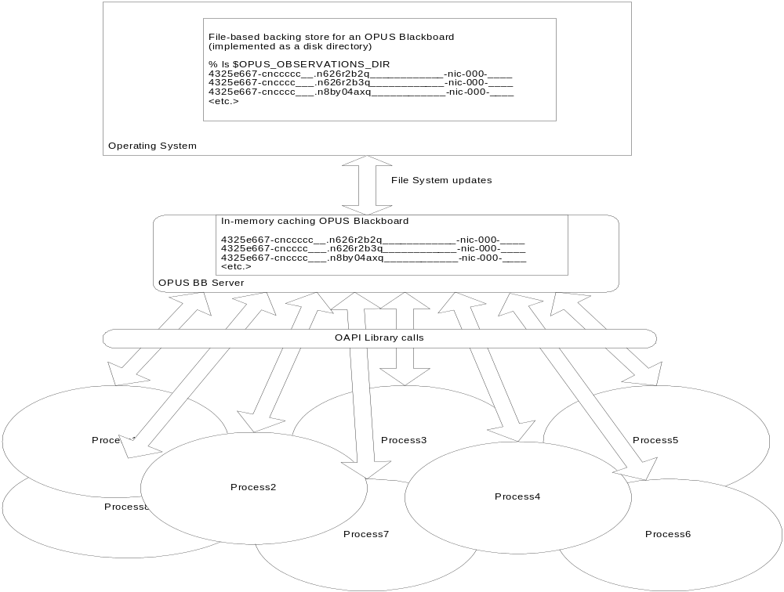
OPUS 3.2
Key features (cont.)‏

Slide 15
OPUS 3.2
Key features (cont.)‏
Uses 3rd-party package for CORBA/C++ layer (ACE/TAO)‏
Later added CORBA/Python layer (omniORB)‏
GUIs are now Java applications (thick-clients)‏
  Use CORBA event channel for BB server communication
  No longer need to have direct disk mount to file system backing store
  Support “user-bean” drop-ins for added functionality

Slide 16
OPUS 3.2
The main goals of the redesign were to
  Provide a more scalable blackboard event model
  Allow GUIs to run native on WinPCs with no direct file system BB access
  Lessen the BB updates sent to the GUIs (change-only over the event channel)‏
  Take advantage of OOD to open up for future enhancements (e.g. Other blackboard types, like databases)‏

Slide 17
OPUS 3.2
After it settled in (it was quite a change from the previous architecture), it was considered a major improvement
Was distributed on CD-ROMs to other missions, up through v5.4b
Of course as time went by, problems accumulated...

Slide 18
OPUS today
Various difficulties
  Complexity
    Behavior visible under OPUS 1.x is now hidden within the BB servers and CORBA libs
    We don't have many problems with the servers (they are pretty solid, aside from some small memory leaks, network “hiccups”, etc.), but debugging and diagnosing those we have are more difficult- most server problems are addressed by restarting them

Slide 19
OPUS today (cont.)‏
Various difficulties
  Performance
    Java GUI applications updated via a CORBA “push” event channel were SLOW (this was early Java). Better now, but not great, probably less caused by Java and more by the event-communication model
    The “push” model means the servers have to be able to find the GUIs on the network, which is where network security issues get in the way
    OPUS pipeline infrastructure w/CORBA libs is too “heavy-weight”, eating up too many system memory and process-space resources for the features it provides

Slide 20
OPUS today (cont.)‏
Today's difficulties...
  Stability
    GUI network connections can be impacted by outages and network security “clamp-downs”, and once a server connection is lost, it cannot be re-established (requires pipeline restart to regain control/monitoring capability)‏
  Portability
    The Java GUIs must be installed on each user's machine
  Maintainability
    Honestly, we no longer have the expertise to maintain/enhance the core system, and the skill set (highly-detailed object-oriented C++, CORBA, Java thick clients, JNI) is not attractive to most developers.

Slide 21
Future Of OPUS (FOO) project
We have reached an opportune moment to examine alternatives to OPUS
The current system is working for us, allowing us to support our active missions (HST, Kepler), but we see the cracks and worry that it is not sustainable as is.
We intend to examine alternative systems, hybrids, and will also consider re-implementation of the core OPUS design.

Slide 22
Future Of OPUS (FOO) project
Timeline – we want to make a decision on our future pipeline approach by Fall 2010, with hopefully some development accomplished along the way.
We want to be ready to use the new approach by the time JWST Data Processing development begins.
HST pipelines may come along, depending on costs/benefits.
Kepler pipelines will likely remain OPUS.

Slide 23

Future Of OPUS (FOO) project
Resources - < 2 FTE
  Mike Swam (mostly full-time)‏
  Chris Sontag (part-time)

