Slide 1
NOAO & Pipelines
Frank Valdes
Rob Swaters

Slide 2
NOAO & Pipelines
Current NOAO Pipelines: Mosaic & NEWFIRM
Dark Energy Camera Community Pipeline
One Degree Imager Automatic Cal. Pipeline
BigBOSS Pipeline

Slide 3
Meeting Goals
Learn new things
Share lessons learned
Experiences with Teragrid/XSEDE
State of science codes for
astrometry, psf regularization, difference imaging
Collaboration possibilities
Pipeline Workflow Description
PDL, diagrams
Communicate interesting ideas:
wrapped pipelines

Slide 4
Meeting Outcomes (cont)
Standardizations?
data formats: e.g. data quality maps
data quality flags
Operations models
Categorize types of pipelines
map-reduce
DAG
other

Slide 5
NOAO High Performance Pipeline System (NHPPS) and Applications

Slide 6
NHPPS
Event driven executor (blackboards, files, …)
XML Pipeline Description Language (PDL)
Executes host commands
Service-oriented features
Hierarchical/Map-Reduce organization

Slide 7
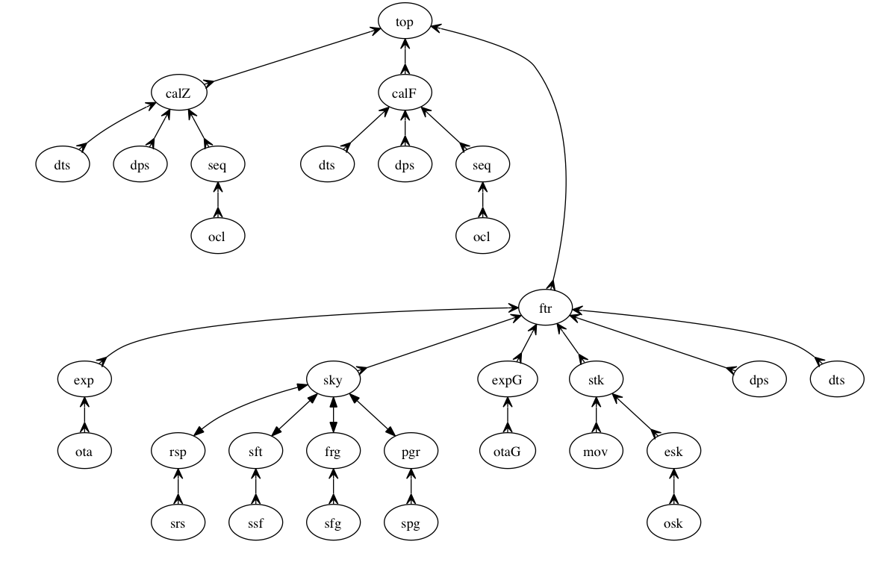
ODI NHPPS Workflow

Slide 8
NHPPS Status
Extremely Robust (runs for months at a time)
Not many changes:
tools for keeping blackboard clean
capture of output into PDL logic
NHPPSAPP: run pipeline as host command

Slide 9
Pipeline Applications Status
Three production “pipeline applications”
MOSAIC for three telescopes and three cameras
NEWFIRM for two telescopes and one camera
NEWFIRM quick-reduction for two telescopes
MOSAIC Pipeline Archive
22K exposures, ~ 30TB, 7 years, 28 tel-sem
1 manager/4 compute (16 cores) = 1-2 wk/tel-sem

Slide 10
NOAO Operations Model
With lots of production experience now:
pipeline scheduling agent
campaign processing
parallel staging important
some operator review during processing
some amount of “redo”
operator review before committing data to an archive required
notification to current PI in a week or two

Slide 11
Basic Calibration Workflow

Slide 12
Dark Energy Camera Community Pipeline

Slide 13
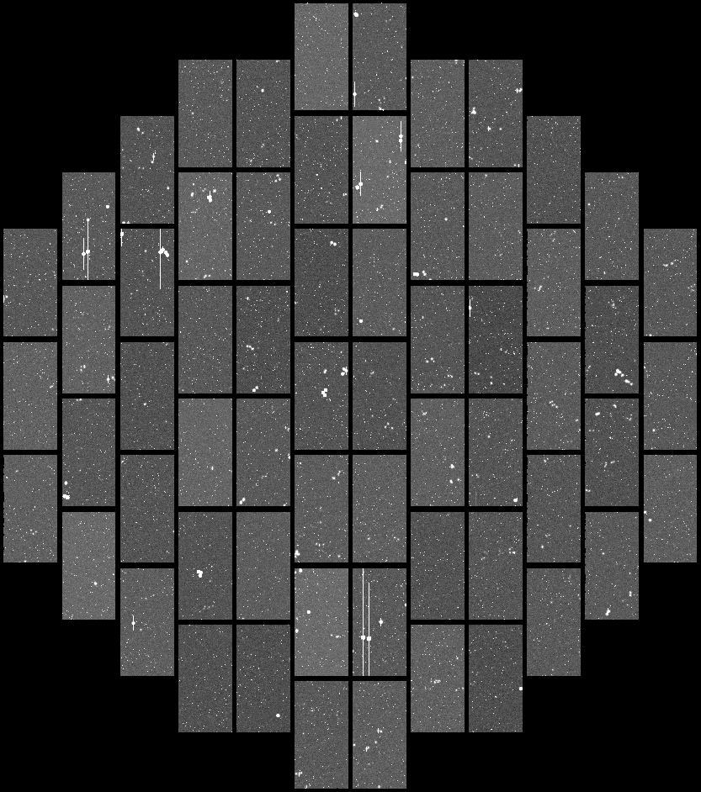
Dark Energy Camera
Blanco Prime Focus
62 2048x4096 CCDs
1.1 degree FOV
0.27 arc/pixel
1 Gb/exposure

Slide 14
DEC-CP
Developed by DESDM
subset of DES pipeline
Delivered to NOAO
Run on an NOAO cluster
Operated by NOAO

Slide 15
DEC-CP Architecture
Orchestrator
ELF
Ogrescript
Scheduler (Condor)
Database (Postgres)
Shared file system (GPFS)
Science Codes
custom written
Astromatics (e.g. Sextractor, Swarp)

Slide 16
DEC-CP Status
Current version
conversion to NOAO test cluster successful
production cluster being procured
performance is poor
data products are inadequate
significant work yet to be done
First light version due in January

Slide 17
ODI Automatic Calibration Pipeline (AuCaP)
Frank Valdes, Rob Swaters (NOAO)
Univ. of Indiana, PTI

Slide 18
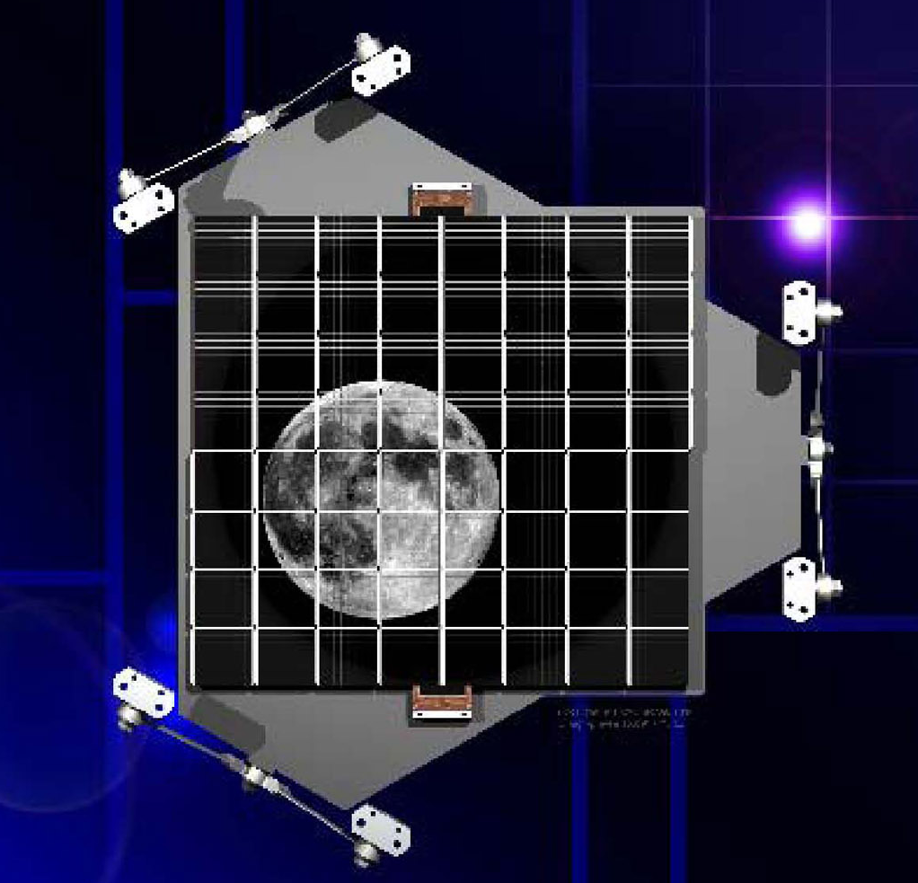
WIYN One-Degree Imager
Gigapixel camera
64 OTA CCDs
64 cells / OTA
3.5m telescope
1 degree FOV
0.1 arcsec pixels
Static, coherent, local guiding
Facility instrument

Slide 19
ODI PPA
Project includes
portal
pipeline
archive
Portal is somewhat of a new concept and may have user driven component

Slide 20
ODI AuCaP Architecture
XSEDE
OGCE
Wrapper Scripts
NHPPS
IRAF Modules
IRAF

Slide 21
OGCE
Wraps application code, which is in the form of a host callable program, into web services. The web services have input and output parameters (from STDOUT) which can be supplied or interconnected into a DAG workflow. OGCE supplies all the support for XSEDE execution.

Slide 22
OGCE-NHPPS Wrapping
OGCE Service
Host Command
NHPPSAPP
OGCE Parameter Interface
NHPPS
Pipeline(s)
dataset1 pipe1 cccp---
dataset2 pipe1 cpp----
dataset3 pipe1 cpp----
dataset4 pipe1 ccccw--
dataset4.1 pipe2 ccp-
dataset4.2 pipe2 cp--
Modules
Module

Slide 23
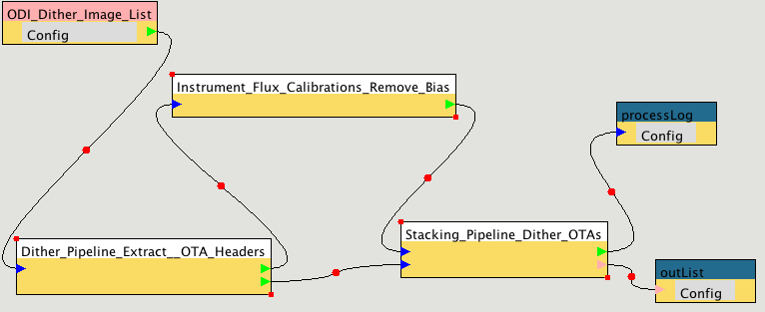
ODI OGCE/NHPPS Demo

Slide 24
Converting NHPPS/Map-Reduce to OGCE DAG
Workflow Graphical Diagram

Slide 25
ODI Prototype Workflow

Slide 26
ODI PPA Status
Completed a preliminary review (PDR)
Working towards a second review (CDR)
Interim MOU between WIYN, NOAO, IU
Hosted at IU: Portal, Pipeline, Archive
NOAO will develop the AuCaP to be wrapped by OGCE

Slide 27
Wish List
An XSEDE mode that allocates a cluster of machines that can then operate as a local cluster (i.e. with intra-cluster communications)
The NHPPS map-reduce (non-DAG) structure is more efficient that classic Condor or Grid DAG organizations

