Slide 1



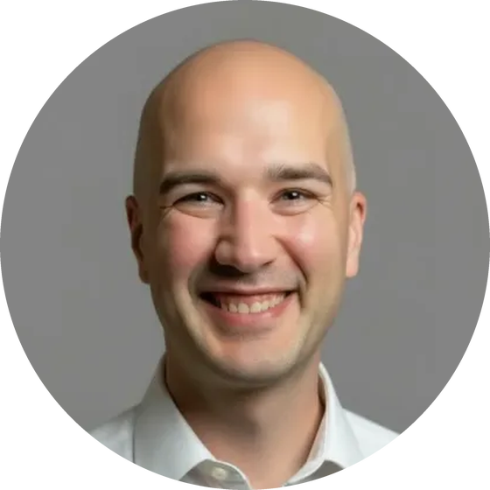
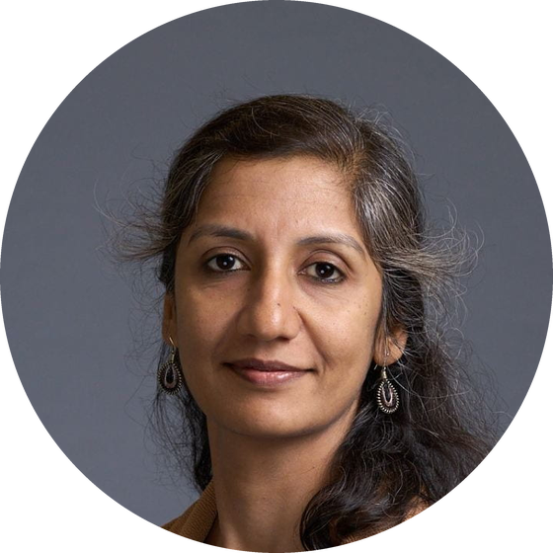

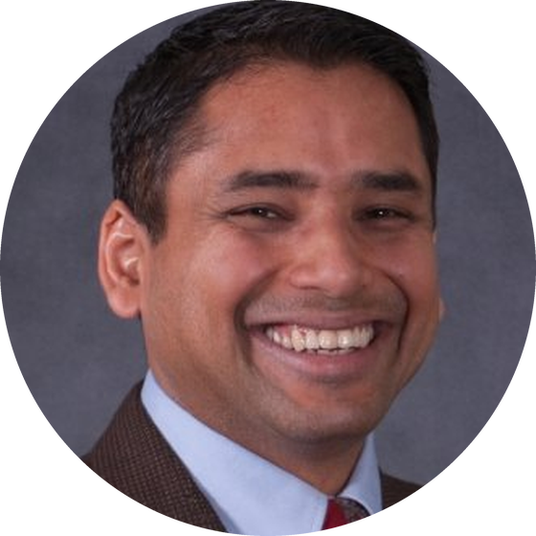

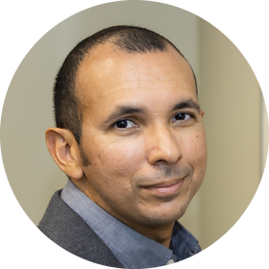









BIRDS OF A FEATHER
Real-Time Scientific Data Streaming to HPC Nodes:
Challenges and Innovations VI
FEATURED
SPEAKERS
ADAM THOMPSON
RACHANA ANANTHAKRISHNAN
ELI DART
RAJIVE JOSHI
NVIDIA
University of Chicago
Energy Sciences Network (ESnet)
Real-Time Innovations (RTI)
ORGANIZERS
Thursday, Nov 19, 2026
12:15pm–1:15pm CST
BJOERN ENDERS
Lawrence Berkeley National Laboratory
RAFAEL FERREIRA DA SILVA
Oak Ridge National Laboratory
ALEX UPTON
Swiss National Supercomputing Centre

