Slide 1



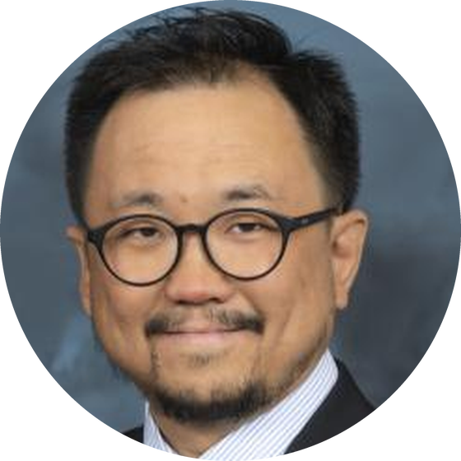
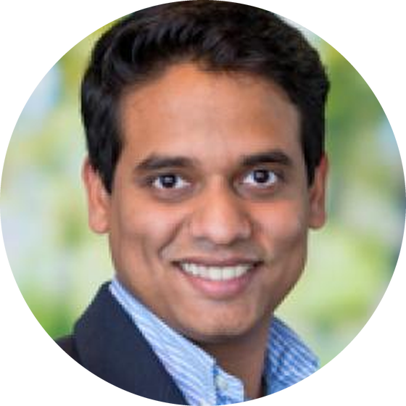
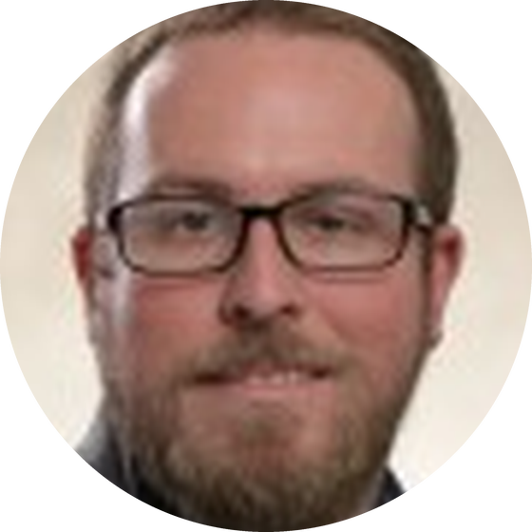
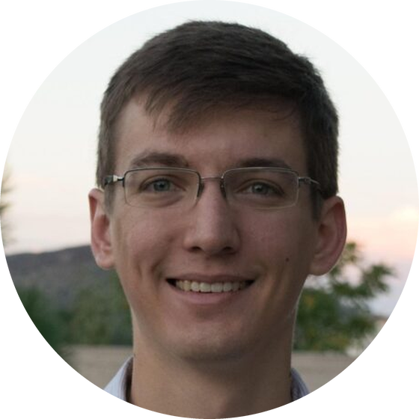
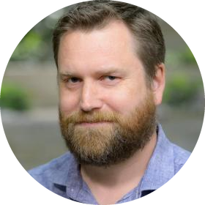
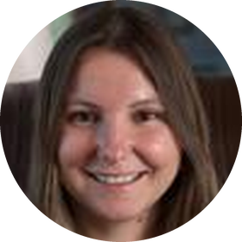
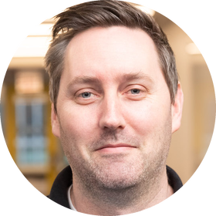




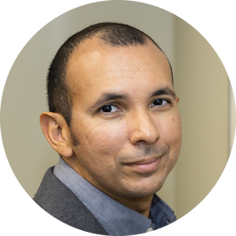

BIRDS OF A FEATHER
Next-Generation Workflows for HPC:
AI, Agentic Systems, and Scientific Discovery
FEATURED
SPEAKERS
WOONG SHIN
MATHEW J. CHERUKARA
MATT SINCLAIR
LOGAN WARD
Oak Ridge National Laboratory
Argonne National Laboratory
Argonne National Laboratory
NVIDIA
ORGANIZERS
Tuesday, Nov 17, 2026
12:15pm–1:15pm CST
STEPHEN HUDSON
Argonne National Laboratory
DANIELA CASSOL
Lawrence Berkeley National Laboratory
KYLE CHARD
University of Chicago
RAFAEL FERREIRA DA SILVA
Oak Ridge National Laboratory

