Slide 1





WATER QUALITY PREDICTION
By: AKSHAR NATH GORAIN
Registration ID: STU6829b3f24d2691747563506
AICTE Internship ID: INTERNSHIP_1746416864681834e0e35d8

Slide 2

Learning Objectives
- To develop an AI-powered system for predicting water pollutants using machine learning.
- To utilize historical station-based monitoring data for environmental analysis and forecasting.
- To implement a multi-output machine learning model for pollutant prediction.
- To deploy the prediction model as a user-friendly web application using Gradio.
- Understand how to use Python libraries like Pandas, NumPy, Scikit-learn for analysis and model building.
- Understand how to use Matplotlib, Seaborn for visualization.
- Understand how to use GitHub for project version control and uploading.
- Understand the web deployment process via Gradio in Google form Colab.
GOAL
Source :
www.freepik.com/

Slide 3
Tools and Technology used
Tools used :
Coding Language : Python
Environment used : Collab
• Libraries used :
Numpy :For handling arrays & mathematical operations.
Pandas :For data analysis, cleaning and filtering.
Matplotlib :For visualisation.
Seaborn : For making attractive graphs.
Sklearn : Used in ML(Regression , classification).
• Models used :
Linear regression : Used in SML for predicting continuous numeric values.
Random forest regressor :SML algorithm used for regression task, good for
overfitting problem.
• Evolution metrices :
RMSE(Root Mean Squared Error), MAE(Mean Absolute Error), R2 Score.

Slide 4
Methodology
- Data Collection: Used PB_All_2000_2021.csv dataset, covering the time period 2000–2021.
- Data Cleaning: Cleaned null values and filtered key stations from the dataset.
- EDA & Visualization: Conducted exploratory data analysis and visualized pollutant trends.
- Model Building: Implemented a MultiOutputRegressor with RandomForestRegressor.
- Input Features: Year, Station ID
- Output Pollutants: O₂, NO₃, NO₂, SO₄, PO₄, Cl⁻
- Model Persistence: Saved the trained model as pollution_model.pkl and column features as model_columns.pkl using Joblib.
- Web Deployment: Converted the application to Gradio for web deployment in Google Colab.

Slide 5
Problem Statement:
- Lack of a proactive system to forecast water pollutant levels, hindering effective environmental management.
- Difficulty in rapidly assessing potential water quality issues based on historical trends and station-specific data.
- Need for an accessible and user-friendly tool that can provide quick insights into future water quality to aid decision-makers.

Slide 6
Solution:
- Developed an AI-powered machine learning model capable of predicting six key water pollutants (O₂, NO₃, NO₂, SO₄, PO₄, Cl⁻).
- The model leverages historical year and station_id data for predictions.
- Created an interactive web application using Gradio, allowing users to input a year and station ID to get immediate pollutant level predictions.
- Provided a deployment solution via Google Colab, making the prediction tool easily accessible for environmental analysis and forecasting.

Slide 7
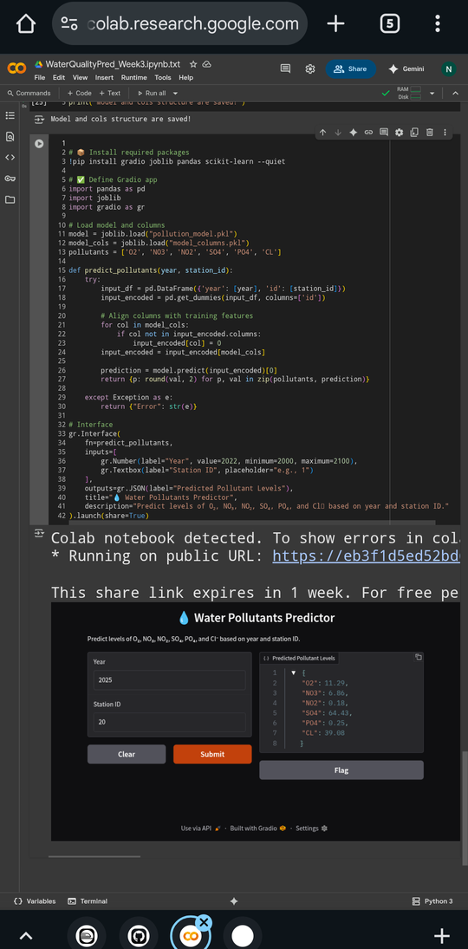
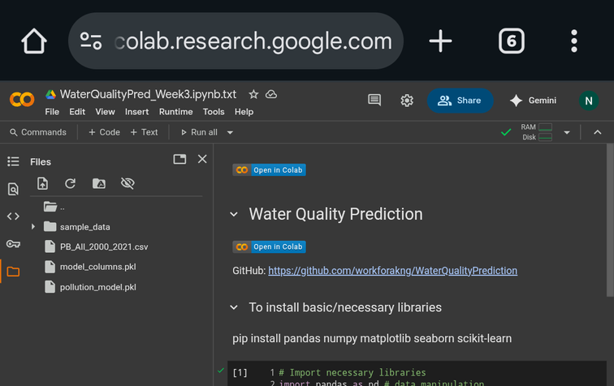
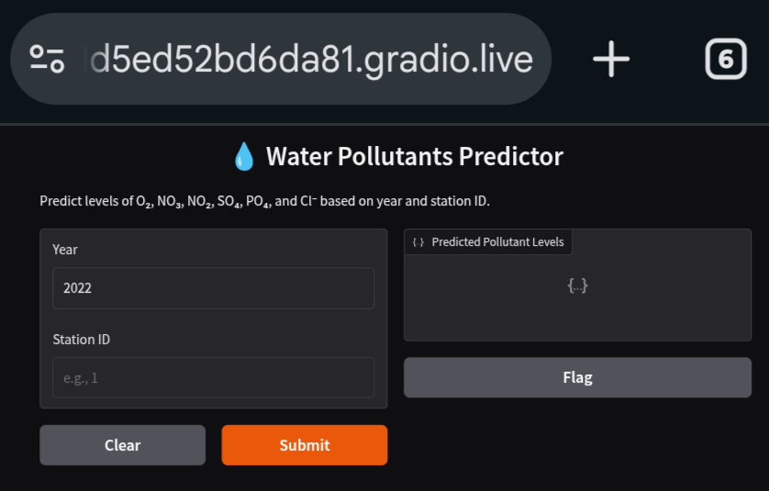
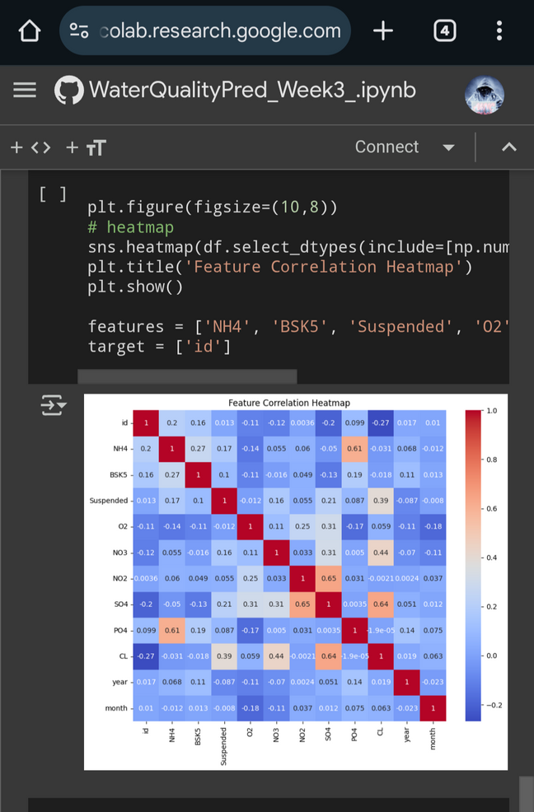
Screenshot of Output:
Gradio Interface

Slide 8
Conclusion:
- Successfully developed and deployed an AI-powered water quality prediction model using historical monitoring data.
- The Multi-output Random Forest Regressor effectively predicts six major water pollutants (O₂, NO₃, NO₂, SO₄, PO₄, Cl⁻).
- The Gradio web application provides an accessible and intuitive tool for environmental analysis and forecasting.
- This project demonstrates the significant potential of machine learning to support proactive environmental management and decision-making for a healthier future.
Click to open GitHub Link : https://github.com/workforakng/WaterQualityPrediction.git

Slide 9
GITHUB:
GitHub Repository: https://github.com/workforakng/WaterQualityPrediction.git
- Find the full project code, dataset, and trained model files on GitHub.
Run the App in Google Colab:
- Click below to launch the prediction app:
- 👉
Run Locally using Gradio:
- pip install -r requirements.txt
- python app.py
Click to open Repository
Run on Colab

