Slide 1
MACHINE LEARNING PROJECT & ALGORITHM OPTIMIZATION
Improving k-Nearest Neighbors on Fashion-MNIST
with Learned Distances
Systematic progression from 85.24 % to 89.51 % Test Accuracy via Metric Learning, Distillation & Convex Fusion
TEAM MEMBERS & STUDENT IDS:
• Akshar Nath Gorain (241001001213) • Sourodyuti Biswas Sanyal (241001001246)
• Aditi Barman (241001001182) • Sanjana Mahata (241001001274)
Department of Computer Science & Engineering | Techno India University, West Bengal | Batch: BCS 3B

Slide 2
MACHINE LEARNING COURSEWORK
1. Problem Statement & Classical Distance Baselines
• Curse of Dimensionality: In raw 784-D pixel space, distance concentration causes relative distances between nearest and farthest neighbors to converge, degrading discrimination.
• Loss of 2D Spatial Structure: Flattening 28x28 images into 1D vectors discards translation invariance and local topological correlations.
• Inference Latency Bottleneck: Standard KNN requires O(N·D) brute-force comparisons against 54,000 instances for every single query.
• Rigorous Experimental Protocol: 60,000 samples partitioned into 54,000 fit and 6,000 validation images (stratified, seed 42). 10,000 test images held out strictly for final reporting.
Metric | Val (%) | Test (%) | Latency
Euclidean (L2) | 86.13 | 85.24 | 4.64 s
Manhattan (L1) | 86.97 | 85.91 | 84.00 s
Cosine Distance | 86.18 | 85.63 | 10.75 s
CORE BASELINE FINDINGS:
• Manhattan distance (L1) outperforms Euclidean by +0.67 pp, aligning with high-dimensional norm theory.
• However, Manhattan query latency is 18x slower (84 s vs 4.6 s).
• Demonstrates the imperative for learned dimensionality reduction.

Slide 3
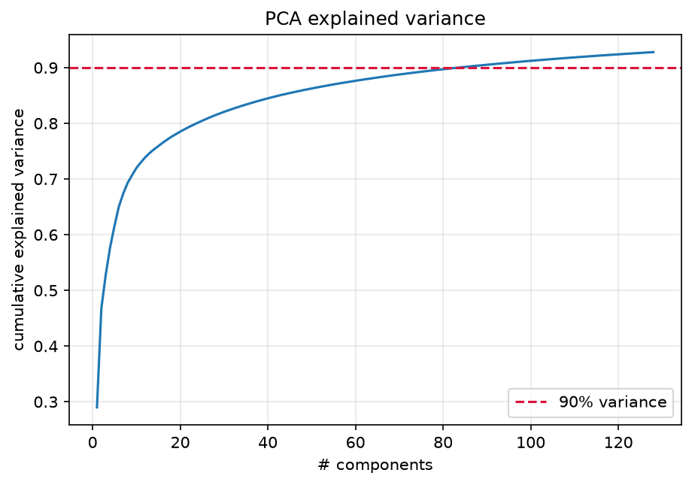
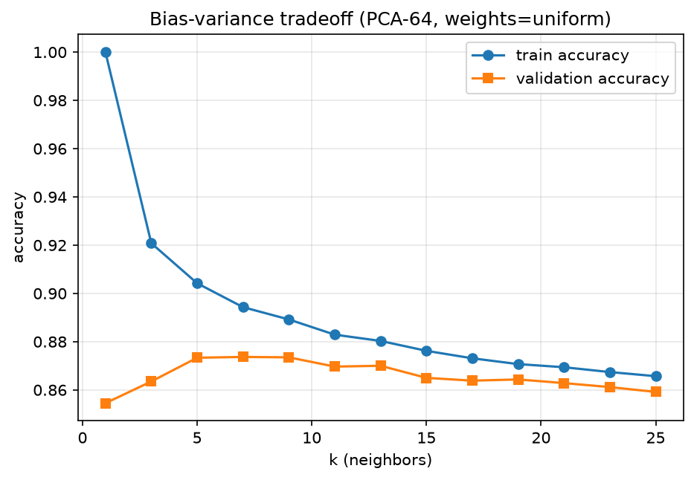
MACHINE LEARNING COURSEWORK
2. Dimensionality Reduction & Bayesian Optuna Tuning
• PCA Spectral Compression: Projecting 784-D -> 64-D preserves 88.1 % of cumulative variance, eliminating high-frequency sensor noise.
• 7.12x Query Acceleration: Querying 6,000 samples drops from 2.98 s (raw 784-D) to 0.418 s (PCA-64), enabling rapid real-time retrieval.
• Bias-Variance Peak at k=7: Sweeping k from 1 to 25 shows classic inverted-U; peak validation accuracy occurs at k=7 (87.37 %).
• Optuna Optimization (E3): 40-trial Bayesian search selects k=5, Manhattan distance, and inverse-distance weights (w_i = 1/d_i), reaching 86.43 % test accuracy (+1.19 pp).

Slide 4
MACHINE LEARNING COURSEWORK
3. Novelty: Soft-KNN & ConvNet Metric Learning
• Why Soft-KNN?: Discrete majority voting has zero gradient almost everywhere. Soft-KNN formulates a continuous, temperature-scaled Boltzmann neighbor assignment.
• Memory Bank Architecture: A 54,000-instance memory bank stores unit-normalized embeddings z = f_theta(x) / ||f_theta(x)|| in S^127, updated periodically.
• Local Mean Prototype Formulation: For query z, the mean distance to class c among its m nearest exemplars is:
delta_bar_c(x) = (1/m) sum_{i in A_c(x)} ||z - b_i||_2
• Temperature-Scaled Softmax: P_tau(y = c | x) = exp(-delta_bar_c / tau) / sum_{c'} exp(-delta_bar_c' / tau)
Trained end-to-end via cross-entropy loss: L = -log P_tau(y | x).
LINEAR SOFT-KNN HEAD (E6):
• 784 -> 128 linear projection initialized from PCA.
• Adam optimizer (lr 1e-3, tau=0.5, m=7).
• Validation Acc: 88.22 % | Test Acc: 87.10 %
• Outperforms tuned classical PCA-KNN by +0.67 pp.
CONVNET METRIC BACKBONE (E19):
• 2 stages of 3x3 Convolutions (32, 64 channels), ReLU, 2x2 Max-Pool.
• Preserves 2D image topology prior to metric lookup.
• Validation Acc: 89.07 % | Test Acc: 87.63 %
• Provides the core structural backbone for ensembling.

Slide 5
MACHINE LEARNING COURSEWORK
4. Multi-Seed Ensembling, Distillation & Convex Fusion
• Multi-Seed ConvNet Ensemble (E21): Trained across seeds {42, 7, 123}. Individual test accuracies: 87.53 %, 86.92 %, 87.57 % (spread: 0.65 pp). Probability averaging yields 88.06 % (+0.72 pp over mean).
• Knowledge Distillation (E23): Trained student ConvNet using KL-divergence soft targets from the 3-teacher ensemble. Achieves 90.10 % validation and 89.03 % test accuracy (+0.97 pp gain).
• Test-Time Augmentation (TTA): Queries evaluated across 6 perturbations (original, horizontal flip, 4 directional 1-pixel shifts) to smooth boundary sensitivity.
• 7-Source Convex Simplex Search (E25): Exhaustive grid search over 8,008 simplex weight vectors (step 0.1) on validation set.
Metric Source | Role | E25 Weight
Distilled Student (E23) | High-capacity ConvNet | w = 0.5 (50 %)
Linear Soft-KNN (E14) | Augmented memory bank | w = 0.4 (40 %)
PCA-64 KNN (E3) | Classical Manhattan lookup | w = 0.1 (10 %)
Other 4 heads | Seeds 42, 7, 123, MLP | w = 0.0 (Pruned)
CHAMPION MODEL METRICS (E25):
>>> UNBIASED TEST ACCURACY: 89.51 % <<<
>>> VALIDATION ACCURACY: 90.85 % <<<
Macro F1: 0.8936 | Precision: 0.8944 | Recall: 0.8951

Slide 6
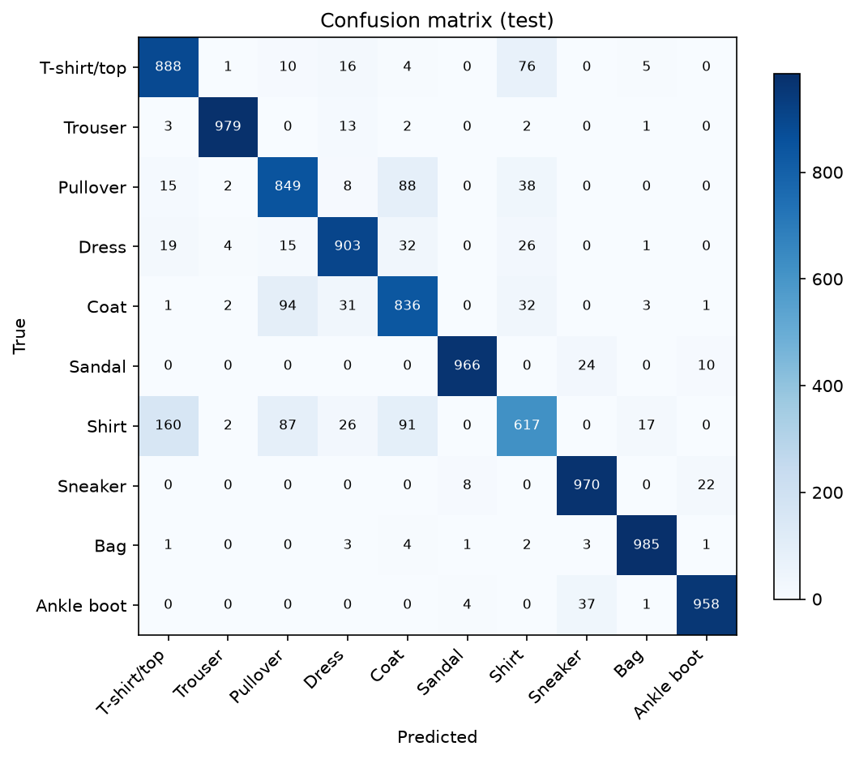
MACHINE LEARNING COURSEWORK
5. Benchmark Results, Error Diagnostics & Key Takeaways
• Rigorous Algorithmic Progression: 85.24 % (Baseline E1) -> 86.43 % (PCA-64 E3) -> 87.10 % (Linear Soft-KNN E6) -> 87.63 % (ConvNet E19) -> 89.03 % (Distillation E23) -> 89.51 % (Convex Fusion E25).
• Diagnostic Confusion Matrix: Near-perfect recall on distinct silhouettes: Bag (98.5 %), Trouser (97.9 %), Sneaker (97.0 %).
• Garment Confusion Bottleneck: Shirt achieves only 61.7 % recall; 16.0 % misclassified as T-shirt/top and 10.4 % as Pullover due to unresolved low-resolution grayscale texture.
• Academic Takeaway: Non-parametric instance classifiers can achieve competitive deep-learning performance (>89.5 %) while retaining neighbor-lookup interpretability.
• Open-Source Reproduction: Code, audited ledgers, and standalone Colab notebook public on GitHub: github.com/workforakng/fashion-mnist-knn-optimization.

