Slide 1
Introduction to Model Context Protocol (MCP)

Slide 2
Javier Suárez Ruiz
Software Engineer at Microsoft
Email: javiersuarezruiz@hotmail.com
Twitter: @jsuarezruiz

Slide 3
The agenda
Why? – The Need for MCP
What? – Understanding MCP
How? Using MCP

Slide 4
Why?
The Need for MCP

Slide 5
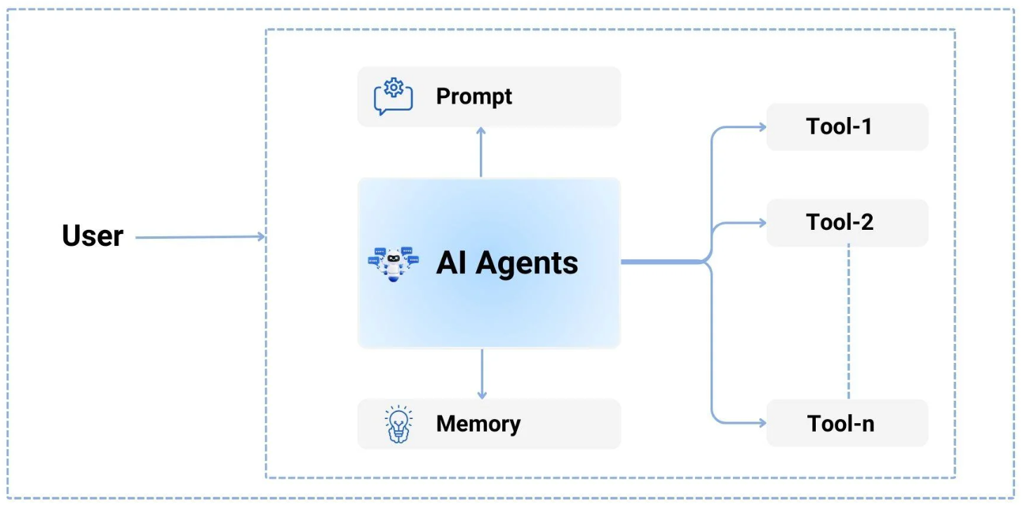
Typical AI Application with Single-Agent Architecture

Slide 6
Challenges with Current AI Applications
GitHub offers features for handling code, issues, pull requests, and more.
Their goal is to extend these capabilities by integrating with various AI-powered IDEs, such as VS Code, Cursor, Windsurf, Zed, Cline, and others.
To achieve this, they must develop dedicated GitHub integration tools tailored to each individual IDE, implementing them step by step for compatibility.

Slide 7
Pain Points for Developers
For Tool developers:
If GitHub plans to integrate with the top 100 AI applications, they must create and implement integrations individually for each AI application, addressing its specific requirements and features.
For AI application developers:
If Rider seeks to integrate with GitHub's VS Code GitHub Copilot tool, they wouldn't be able to reuse it directly. Instead, they'd have to develop a new integration tailored to their platform from scratch.

Slide 8
The Demand for Standardization
Need for a universal protocol to streamline AI integrations:
Reduce fragmentation
Promote interoperability

Slide 9
What?
Understanding MCP

Slide 10
What is the Model Context Protocol (MCP)?
MCP is an open protocol that enables seamless integration between LLM applications and your tools & data sources.
APIs
Standardize how web applications interact with the backend:
Servers
Databases
Services
MCP
Standardizes how AI applications interact with external systems:
Prompts
Tools
Data & resources
Sampling

Slide 11
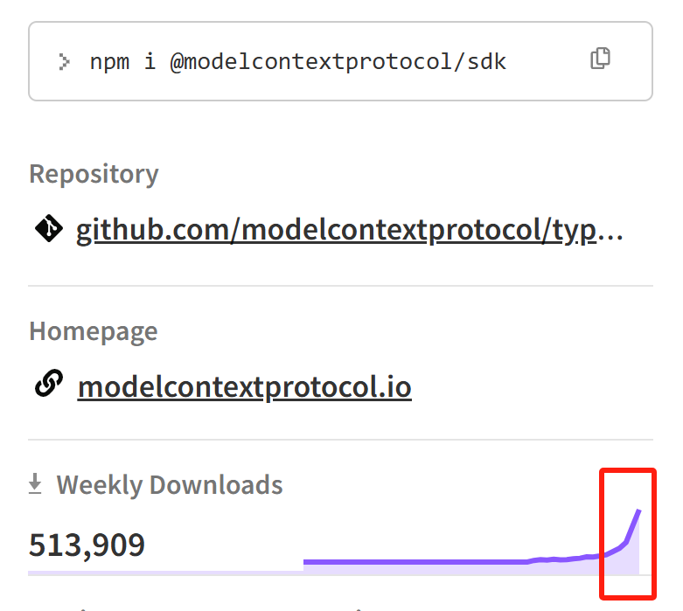
Timeline & Trend
Nov 2024​ - Anthropic announced MCP, Zed supported MCP
Dec 2024 - Cline supported MCP
Jan 2025 - Cursor supported MCP
Feb 2025 - Windsurf supported MCP
March 2025 – VS Code supported MCP

Slide 12
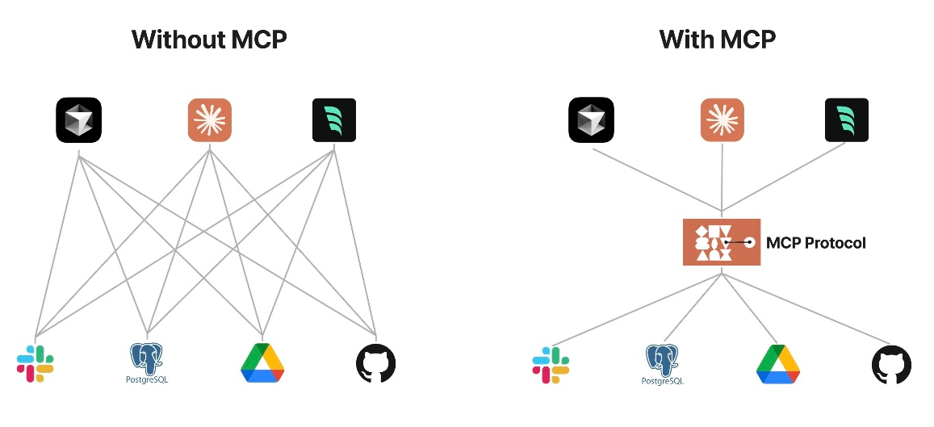

Slide 13
With MCP: Standardized AI Development​
For AI Application developers​
Connect your app to any MCP server with 0 additional work ​
​
​
For Tool or API developers​
Build an MCP server once, see adoption everywhere​

Slide 14
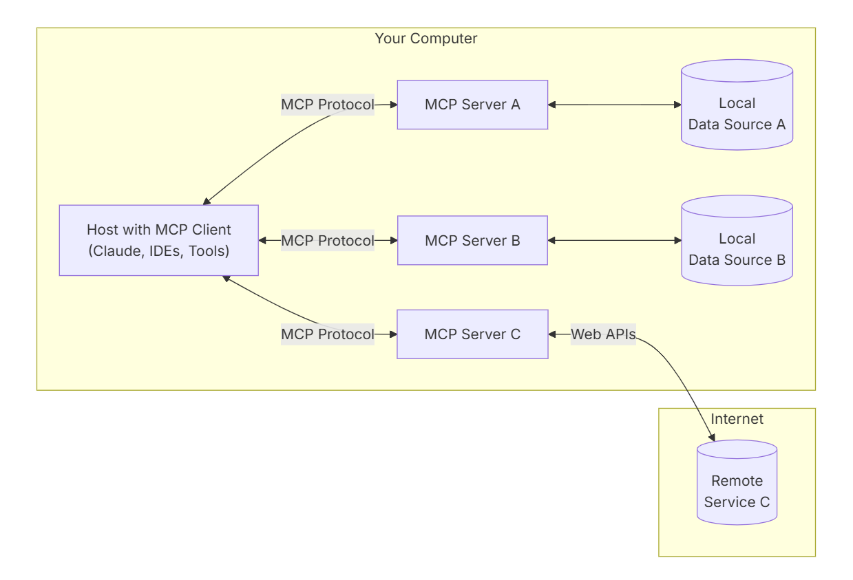
General Architecture

Slide 15
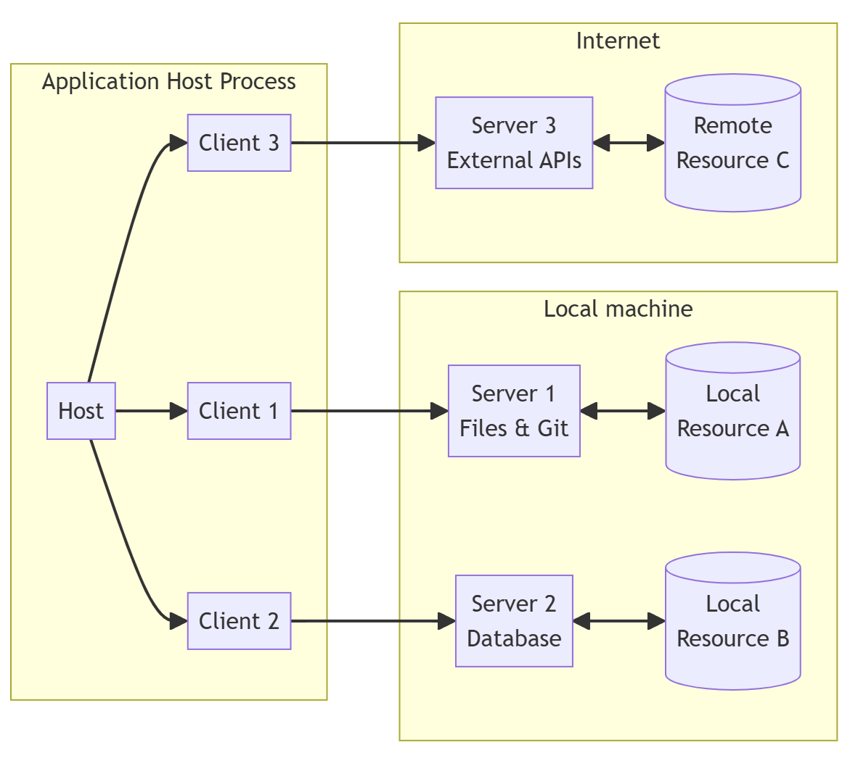
Core Components
MCP Hosts: Programs like Claude Desktop, IDEs, or AI tools that want to access data through MCP
MCP Clients: Protocol clients that maintain 1:1 connections with servers
MCP Servers: Lightweight programs that each expose specific capabilities through the standardized Model Context Protocol

Slide 16
Transports
Two standard transport mechanisms for client-server communication:
stdio, communication over standard in and standard out
HTTP with Server-Sent Events (SSE)

Slide 17
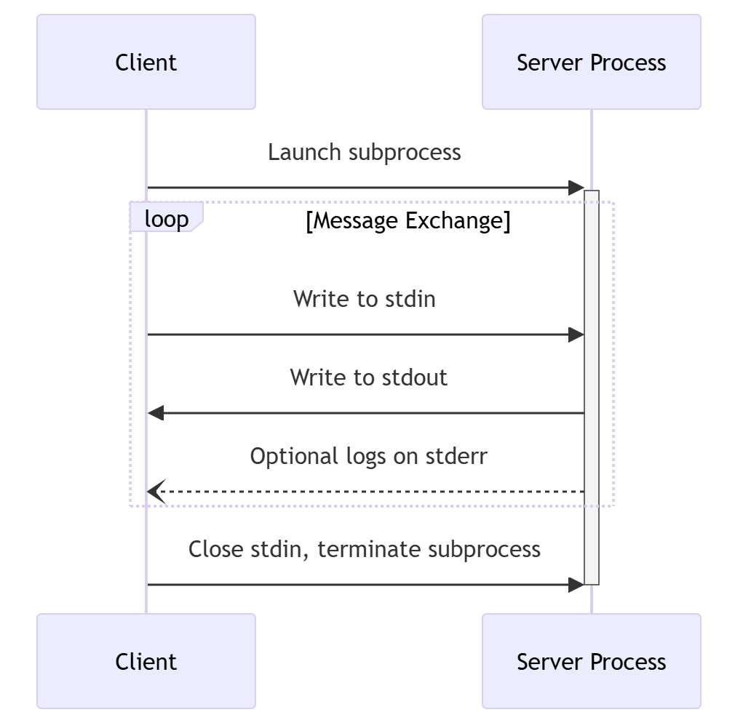
stdio
Server could only run in local.
The client launches the MCP server as a subprocess.
The server receives JSON-RPC messages on its standard input (stdin) and writes responses to its standard output (stdout).

Slide 18
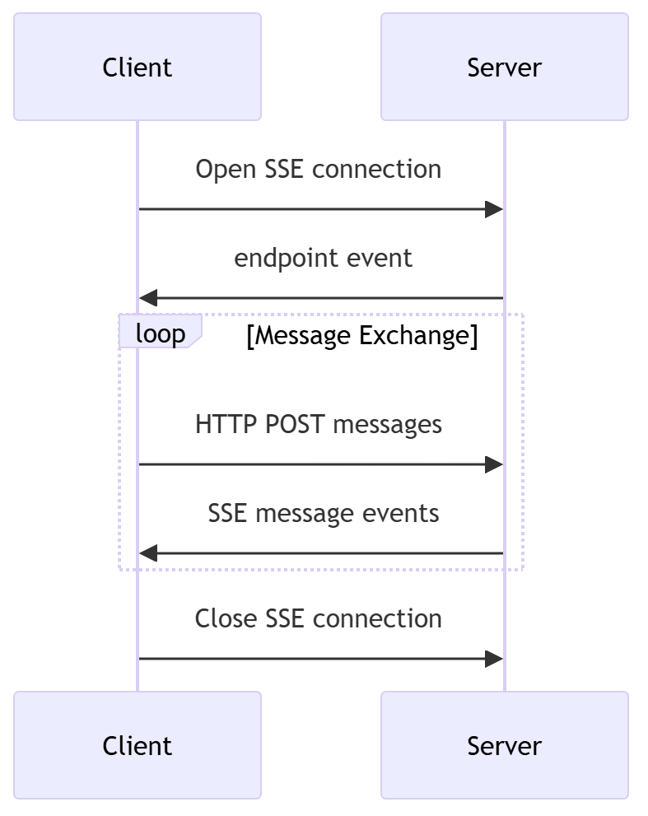
HTTP with SSE
Server could run in both local and remote.
The server MUST provide two endpoints:
  An SSE endpoint, for clients to establish a connection and receive messages from the server
  A regular HTTP POST endpoint for clients to send messages to the server

Slide 19
Server Features
MCP Client
Queries for Resources
Invokes Tools
Interpolates Prompts
MCP Server
Exposes Resources
Exposes Tools
Exposes Prompt Templates
Tools
Resources
Prompt Templates
Functions and tools that can be invoked by the client
Data or content exposed by the server
User-invoked prompts to interact with the model
Retrieve / search
Files
Document Q&A
Send a message
Database Records
Transcript Summary
Update DB records
API Responses
Output as JSON

Slide 20
How?
Using and Implementing MCP

Slide 21
Using MCP
1. Install application that support MCP integrations:
https://modelcontextprotocol.io/clients
2. Install/config MCP Server:
https://modelcontextprotocol.io/examples

Slide 22
Popular Applications that support MCP
Claude Desktop
Cline
VS Code
https://modelcontextprotocol.io/clients

Slide 23
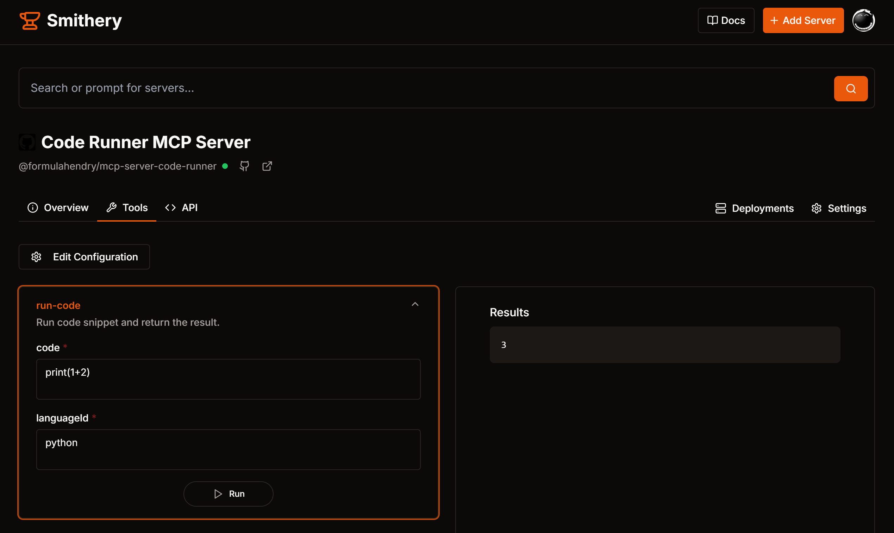
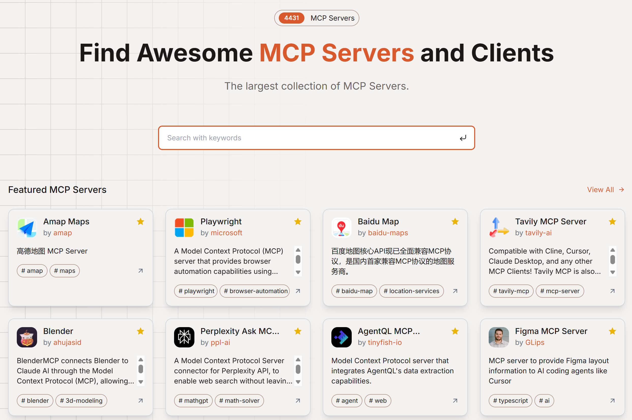
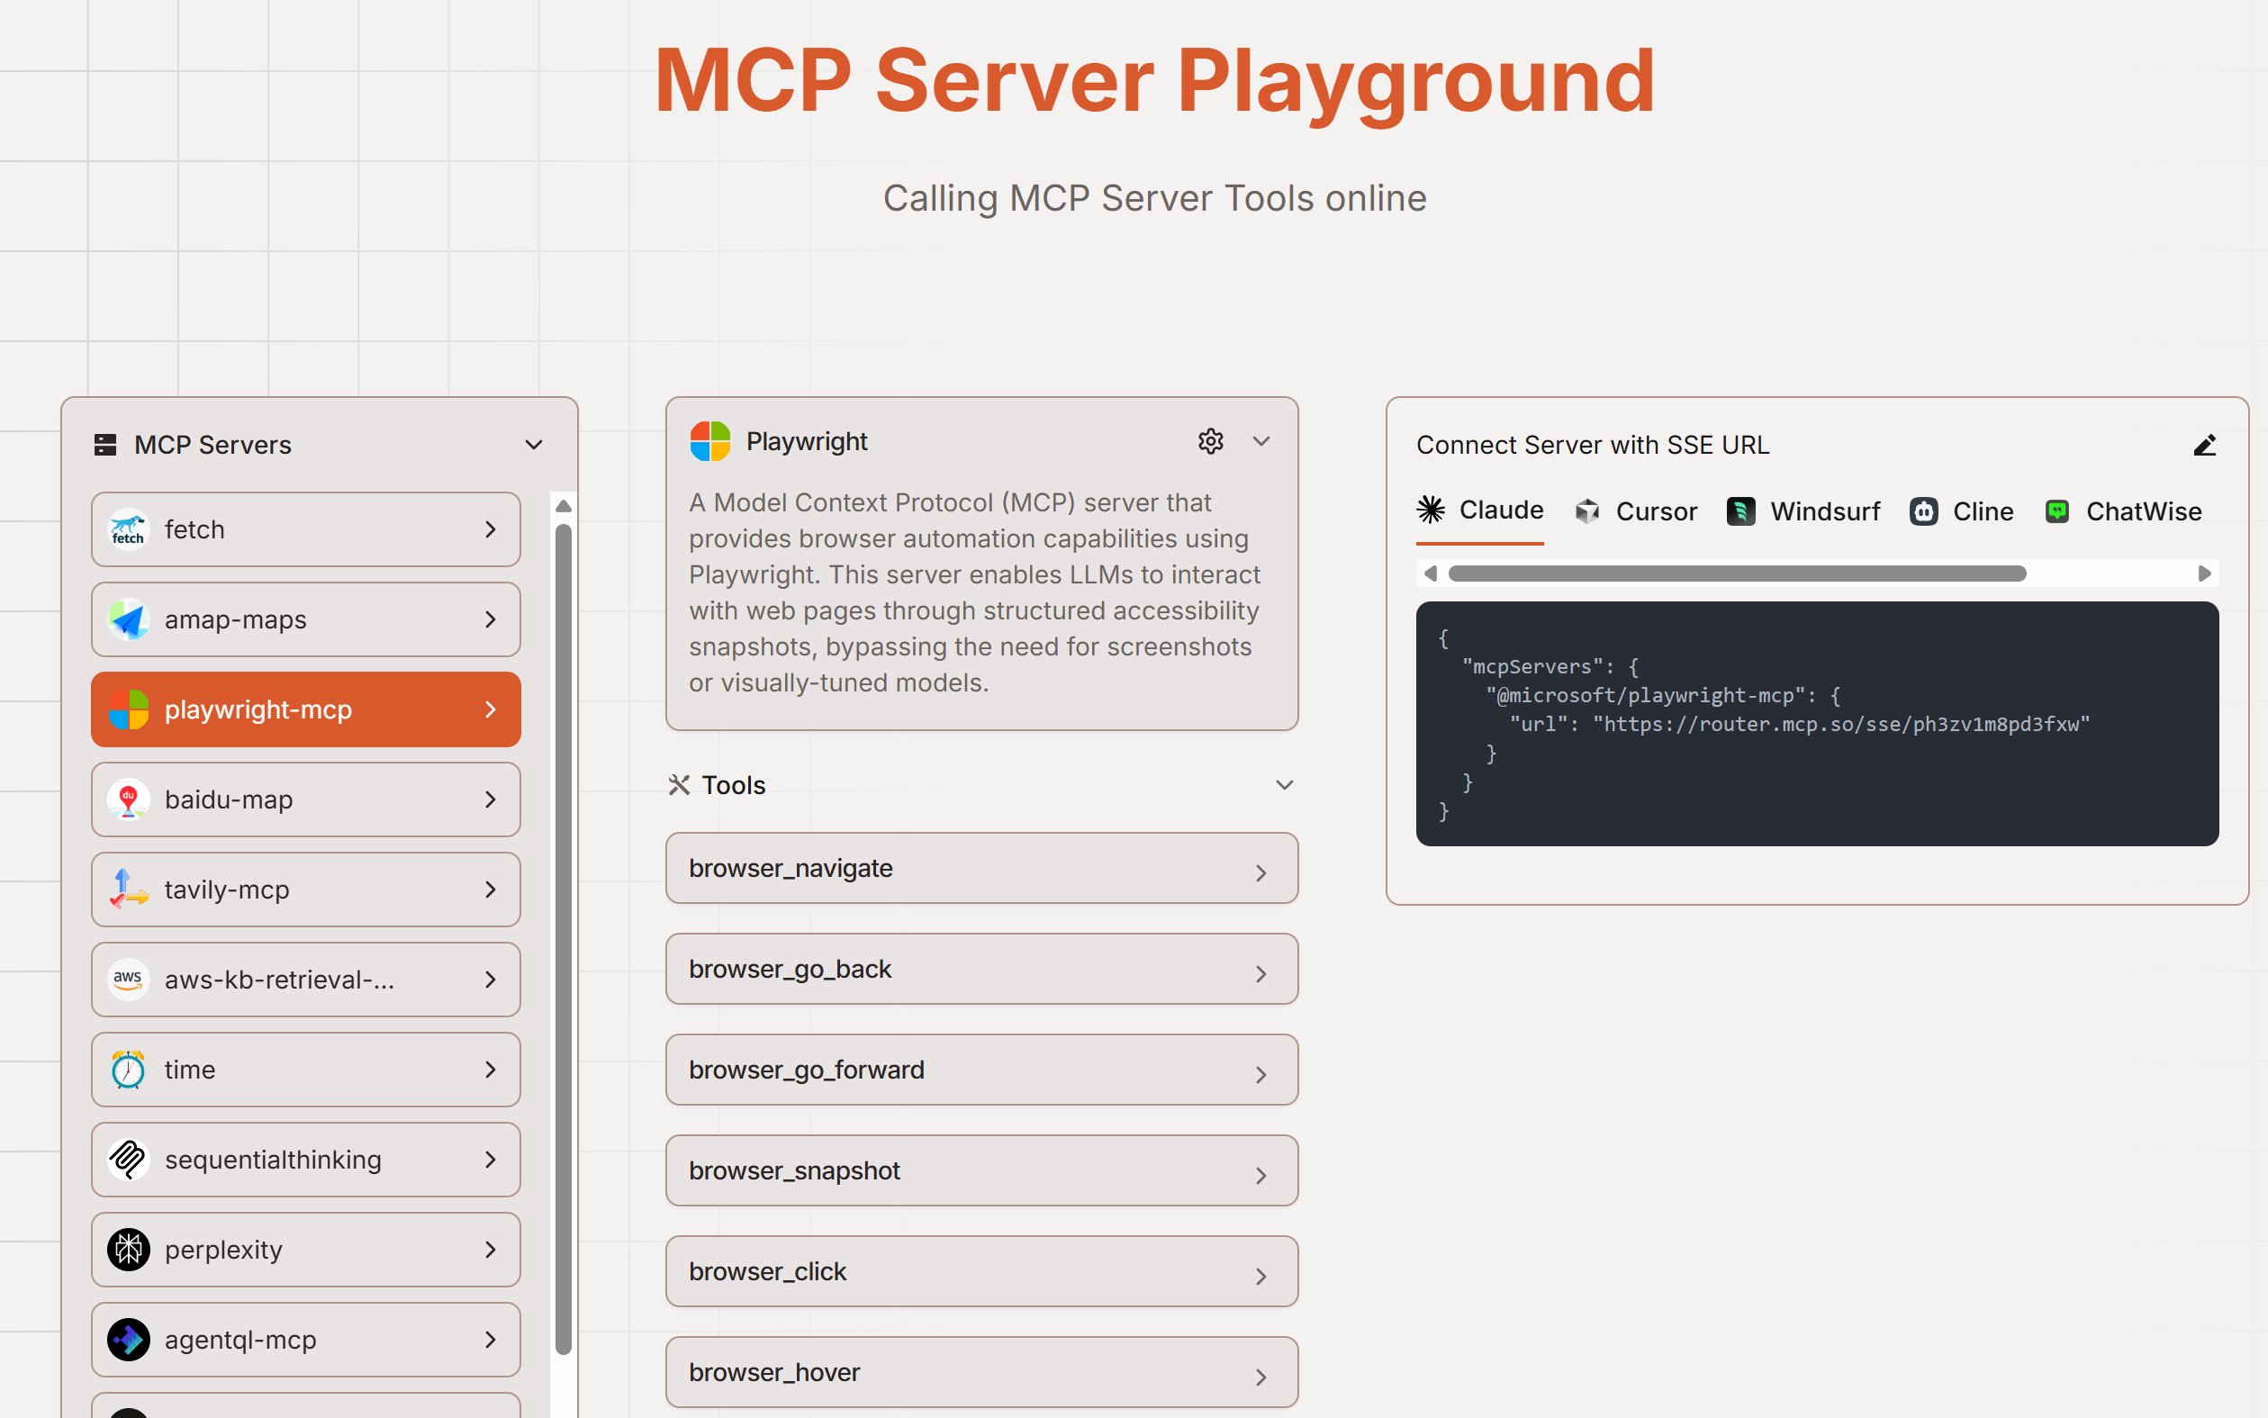
Popular MCP Server Registry
https://mcp.so/servers
https://glama.ai/mcp/servers
https://smithery.ai/
https://www.pulsemcp.com/servers

Slide 24
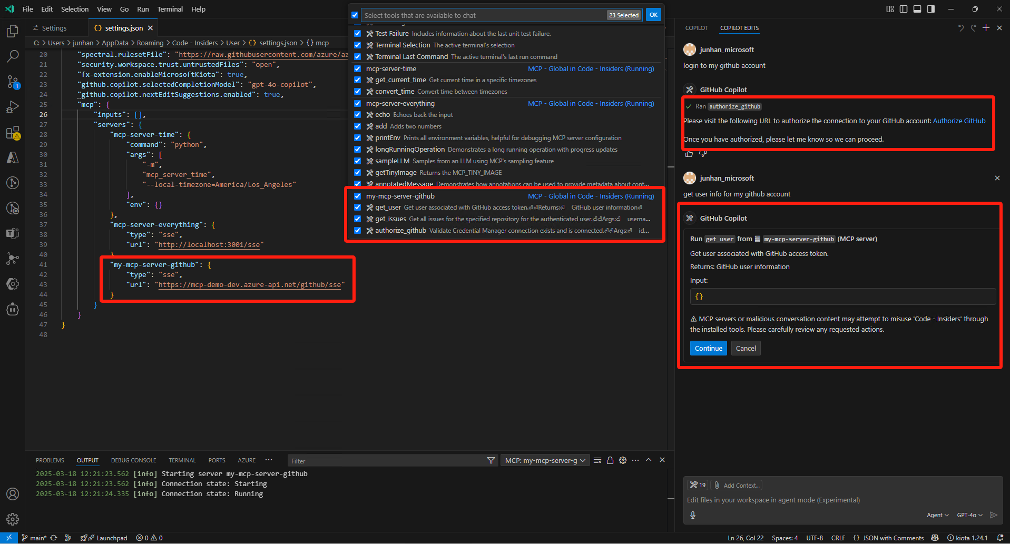
VS Code support MCP now!

Slide 25
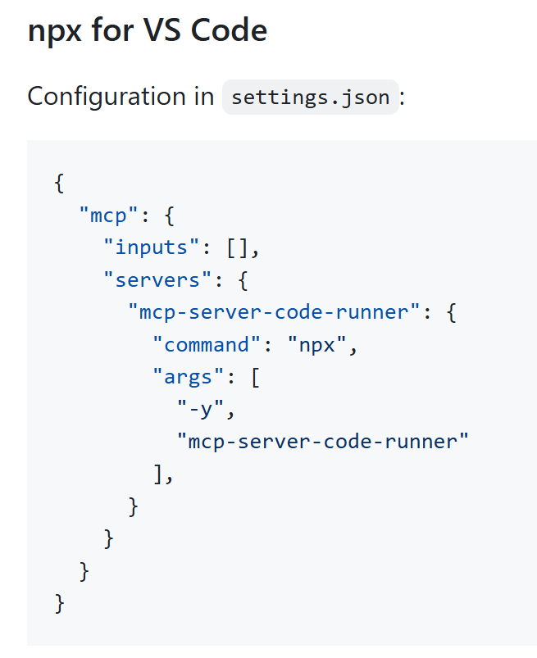
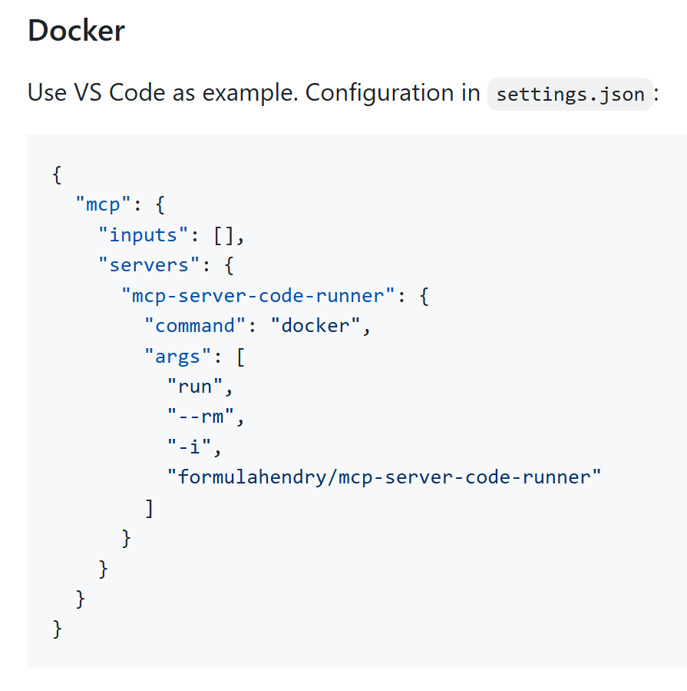
Install/config MCP Server in VS Code
code --add-mcp '{"name":"mcp-server-code-runner","command":"npx","args":[”-y", " mcp-server-code-runner"]}'
Notes:
https://code.visualstudio.com/docs/copilot/chat/mcp-servers#_configuration-format

Slide 26
Implementing MCP
SDKs for building MCP Client and MCP Server
  TypeScript SDK
  Python SDK
  Java SDK
  Kotlin SDK
  C# SDK
Tooling
  MCP Inspector: interactive developer tool for testing and debugging MCP Server
  generator-mcp: Yeoman Generator for MCP Server

Slide 27
Create a MCP Server
Prerequisites:
Latest VS Code Insiders
.NET
Node.js
Steps:
Create a .NET console App.
Add the NuGet package ModelContextProtocol https://www.nuget.org/packages/ModelContextProtocol
Implement your Tool logic for MCP Server
Debug/Test MCP Server in MCP Inspector
Run MCP Server in VS Code Agent Mode

Slide 28
Starting up our server
Update the Program.cs with some basic scaffolding to create the MCP server, configure standard server transport, and tell the server to search for Tools (or available APIs) from the running assembly.
using Microsoft.Extensions.DependencyInjection;
using Microsoft.Extensions.Hosting;
using ModelContextProtocol.Server;
using System.ComponentModel;
var builder = Host.CreateEmptyApplicationBuilder(settings: null);
builder.Services
.AddMcpServer()
.WithStdioServerTransport()
.WithToolsFromAssembly();
await builder.Build().RunAsync();

Slide 29
Defining a tool
In our startup code, the WithToolsFromAssembly will scan the assembly for classes with the McpServerToolType attribute and register all methods with the McpServerTool attribute. Notice that the McpServerTool has a Description which will be fed into any client connecting to the server. This description helps the client determine which tool to call.
[McpServerToolType]
public static class EchoTool
{
[McpServerTool, Description("Echoes the message back to the client.")]
public static string Echo(string message) => $"Hello from C#: {message}";
[McpServerTool, Description("Echoes in reverse the message sent by the client.")]
public static string ReverseEcho(string message) => new string(message.Reverse().ToArray());
}

Slide 30
Publish a MCP Server
.NET makes it simple to easily create container images for any .NET app. All that needs to be done is add the necessary configuration into the project file:
If we want to take these images and upload them, we are able to do it all from the CLI by passing in the specific container register to push to:
<PropertyGroup>
<EnableSdkContainerSupport>true</EnableSdkContainerSupport>
<ContainerRepository>jsuarezruiz/mobile-dev-mcp-server</ContainerRepository>
<ContainerFamily>alpine</ContainerFamily>
<RuntimeIdentifiers>linux-x64;linux-arm64</RuntimeIdentifiers>
</PropertyGroup>
dotnet publish /t:PublishContainer -p ContainerRegistry=docker.io

Slide 31
Publish a MCP Server
We can configure the MCP on VS Code or other tolos in this way:
{
"inputs": [],
"servers": {
"monkeymcp": {
"command": "docker",
"args": [
"run",
"-i",
"--rm",
”jsuarezruiz/ mobile-dev-mcp-server "
],
"env": {}
}
}
}

Slide 32
Resources
Documentation for guides and tutorials: https://modelcontextprotocol.io/
Specification for protocol details: https://spec.modelcontextprotocol.io/
GitHub: https://github.com/modelcontextprotocol
MCP Servers: https://github.com/modelcontextprotocol/servers
CSharp SDK: https://github.com/modelcontextprotocol/csharp-sdk

Slide 33
Questions and answers
Questions?
Q&A

Slide 34
Thank you all!

