Slide 1
Version Control Systems - Git
Murat Caliskan

Slide 2
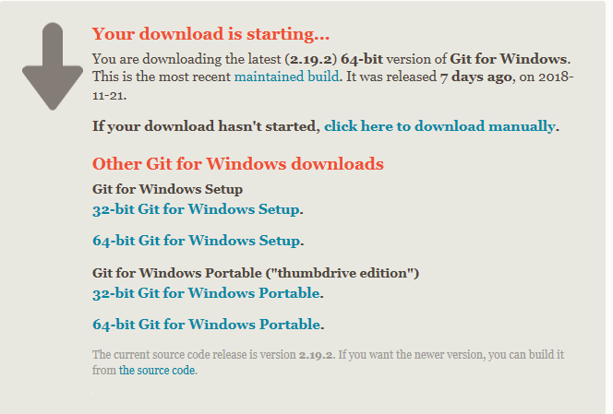
Git Installation for Windows
https://git-scm.com/download/win

Slide 3
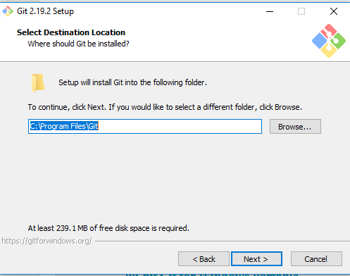
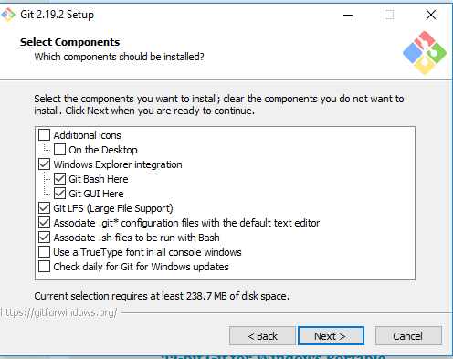
Git Installation for Windows

Slide 4
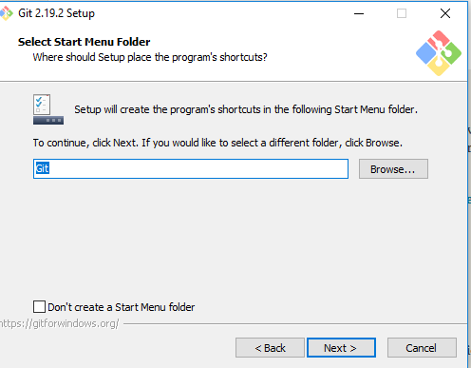
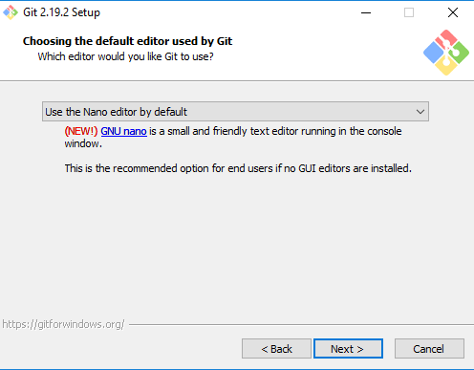
Git Installation for Windows

Slide 5
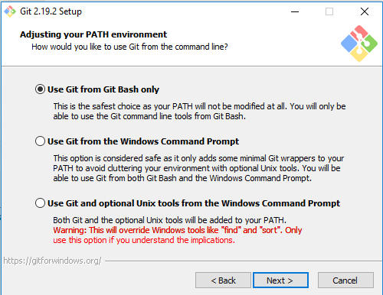
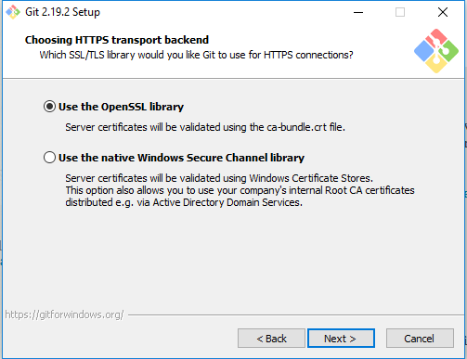
Git Installation for Windows

Slide 6
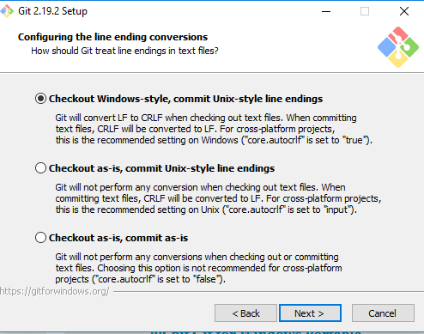
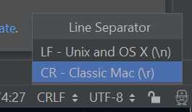
Git Installation for Windows

Slide 7
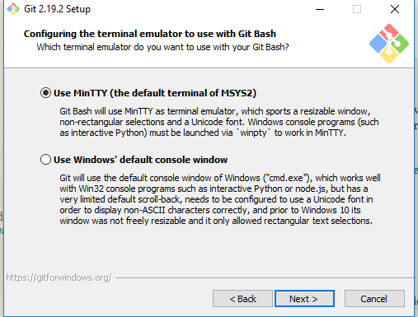
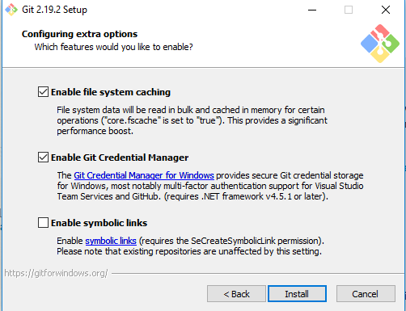
Git Installation for Windows

Slide 8
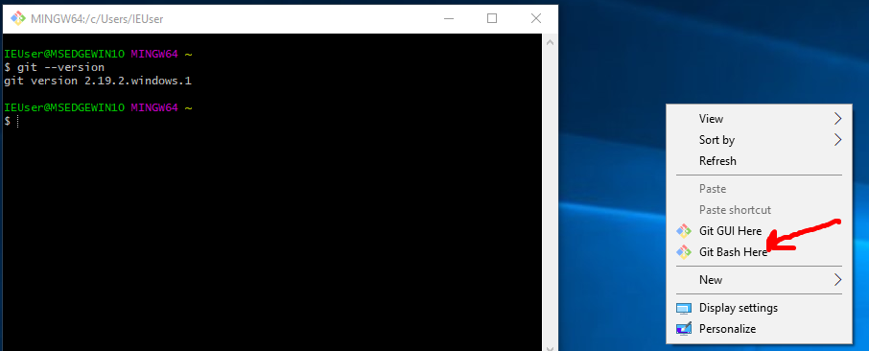
Git Installation for Windows

Slide 9
Git Installation for Mac
Enter terminal
Write git at terminal and verify if it was pre-installed
If it writes “command not found ”
Download https://git-scm.com/download/mac
Install straight way.
Check with git version if installed

Slide 10
Git Installation for Linux (Ubuntu)
Enter terminal
Write git version at terminal and verify if it was install
If it writes “program git is currently not installed”
Visit https://git-scm.com/download/linux
Check related installation guide for your linux operating system
For Ubuntu: sudo apt-get install git
Sudo: Gives administrative rights. It will ask your admin password.
Check with git version if installed

Slide 11
Step 2 = Learning Concept of VCS
VCS = Version control system.
Version control system: is a software that can store and maintain information about each and every change made to files and directories brought under it’s control against specific version.
Question: What does it mean version?
When you create a file which is monitored by the VCS we can say that it is version 1.
When you modify the file than it would be different from original so we can say it is version 1.1

Slide 12
Step 2 = Learning Concept of VCS
VCS records history of all changes to a file against version numbers.
This is also called commit history. You can change the file to a particular version in commit history at any time you want
You can also revert entire projects not just files previous state.
Question: Why we may need to revert entire projects?
If you are doing some recent changes (experimenting a big refactoring to improve performance etc) and it has created various bugs or some other problems then you can simply discard all changes and go back to beginning.

Slide 13
Step 2 = Learning Concept of VCS
If you are working with many developers using VCS you can find:
Who did change?
What change was it?
When was that change?
You can compare different versions of file or files.
Question: What its use to compare different versions?
Can help for debugging purpose.
For solo developer it is good for memorizing if many changes were done.

Slide 14
Step 2 = Learning Concept of VCS
There are 2 types of VCS
Centralized Version Control Systems
Example: CVS, Perforce, Subversion
Distributed Version Control Systems
Example: Git, Mercurial
Centralized Version Control Systems
Single central server
Checkout only from that central server
Question: What is the Problem of Centralized Version Control Systems
When server goes down. No more check outs.
No Back up servers. Commit history is lost.

Slide 15
Step 2 = Learning Concept of VCS
Distributed Version Control Systems
When client checks out a repository (code base) from a server, it fully mirrors that repository.
So if the server goes down. No problem we have all history at local computer.

Slide 16
Step 2 = Learning Concept of VCS
Server: Version control software running on a server grade machine that hosts or control & manages the repositories.
Client: Software which communicates to the server. Mostly our local desktop software. Either command line or GUI interface (from Intellij)
Communication: Accessing the repository for writing or reading files.
Repository: Large collection of source code hosted on a remote server. Can be publicly or privately accessed.
Public access: Free of all.
Private access: Selected group of individuals with some kind of access control

Slide 17

Git
Created in 2005 by Linus Torvalds. Father of Linux.
Linux project was using Bitkeeper as version control.
Because it turned into a paid model, Linux community rioted.
Now it is most popular DVCS in the world.

Slide 18
Git States
Every files goes through Three states if you want to add to repository.
Modified state: In this state file gets modified and saved in the file system under the operating system that the user is using.
This is changes that are NOT COMMITED yet to git database.
Staged state: In this stage a modified file is marked in its
Git add command will be used.
Commited state: In the sate which the file is stored in the local Git Database.
Git commit command will be used.

Slide 19
Git States
Every files goes through Three states if you want to add to repository.
Modified state: In this state file gets modified and saved in the file system under the operating system that the user is using.
This is changes that are NOT COMMITED yet to git database.
Staged state: In this stage a modified file is marked in its
Git add command will be used.
Commited state: In the sate which the file is stored in the local Git Database.
Git commit command will be used.

Slide 20
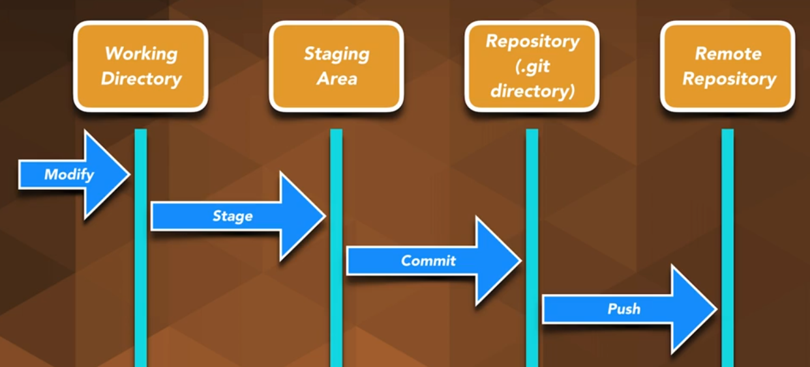
Git States

Slide 21
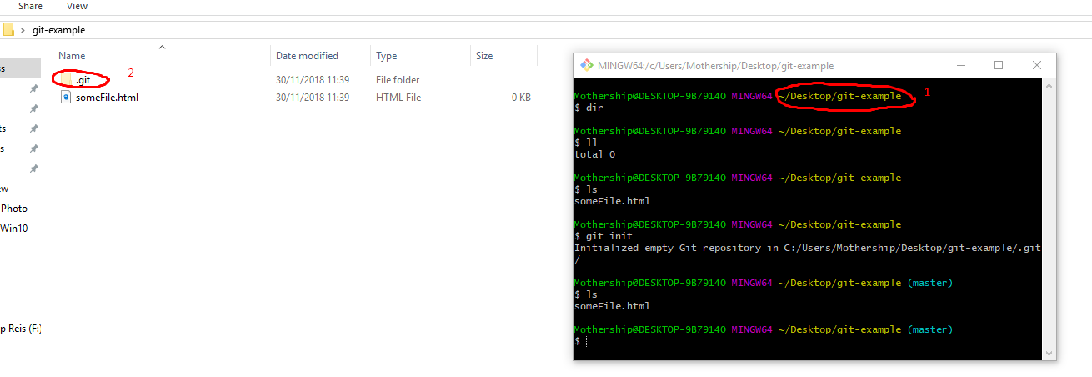
Git States
1 is the working directory where you create and modify files.

Slide 22
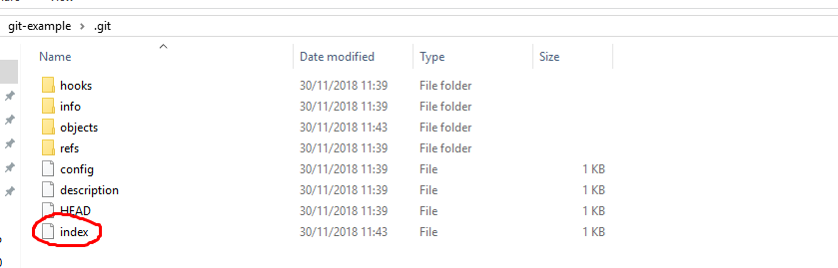
Git States
The file “index” represents the index or staging area in Git. It contains meta-data such as timestamps, file names etc.

Slide 23
Git Repositories
How to create?
From scratch by executing the “git init” command in an empty folder.
From existing project by executing “git init” command
Cloning from remote repository from a remote server. Bitbucket or Github.

Slide 24
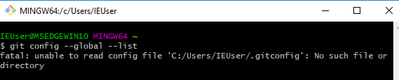
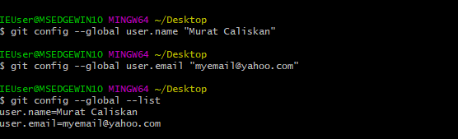
Git Commands – git config
Git help => Help section of how to use git
Setup name and email address for Git

Slide 25
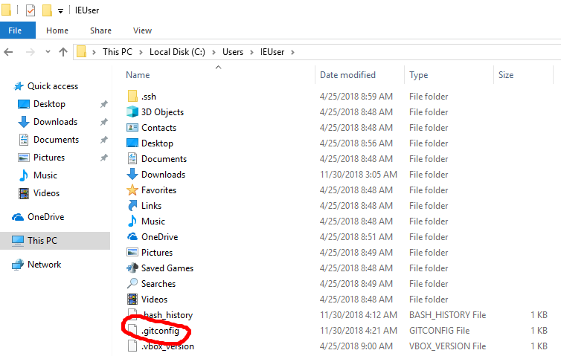
Git Commands – git config
Global Configuration file: Configuration values are applied to single user.

Slide 26
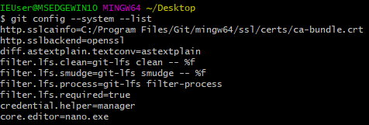
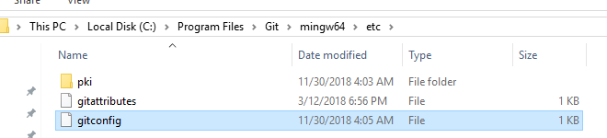
Git Commands – git config
System Configuration file: Configuration values are applied to all users.

Slide 27
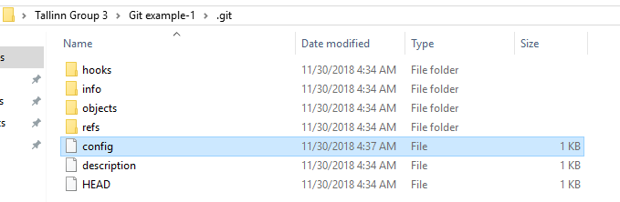
Git Commands – git config
Local Configuration file: Configuration values are applied to a single repository. This file can overwrite configuration values set in Global and System

Slide 28
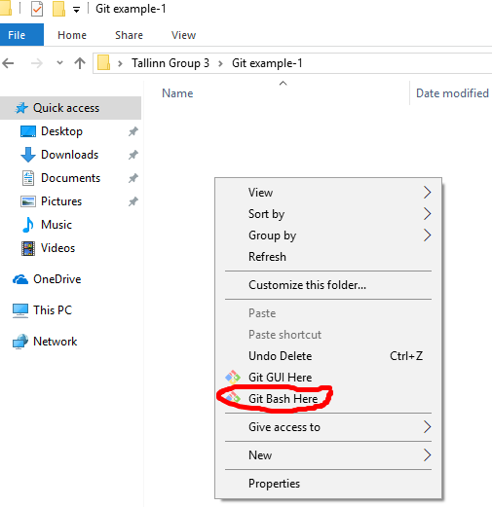
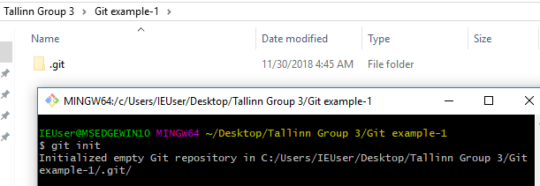
Git Commands – git init (for empty folder)

Slide 29
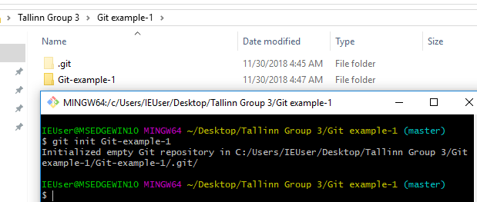
Git Commands – git init
Git init <folder name>
Will create the git repository with the folder name

Slide 30
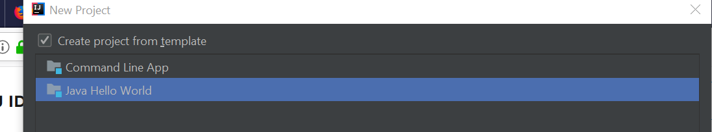
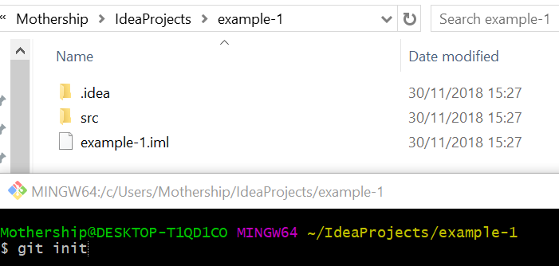
Git Commands – git init (for existing project)
Create a sample project Init Git to that project

Slide 31
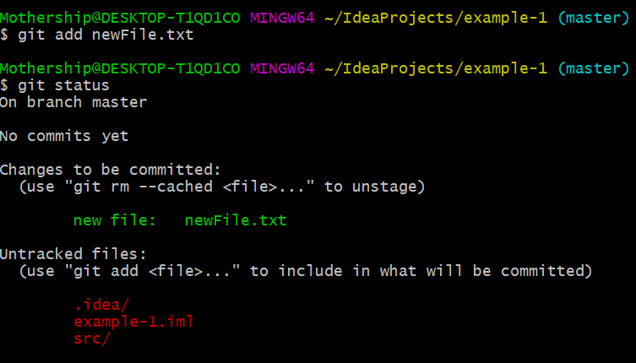
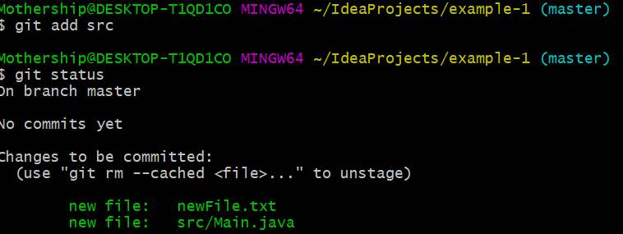
Git Commands – git add
Create a text file in the sample project Add the file for the git to control Check status if it is really ready to be committed. Git status command is used to check status.
You can also add folder and all its content. If you want all the files and folders: “Git add .” command will work.

Slide 32
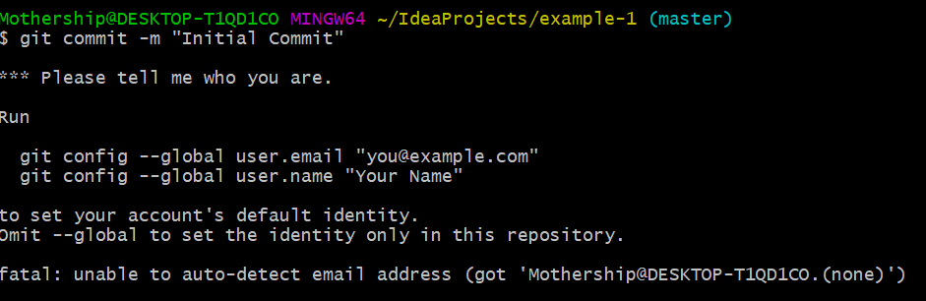
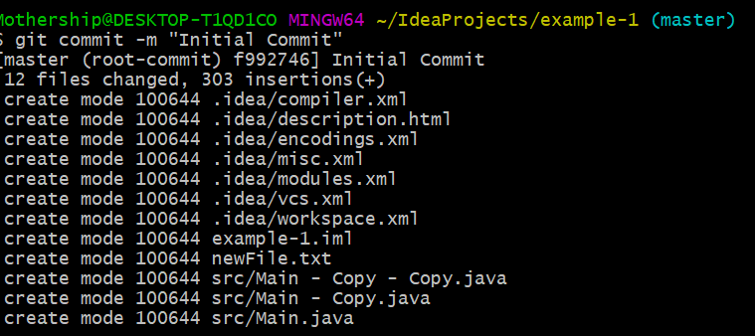
Git Commands – git commit
Commit the files which we have added using the git add command If you did not do git config --global user.email git config --global user.name Left side error will happen.
Successful commit 303 => is line amount F992746 => commit id. Identifies the commit. Initial Commit => our commit message 12 files => affected file amount

Slide 33
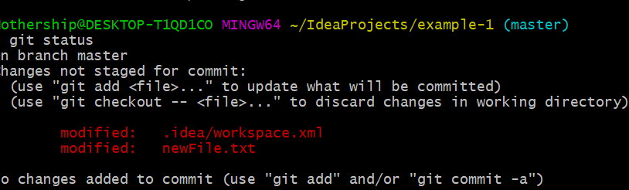
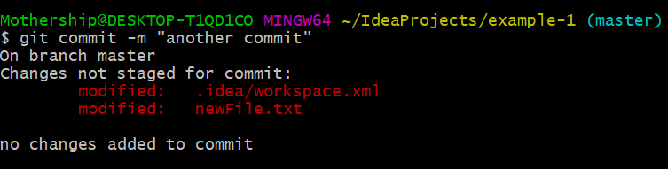
Git Commands – git status
Gives the status of your repository We changed newFile.txt Even though we did commit it does not insert to git repository as it is not staged. You must first do git add newFile.txt Then commit. In intellij it does both actions with one click.

Slide 34
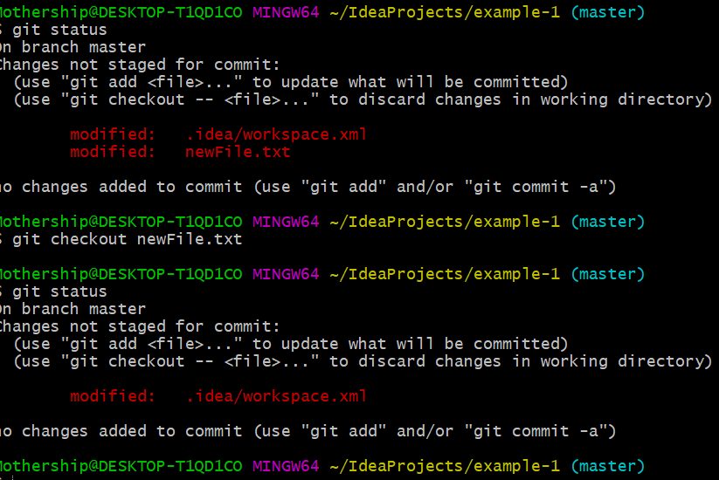
Git Commands – Reverting changes.
Git checkout : Gets the file from the git repository.

Slide 35
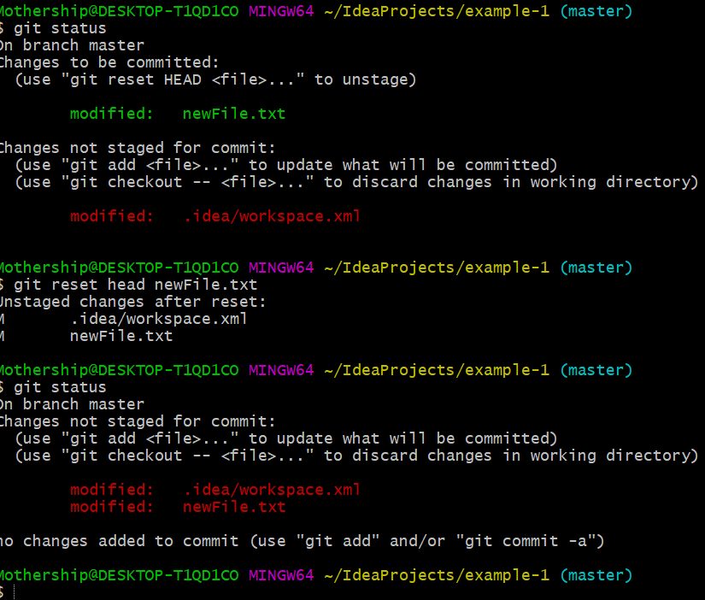
Git Commands – Reverting changes.
Git reset Head command: In case you want to revert file which you did “git add” command. It will take the file back to the previous state.

Slide 36
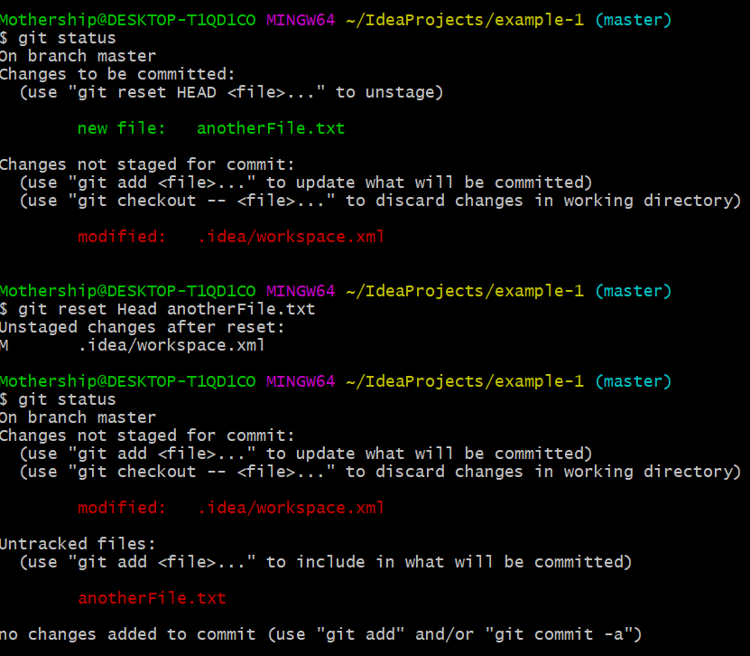
Git Commands – Reverting changes.
Git reset Head command: In the case of newly added file same command can be used to take the file to previous state. Warning: If you just delete the file after you did “git add”; the file will still be added if you do “git commit”

Slide 37
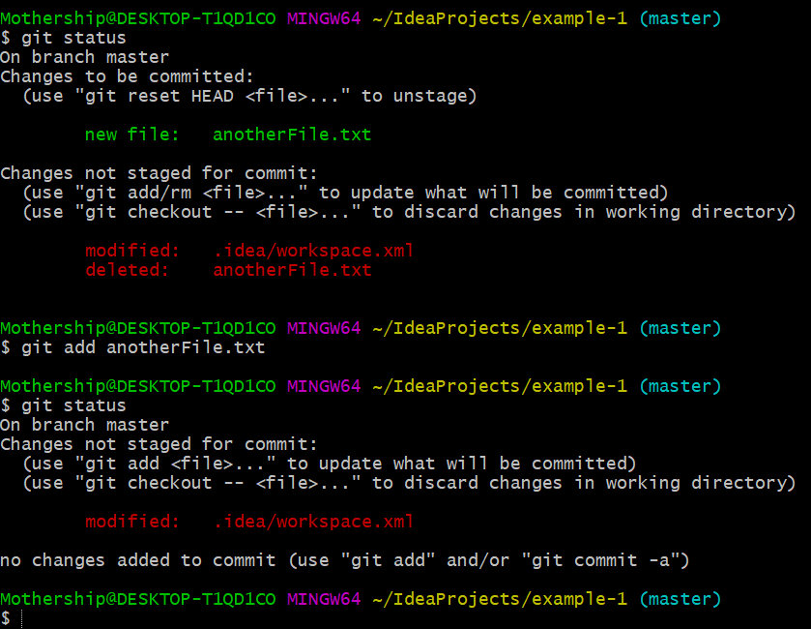
Git Commands – Reverting changes.
Another option is to remove the change delete the file from file system “git add <filename>”.

Slide 38
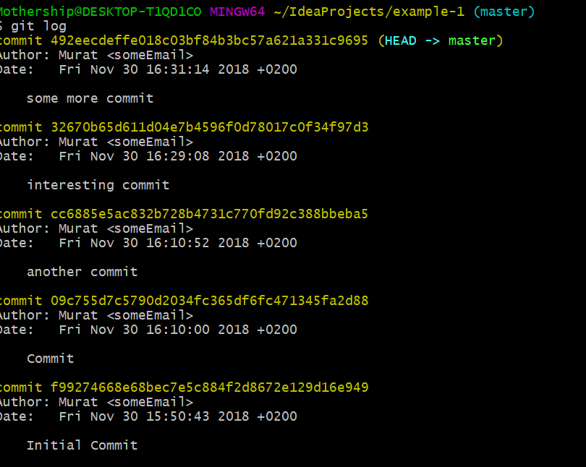
Git Commands – Git log
This command shows the commit history Git log –oneline = for summary look Git log –n 3= last 3 commit history Git log <filename> = file commit history

Slide 39
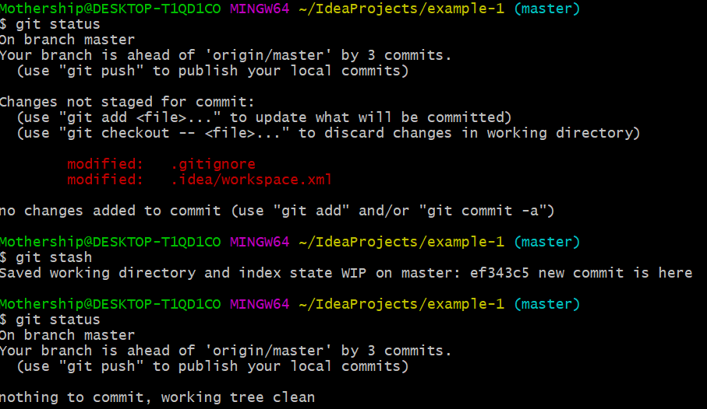
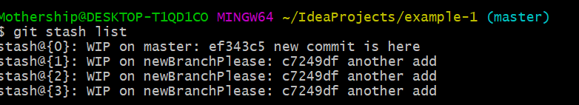
Git Commands – Git stash
In scenario for emergency fixes we may need to stash. Or we need to rebase our branch we may be requested for stash or commit. Only tracked files. Git stash –u : will include untracked files Git stash pop : applies the stash and drop the stash.

Slide 40
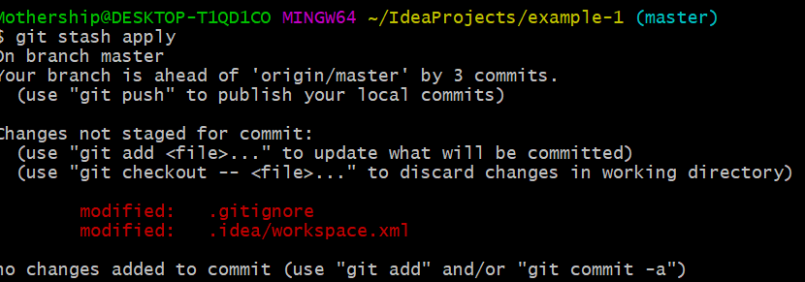
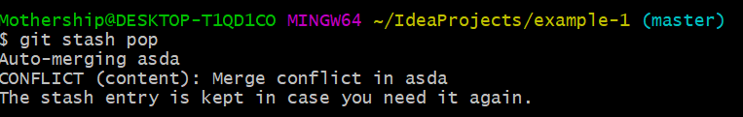
Git Commands – Git stash
Git stash apply to get back the changes. Git stash drop to erase the applied stash. If you do change on same file after stash. When poping back it will create conflict.

Slide 41
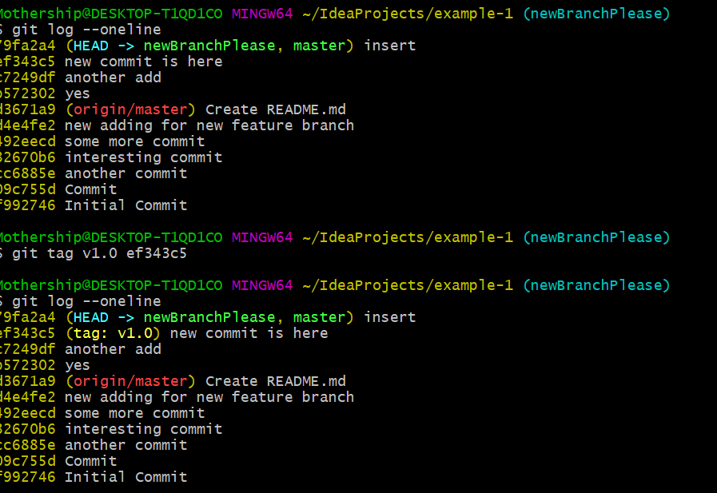
Git Commands – Git tag
Git tag <tagName> : it is just a marker on a commit.

Slide 42
Git ignore file
Some folders and files are not meant for Git. https://www.atlassian.com/git/tutorials/saving-changes/gitignore .gitignore file is responsible for this need.

Slide 43
Git branching
Whenever you create a repository in Git, a branch called master is created automatically.
Branches are simply a lightweight movable pointer to a commit you have made in your repository.
Different branches can have different versions of the files. You can add and remove from specific branches.

Slide 44
Git branching
Why it is good to have branches:
Good for developers to update them anytime they like.
Freedom to experiment without other developers.
Companies policies for “one feature one branch”
Master is considered production ready deployment.
Fixing of the major bugs while other developers do new features.

Slide 45
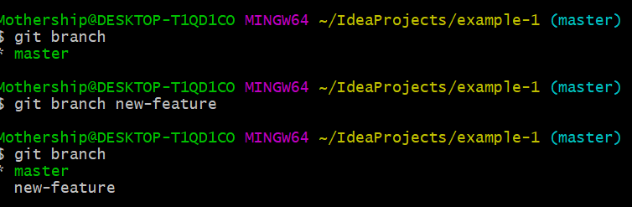
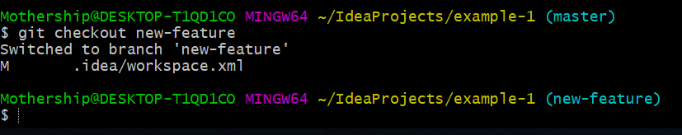
Git branching
Git branch <branchName> : will create the branch.
Git checkout <branchName> : will check out the branch. All changes will be effecting this branch

Slide 46
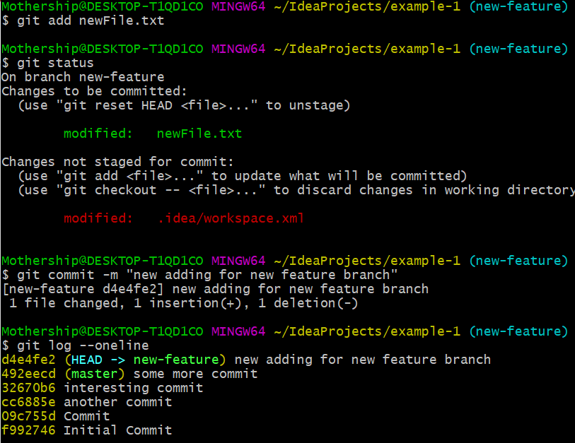
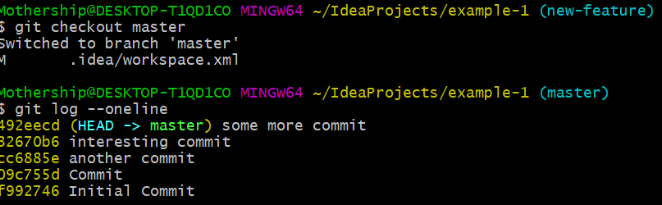
Git branching
We modify the newFile.txt
We add the change then commit.
Now we can see branch will contain this change.
We checkout back to the master
As seen our latest change is not in master yet.
It is located at the branch.

Slide 47
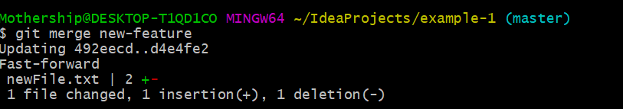
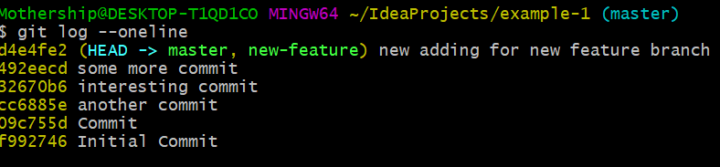
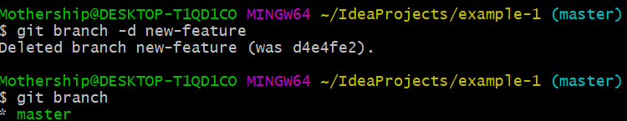
Branch merging & deletion
Git merge <branchname>: With the merge latest changes appear in the master branch.
Git branch –d <branchname>: After your merge you can delete your branch.

Slide 48
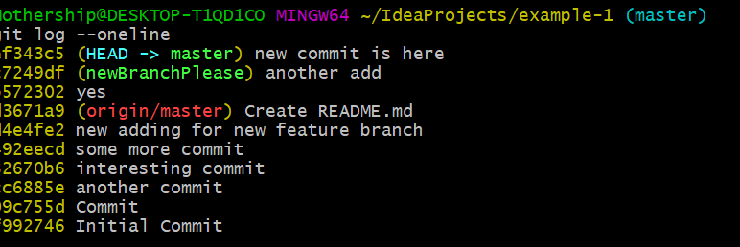

Git Rebase
Lets suppose you have a branch
A critical bug happened at master and it is fixed with the new commit
Now you want to update your branch to the newest additions of the master
Note: You have to stash or commit changes in your branch before rebasing.
Git stash: temporary save changes

Slide 49

Github
GitHub Inc. is a web-based hosting service for version control using Git. It is mostly used for computer code. It offers all of the distributed version control and source code management functionality of Git as well as adding its own features.
https://github.com/

Slide 50


Git Remote
Git remote: used to manage remote connections in git.
Git remote add: adding new remote connection
Origin: reference to the remote connection. It is tradition.

Slide 51


Git Push
Git push –u origin master : Pushes the committed master at the remote repository.

Slide 52



Git Pull
Git pull: Get the latest changes from the remote repository
Warning: First pull before a push. Maybe some developer pushed some changes which may break your changes.

Slide 53

Github Fork
Creating personal repository from another users repository. A copy.
Why we do forking:
Experimental purpose
Contribute to the original project

Slide 54


Git clone
Cloning the project from the remote repository.
Warning: Clone is not checkout .
Clone: fetching repositories you do not have
Checkout: switching between branches in a repository which you have.

Slide 55

Git – Working with Intellij

Slide 56

Git – Working with Intellij

Slide 57
Git – Working with Intellij
Task 1
Create a new project
Create new repository at github
Push to github
Put in github a file from the github.com.
Pull it to your local repository
Delete that file and push it to github
Insert a class and commit.
Then revert this commit.

Slide 58
Git – Working with Intellij
Task 1
Create a new project
Create new repository at github
Push to github
Put in github a file from the github.com.
Pull it to your local repository
Delete that file and push it to github
Insert a class and commit.
Then revert this commit.

Slide 59
Git – Working with Intellij
Task 2
Clone the project from github
Add new text file
Push to github
Task 3
Clone the project from github
Add new text file
Push to github
Task 4
Clone the project from github
Create a branch
Change any file.
Push to branch.
Merge to master

