Slide 1


Database Management Systems
Design and creation

Slide 2
Database Creation
Design is very important
Long lasting implications
How is our data being stored again?
in tables (rows and cols)
- How do we manipulate data?
by writing queries SQL codes acting on those tables
Notes:
Intuition: it’s very easy to add but hard to delete => design is important

Slide 3
Example
◼ We wish to create a database for the following:
We have a company that is organized into departments
Name, number, employee
May have several locations
Each department controls a number of projects
Name, number, single location
Each department as a number of employees
Each employee can work for one department, but may have many projects
Number, name, address, salary
Each employee may have a number of dependents
Name, birthdate, relationship

Slide 4
Creating a Database
First step:
Define your entities and attributes
Simple vs. Composite attributes
Is it easier to store in a binary file or split into chunks?
Address is composite attributes because it’s composed of city, province, state, country.
I don’t need count of employee as an attribute because every row is an entity and it changed quite often. (Ask yourself is it easier to compute or store)

Slide 5
Key Attributes
◼Key attributes are values that must be unique for an entity (underline)
– What would qualify in this example?
◼Why do we care about key attributes?
it ultimately becomes primary key

Slide 6
Design
◼ Let's start drawing a diagram to represent our design

Slide 7
Relationships
Identifying relationships is important
– Why? It prevents us from data incorrectly referenced
What types of relationships exist?
one-to-one; one-to-many; many-to-many
What relationships exist in our diagram?
Recursive Relationships
“employees can manage employees”
Let's update our design

Slide 8
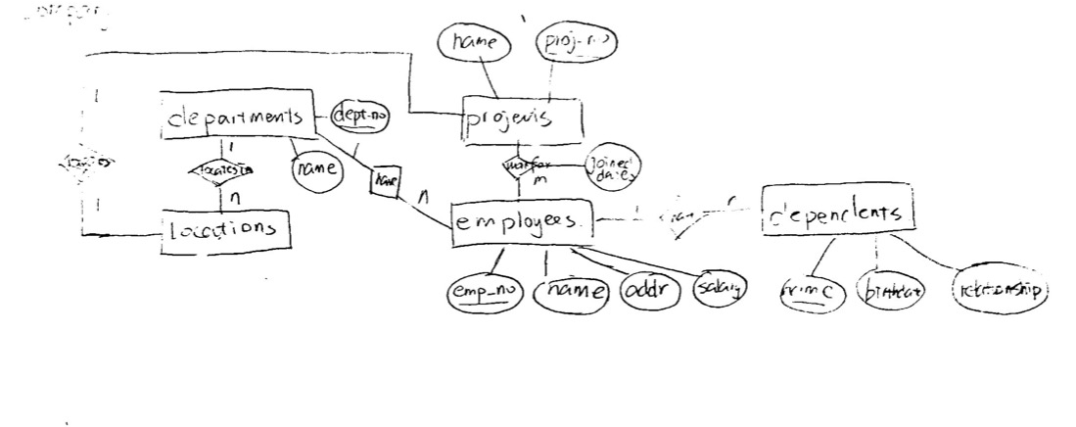
ER Diagram

Slide 9
Normalization
Goal: reduce data redundancy
Data stored in exactly one place
Accomplished by applying forms
Seven forms total
Three is sufficient
Notes:
ER Diagram更重要，说这个部分是为了希望我们可以回答类似问题”Why this is in 3rd normal form”

Slide 10
Normalization
First normal form
–The value stored at the intersection of each row and column must be scalar (store unit of data)
–A table must not contain any repeating column
Will still likely have repeating values in rows

Slide 11


Normalization

Slide 12
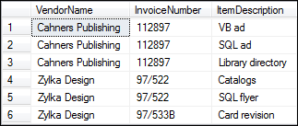
Normalization

Slide 13
Normalization
Second Normal Form
Every non-key column must depend on the entire primary key
If the above is false it indicates there are multiple entities within the table
Application
Move columns that don’t depend on the entire key to a
different table
Establish a relationship between the tables
The step removes redundant row data(two entities cramed in same table)

Slide 14
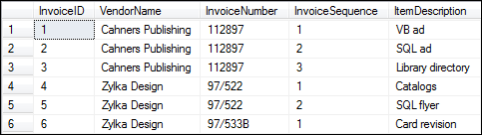
Normalization

Slide 15

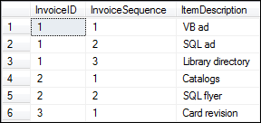
Normalization
Surrogate key: 代理键是指在关系型数据库设计中，当资料表中的候选键都不适合当主键时，例如资料太长，或是意义层面太多，就会用一个attribute来当代理主键，此主键可能是用流水号，来代替可辨识唯一值的主键。 e.g 1,2,3

Slide 16
Normalization
Third Normal Form
–Each non-key column must depend only on the primary key
If a column does not depend only on the primary key
–Assigned to the wrong table
–Can be computed from other columns
Derived data

Slide 17

Normalization
Invoices
InvoiceID
VendorName | InvoiceDate
VendorAddress | InvoiceTotal
VendorCity | PaymentTotal
VendorState | CreditTotal
VendorZipCode | Terms
VendorPhone | InvoiceDueDate
VendorContactFName | PaymentDate
VendorContactLName | AccountNo
InvoiceNumber
 | InvoiceLineItems
 | InvoiceID InvoiceSequence AccountNo InvoiceLineItemDescription ItemQuantity ItemUnitPrice InvoiceLineItemAmount
Notes:
2和3可能同时被破坏
“a table contains another whole table”

Slide 18
Normalization
Does the vendor information depend only on the InvoiceID column?
Does the Terms column depend only on the InvoiceID column?
Does the AccountNo column depend only on the InvoiceID column?
Can the InvoiceDueDate and InvoiceLineItemAmount columns be derived from other data?

Slide 19
Normalization
Vendors
Invoices
InvoiceLineItems
VendorID VendorName VendorAddress VendorCity VendorState VendorZipCode VendorPhone VendorContactFName VendorContactLName DefaultTermsID DefaultAccountNo
InvoiceID VendorID InvoiceNumber InvoiceDate InvoiceTotal PaymentTotal CreditTotal TermsID InvoiceDueDate PaymentDate
InvoiceID InvoiceSequence AccountNo InvoiceLineItemAmount InvoiceLineItemDescription
GLAccounts
AccountNo
AccountDescription
Terms
TermsID TermsDescription TermsDueDays

Slide 20
Difference between 2nd and 3rd
- Second normal form states that a column must depend on the entire primary key. The only time this is relevant is if there is a composite primary key (a primary key that consists of more than one column). If a column depends on only part of the key (can be uniquely identified with only some of the columns from the composite key), then it has violated second normal form.
- Third normal form states that columns must depend entirely on the primary key. That is to say, if a non-primary key column depends on an additional column that is not the primary key, it would violate third normal form.

Slide 21
Implementation
◼ How can we turn this into an actual database?
– What are we missing?
Data Type because design doesn’t interest in your data type but your structure of data. E.g String: varchar or char? Max_len?
◼Pay attention to…
Many-to-many: linked table (don’t need primary key e.g projects and employees in our previous example, if so, a composite key based on foreign key, if you need to create on your own)
Entities and tables are not the same thing, e.g linked table

Slide 22
Creating Databases
Each table must be contained in a separate database
CREATE DATABASE company;
What happens when we run this query?

Slide 23
Create Tables
When we create tables, we must specify column names and types
Primary key? unique
Foreign key? not unique
CREATE TABLE pet (name VARCHAR(20), owner VARCHAR(20),
species VARCHAR(20), sex CHAR(1), birth DATE);
NULL, AUTO_INCREMENT
What happens when we run this query?

Slide 24
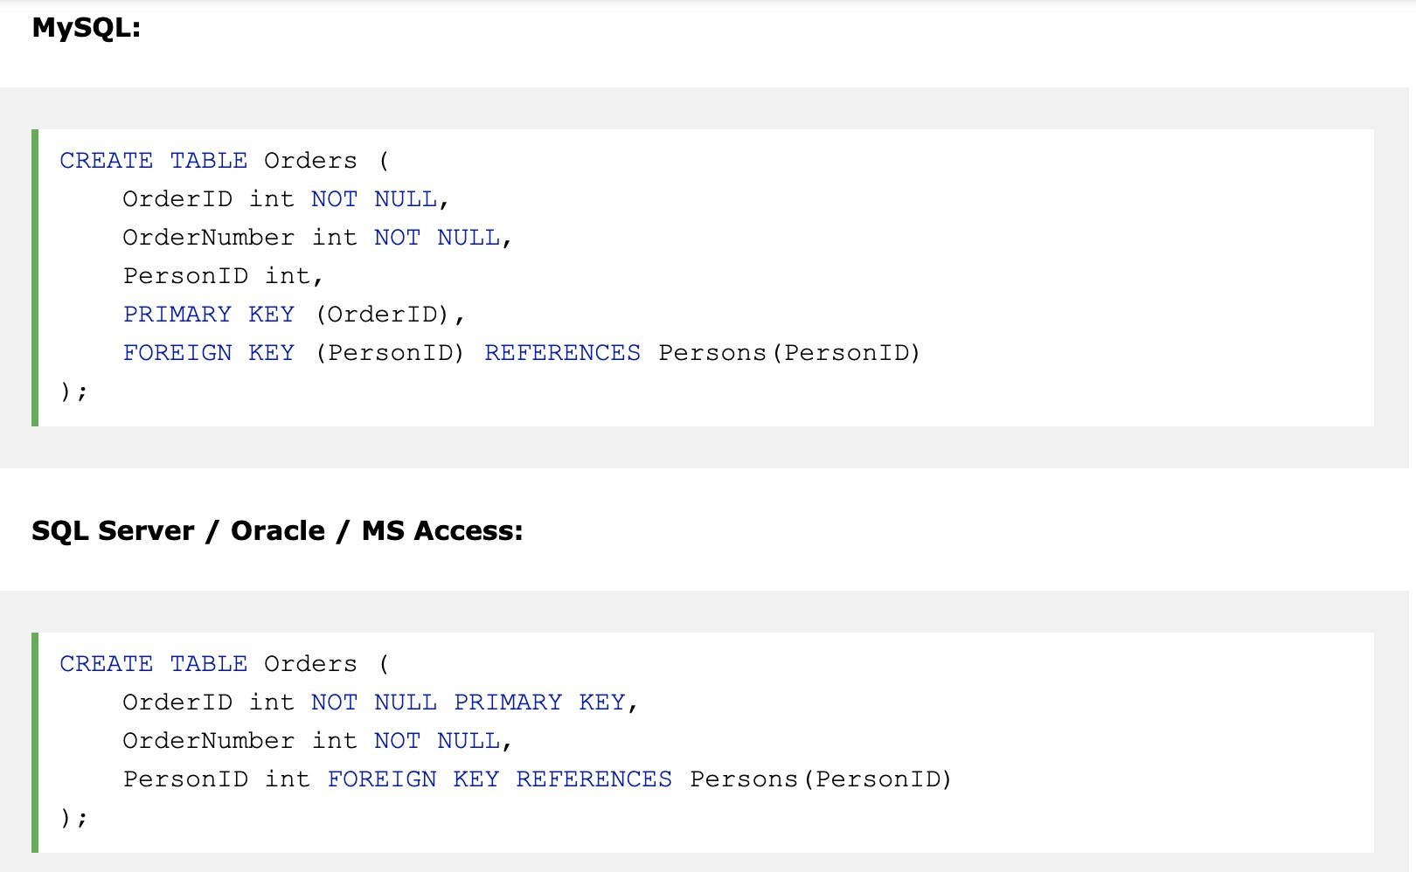
CREATE WITH primary key and foreign key

Slide 25
INSERT
◼ Enters a new row
–Must specify values
–NULL?
–AUTO_INCREMENT?
–Data types?
INSERT INTO pet(name, owner, species, sex, birthdate) VALUES ('Seth', 'Doug Shook', 'Cat', 'M', '2007-04-03');

Slide 26
UPDATE
Used to modify existing values
UPDATE pet
SET name = 'Franklin'
WHERE name = 'Seth';
Order of operations?
Update(we need to know the table)>Where>Set

Slide 27
DELETE
Removes a row
DELETE FROM pet
WHERE name = 'Franklin';
Careful!(delete all records that meet the Where condition )

Slide 28
Exercises
Practice creating the remaining tables from an employees example
Practice inserting, updating, and deleting values from the tables you created

