Slide 1
Database Management Systems
Course structure and expectations

Slide 2
Instructor
Doug Shook
Office: Jolley 534
Office Hours: Wednesdays: Tuesday, Thursday 10-11:30
TA Office Hours: Posted on Canvas

Slide 3
Course Breakdown
Website – Canvas
Homework – 70%
5 over the course of the semester
Groups of 2
Exams – 30%
Midterm and Final

Slide 4
Policies
Grading will be done on a straight scale
– Curved if necessary (hint: it probably won't be)
Late work / Extensions

Slide 5
Academic Dishonesty
Collaboration is encouraged!
Over the line
Working in groups of more than 2
Showing your work to another group
Internet usage:
Finding sources, ideas, examples – OK
Copying text, ideas, code – Not OK
Zero Tolerance

Slide 6
How to do well in this class
Put an honest effort into the coursework
Debug!
Ask for help if you need it
In person is always preferred
How to properly ask for help
Start on assignments early
Come to class!

Slide 7
DBMS
What's your experience with Databases?
What do you think the role of a DBMS is?

Slide 8
DBMS
Advantages of Using a DBMS (csci440)
Controlling redundancy
Restricting access
Persistent program storage
Efficient query processing
Backup and recovery
Multiple user interfaces
Representing complex relationships
Enforcing integrity constraints
Referential Integrity Constraint
Key Constraint
Business rules Constraint

Slide 9
Notes:
✔️

Slide 10
Roles of a DBMS
Definition
Construction: put info in
Manipulation: get info out
Sharing: have a lot of users
Security:
Performance: we don’t want to speed to go slow

Slide 11
Roles of a DBMS
Definition: a computerized system that enables users to create and maintain a database
The DBMS is a general-purpose software that facilitates the process of defining, constructing, manipulating, and sharing databases among various users and applications.
Defining: specify data types, structures, and constraints of data to be stored in DB
Constructing: the process of storing data on some storage medium that is controlled by the DBMS
Manipulating: includes functions such as querying the database to retrieve specific data, updating data and generating reports from data
Sharing: allows multiple users and programs to access the database simultaneously
Other important functions of DBMS includes
Protecting: include system protection and security protection
Maintaining: allow system to evolve as requirements change over time

Slide 12
Users
Back End: ⭐️
Front End：e.g FB

Slide 13
Contents
◼ What does a database contain?
– What does a DBMS need to do its job?
Data; Metadata (data about my data, e.g how many columns);
Notes:
Scheme(format of data): Definition (比较狭隘，是metadata的一种)

Slide 14
*Relational database model
Data is stored in tables
–One or more columns (fields)
–Many, many, rows (records)
Modeled after real world entities
–Attributes (fields)
–Instances (records)
Primary keys are used to identify each record
–Must be unique!
Notes:
NoSql (Documents stored) – One Data Model Type

Slide 15
Concept Clarification
Object vs. Entity
- Object can have method while entity do not.
- Entity is just structural.

Slide 16
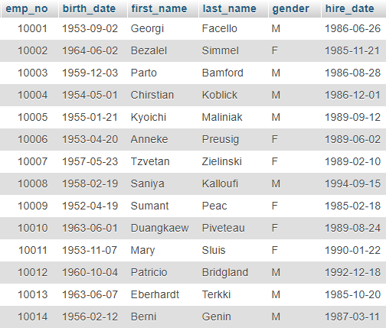
Notes:
Emp_no can be the primary key

Slide 17
Relational database model
◼ Relationships are defined between two tables
–One-to-one
–One-to-many: most common
–Many-to-many
Notes:
We use primary key to define the associated relationships
“I don’t’ believe in one-to-one”

Slide 18
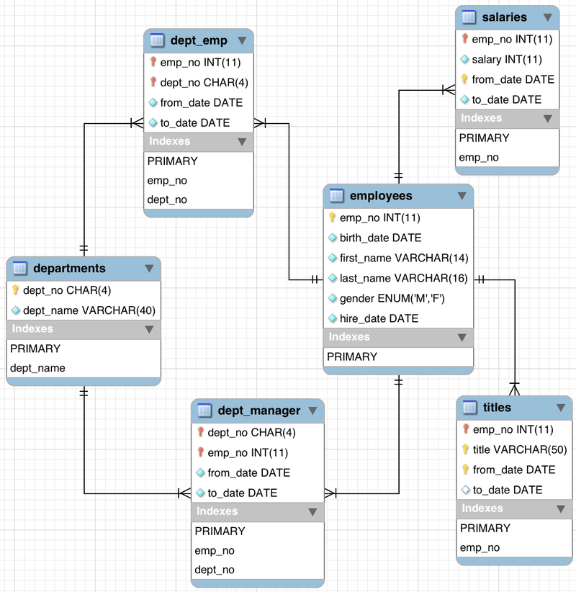
Notes:
Scheme:
To track the employees in the company
One-to-many

Slide 19
Comparison with file systems
Databases...
–Are consistent
Same basic structure for all data
–Are easier to maintain
Due to centralization
–Can perform validations
–Can enforce relationships
–Can access many records at once
–Allow concurrent access
File Systems...
- files on the computer (many formats)

Slide 20
Data Models
High Level
–Schema: what table exists, what data exists, how they relate
Low Level
–Physical: how data stored in disk

Slide 21
Data Models
Data Abstraction to decouple data organization and storage from higher-level essential features
Categories of data models:
High/Conceptual Level
–ER Diagrams: entity, attr, relation
Implementation model
- relational
Low/Physical Level
–linear, b-tree, hash table, …

Slide 22
Database System Concepts
Structure (schema)
metadata, doesn’t change often, stored in somewhere else
Description of the structure of the database
Instance (contents)
- database state at an instance of time, changing often

Slide 23
Disk Storage Concepts
File Headers
- identifying at least the first-block address, field names and data types, other information.
Notes:
http://www.cs.montana.edu/~halla/csci440/n17/n17.html

Slide 24
Heap Files
Simple unit of physical storage
How do we....
–Add data? (insert)
–Find data? (search)
–Remove data? (delete)
◼ How would you describe the structure of a heap file?
Notes:
One way we can store data physically.
Heap Data Structure
“trade-off”: Speed and Space
“one-convenient-way” a header making efficient

Slide 25
Heap Files
Files of unordered records
- Heap File
- Often the default unless otherwise
- append new records to the end, very efficient O(1)
- searching is linear search O(n) unless other structures are combined with it
- deletion can reorganize the block, or write a deletion marker onto the deleted record O(n)
- deletion leaves a gap in the block; they accumulate over time requiring reorganization
- modification of variable-length records that increase length will be deleted and reinserted O(n)
Notes:
In this simplest and most basic type of organization, records are placed in the file in the order in which they are inserted, so new records are inserted at the end of the file. Such an organization is called a heap or pile file.

Slide 26
Heap Files
Inserting
- the last disk block of the file is copied into a buffer, the new record is added, and the block is then rewritten back to disk. The address of the last file block is kept in the file header.???
Searching
- for a file of n blocks, this requires to read and search all n blocks in the file
Deleting
- a program must find its block first, copy the block into a buffer, delete the record from the buffer, and finally rewrite the block back to the disk. This leaves unused space in the disk block. Deleting a large number of records in this way results in wasted storage space.
Notes:
不是说header只放0/1？

Slide 27
Heap Files
Deleting
- Another technique is to have extra byte or bit, called a deletion marker, stored with each record. A record is deleted by setting the deletion marker to a certain value. A different value for the marker indicates a valid (not deleted) record. Search programs consider only valid records in a block when conducting their search.
Both of these deletion techniques require periodic reorganization of the file to reclaim the unused space of deleted records. During reorganization, the file blocks are accessed consecutively, and records are packed by removing deleted records. After such a reorganization, the blocks are filled to capacity once more.
- Another possibility is to use the space of deleted records when inserting new records, although this requires extra bookkeeping to keep track of empty locations.

Slide 28
Sorted Files
Files of ordered records

Slide 29
Data Independence
Logical
- Changing the physical without changing the scheme
Physical
- Changing the logical without changing the scheme
◼ How do these types of changes affect our mappings?
Notes:
More efficient
Changing the logical without changing the scheme

Slide 30
Language
◼ Two primary sections:
–Data Definition Language (DDL): Used to create schemas. In SQL, CREATE TABLE, DROP TABLE, ALTER TABLE
–Data Manipulation Language (DML): “queries” that search, add, delete, or change data. In SQL, SELECT, INSERT, UPDATE, DELETE

Slide 31
Data Retrieval
SELECT: columns
FROM: table
WHERE: condition
GROUP BY
ORDER BY
Notes:
顺序
分仓 OVER PARTITION BY

Slide 32
SQL执行顺序
from子句组装来自不同数据源的数据；
where子句基于指定的条件对记录行进行筛选；
group by子句将数据划分为多个分组；
使用agg聚集函数(min/max/avg/sum)进行计算；
使用having子句筛选分组；
计算所有的表达式；
select 的字段；
使用order by对结果集进行排序。
Notes:
GROUPBY is used in conjunction with an AGG so that group piece of information and perform the AGG on those individual groups

