Slide 1


Database Management Systems
Optimization

Slide 2
How can we make things faster?
Indexing: when using, it is stored in memory and itself will not have duplicated keys
Query Optimization: query itself optimize the performance
Both of these two methods make the most of memory and improve on average but for the worst case it doesn’t make any significant influence because going to the disk is extremely slow.
Extra access structure or indexes can be created on a file.
They are stored on disk just like the main data file, and provide other access paths that can be quicker for certain operations.

Slide 3
Indexing
Provides a secondary access path
Does not alter primary physical representation
Indexes can take many forms:
Single Level (categorization depends on whether the field is a key(unique) and whether the main file is sorted or not)
Primary Index, clustered index, secondary indexes
Multi Level
Trees

Slide 4
Single Level
Much like an index from a book
Select a column to be indexed
Make a list of all values contained within that column
Create an index that has a column value as the key and a list of pages as the value
Indexing values are ordered
How does this help? For more efficient searching operation, normal requires linear search while indexing requires binary search
Size in comparison to primary storage?
- Significantly less than original table space

Slide 5
Primary Indexes
One entry per page <key, block pointer> pair
Key: First index value on the page (first index record a.k.a anchor record)
Value: file address of the page
Requires that data be stored in order (why?) binary search
– Requires that the index is based on the primary key (why?)
unique to identify page
Primary indexes are an example of sparse indexes
Search time? O(logn)

Slide 6
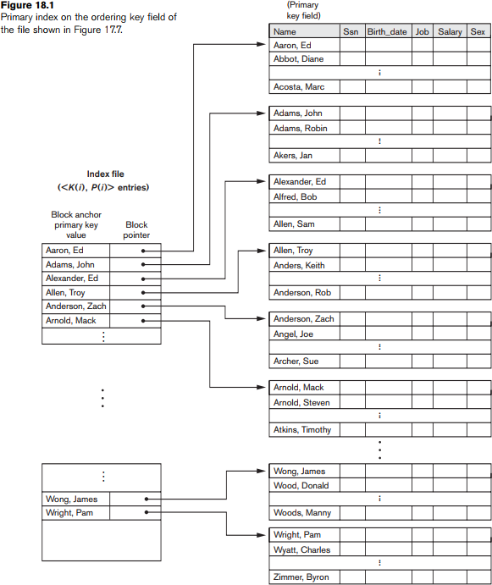

Slide 7
Primary Indexes
◼ How is this scheme affected by insertions and deletions?
- There must be only one primary index in a file
- insert/delete records in the main file
- must move other records since it’s ordered
- some insertion or deletion must also change index entities if the anchor records change.

Slide 8
Clustered Index
sparse: only contain entities of some of the records in the original file
dense: had all records in the original file
Indexing technique for non-key columns
– What's the major difference? Just ordered not unique key
Record difference
Record first page (首次出现)
Is this sparse or dense？
How does this affect insertion and deletion?
- not that severe than primary indexes
注：At most one primary index, one clustered index per table.
But we would prefer to use more clustered index because it searches faster but consider space consumption which is a trade-off

Slide 9
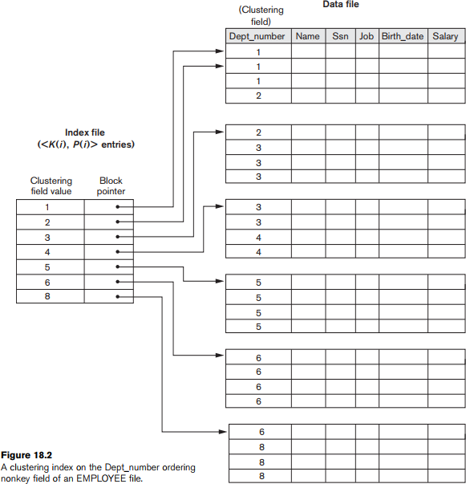

Slide 10
Secondary Index
◼ What if we want to index by a column that is not ordered?
–Unique(key) vs. not unique(non-key)

Slide 11
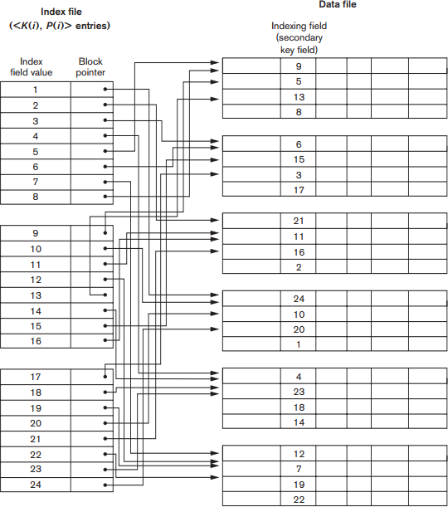

Slide 12
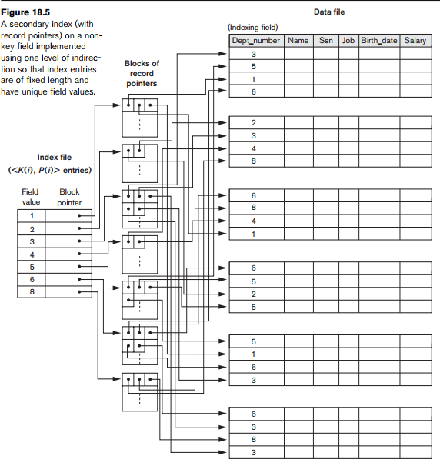

Slide 13
Secondary Index
Dense or sparse?
Performance?
–Performance improvement?
Still need to squeeze because we need to use binary search;
Still sacrifice…

Slide 14
Multilevel Indexes
Same idea as a single level index
–Try to reduce the search space even faster
Idea: create an index (first layer)
–Then create another index into that index
–Repeat
If we keep our indexes ordered, what kind of index can we use for the upper layers?
- Primary index or clustered index
Restrictions on index type of first layer?
- (ordered key => primary index)

Slide 15
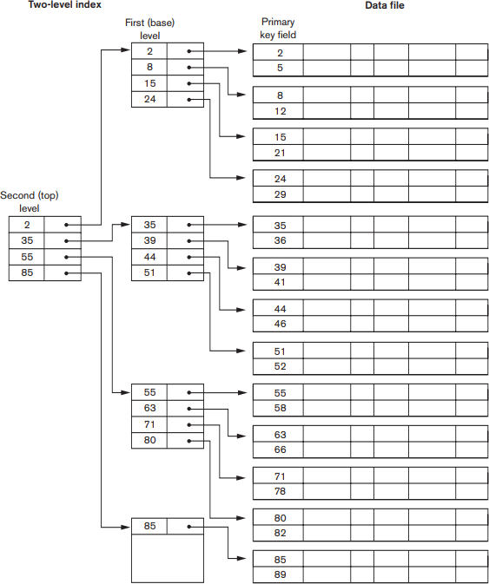

Slide 16
Multilevel Index
First level (primary)
Doesn’t have to be
Second level (HeapFile, page)
Keep it small to fit more in memory, large to benefit search, too large cannot fit into memory.
Search time? n(logn) not just binary search but like binary search, depends on branching factor
How to deal with insert and delete?
even worse than single level

Slide 17
Dynamic Multilevel Index
Common problem for all methods based on index: insertion and deletion because everything is very tightly packed together, in this case even when we insert a single value in, we need to move everything else to make room for it which means we need to redo everything
Attempts to mitigate problems with insert and delete by leaving some empty space in each page of the index
–Tradeoff? Waste in space (give up not only the space for entries but also that for index performance, leave out space in heap file itself) but it worth it because it solves our previous problem
Uses search trees
–B-Trees
–B+-Trees

Slide 18
B-Trees (one node one heap page)
◼ Properties
–Always balanced
–Tries to minimize wasted space due to deletions
–Simplifies insertion and deletion (mostly) [step by step reducing search space]
- Stored in sort
- One node itself will use binary search

Slide 19
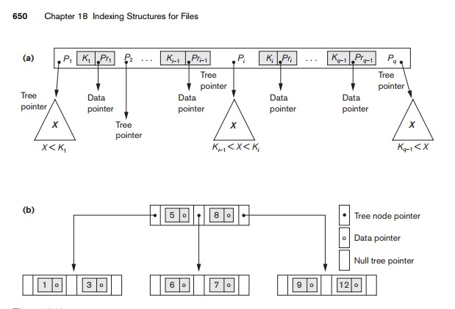

Slide 20
B-Trees
Previous example assumes we're searching a key, equivalently we are searching for a value that is unique
–What if we're not?
Insertion and deletion?
Insertion: if the leaf nodes are full, we need to create a new node. Even worse, if the child nodes meet the limit of branching factor, we need to create a layer (still sucks)
Deletion: if we want to delete, we just leave it there with no need to rebalance the tree (a lot better in general case, but there is edge case when we need to rebalance)

Slide 21
B-Trees
Each node has at most m children and at most m-1 keys.
Nodes may leave some empty space, allowing for inserting new entries. (Each node has at minimum (m-1)/2 keys.
Insertion into a non-full node is very efficient.
If the node is full it causes a split.
- Splitting the root node creates two children, with only the middle value left in the original root.
- Splitting a branch node divides it into two branch nodes, and moves the middle value to the parent node.
Splitting can propagate to other tree levels.
Deletion from a node more than ½-full is very efficient.
If the node becomes ½-full it must be merged with neighboring nodes. Specific approaches to deletion merging vary.
Equilibrium at 69%.

