Slide 1


Database Management Systems
Physical Layer

Slide 2
Physical Layer: actual data stored in files
◼ The way data is stored (physical layer) is different than the
way data is shown to the user (schema)
– Why?
Because computer loves binary. It’s more efficient for them to manipulate data at such level
Notes:
Metadata: what are the tables and what are the columns

Slide 3
Physical Layer
What kind of information is stored in a database system?
Should all of this data be stored in the same way?
No
What should the criteria for data storage be?
consider a big trade-off: speed and space

Slide 4
Data Types
Each column has a data type associated with it
– Not exactly the same as the data types from other languages....
What data types have you seen?
- Numeric: INT/SMALLINT; FLOAT/REAL/DOUBLE; DECIMAL
- Character-String: CHAR; VARCHAR
- Bit-string: BIT; BIT VARYING
- Boolean: three-value-logic True, False, Unknown
- Date: data type has ten positions, and its components are YEAR, MONTH, and DAY in the form YYYY-MM-DD.
- Time: at least eight positions, with the components HOUR, MINUTE, and SECOND in the form HH:MM:SS.
- Timestamp: includes Date and Time fields, plus a minimum of six positions for decimal fractions of seconds and an optional WITH TIME ZONE qualifier.
- Interval: a relative value that can be used to increment or decrement an absolute value of Date, Time, Timestamp
Notes:
Number
Int
Char
Varchar

Slide 5
Data Types
- Character-String: CHAR; VARCHAR
CHAR vs. VARCHAR
If I have 6 characters for varchar(8) on disk, it only stored 6 characters. However,
Non-variable does padding with blank to the right.

Slide 6
Records
One record represent one entire row. A record needs to be stored together in one unit file.
To understand how data is stored, we must understand the structure of that data
What affects the size of a record?
Metadata (the data types of columns)
Are all records in the same table going to be the same size?
For stories the answer is maybe, maybe yes or no, depends on the data types (whether they are variable).
How does this affect how a record is stored?
Pros: If I want to skip an entire record and if I know it is fixed, it is much easier to do.
Cons: less flexible
Notes:
In this slide, a record is one entire row
A record needs to be stored in one unit file

Slide 7
Operations
◼ What kinds of operations will be performed on these files?
find; insert/add; delete
– How does that affect the way the data is stored?
Fast insertion: append to the end of the file
Fast retrieval: sort things in order (very expensive)
Notes:
Add: append to the end (faster )
Find
Delete

Slide 8
Heap Files
Simplest format
Unordered records
How to insert?
Efficiency? O(1):append directly to the end; O(n):not assuming fixed record length, sacrifice to find a gap
How to search?
Efficiency? O(n): on average without any search condition
How to modify/delete?
Efficiency? O(n): best case without thinking about space efficiency
Notes:
Insert:
Appned at the end O(1)
Find a gap: O(n)
Search: (no order so we can’t use binary search)
Assume Fixed record length
linear search O(n)
Remove: O(n)

Slide 9
Heap Files
◼ table is too big and there is no limit for table size.
◼ Is it faster to manipulate data on disk or in memory?
Of course it is faster to manipulate in memory but the memory is limited
– How can we accommodate this?
Cache: break data into smaller chunks called pages, where pages are fixed-size that can fit into memory
Cache vs. Buffer
Cache是为了弥补告诉设备和低速设备的鸿沟而引入的中间层，最终达到加速访问速度的作用
Buffer的主要目的是进行流量整形，把突发的大数量较小规模的I/O整理成平稳的小数量较大规模的I/O，以减少响应次数
Notes:
One heap file per table

Slide 10
Heap Pages
Contains:
Header: a series of 0 and 1 (help us to data manipulation)
Tuples: record
Heap Pages are typically constant in size
Manages addition/deletion of tuples
How does this affect the design of our records?
- what if it is full? Split one record into half or put it in a new page, which is a trade-off
-
Notes:
Split down to pages

Slide 11
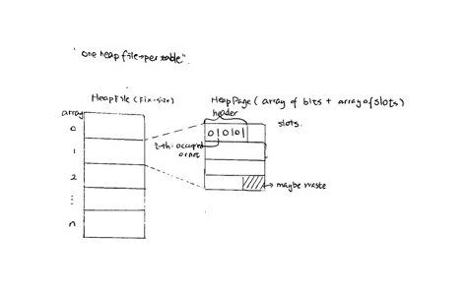
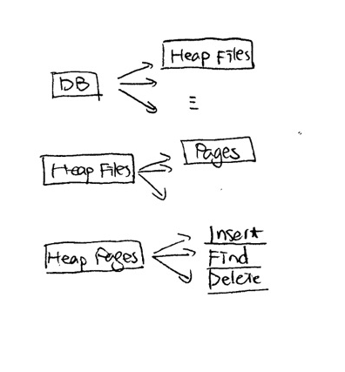
Heap File
Notes:
Heap file can have as many as possible heap pages.
The number of bits in header = the number of slots (one-to-one)
We consider Fix-size tuple so one slot = one tuple
The size of slots for one table can be different, depending on the data types.
How to utilize the waste? “Space Utilization” space is cheap

Slide 12
Heap File
If I want to insert…
1. Find a heap page with open slot (Edge Case: if all is full, make a new one)
2. Look at header until find 0
3. change 0 to 1, indicating the slot is occupied
If I want to delete…
1. set header to 0
2. … (Do I need to do anything with the data? NO!)
If I want to search…
Header speed up but still O(n) when linear search

Slide 13
Heap File
How big header takes?
在课堂上假定记录定长，因为这是最简单的设计方法；
如果要应付变长，则需要增加系统复杂度(可以加一个terminator或者加一个left starter或者都加)

Slide 14
Exercise 1
Design your Tuple class(Tuple.java and TupleDesc.java)
What information does it need to do its job?
data and data types
What behaviors will it have?
insert/search/delete

Slide 15
*Exercise 2
◼ Given a heap page of size m bytes and a record of size n
bytes determine how many records can fit on the page.
Hint: don't forget the header!
1 bytes = 8 bits
# of records = floor((8m)/(8n+1))

Slide 16
Exercise 3
Develop pseudocode for adding a record to a heap file. The input should be a tuple. (HeapPage.java)
public void addTuple(Tuple t) throws Exception {
// your code here
int insertIndex = 0;
int flag = 0;
while (insertIndex < tuples.length) {
if (!slotOccupied(insertIndex)) {
flag = 1;
break;
}
insertIndex++;
}
if (flag == 0) {
throw new IllegalStateException();
}
if (!t.getDesc().equals(td))
throw new IllegalStateException(); int nextIndex = insertIndex;
tuples[nextIndex] = t;
setSlotOccupied(nextIndex, true);
}

