Slide 1
Database Management Systems
Query Optimization

Slide 2
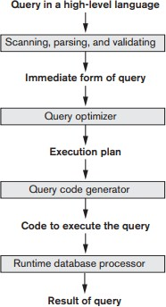
Query Execution
Parsing doesn’t care whether column or table exists or not. Parsing means you have stated a query that computer understand.
Execution plan: one of query tree
Query Operation: relational algebra on sets
Parse Tree
Query Tree

Slide 3
Query Optimization
Optimization is hard
◼ Many possible combinations of operations that we can get to the same place. We are looking the way that is fastest
Maybe we aren’t finding the “optimal” solution
- we don’t have to find all trees and check because it can take longer than randomly choose one
What operations should we focus on?
- Join and Select relational operation

Slide 4
SELECT Optimization
Consider a simple SELECT query:
SELECT ？
FROM ①
WHERE ？
How many possible ways are there to execute this?
◼ What if WHERE is more complex?
We can do WHERE clause first because it can filter out many
data, in this case it will speed up SELECT But if WHERE is too complicated we can do SELECT first
- Use indexing on columns

Slide 5
Selectivity
Ratio of tuples that satisfy the condition to the total number of tuples
Can we compute this value exactly?
- Yes but only after I run the query, so I cannot compute this ahead of time
How does this help us with optimization?
- Assume the first cannot be optimized and store selectivity in metadata for later use. So we want to eliminate the most data and do these first because the future the operations after that will have less things that they have checked
The most selectivity clause is the one with 0 selectivity.
- Selectivity ranges (0,1)

Slide 6
JOIN Optimization
There’s more than one way to perform a JOIN
Nested Loop (simplest, worst performing we don’t want to do that if we don’t have to): we have a outer loop for one table and I have an inner loop for another table. It is N squared because I have to match every tuple against every tuple from another table (cartesian product)
Single Loop (also common) : If a primary index exists on one of the tables for the join column, then the DBMS can use this index and perform the join with a single loop. One of the most common column that I will index is the foreign key columns, greatly improve the performance of a Join.
Sort-merge (rare, fastest): If both of join conditions are in sorted order. This is very very fast. (time complexity: linear)
Partition-hash: Hash joins are typically more efficient than nested loops joins, except when the probe side of the join is very small. However, hash joins can only be used to compute equijoins. And one table need to be small enough to fit into memory.

Slide 7
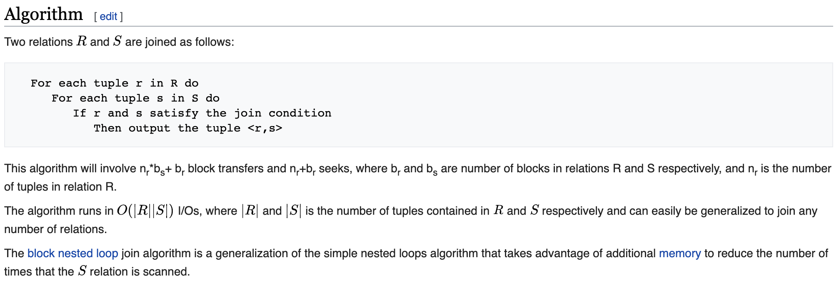
Nested Loop Join

Slide 8
Nested Loop Join
How does table size affect this type of join?
- if the table size is very big with a lot of rows in it, our implementation will not be robust enough to handle it in an efficient way
Example: assume one table has 10 pages and another has 2000 pages. How many page reads do we need for each nested loop configuration?
When we want to Join A and B, if we swap them, it will not affect the outcome of inner join but it will affect the performance.
For (10):
For (2000):
2000 * 10 + 10 = 20,010
For (2000):
For (10):
2000 * 10 + 2000 = 22,000

Slide 9
JOIN Selection Factor (store in metadata)
Help WHERE clause as well
How many records from each table do we expect to match the join condition?
- we cannot calculate it ahead of time either
How does this help us?
◼What type(s) of join does this affect?
Single Loop (we want to do the join first the one that results in fewest number of entries because it will make our future join be more efficient)

Slide 10
Heuristics
Heuristics can not guarantee we can get an optimized tree
We can optimize queries by manipulating the query tree directly
Must satisfy order of operations
Idea: one tree can be rewritten in numerous ways
Let’s find the fastest version

Slide 11
Heuristics
Select(WHERE)
Can cascade conjunctive select conditions break it one after another
Operations are commutative
Project
Cascading projects are somewhat irrelevant
Can be commuted with a select
◼When?
We cannot project off the column we need in WHERE

Slide 12
Heuristics
JOINs
Can be commuted with select if select only affects one side of the join
Can be commuted with project if all projected columns are part of the tables being joined
Set operations
Union and intersection are commutative
Union, intersection, and join are associative
All set operations are commutative with select
Project is commutative with union
Cartesian product + select = Join

Slide 13
Optimization Using Heuristics
Break up conjunctive selects
◼Allows us to move them around more easily
Use select commutativity to move selects as far down the tree as possible
When performing operations on multiple tables, move relations with select restrictions as far down the tree as possible
Combine cartesian products with selects when possible
Move projects down the tree as far as possible

Slide 14
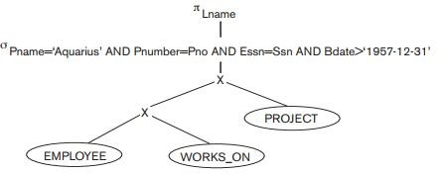
Heuristic Example

Slide 15
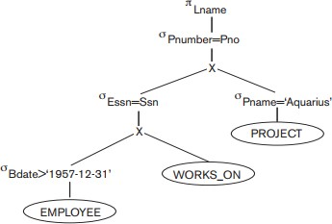
Heuristic Example

Slide 16
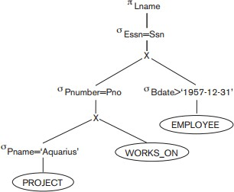
Heuristic Example

Slide 17
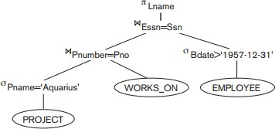
Heuristic Example

Slide 18
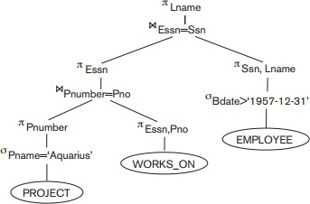
Heuristic Example

