Slide 1
Database Management Systems
Concurrency Control

Slide 2
Review
Why do we need transactions?
What does a transaction contain?
What are the four properties of a transaction?
What is a schedule?
What is a conflict?
What does it mean for a schedule to be serializable?
Notes:
Logically group our tasks
Transaction is a bunch of rights
1.1 (theoretical) read and write
1.2 A(ATOMIC) C(CONSISTENCY)I(ISOLATION)D(DURABILITY)
2.
2.1 Read/Write Write/Write
2.2 YOU CANNOT AVOID THE CONFLICT BY HAVING A S C

Slide 3
Locking
We wish to create serializable schedules
Many techniques for this
Locking
Timestamps
Multiversion
In practice, locking is used most frequently
Notes:
We need to guarantee that all schedules are correct (i.e serializable ) without knowing the entire schedule ahead of time.
Passive assumption
Locks don’t need to be store on disk, you don’t need to put it into buffer pool. It doesn’t need to be consistent

Slide 4
Binary Locks
Two states:
◼Locked/Unlocked
◼Cannot access an item while it is locked
Enforces mutual exclusion

Slide 5
Implementation
Must maintain a table of locks
◼And a queue…for waiting locks
Must obey locking rules
In practice this works fine, but it is too restrictive
◼Why?

Slide 6
Shared / Exclusive Locks
We wish for our locks to mesh well with conflicts
Two kinds of locks
- shared locks for reads (s-lock)
- exclusive locks for writes (x-lock)
How can we track them?
Notes:
2.
Shared lock;
Exclusive lock (restricted itself)

Slide 7
Shared / Exclusive Locks
Still must obey locking rules
Can convert between the two types of locks
◼What must be true?

Slide 8
Two Phase Locking
All locks must be acquired before first unlock statement
◼Two phases: acquisition and release
Guarantees serializability
Notes:
2PL can generate s s

Slide 9
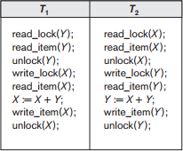
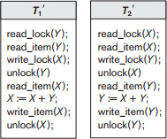
Two Phase Locking
Notes:
Dead lock : when I write the locks

Slide 10
Types of Two Phase
Basic
Conservative
Strict
Notes:
“trade-off”
Strict (we care about performance) is the subset of serializable (we care about correctness)
Two-phase locking[edit]
According to the two-phase locking protocol, a transaction handles its locks in two distinct, consecutive phases during the transaction's execution:
Expanding phase (aka Growing phase): locks are acquired and no locks are released (the number of locks can only increase).
Shrinking phase (aka Contracting phase): locks are released and no locks are acquired.
The two phase locking rule can be summarized as: never acquire a lock after a lock has been released. The serializability property is guaranteed for a schedule with transactions that obey this rule.
Typically, without explicit knowledge in a transaction on end of phase 1, it is safely determined only when a transaction has completed processing and requested commit. In this case, all the locks can be released at once (phase 2).
Conservative two-phase locking[edit]
The difference between 2PL and C2PL is that C2PL's transactions obtain all the locks they need before the transactions begin. This is to ensure that a transaction that already holds some locks will not block waiting for other locks. Conservative 2PL prevents deadlocks.
Strict two-phase locking[edit]
To comply with the S2PL protocol, a transaction needs to comply with 2PL, and release its write (exclusive) locks only after it has ended, i.e., being either committed or aborted. On the other hand, read (shared) locks are released regularly during phase 2. This protocol is not appropriate in B-trees because it causes Bottleneck (while B-trees always starts searching from the parent root).

Slide 11
Issues with Two Phase
Cannot generate all possible serializable schedules
Reduces Concurrency
Can lead to deadlock
Can lead to starvation
Notes:
Two possible problems
Dirty reads (strict 2PL) – not until commit
Deadlocks

Slide 12
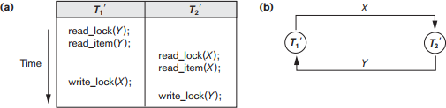
Deadlock
Notes:
A cycle of transactions waiting for locks to be released by each other
Deadlock Detection

Slide 13
Deadlock Prevention
Timestamp based (one solution)
Wait-die: younger transaction dies, older can wait
Wound-wait: Older can abort younger, younger simply wait
Problems?
Notes:
Doing anything to allow older to complete

Slide 14
Deadlock Prevention
Non-timestamp based
No-wait: abort if unavailable
Cautious wait
Notes:
1. Never get dead lock because we don’t allow any of them wait

Slide 15
Deadlock Detection
Create a graph:
Nodes are transactions
Edges occur when transactions must wait
When do we know when deadlock has occurred?
Performance considerations?

Slide 16
Starvation
Occurs when a transaction has to wait a long time
Perhaps forever?
When does this happen?
Solutions:
Time scaling priority
FCFS

Slide 17
Granularity
What should we be locking?
Fields?
Columns?
Pages?
Tables?
How does this affect concurrency?
Why not just lock everything on the field level?
What is the best size?

Slide 18
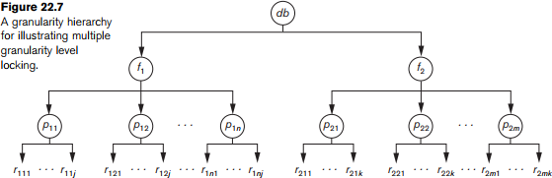
Granularity
◼ Two transactions:
◼ One wants to update all records in a file, the other wants to update a single record

Slide 19
Intention Locks
What locks would be requested on descendants of the tree?
Intention Shared/Exclusive
Shared Intention Exclusive

Slide 20
Intention Locks
Lock the root first
Can be locked in S or IS if parent is locked in IS or IX
Can be locked in X, IX, or SIX if parent is locked in IX or SIX mode
Can only be unlocked if children are unlocked

Slide 21
Exercises
◼ You are given the following schedule:
R2(A) R2(Y) R3(Z) W2(Y) R1(A) W3(Z) W2(A) W1(Z) W1(A)
Prove whether or not the schedule is conflict serializable
If the schedule is serializable, determine an equivalent serial schedule and prove that they are equal. If it is not, use the same transactions to create a non-serial schedule that is serializable and prove that it is serializable.

Slide 22
Exercises
Does strict two phase locking prevent deadlock? If yes, explain how. If no, provide an example of a schedule that obeys two phase locking but also creates deadlock.
Will basic two phase locking lead to better performance than strict two phase locking (in general)?
Notes:
No. Counter Example:
Yes.

