Slide 1
Database Management Systems
Distributed Databases

Slide 2
What does it mean to be distributed?
Multiple nodes connected by a network
Data on the nodes is logically related
The nodes do not need to be homogeneous
The network matters a lot:
Topology
Proximity

Slide 3
Transparency
Do our users need to be aware of the fact that a database is distributed?
Data organization transparency
Location transparency
Naming transparency
Replication transparency
Fragmentation transparency
Horizontal
Vertical

Slide 4
Autonomy
◼Can nodes operate independently?
–Design autonomy
–Communication autonomy
–Execution autonomy

Slide 5
Reliability and Availability
Reliability: probability that a system is running
Availability: probability that the system is continuously available
How do we construct reliable systems?
– Fault tolerance

Slide 6
Advantages
Flexibility for large operations
Increased reliability and availability
Improved performance
–Data localization
Easier Expansion

Slide 7
Additional Functions
Manage data distribution
Distributed query processing
Replication management
Distributed transaction management
Recovery
Security

Slide 8
Distributed Database Properties
Degree of homogeneity
Degree of local autonomy

Slide 9
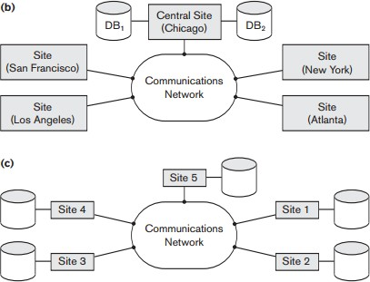
Architecture

Slide 10
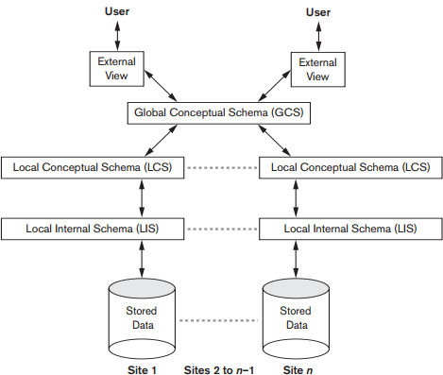
Schema Architecture

Slide 11
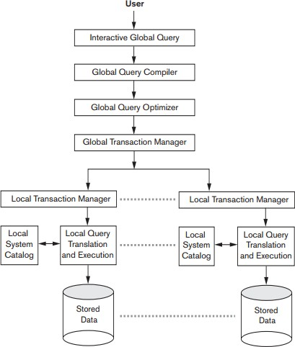
Component Architecture

Slide 12
Data Fragmentation
Where should the data go?
Break the data down into logical units
–What pieces of our database make sense as logical units?

Slide 13
Types of Fragmentation
Horizontal Fragmentation
Break a relation down into subsets of tuples
Specify a set of conditions for this purpose
What about relationships?
Vertical Fragmentation
Break a relation down into subsets of columns
How do we reconstruct the original tuples?
We can use relational operations to specify fragmentation
Which ones?
Which operations will reconstruct fragmented tuples?

Slide 14
Replication and Allocation
Replication improves availability
–How?
Should we replicate everything?
–Pros?
–Cons?

Slide 15
Example
Three sites
Site 1 is HQ, accesses all data
Site 2 is the home of department 5
Needs access to employee and project info
Site 3 is the home of department 4
Needs access to employee and project info
Which part of the DB should be at each site?
What kind of fragmentation is required?
What should we do if an employee from department 5 works on a project owned by department 4?

Slide 16
Query Processing
Processed in stages
–Mapping
–Localization
–Global Optimization
What are we optimizing here?
–Local Optimization

Slide 17
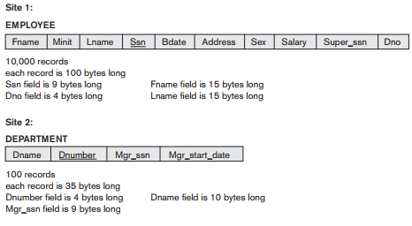
Data Transfer Costs

Slide 18
Data Costs
We submit our query at a third site
Assume each record in the result is 40 bytes long
Three options
Transfer both relations to third site, perform the join
Transfer EMPLOYEE to site 2, perform the join there, send the results
Transfer department to site 1, perform the join there, send the results
Which option results in the least amount of data being sent?

Slide 19
Practice Problem
◼ Redo the following example using the following query:
◼ In the previous examples we assumed that the queries were being submitted from a third site. What if the query is being submitted from site 2? Compute the data costs.

Slide 20
Decomposition
If multiple copies exist, which one should we read from?
–What if we need to update that information?
Where do we go to find out how many copies of a piece of information there are and where they are stored?

Slide 21
Transaction Management
Since data will be accessed from many sites, we need a way to coordinate
–Global transaction manager is in charge of each transaction
Idea: Two phase commit
◼Some problems though…

Slide 22
Three Phase Commit
Break the commit into two phases:
–Prepare to commit
–Commit
Prepare-to-commit
–All participants vote on whether the commit should happen
–If yes, then proceed to commit as normal
–What do we do on a crash?

Slide 23
Concurrency Control
◼ Problems:
–Multiple copies of the same data
–Failure and recovery of individual sites
–Failure of communication
–Distributed Commits
–Distributed Deadlock

Slide 24
Distinguished Copy
How do we track locks for distributed items?
–Idea: make a distinguished copy
–All locking requests are sent to this copy
Where does this distinguished copy live?
–Called the coordinator site

Slide 25
Coordinator Sites
Primary Site
–One site has all the distinguished copies
–Disadvantages?
Primary with backup
Primary Copy
What happens when a site goes down?

Slide 26
Voting Method
◼ No distinguished copy
–Lock requests are sent to all sites with the item
–Must receive a majority of locks
–Advantages?
–Disadvantages?

Slide 27
Distributed Catalogs
How do we track catalog information with multiple sites?
–One copy?
–Many copies?
Centralized vs. Replicated

Slide 28
Review Questions
Name one advantage and one disadvantage of replication.
Under what circumstances would it be preferable to use a distributed catalog as opposed to a centralized catalog.
What is the difference between reliability and availability? How does distribution affect these properties?

Slide 29
Review Questions
When replication is used, the database must decide which replica to use for a given query. What factors will the database use to make this decision?
Assuming that we are not using any replication, which partitioning scheme will take up more space? Vertical or horizontal? Why?

Slide 30
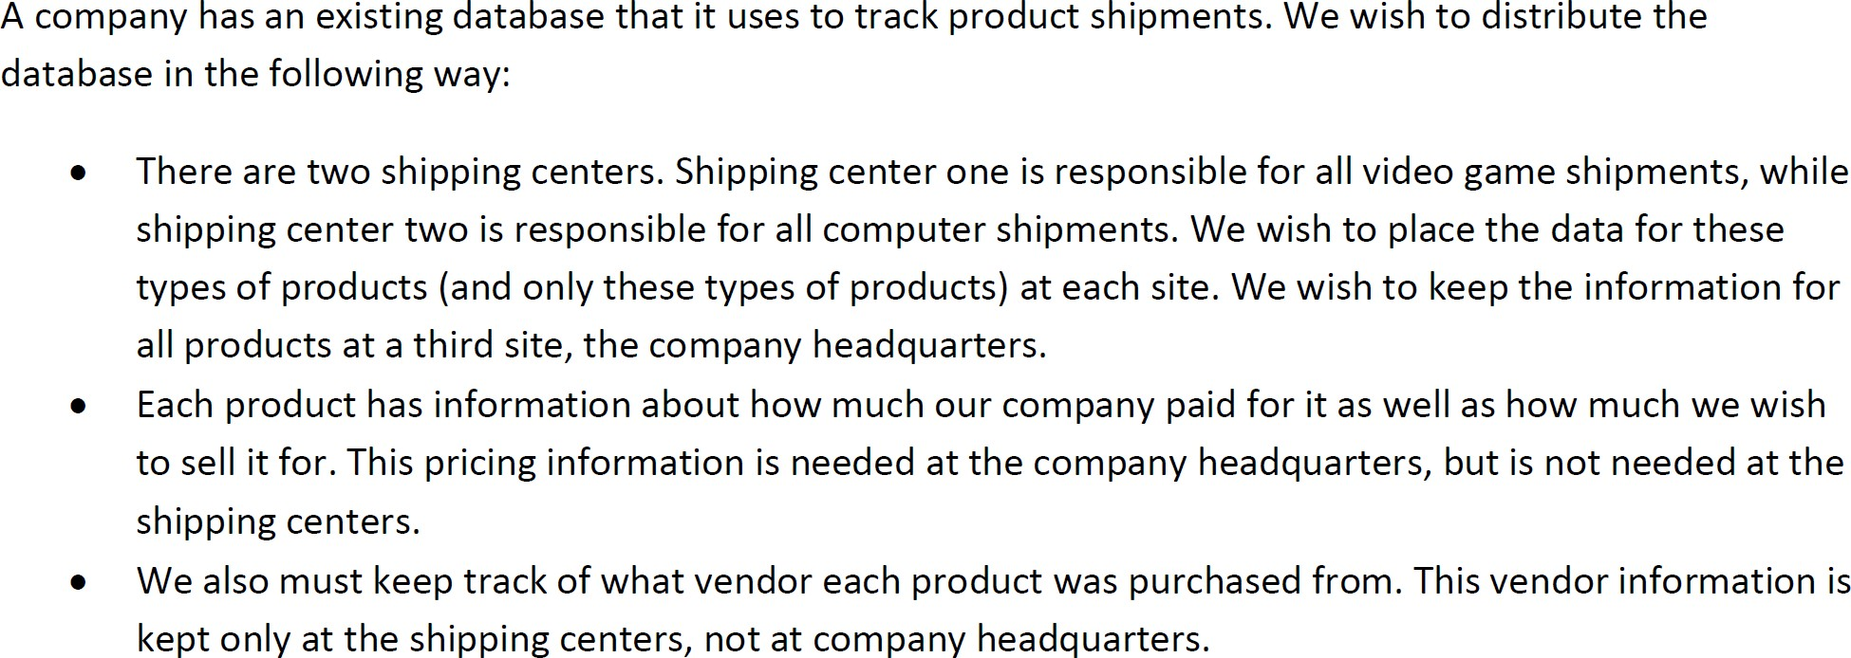
Practice Problem
What kind of fragmentation is being used?

Slide 31
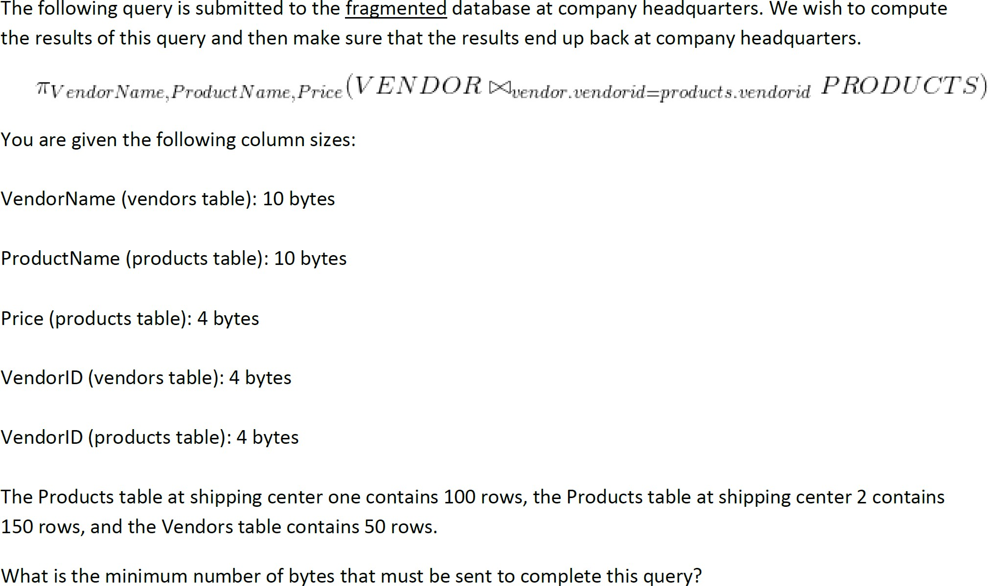
Practice Problem

Slide 32

Practice Problem
◼ Which of the following schedules is conflict serializable?
–Determine an equivalent serial schedule

Slide 33

Practice Problem
◼ Sketch the conflict graph for each schedule below
–Come up with an equivalent serial schedule, if possible.

Slide 34
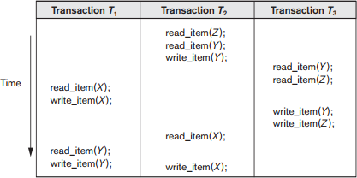
Practice Problem
◼ Insert locks into the following schedule such that it satisfies strict two-phase locking. Will your schedule suffer from deadlock?
◼Is this schedule serializable?

Slide 35
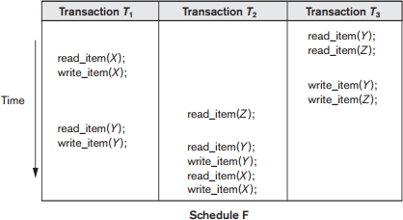
Practice Problem
Insert locks into the following schedule such that it satisfies strict two-phase locking. Will your schedule suffer from deadlock?
Is this schedule serializable?

Slide 36
◼ Consider the following relations:
BOOKS(Book#, Primary_author, Topic, Total_stock, $price) BOOKSTORE(Store#, City, State, Zip,
Inventory_value)
◼Consider that BOOKS are fragmented by $price amounts into: B1: BOOK1: $price up to $20
B2: BOOK2: $price from $20.01 to $50 B3: BOOK3: $price from $50.01 to $100 B4: BOOK4: $price $100.01 and above
◼ Similarly, BOOK_STORES are divided by zip codes into: S1: EAST: Zip up to 35000
S2: MIDDLE: Zip 35001 to 70000
S3: WEST: Zip 70001 to 99999

Slide 37
What kind of fragmentation exists in this database?
Consider the query: SELECT Book#, Total_stock FROM Books
WHERE $price > 15 AND $price < 55;
Assume that fragments of BOOKSTORE are nonreplicated and assigned based on region. Assume further that BOOKS are allocated as:
EAST: B1, B4 MIDDLE: B1, B2 WEST: B1, B2, B3, B4
Assuming the query was submitted in EAST, what remote queries does it generate?

