Slide 1


Database Management Systems
What is a Data Warehouse?
Dimensional Modeling

Slide 2
Data Warehouses
◼Data Analysis Environment
–Subject oriented
–Integrated
–Time variant
–Stable
◼Data warehouses store information in an organized, unified way
–Assist in decision making

Slide 3
Elements of a Data Warehouse
Operational Systems
Captures business transactions
Technically outside of DW
Primary data source
Data Staging Area
Responsible for Extract-Transform-Load
Extract from operational systems
Transform data to make it suitable for presentation
Perform bulk loading into data marts

Slide 4
Elements of a Data Warehouse
◼Data Presentation
– Data Marts
– Broken down by departments
– Accessible by business users
– Contains raw data as well as metadata (aggregates, summaries)
– Relies on dimensional modeling
◼Data Access Tools
– Ad-hoc querying
– Data mining

Slide 5
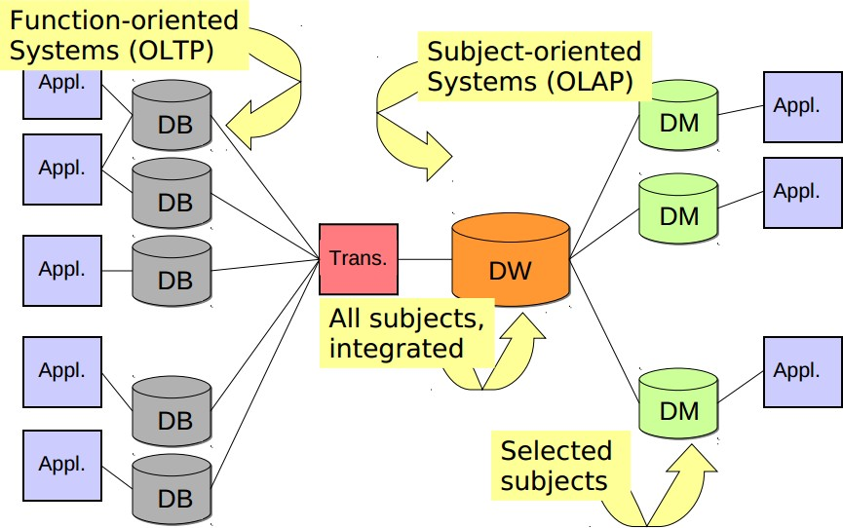
DW Structure

Slide 6
OLTP vs. OLAP
On-line Transaction Processing
Many small, fast queries
Geared towards business processes (functions)
Less historical data
Frequent updates
On-line Analytical Processing
Fewer, larger queries
Fewer, larger updates
More historical data
Dimensional / subject oriented

Slide 7
Example Queries
Which product has been the most profitable in the past ten years?
Which week of the year do we have the most sales?
Do the sales of product X increase over time?

Slide 8
Data Integration Issues
Data Redundancy
Heterogeneous sources
DBMS, OLTP
Documents
Legacy
Data designed with operational systems in mind
Quality
Volatility

Slide 9
Multidimensional Modeling
◼ Relational Databases typically use normalized data
–Eliminates redundancies
–Provides for fast insertions
–Modeled through ER diagrams
◼ This approach works well for operational systems, but poorly for data warehouses
–Why?

Slide 10
ER vs. Multidimensional
ER
One table per entity
Minimize data redundancy
Optimize update
OTLP
Multidimensional
One fact table per process
Maximize understandibility
Optimized for retrieval
OLAP

Slide 11
Multidimensional Modeling
◼ Design Concepts
–Facts
–Measures
–Dimensions
–Hierarchies
◼ Logical Design Types
–Star Schemas (Cubes)
–Snowflake Schemas

Slide 12
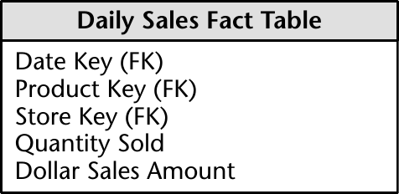
Fact Tables
◼ Purpose: store performance measurements from business process events
–Sales, shipments, purchases, etc.
–Events have a 1 to 1 relationship with rows in a fact table

Slide 13
Fact Tables
A measure is a numerical property of a fact
Sales Dollars, units, etc.
Most useful measures are also additive
I.e. Sales Dollars vs. Unit Price
Fact tables contain true data
No filler
Typically quite sparse
Foreign Keys link facts with dimensions

Slide 14
Types of Facts
Transaction
– A fact for every business event
Snapshot
– A fact for every dimension combination at a given time interval
– Captures current status
Accumulating Snapshot
– Like regular snapshot, except cumulative

Slide 15
Granularity
What does a single fact mean?
What does each row in a fact table represent?
Related to the primary key
Small grain – lots of detail, lots of data
Every item scanned at check out
Every transaction of a bank account
Large Grain – more efficient at loss of detail
Every sale made
Monthly statement data for a bank account

Slide 16
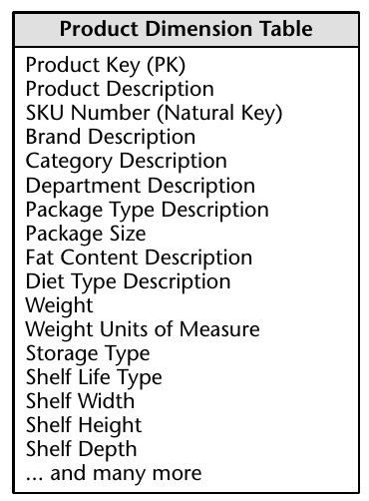
Dimension Tables
Describe textual properties of facts
Who, what, when, where, how, and why
Typically discrete values
Limited range of values
Typically very large

Slide 17
Dimension Tables
◼ Vital role within the data warehouse
– Grouping
– Constraints
– Labels
◼ Avoid using cryptic descriptions
– Spell it out
– Use real language
– If you must use codes, include another column that describes the encoded data

Slide 18
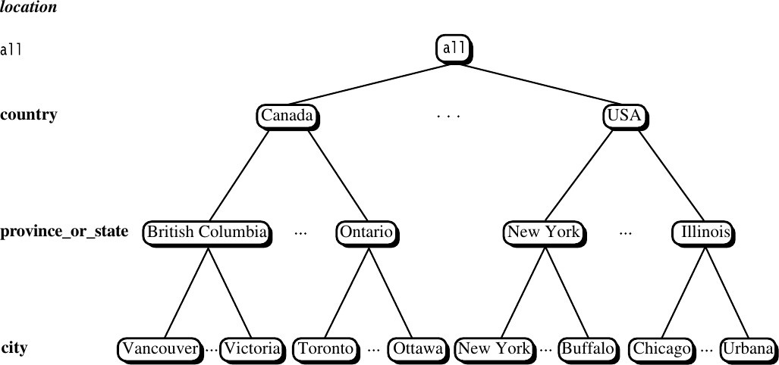
Multidimensional Modeling

Slide 19
Data Cubes
Defined by a combination of dimensions and facts
–Can have many dimensions, usually > 4
–Only 2-3 can be viewed at one time
Cubes are represented by cells
–Combination of dimension values
–Can be empty

Slide 20
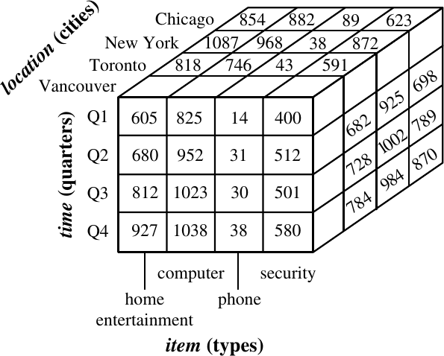

Slide 21
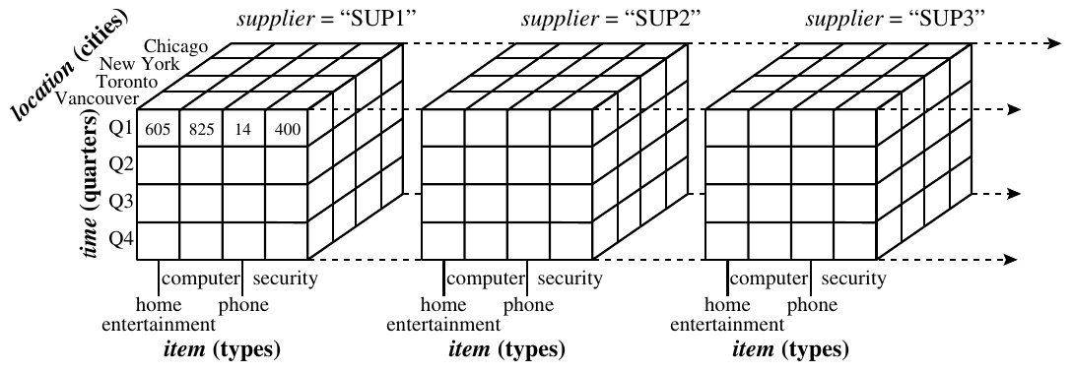

Slide 22
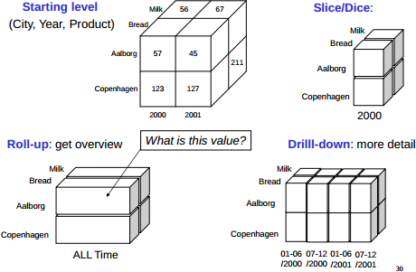
Data Cube Operations

Slide 23
Data Cube Operations
Slice
–Creating information based on one dimension
Dice
–Creating a sub-cube
Drill down / up
–Change level of detail of a dimension
Roll up
–Summarize data within a dimension

Slide 24
Data Cubes
True building block of Dimensional Modeling
–Certain DB platforms include syntax for dimensions, cubes, etc.
Most of the world is built around RDBs
–Enter star schemas: Data cubes modeled using ER like diagrams

Slide 25
Star Schemas
Simple way of modeling dimensional data cubes
–Easy enough for non-technical users to understand
–Fewer tables, increased performance
–Easily extensible
New facts and dimensions can be added at any time

Slide 26
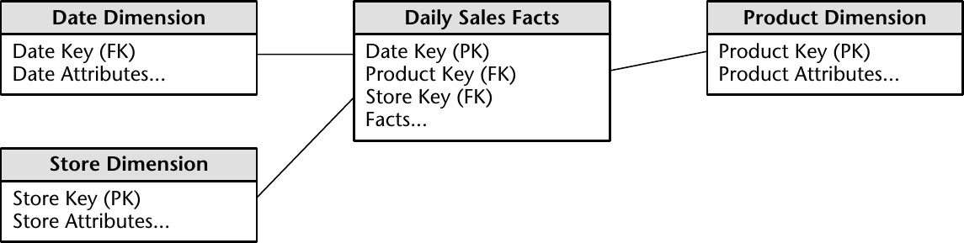
Star Schemas

Slide 27
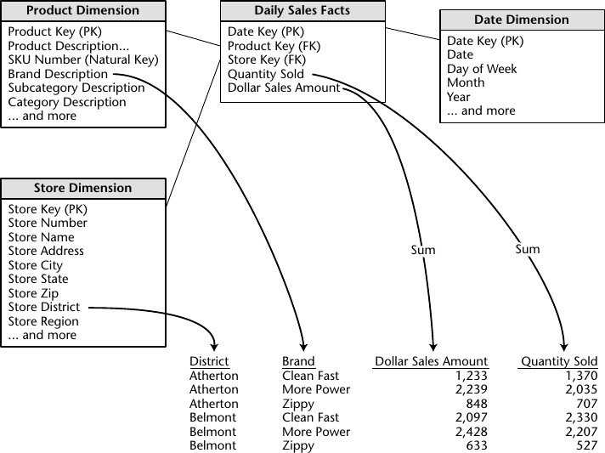
Generating Reports

Slide 28
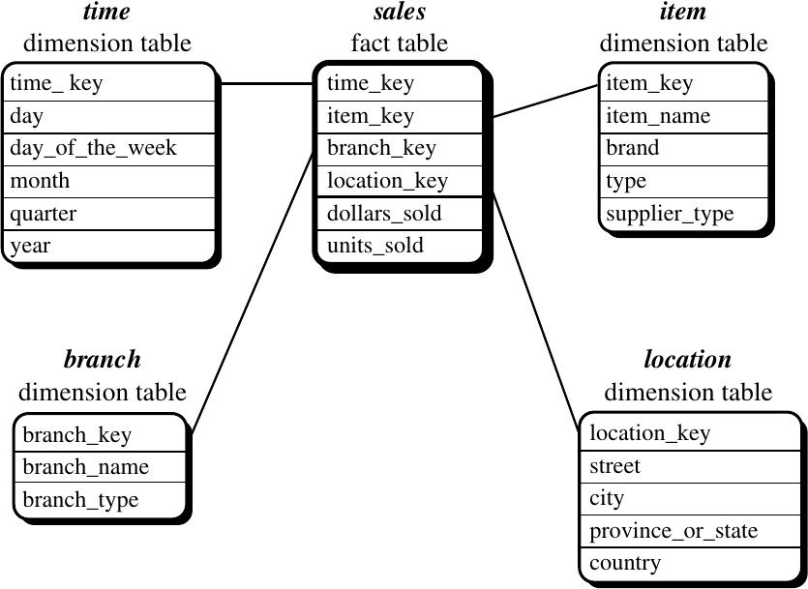
Star vs. Snowflake

Slide 29
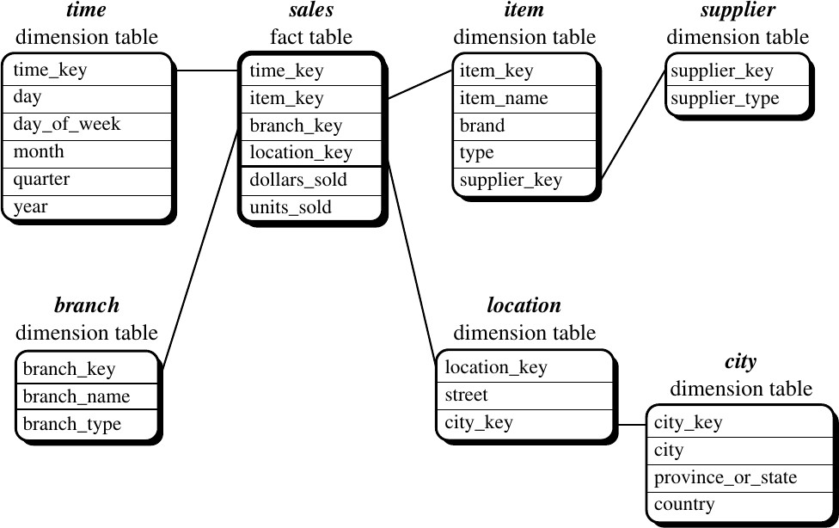
Star vs. Snowflake

Slide 30
Star vs. Snowflake
Star Schemas
Simple and easy overview
Relatively flexible
Dimension tables often relatively small
Recognized by many RDBMSes
Hierarchies are ”hidden” in the columns
Dimension tables are de-normalized
Snowflake schemas
Hierarchies are made explicit/visible
Very flexible
Dimension tables use less space
Harder to use due to many joins
Worse performance

Slide 31
Questions
◼Which will typically be larger: a dimension table or a fact table? Why?
Explain granularity, and the difference between small grained and large grained data. Do you think that one is preferable over the other? Why?
What is the relationship between dimensions and facts (1-1, 1- M, M-M)?
Why is it necessary for measures to be numerical? Can you think of an example of a non-numerical measure?

Slide 32
Questions
Would you expect to see more tables in an ER diagram or a star schema? Why?
Would you expect to see more columns in a fact table or a table in a RDBMS? Why?

Slide 33
Questions
Suppose you have a data warehouse for a university. This warehouse contains student, course, semester, and, instructor dimensions as well as measures count, and avg_grade.
What possible hierarchies exist in this example? List at least one for each dimension.
Draw a star schema for this example.
Starting with a [student, course, semester, instructor] cube, which cube operations would be needed to display the average grade of computer science courses for each student?

