Slide 1


Database Management Systems
Relations and Constraints

Slide 2
Relations
A relation can be thought of as a set of tuples
Much like a table
Tuples contain attributes
Each tuple has an attribute that uniquely identifies it
We use relations as a mathematical model of a database
All operations are performed on relations

Slide 3
Schema
Schemas come in the format R(A1, A2, A3, …, An)
Example:
Student(id, fname, lastname, birthdate)

Slide 4
Tuples
Does the order of a tuple matter?
Relations are sets of tuples
– Any problems with this?
Notes:
Theoretically no but Empirically yes.
Avoid duplicate

Slide 5
Domain
Every attribute has a domain associated with it
Data type
Set of possible values
What are the domains for:
A student ID?
First and last names?
Phone numbers?
Notes:
(string/int, 6)
(string, )

Slide 6
State
The state of a relation is some subset of all the possible combinations of domains
Sometimes called a “value” or “population”

Slide 7
Exercise
Given the following schema:
– R(A1, A2)
– dom(A1) = (1, 2)
– dom(A2) = (a, b, c)
What is the domain of the entire relation?
The union
How many possible states are there?
6 tuples
Notes:
A1, A2
6

Slide 8
Constraints
Three main types:
Implicit
Explicit
Application based

Slide 9
Schema Integrity
◼ When using constraints for integrity, we have three types:
–Key constraint
–Entity integrity constraints
–Referential integrity constraints
◼ Domain constraints are considered separately

Slide 10
Key constraints
Super Key
–One or more attribute that guarantees uniqueness for a set of tuples
Key
–“minimal” super key
If a tuple has n attributes, what is the maximum number of possible superkeys?

Slide 11
Primary Keys
◼ From the list of candidate keys, we choose a primary key
–How should we narrow down the candidates?
–What will the primary key be used for?
link other tables
◼ Entity integrity
– The primary key attributes of each relation cannot be null

Slide 12
Schemas
A schema consists of:
–A set of relations
–A set of integrity constraints
Example:
S = {Student, Course, Department}

Slide 13
Database State
The database state consists of a set of relation states
–These relation states must satisfy integrity constraints
Sometimes referred to as a snapshot, or instance
How do we modify this state?

Slide 14
Referential Integrity
Involves two relations
–Primary key → foreign key
The foreign key MUST exist in the primary key table
Notes:
Foreign key can be duplicated (1-to-many)

Slide 15
Exercise
◼ For each of the modification operations (INSERT, UPDATE, DELETE), determine whether it is possible for them to violate:
–Domain Constraints
–Key Constraints
–Referential Integrity
–Entity integrity
◼ If it is possible, explain how

Slide 16
Handling Violations
◼ What should we do if a violation occurs?

Slide 17
Constraints in SQL
◼ Domain constraints require triggers:
DELIMITER $$
CREATE TRIGGER pos_id BEFORE INSERT ON FOR EACH ROW BEGIN
IF NEW.sid < 0 THEN SIGNAL SQLSTATE '45000'
SET MESSAGE_TEXT = "sid must be positive"; END IF;
END$$ DELIMITER ;
after
Students
Sid: Primary Key
Notes:
If one row fails, all theirs fails
Little violate to keep more data and fix later.
其中45000是一个通用SQLSTATE值，用于说明未处理的用户定义异常。

Slide 18
Constraints in SQL
◼ Foreign keys can be created before or after table creation:
CREATE TABLE Student (sid int, courseid int,
FOREIGN KEY (courseid) REFERENCES Course(courseid));
ALTER TABLE Student
ADD FOREIGN KEY (courseid) REFERENCES Course(courseid);

Slide 19
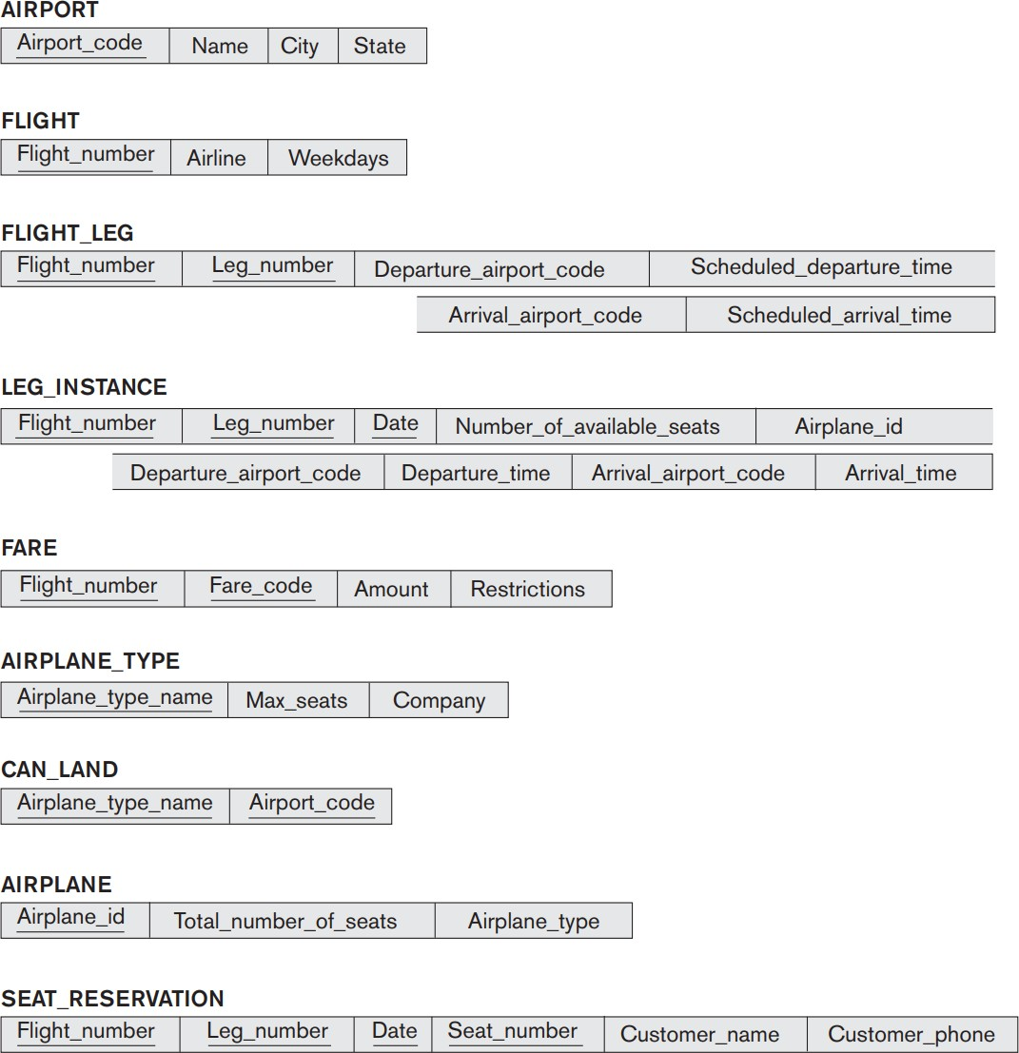
◼ If we wish to add a reservation to this database, what constraints would you be expected to uphold?
Notes:
If flight_no appears many times, it might be primary/foreign
Composite key 可能存在
Date

Slide 20
Exercise
This exercise requires that you have completed studio 2
◼Add foreign keys to your course tracking database based on the design you came up with.
Hint: If you need to add a column (such as a foreign key column) to a table, you can do so as follows:
ALTER TABLE Student
ADD COLUMN courseid int;

Slide 21
Exercise
◼ This exercise requires that you have completed studio 2
◼Go through your course tracking database and come up with some domain constraints. Add those constraints using triggers, then test them.

