Slide 1


Database Management Systems
SQL Language Processing

Slide 2
Processing Language
Known as parsing
Multiple Techniques
Top Down
Bottom Up
The result of parsing is what is known as a parse tree
Not the same as a query tree

Slide 3
Grammars
The rules that dictate how a language is parsed is called a grammar
What tokens do we expect to see?
In what order do we expect the tokens to appear?

Slide 4
Simplified Grammar for Select
Query ::= SELECT SelectItem
FROM FromItem WHERE Expression GROUP BY Column
SelectItem ::= Column |
Column, SelectItem FromItem ::= Table |
Table JoinItem
JoinItem ::= JOIN Table ON Expression |
JOIN Table ON Expression JoinItem Expression ::= Column Operator Column

Slide 5
Example Parse Tree
◼ SELECT FirstName, LastName FROM Employees

Slide 6
Execution Plans
If we can construct a valid parse tree we know the query is valid
But how to execute?
We must transform this parse tree into something more useful
Like what?
How do we do this?

Slide 7
Visitor Pattern
Idea: We wish to categorize the nodes of our parse tree
Inheritance, interfaces, etc.
We can then use these categories to locate nodes of interest to us
Example: Aggregates

Slide 8
Creating A Visitor
Class contains visit methods
Parameter is node type of interest
As we traverse the tree, we search for nodes that we care about
Start with most specific type, work towards more
general
Code in visit methods performs the desired task

Slide 9
Execution Plan
Once we have finished processing the parse tree, we now have a query tree that can be used to execute the query
◼Called an execution plan
But are we done?

Slide 10
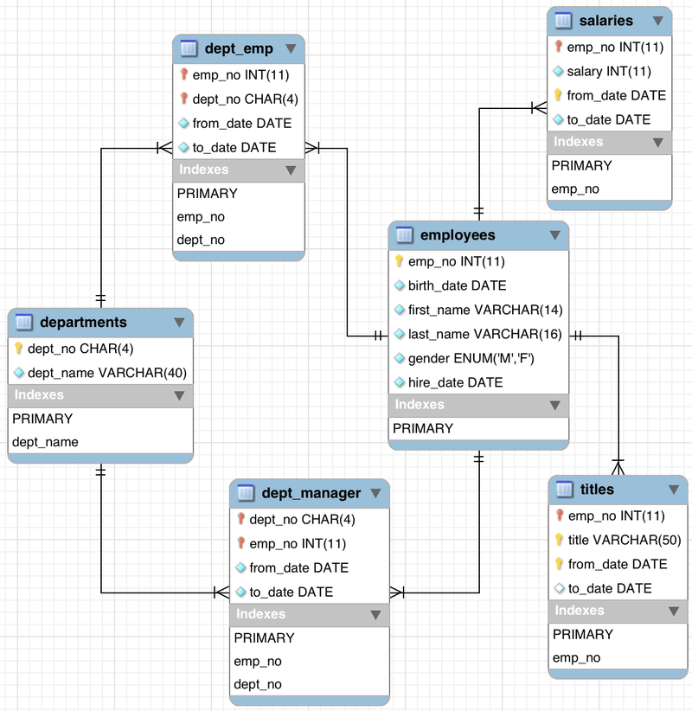
ER Diagram

Slide 11
Practice Problem
◼ Write a query that will return a list of all employees who do not have a title
SELECT employees.emp_no, title, FirstName, LastName
FROM employees OUTER JOIN titles
ON employees.emp_no = titles.emp_no
WHERE title is NULL

Slide 12
Practice Problem
◼ Constructe a parse tree and a query tree for the following query:
SELECT Title, Developer, Platform FROM VideoGame JOIN Developer ON
VideoGame.DevID = Developer.ID WHERE Year = 1989

Slide 13
Practice Problem
◼ You are given the following relational algebra query. Construct the original SQL query.

Slide 14
Practice Problem
◼ Create an ER diagram for an application that allows users to create playlists of songs. A playlist contains one or more songs. A song can have one or more artists associated with it.

