Slide 1
Database Management Systems
Relational Operations

Slide 2
Retrieving information
SELECT ③ columns
- chop off columns
FROM ① tables
WHERE ② conditions
- Speed up operations of rest data by eliminating data
ORDER BY ⑤ sorting
GROUP BY ④ aggregate entire set/relation
注：
②③非必须但reasonable
But it will not do step by step strictly

Slide 3
Relational Algebra
All of these queries can be broken down using relational algebra
Operates on sets
Unary: an operation with only one operand
Select
Project
Rename
Relational
Union
Intersection
Difference
Cartesian Product

Slide 4
Select
Careful!
– Not like SELECT
Specifies which tuples to keep from a relation based on a condition:
^{σ} hire date after 1-1-1990 ^{(EMPLOYEES)}

Slide 5
Select(WHERE)
Result set will have the same attributes as the relation
Its commutative!
Bound on number of tuples? [0,n]

Slide 6
Project(SELECT)
◼ Keeps certain columns, discards the rest
^{π} LNAME, FNAME, SALARY ^{(EMPLOYEE)}

Slide 7
Project (SELECT)
Duplicate tuples are removed (why?)
Not include primary key => duplicate
Query operation on set => remove
Bound on tuples? At most n
Commutative?

Slide 8
Rename(AS)
◼ Applies a different name to attribute(s) of a relation
– Necessary in some cases
^{ρ} (A1, A2, A3, A4, A5) ^{(R)}

Slide 9
Union
R ∪ S includes all tuples in R, in S, or in both R and S
Relations must contain the same number of columns Columns must have the same data type
SQL Syntax:
SELECT *
FROM dept_emp
UNION SELECT *
FROM dept_manager

Slide 10
Intersection and Difference
R ∩ S includes all tuples that are in R and S
* INTERSECT
R – S includes all tuples that are in R but not in S Not often used
◼ Commutative?
For intersection yes while for difference no

Slide 11
Cartesian Product
Combine tuples from two relations combinatorially
– R x S
Number of attributes in the result?
- N + M
Number of tuples in the result?
- N * M

Slide 12
Cartesian Product
◼ Under what conditions is this a useful operation?
–What do we have at our disposal to help us with this operation?
- Getting every single combinations of tuples. Itself doesn’t really helpful because it is too broad and we want to have more controls on it. (some shared meaning)

Slide 13
JOIN inner join
Foreign key: a column or group of columns in a relational database table that provides a link between data in two tables. It references the primary key of another table.
Primary key: a specific choice of a minimal set of columns(attributes) that uniquely specify a row(tuple) in a table(relation).
Cartesian Product combined with a select (WHERE)
- This is where Primary keys and foreign keys are so useful to us.
Example:
SELECT * FROM employees JOIN salaries ON employees.emp_no = salaries.emp_no
Can join more than 2 tables if necessary?
- Yes, even different kind of joins (like inner join and outer join)
Natural Join(practical): JOIN with PROJECT
Equijoin(default): duplicated content in result
For inner join, it is communicative while for outer not

Slide 14
Outer JOINs even if the requirement is not satisfied
◼Three types
–LEFT: keep tuples from left side
–RIGHT: 一般不用，直接用交换位置然后用left join
–FULL: keep tuples from both side
What are “missing” values replaced with?
- null
What could this be used for?
Find out some requirement that is not satisfied (null in domain E.g employees don’t have departments)

Slide 15
Combinations
The six operations (select, project, union, difference, rename, cartesian product) are a complete set
– This means any other expression can be expressed using these operations E.g join = cartesian product + select
Question: how can we express intersection using these operations?
- R ∩ S − (R − S )
What order are the SQL clauses that we've been using executed in?(*)

Slide 16
Aggregates
◼ “outside” the realm of relational algebra
Without-Groupby: ^{ℱ} AVERAGE SALARY ^{(SALARIES)}
Groupby: emp_no ^{ℱ} AVERAGE SALARY ^{(SALARIES)}
◼Order by may share the same symbol

Slide 17
Query Trees
Data structure used to organize the operations to be performed
Example: Employee names and salaries
SELECT last_name, salary
FROM employees JOIN salaries ON employees.emp_no = salaries.emp_no

Slide 18
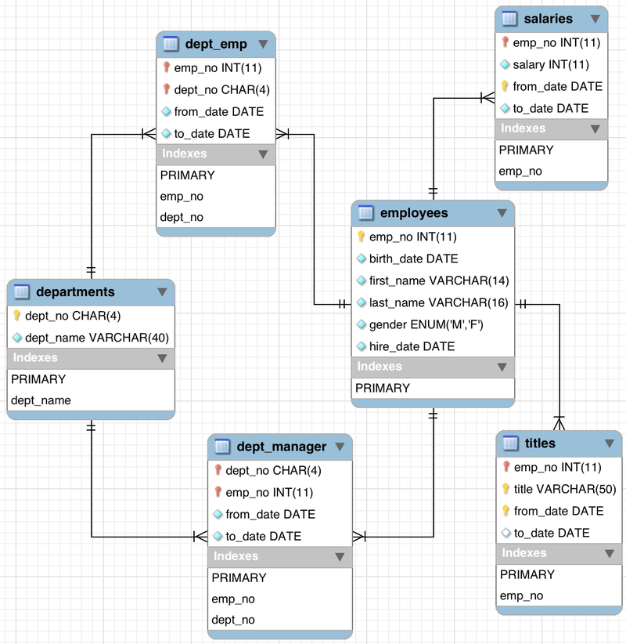
ER Diagram

Slide 19
Relational Calculus (不要写但能看懂)
Relational algebra is procedural
- Tell computer how to do
Relational calculus is declarative
– No order of operations
Tuple Calculus:
{t.first_name | EMPLOYEE(t) AND t.birth_date > 1960-01-01}
Look at first_name of all the tuples that in the employee relation and have a birth_date after 1960-01-01
Domain Calculus: (specify conditions based on broad domain)
{ uv | (Ǝr) (Ǝs) (Ǝt)(EMPLOYEE(rstuv) and r>1960-01-01)}
Look for columns u and v where columns r, s, t exist in this Relation and have a column r value of greater than 1960-01-01

Slide 20
Quantifiers
Ǝ is called the existential qualifier. To satisfy the condition, a tuple must exist within the specified domain of tuples.
∀ is called the universal qualifier - every tuple must conform to the condition.

Slide 21
Practice Problems
◼ Write a query to show the names and birthdays of all employees
–What relational operations did you use?
–Write the query using relational algebra
SELECT (last_name, first_name) AS name, birthdate
FROM employees

Slide 22
Practice Problems
◼ Write a query to show the department of each employee
–Hint: you'll need a join (maybe more than 2 tables)
–What relational operations did you use?
–Write the query using relational algebra
SELECT dept_name
FROM employees FULL JOIN departments
ON employees.emp_no = departments.emp_no

