Slide 1
Database Management Systems
Exam Review

Slide 2
Topic Outline (I)
General DB Structure
Tables, rows, columns
Data types: String, Number
Metadata: data of data
Relationships: one-to-one, one-to-many, many-to-many
Basic SQL (顺序)
SELECT, FROM, WHERE, GROUP BY, ORDER BY
Design
ER Diagrams (大题顺序)
Normalization (3 types)
CREATE TABLE, INSERT, UPDATE, DELETE
Notes:
FROM>WHERE>SELECT>GROUPBY>ORDERBY
ER Diagrams: ENTITIES>ATTRS>RELATIONSHIPS>LINKED TABLES
(do not include foreign key which needs !!!; we didn’t put data type and linked in table on it )
注意符号
Normalization (If you made a good design, you don’t have to)
Query Tree Parse Tree?

Slide 3
Topic Outline (II)
Physical Layer
Heap File Structure
Insertion and deletion of data
Retrieval of data
Relations and Constraints
Type of relationships
Primary keys / foreign keys
Triggers ?
Relational Operations
Type of operations
Converting queries to relational operations

Slide 4
Topic Outline (III)
Indexing
Types of indexes (single-layered)
Properties of indexes
B+ tree operation
Query optimization
Query tree creation
Optimization heuristic

Slide 5
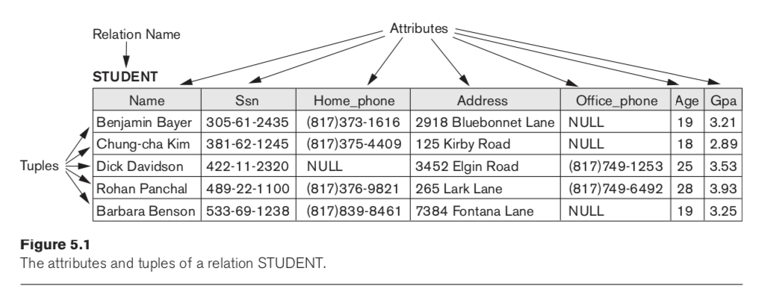
General DB Structure
- Tables, rows, columns

