Slide 1


Database Management Systems
NoSQL
Notes:
Sadalage, Fowler, “NoSQL Distilled: A Brief Guide to the Emerging World of Polyglot Persistence” 2012

Slide 2
Why NoSQL?
◼Better question: why relational databases?
Organizational structure is pretty simple and intuitive
People are familiar with relational database and there are a lot of related resources because of long time dominance
Keep large amounts of persistent data
Control concurrency
Integration: share a single database for application
A mostly standard model with core mechanism

Slide 3
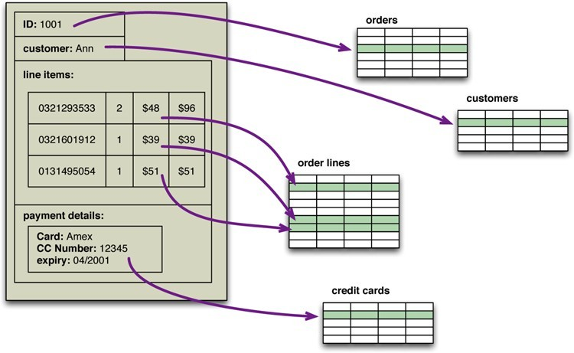
Problems with the Relational Model
Impedance Mismatch: the difference between the relational model and the in-memory data structures because their structures are richer
In Relational db, we need to break into chunks(table) and stick them together when querying by SQL.
- Relational: Normalization
- NoSQL: Against Normalization

Slide 4
Application vs. Integration
What are you using the database for?
- Application database(NoSQL): suit just one particular application
- Integration database(Relational): with multiple applications, usually developer by separate teams, storing data in a common database
–How does this effect...
Complexity? Integration database because structure that’s designed to integrate many applications end up being more complex.
Performance? Integration database is more difficult. If it want to change, it needs to coordinate with other applications using the database
Development? Application database is more flexible

Slide 5
The effect of scale
◼Consider how the internet looks now compared to 15 years ago....
–How did we come to meet the increase in demand?
To use computer that is more powerful
Throw more databases to learn the communicator
SQL DB cannot really erase this problem, However, NoSQL database do have this scale in mind

Slide 6
Here comes NoSQL
What is it?
– Not Relational
How is it different?
– To organize data differently based on larger documents. They takes scaling into account and can be much more effective
Why should we be using it?
- NoSQL: application oriented

Slide 7
Aggregates
◼How does a relational database store records?
A relational database store records in tables (columns and rows)
–What are the limitations of this?
It takes some efforts to aggregate data.

Slide 8
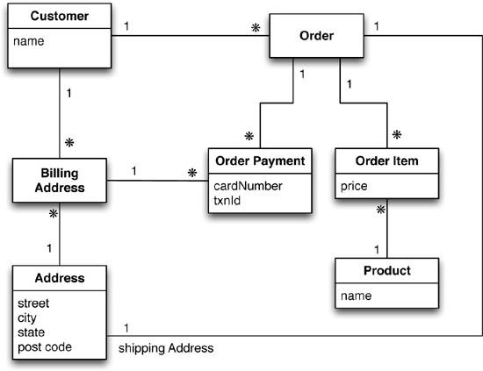
Example: A relational data model
Notes:
* For aggregation
Order oriented

Slide 9
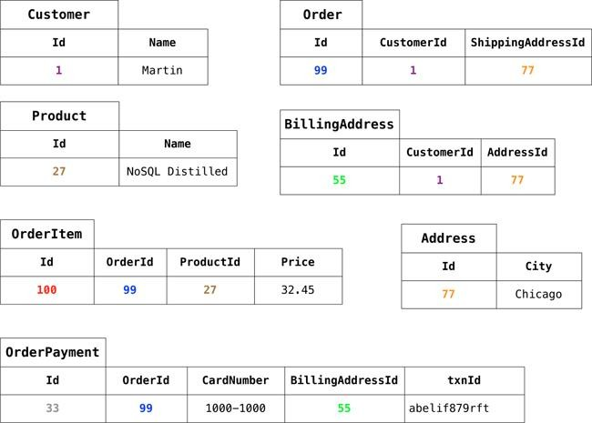
Typical data using RDBMS data model
As we are good relational soldiers, everything is properly normalized, so that no data is repeated multiple tables. We also have referential integrity. A realistic order system would naturally be more involved than this.

Slide 10
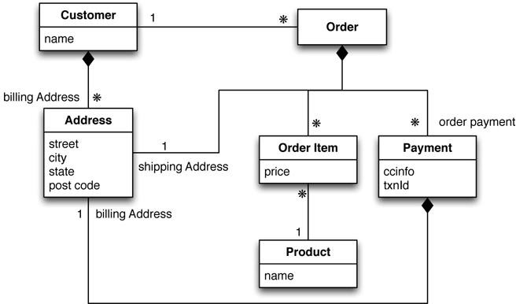
A different aggregate data model
Notes:
Customer oriented

Slide 11
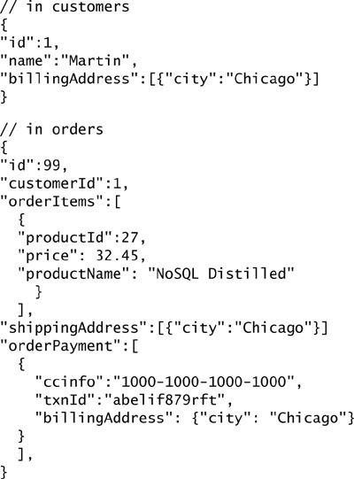
Aggregate Data
In this model, we aggregates based on customers and orders
Pros:
Cons:
If I want to find some specific products, the structure is not quite efficient. We may change the structure then, this makes it very important to decide how we want to use our data
The link between aggregates isn’t within either aggregate
Notes:
* to list []
For the embedded documents, we can do query but for relational database we have to do joins, which is really time comsuming

Slide 12
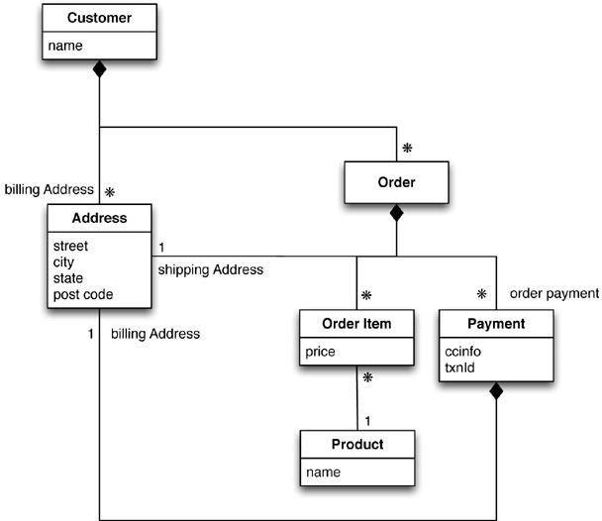
A different aggregate data model

Slide 13
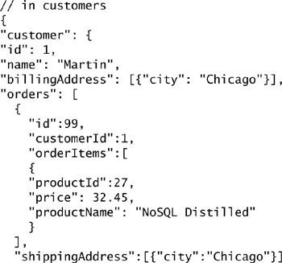
A different set of data
In this model, we do care more about customers as a unit not the products because otherwise we won’t keep them difficult to access.
Reduce the complexity and make the customer information more useful because I don’t need to match up the customer ID every single time

Slide 14
Consequences
How are these aggregates represented in relational databases?
- We need to perform Join to aggregate.
What benefits are gained from using these aggregates in this way?
- We don’t need Join anymore
ACID Transactions
- We don’t have to do the relation. Like Foreign Key
Thus we don’t need transactions because if we want to change multiple documents together, they seem unrelated to each other.

Slide 15
Schemaless Databases
Under this model we do not require a schema
The structure of data: when I put data in the database, it verifies data type matches the schema
–How is this possible?
Advantages? Flexible and Skip checking step means a lot faster because we don’t need validation
Disadvantages? Format
◼ Are they actually schemaless?
- No, implied schema. We programmer need to ensure the database is in schema. We move the schema from the database to the frontend

Slide 16
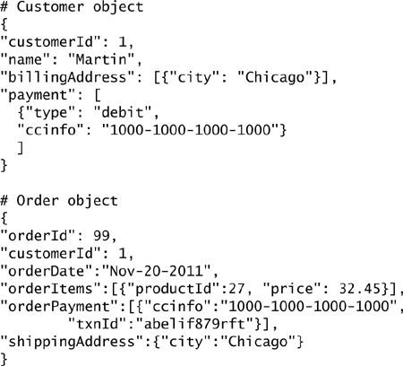
Modeling for Data Access
customerID is like foreign key but there’s no referential integrity, it doesn’t
Require customerID = 1 to exist

Slide 17
Distribution
◼One of the major benefits of NoSQL (why?)
–Comes with one major drawback...

Slide 18
Single Server
Is this really distribution?
Why might you want to do it this way?

Slide 19
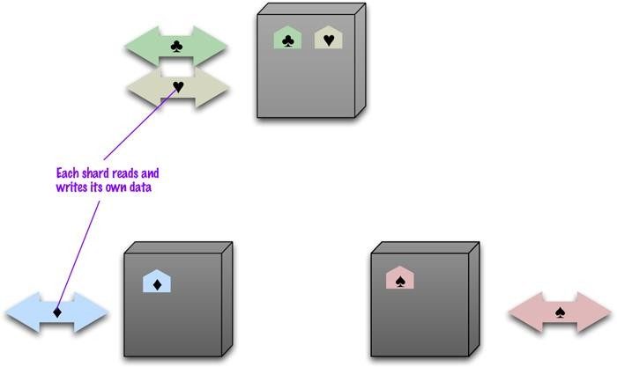
Sharding

Slide 20
Sharding
What is the ideal case for # of users / servers?
How do we decide how to split up the data?
–What data will commonly be accessed together?
What can we use to help us perform these tasks?

Slide 21
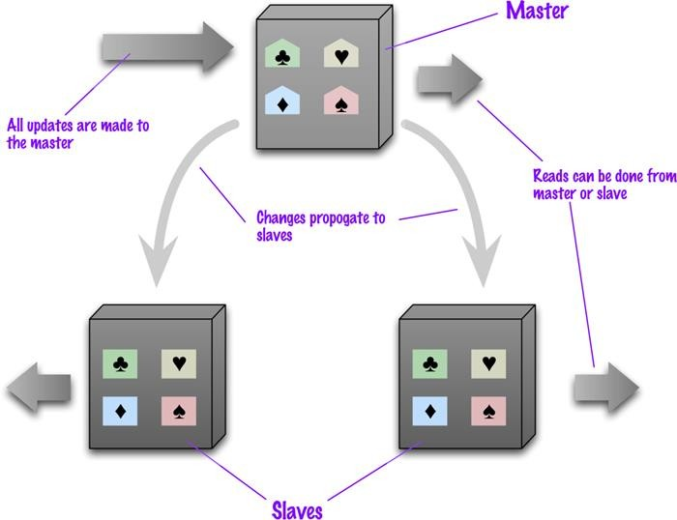
Primary-Secondary Replication

Slide 22
Primary-Secondary Replication
How does this affect performance of reads? Writes?
How does this affect data resilience?
What about consistency?

Slide 23
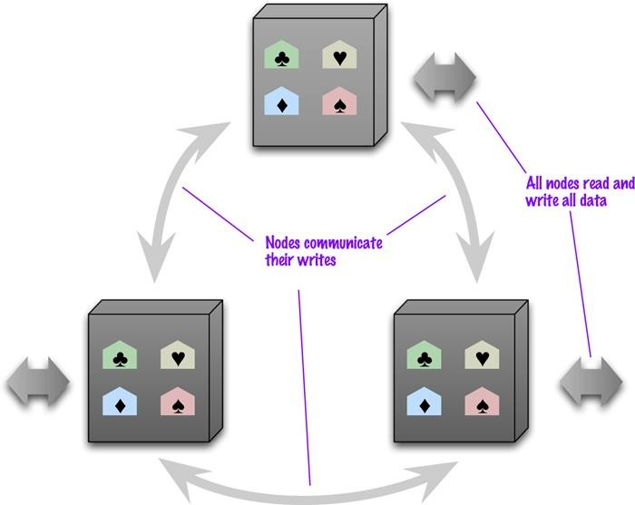
Peer-to-Peer Replication

Slide 24
Peer-to-Peer Replication
How does this affect performance of reads? Writes?
How does this affect data resilience?
What about consistency?

Slide 25
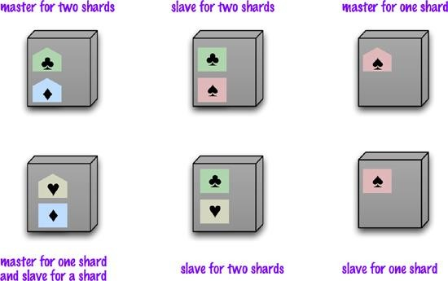
Combinations

Slide 26
Update Consistency
Imagine two people try to update the same piece of data at the same time
–What happens?
–What do we want to happen?
Pessimistic vs. Optimistic

Slide 27
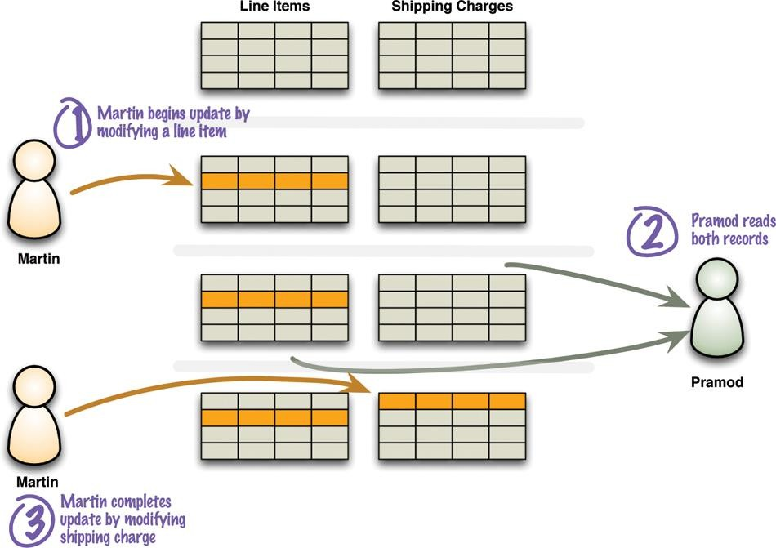
Read Consistency

Slide 28
Read Consistency
Logical consistency
–How do relational DBs handle this?
How does NoSQL handle it?
–Inconsistency window
How does replication complicate this kind of consistency?

Slide 29
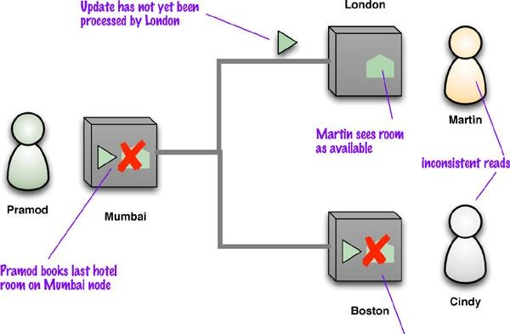
Read Consistency

Slide 30
Read Consistency
Read-your-writes consistency
Session consistency
–Sticky Sessions

Slide 31
Relaxing Consistency
◼ It is always possible to design a system that is consistent
–Why might we want to sacrifice this?
◼ CAP Theorem

Slide 32
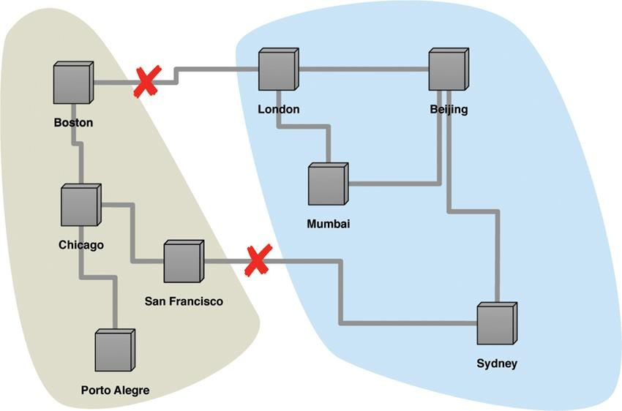
Partition Tolerance

Slide 33
CAP Theorem
What is an example of a system without partition tolerance?
–Should we aim for this?
It is all about the trade off!

Slide 34
CAP Theorem
How can we improve consistency?
How can we improve availability?
◼ Inconsistent writes
–What about reads?

Slide 35
Quorums
How many nodes do we actually need to get consistency?
Write quorums
Replication factor
How does this affect reads?

Slide 36
Review Questions
We discussed how NoSQL databases are often schemaless, however there is often an implied schema. Explain what is meant by an implied schema.
Give a brief description of each of the three parts of the CAP theorem.
What is the practical implication of the CAP theorem as it applies to a distributed database?

