Slide 1


Database Management Systems
Key-Value Stores
Graph Databases

Slide 2
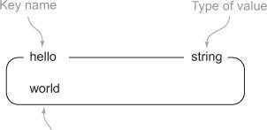
Redis
Key-Value pairs
–Limited data types
In-memory database
–What about persistence?

Slide 3
Data Types
String
List
Set
Hash
Zset

Slide 4
Strings
set hello world get hello
del hello get hello

Slide 5
Lists
rpush list-key item rpush list-key item2 rpush list-key item
lrange list-key 0 -1
lindex list-key 1 lpop list-key lrange list-key 0 -1

Slide 6
Sets
sadd set-key item sadd set-key item2 sadd set-key item3 sadd set-key item
smembers set-key
sismember set-key item4 sismember set-key item
srem set-key item2 srem set-key item2
smembers set-key

Slide 7
Hashes
hset hash-key sub-key1 value1 hset hash-key sub-key2 value2 hset hash-key sub-key1 value1
hgetall hash-key1
hdel hash-key sub-key2 hdel hash-key sub-key2 hget hash-key sub-key1
hgetall hash-key

Slide 8
Zsets
zadd zset-key 728 member1 zadd zset-key 982 member0 zadd zset-key 982 member0
zrange zset-key 0 -1 withscores
zrangebyscore zset-key 0 800 withscores zrem zset-key member1
zrem zset-key member1
zrange zset-key 0 -1 withscores

Slide 9
Persistence
Snapshots
Append only-log files

Slide 10
Suitable Use Cases
Storing Session Information
User Profiles
Shopping Cart Data

Slide 11
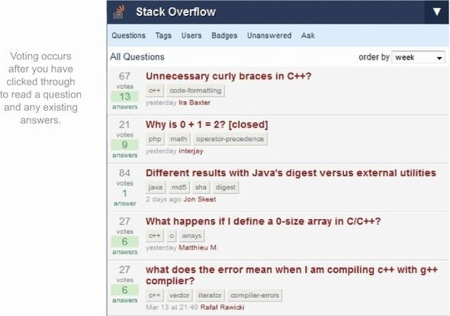
Example Use Case

Slide 12
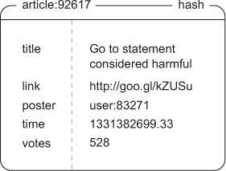
Example Use Case

Slide 13
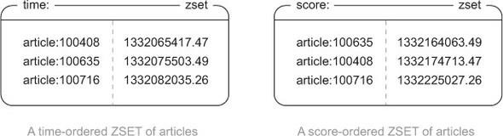
Example Use Case

Slide 14
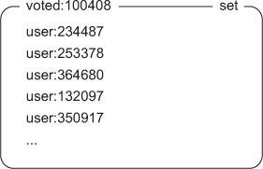
Example Use Case

Slide 15
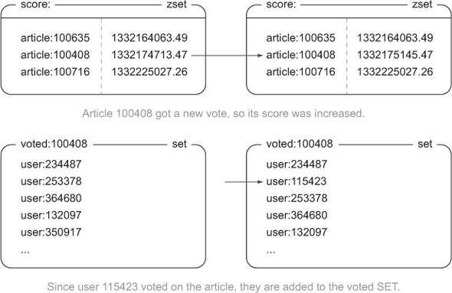
Example Use Case

Slide 16
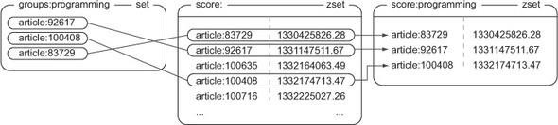
Example Use Case

Slide 17
When Not to Use
Relationships between data sets
Multioperation transactions
Query by data
Operation by sets

Slide 18
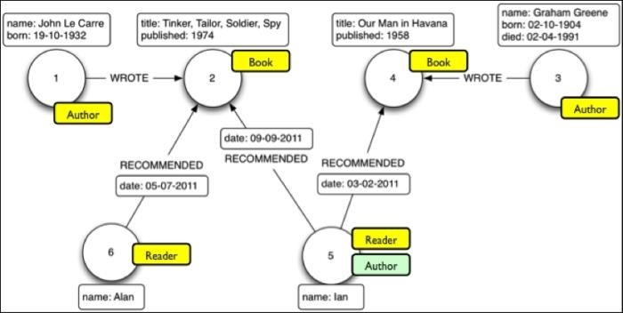
Neo4J Data Model
“Learning Neo4J”, Rik Van Bruggen, 2014

Slide 19
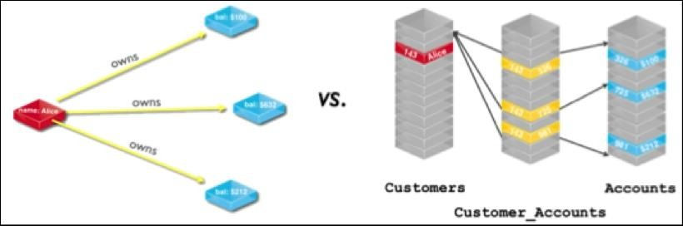
Neo4J Data Model

Slide 20
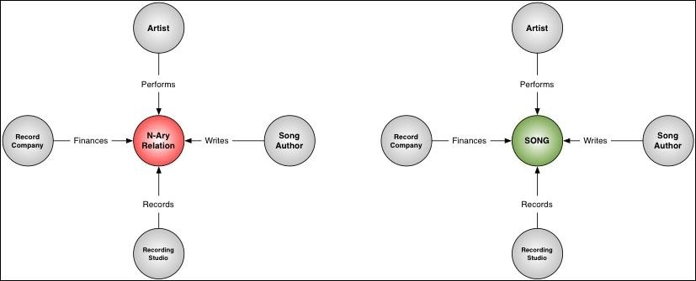
Neo4J Data Model – Best Practices
◼ Design for query-ability
Align relationships with use cases
Look for n-ary relationships

Slide 21
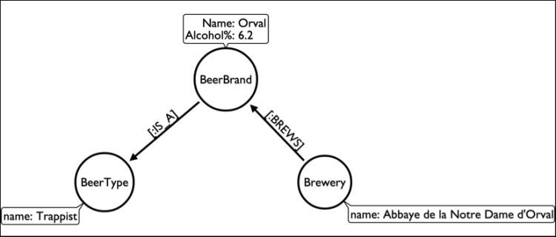
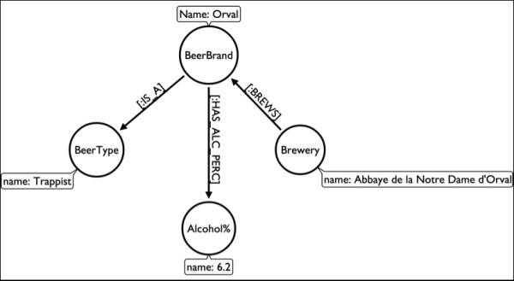
Neo4J Data Model – Best Practices

Slide 22
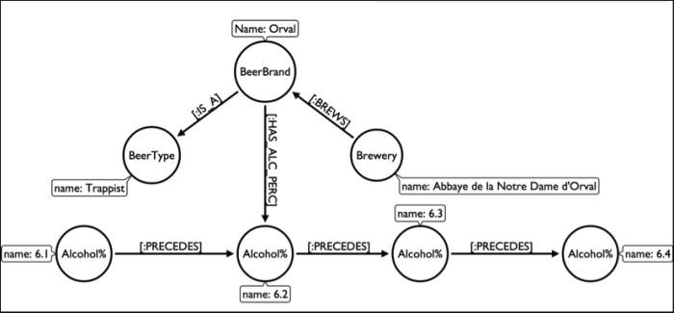
Neo4J Data Model – Indexes

Slide 23
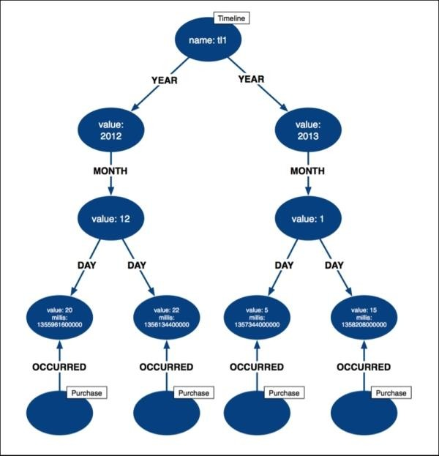
Neo4J Data Model – Indexes

Slide 24
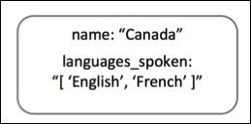
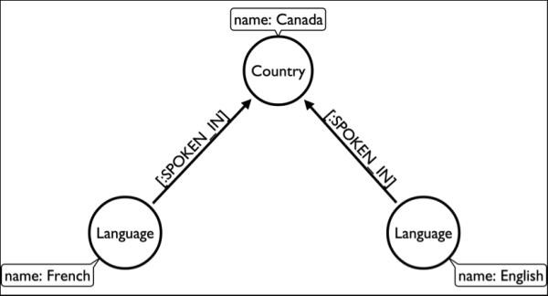
Modelling Pitfalls: Rich Properties

Slide 25
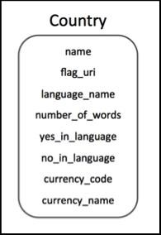
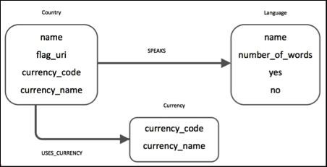
Modelling Pitfalls

Slide 26
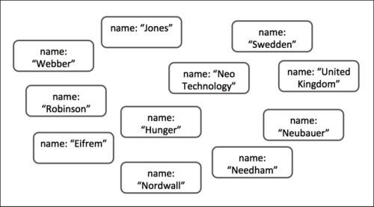
Modelling Pitfalls: Unconnected Graphs

Slide 27
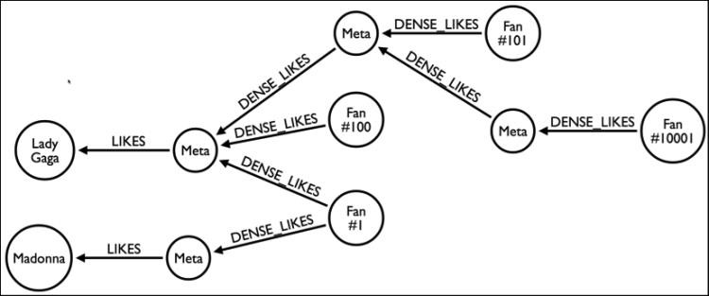
Modelling Pitfalls: Dense Nodes

Slide 28
Other Features
Consistency
Transactions
Availability
Scaling

Slide 29
Use Cases
Connected Data
Routing, Dispatch, Location-based services
Recommendation Engines

Slide 30
Practice Problem
Write a query that will determine actors that Tom Hanks has not worked with.
Write a query that will find someone who has worked with both Tom Hanks and Tom Cruise

