Slide 1
Database Management
Systems
What is a Data Warehouse?
Dimensional Modeling
Doug Shook

Slide 2
Data Warehouses
Data Analysis Environment
Subject oriented
Integrated
Time variant
Stable
Data warehouses store information in an organized, unified way
Assist in decision making
2
Notes:
P1
E.g accounts (centralized storage center)

Slide 3
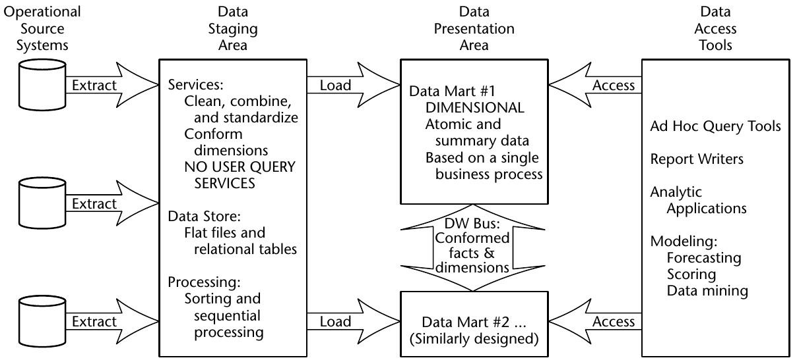
DW Structure
3

Slide 4
Elements of a Data Warehouse
Operational Systems
Captures business transactions
Technically outside of DW
Primary data source
Data Staging Area
Responsible for Extract-Transform-Load(ETL)
Extract from operational systems
Transform data to make it suitable for presentation
Perform bulk loading into data marts
4
Notes:
P2
Integrate data from different sources and clean data

Slide 5
Elements of a Data Warehouse
Data Presentation
Data Marts
Broken down by departments
Accessible by business users
Contains raw data as well as metadata (aggregates, summaries)
Relies on dimensional modeling
Data Access Tools
Ad-hoc querying
Data mining
5
Notes:
p3

Slide 6
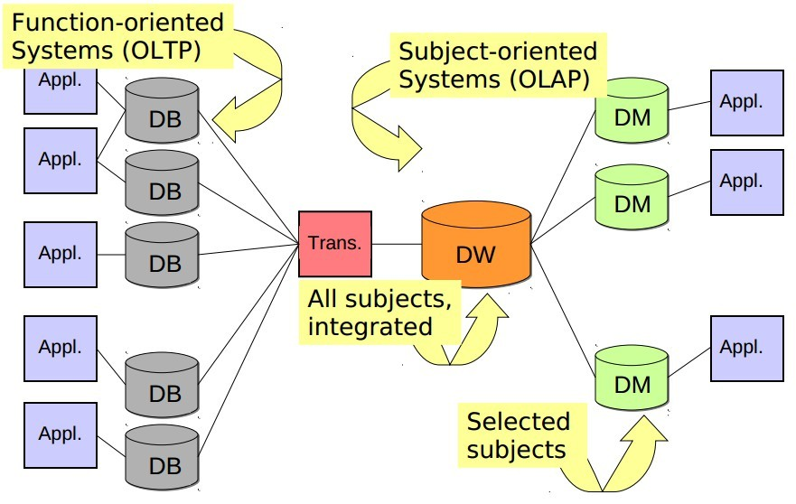
DW Structure
Notes:
P4
Pay attention to data direction for db and dm

Slide 7
OLTP vs. OLAP
On-line Transaction Processing
Many small, fast queries
Geared towards business processes (functions)
Less historical data
Frequent updates
On-line Analytical Processing
Fewer, larger queries
Fewer, larger updates
More historical data
Dimensional / subject oriented
7
Notes:
P5
Subject oriented: twitter users name changed over time not an exact one
OLTP AND OLAP both have different characteristsics

Slide 8
Example Queries
Which product has been the most profitable in the past ten years?
Which week of the year do we have the most sales?
Do the sales of product X increase over time?
These queries are difficult for OLTP systems to answer. Why?
Notes:
P6
Big picture about analytical problems

Slide 9
Data Integration Issues
Data Redundancy
Heterogeneous sources
DBMS, OLTP
Documents
Legacy
Data designed with operational systems in mind
Quality
Volatility
9
Notes:
P7
ETL is like data flow

Slide 10
Query Based Data Integration
Data is integrated on demand
Pros:
Access to up-to-date data
No data duplication
Cons:
Delay in query processing
Competes with existing processes
Data losses cannot be recovered
10

Slide 11
Warehouse Based Data Integration
Data is integrated in advance
Pros:
Better performance
Does not interfere with business processes
Cons:
Duplication of data
Updates not immediate
11

Slide 12
Multidimensional Modeling
Relational Databases typically use normalized data
Eliminates redundancies
Provides for fast insertions
Modeled through ER diagrams
This approach works well for operational systems, but poorly for data warehouses
Why?
Notes:
P8
For inconsistency (fast insertion)
Trade-off: normalization means that we create more tables (joins)

Slide 13
ER vs. Multidimensional
ER
One table per entity
Minimize data redundancy
Optimize update
OTLP
Multidimensional
One fact table per process
Maximize understandibility
Optimized for retrieval
OLAP
Notes:
P9
If I have more copies, it’s easier for me to find data for you

Slide 14
Multidimensional Modeling
Design Concepts
Facts
Measures
Dimensions
Hierarchies
Logical Design Types
Star Schemas (Cubes)
Snowflake Schemas
Notes:
P10

Slide 15
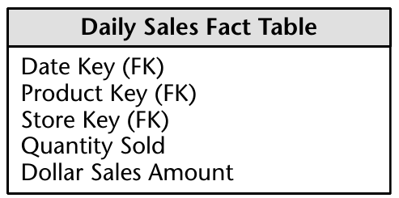
Fact Tables
Purpose: store performance measurements from business process events
Sales, shipments, purchases, etc.
Events have a 1 to 1 relationship with rows in a fact table
Notes:
P11
Quatifiable pieces of data
Composite primary keys (linking table)
Many-to-Many relationship? I wouldn’t use this terminology (Granularity: quantity sold and dollar sales amount for a date key, what if I can change the granularity) change date to hour(small) or month(large)

Slide 16
Fact Tables
A measure is a numerical property of a fact
Sales Dollars, units, etc.
Most useful measures are also additive
I.e. Sales Dollars vs. Unit Price
Fact tables contain true data
No filler
Typically quite sparse
Foreign Keys link facts with dimensions
Notes:
P12

Slide 17
Types of Facts
Transaction
A fact for every business event
Snapshot
A fact for every dimension combination at a given time interval
Captures current status
Accumulating Snapshot
Like regular snapshot, except cumulative

Slide 18
Granularity
What does a single fact mean?
What does each row in a fact table represent?
Related to the primary key
Small grain – lots of detail, lots of data
Every item scanned at check out
Every transaction of a bank account
Large Grain – more efficient at loss of detail
Every sale made
Monthly statement data for a bank account
Notes:
Consider in reversible data, if we have small grain data, we can do.
Data warehouse doesn’t care too much about space (many copies actually)

Slide 19
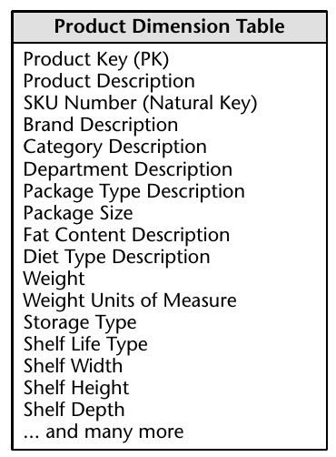
Dimension Tables
Describe textual properties of facts
Who, what, when, where, how, and why
Typically discrete values
Limited range of values
Typically very large

Slide 20
Dimension Tables
Vital role within the data warehouse
Grouping
Constraints
Labels
Avoid using cryptic descriptions
Spell it out
Use real language
If you must use codes, include another column that describes the encoded data

Slide 21
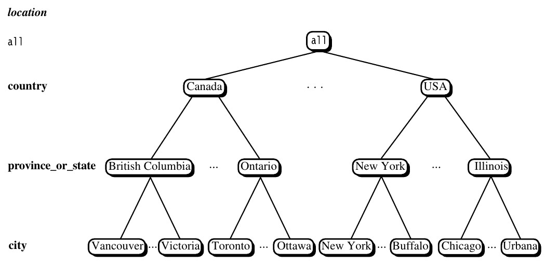
Multidimensional Modeling
Dimension tables often represent hierarchies:
Data in hierarchies is redundant, but that’s OK!
Notes:
Dimension data(hierarchy)
Why this is important to us?(trying to answer analytical questions)

Slide 22
Data Cubes
Defined by a combination of dimensions and facts
Can have many dimensions, usually > 4
Only 2-3 can be viewed at one time
Cubes are represented by cells
Combination of dimension values
Can be empty

Slide 23
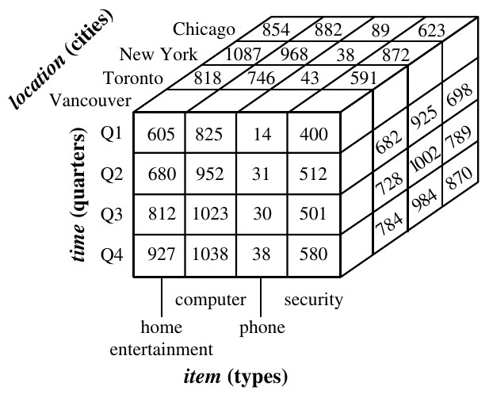

Slide 24
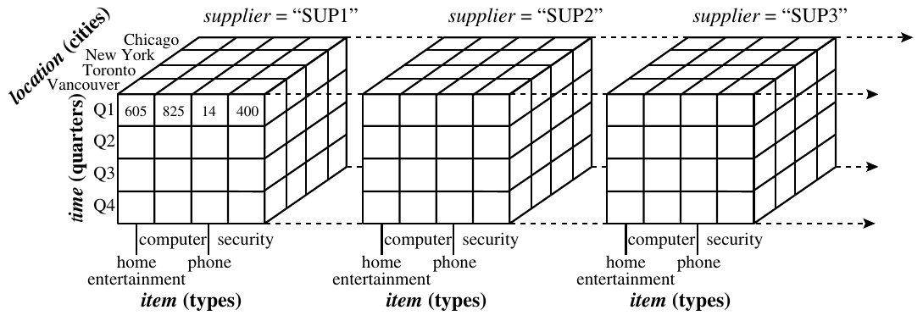

Slide 25
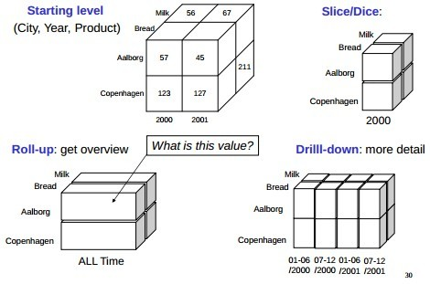
Data Cube Operations
Notes:
In practice, we care about
Slice(sliices) vs. Dice (smaller cubes)
Roll-up vs. drill down(hierarchy)

Slide 26
Data Cube Operations
Slice
Creating a cube with one fewer dimension
Dice
Creating a sub-cube
Drill down / up
Change level of detail of a dimension
Roll up
Summarize data within a dimension
Notes:
“confusing slide”

Slide 27
Data Cubes
True building block of Dimensional Modeling
Certain DB platforms include syntax for dimensions, cubes, etc.
Most of the world is built around RDBs
Enter star schemas: Data cubes modeled using ER like diagrams
Notes:
Multidimensional way converted to RDBs

Slide 28
Star Schemas
Simple way of modeling dimensional data cubes
Easy enough for non-technical users to understand
Fewer tables, increased performance
Easily extensible
New facts and dimensions can be added at any time
Notes:
Start from Fact table

Slide 29
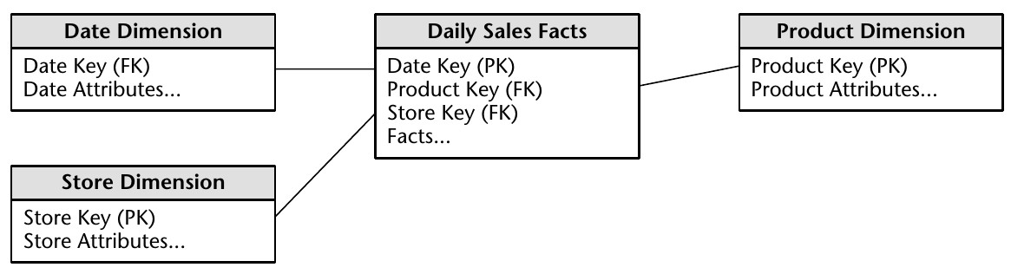
Star Schemas
Notes:
“problematic slide”

Slide 30
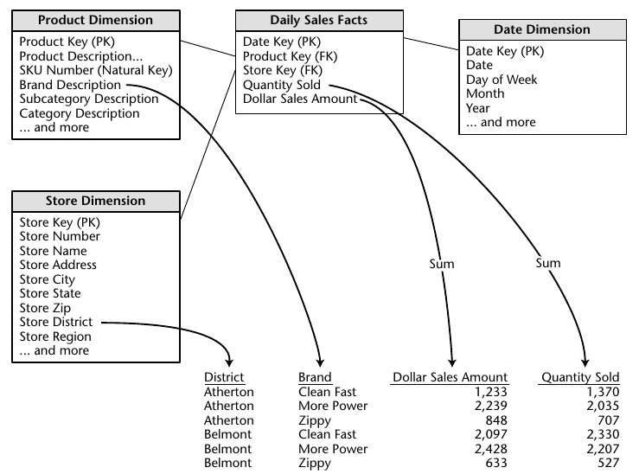
Generating Reports

Slide 31
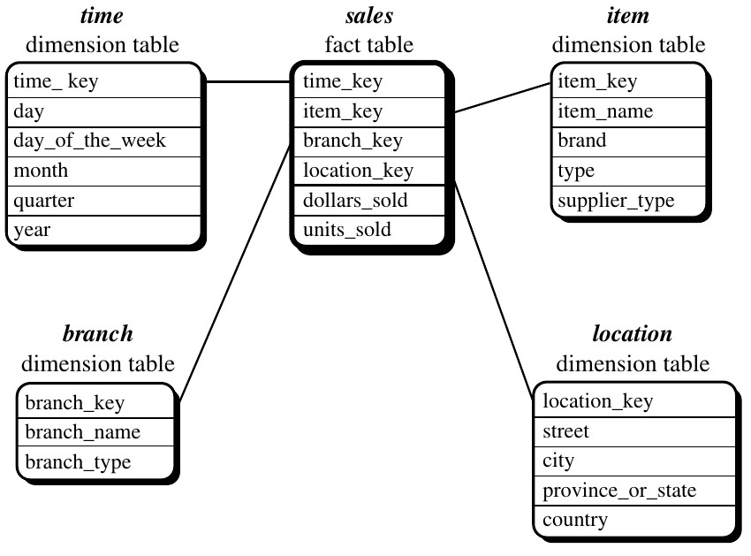
Star vs. Snowflake
Notes:
We don’t normalization in this case we embrace data redundancy.
Normalize Dimension (e.g location. Snowflake way NORMALIZE in next slide ) “trade-off”
”spaces is cheap” so star way is dominating

Slide 32
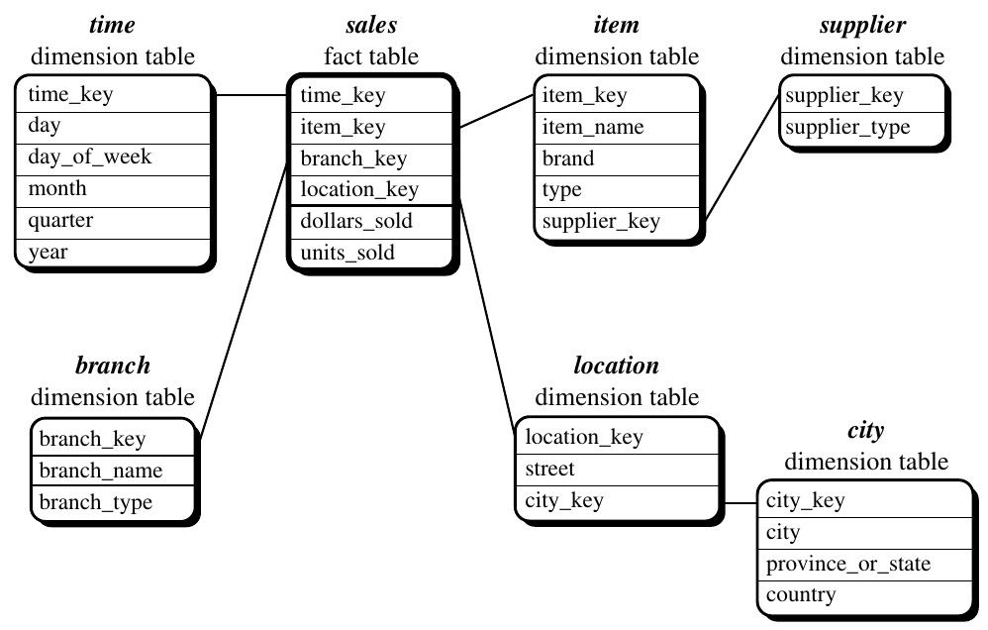
Star vs. Snowflake
32

Slide 33
Star vs. Snowflake
Star Schemas
Simple and easy overview
Relatively flexible
Dimension tables often relatively small
Recognized by many RDBMSes
Hierarchies are ”hidden” in the columns
Dimension tables are de-normalized
Snowflake schemas
Hierarchies are made explicit/visible
Very flexible
Dimension tables use less space
Harder to use due to many joins
Worse performance
Notes:
Trade-off

Slide 34
Questions
Which will typically be larger: a dimension table or a fact table? Why?
Explain granularity, and the difference between small grained and large grained data. Do you think that one is preferable over the other? Why?
What is the relationship between dimensions and facts (1-1, 1-M, M-M)?
Why is it necessary for measures to be numerical? Can you think of an example of a non-numerical measure?
Notes:
Either way: Dimension table because it has more columns while fact table because it is growing faster
Small grain prefer more detailed data, small grained since it can produce large grained data
Actually 1 to many is pretty common. (one product can appear in the same store for many times, one dimension and many is fact)
Because we want to get analytical data over time(perform operations)

Slide 35
Questions
Would you expect to see more tables in an ER diagram or a star schema? Why?
Would you expect to see more columns in a fact table or a table in a RDBMS? Why?

Slide 36
Questions
Suppose you have a data warehouse for a university. This warehouse contains student, course, semester, and, instructor dimensions as well as measures count, and avg_grade.
What possible hierarchies exist in this example? List at least one for each dimension.
Draw a star schema for this example.
Starting with a [student, course, semester, instructor] cube, which cube operations would be needed to display the average grade of computer science courses for each student?

