Slide 1
CASE STUDY
Olist E-commerce Analysis
Delivery — not price, category, or payment — is the single driver of customer satisfaction.
Poi
github.com/workintechpoyrazaka-sketch/olist-ecommerce-analysis
April 2026

Slide 2
THESIS
Olist satisfaction is delivery-driven.
Price, category, and payment type each produce trivial or null effects on review score — despite strong between-category price heterogeneity.
The one operational lever is on-time percentage — not average delivery speed.
Olist Analysis · Poi · April 2026
2 / 14

Slide 3
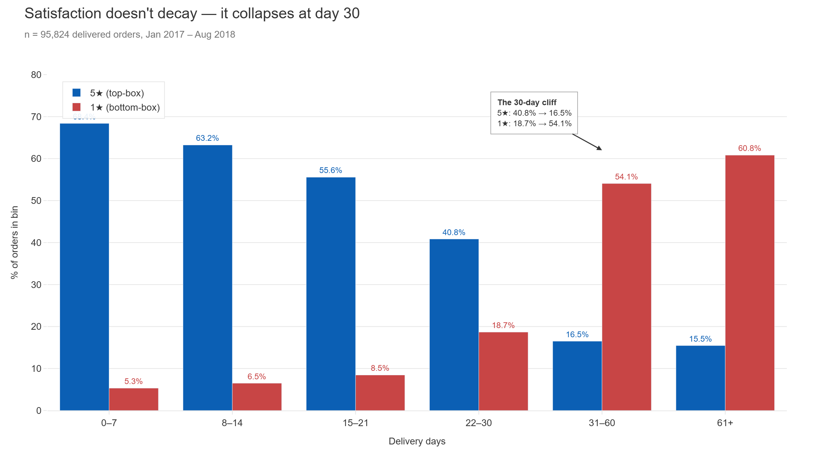
Olist Analysis · Poi · April 2026
3 / 14

Slide 4
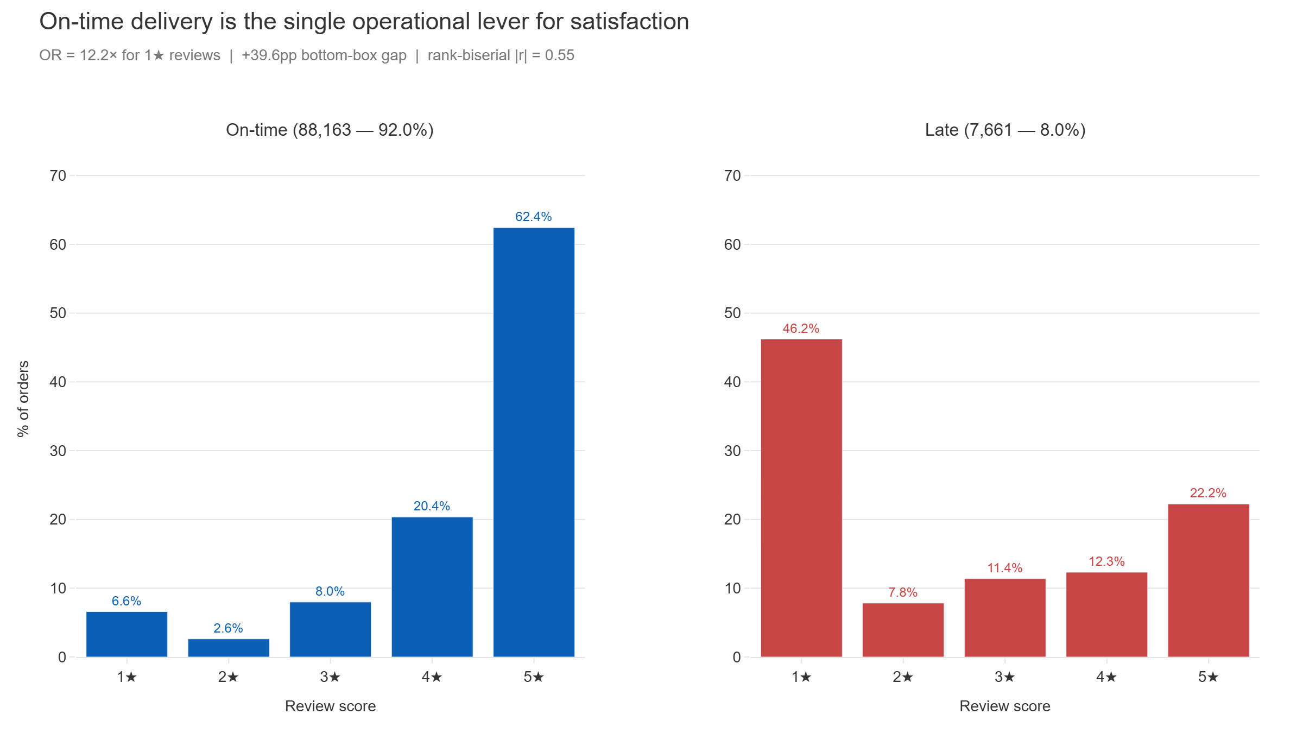
Olist Analysis · Poi · April 2026
4 / 14

Slide 5
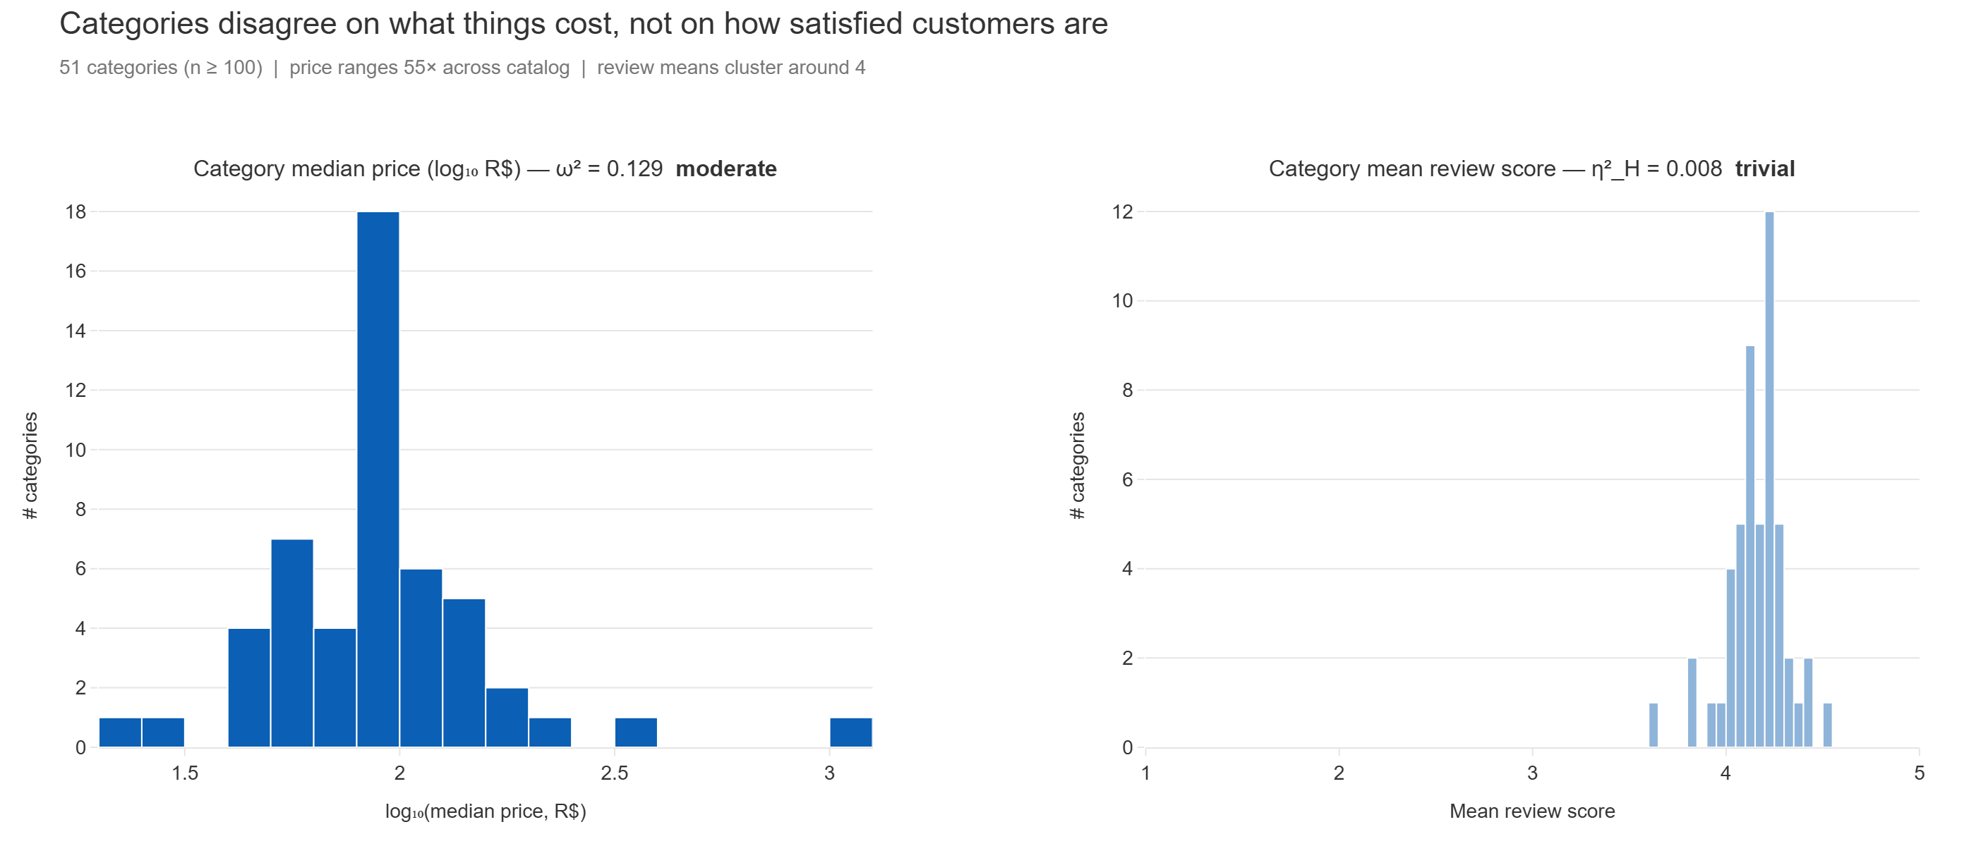
Olist Analysis · Poi · April 2026
5 / 14

Slide 6
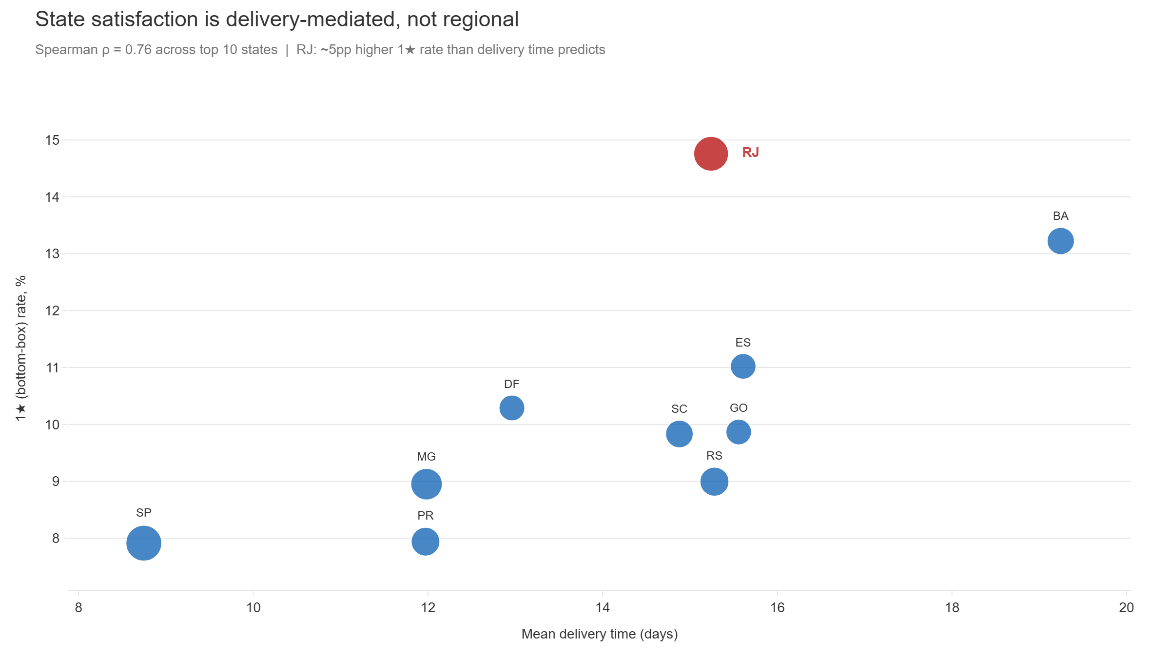
Olist Analysis · Poi · April 2026
6 / 14

Slide 7
METHODOLOGY
How the analysis was done
~96k
99.3%
9
delivered orders
review coverage
statistical tests
Jan 2017 – Aug 2018, 20 full months
Flat across status, month, delivery speed
Spearman, Kruskal-Wallis, Mann-Whitney, Welch's, χ², z
Key decisions
Review score = ordinal.
Top-box (5★) and bottom-box (1★) rates instead of means.
Delivered-only filter.
Satisfaction tests restricted to completed deliveries.
Effect size > p-value.
At n≈96k, significance is near-universal.
Bootstrap CIs on ρ.
2000 resamples, paired, percentile, seed=42.
Min-n filter, 100.
20 tiny categories dropped — 0.8% of sample.
Cohen effect thresholds.
Trivial <0.10, weak <0.30, moderate <0.50, strong ≥0.50.
Olist Analysis · Poi · April 2026
7 / 14

Slide 8
LIMITATIONS
What this analysis can and can't claim
01
Observational, not causal.
The analysis identifies correlations and consistent mediation patterns. It does not rule out unmeasured confounders.
02
Reviews dated before delivery (~8.5%) were retained, not filtered.
These represent customers submitting dispute reviews while still awaiting late shipments — the most dissatisfied segment. Removing them would bias top-box rates upward and systematically understate the delivery-satisfaction relationship.
03
Analytical window: Jan 2017 – Aug 2018.
Excludes late 2016 (low coverage) and Sep 2018 onward (partial month). Black Friday 2017 retained; coverage verified flat.
04
Minimum-n = 100 for category-level tests.
Cleaner rank-statistics and Dunn's matrix at the cost of 0.8% sample coverage. Trade-off documented in notebook 03.
Olist Analysis · Poi · April 2026
8 / 14

Slide 9
WHAT I'D DO NEXT
Three investigations this data opens up
office_furniture
Rio de Janeiro
Voucher orders
Retention dive
Last-mile investigation
Composition audit
The only category combining top-5 median price with bottom-5 satisfaction. Plausible mechanisms — bulk-shipping damage, assembly complexity, expectation-price mismatch — cannot be confirmed from order data alone. Would require review-text NLP or a targeted customer survey.
RJ sits ~5pp above the delivery-time trend line across top-10 states. Same mean delivery as SC/GO/RS, but measurably worse satisfaction. Points to a carrier-handoff or final-mile problem, not a logistics-distance problem.
Voucher completion runs 4.7pp below other payment methods at 1.6% of orders. Most likely explanation is customer-intent composition (promo-driven buyers), not payment-infrastructure failure — but the intent data would need to be joined.
Olist Analysis · Poi · April 2026
9 / 14

Slide 10
THANK YOU
Questions welcome.
If a finding stuck — or didn't — I want to know which one.
GitHub
github.com/workintechpoyrazaka-sketch/olist-ecommerce-analysis
LinkedIn
linkedin.com/in/adilpoyrazaka
Email
akaadilpoyraz@gmail.com

Slide 11
APPENDIX A
Full statistical results
# | Relationship | Test | Result & effect size | Verdict
Q1 | price → delivery | Spearman ρ | ρ = +0.102, CI [+0.095, +0.108] | weak
§4-A | delivery → review | Spearman ρ | ρ = −0.235 — 30-day cliff | headline
§4-B | on-time → review | Mann-Whitney + 2-prop z | |r| = 0.55; OR = 12.2× [11.6, 12.8] | headline
Q2 | price → review | Spearman ρ | ρ = −0.029 (mediation consistent) | trivial
Q3 | category → review | Kruskal-Wallis + Dunn's | η²_H = 0.008; 186/1275 pairs sig | trivial
Q4a | payment → completion | Chi-square + Cramer's V | V = 0.035; voucher −4.7pp | trivial
Q4b | payment → review | Kruskal-Wallis | η²_H ≈ 0.000; p = 0.060 | trivial
§1 | category → log₁₀(price) | Welch's ANOVA + Games-Howell | ω² = 0.129; 899/1275 pairs sig | moderate
Olist Analysis · Poi · April 2026
11 / 14

Slide 12
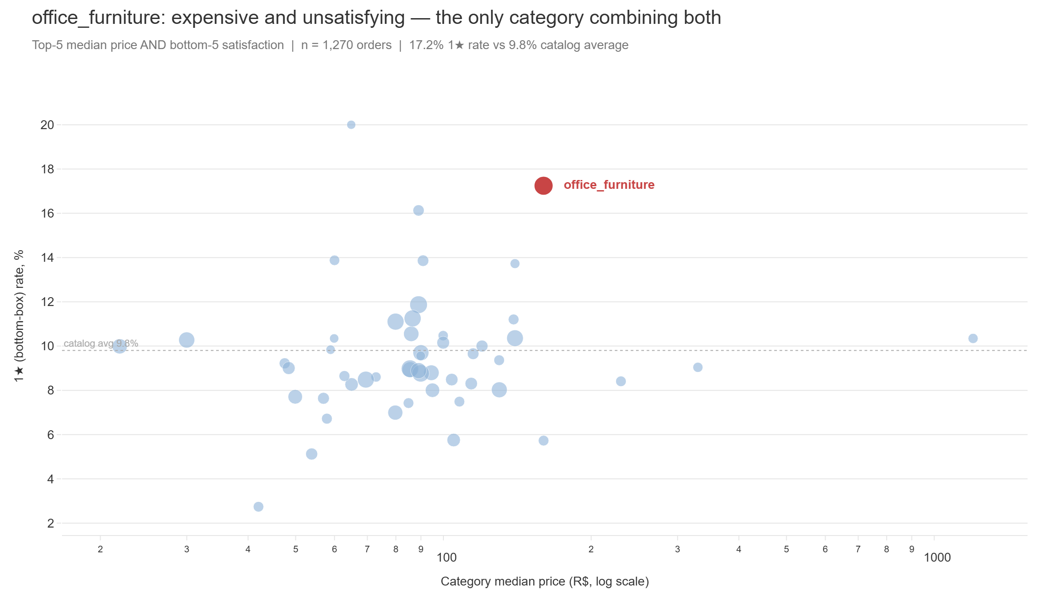
APPENDIX B
office_furniture — the one category combining high price and high 1★ rate
Olist Analysis · Poi · April 2026
12 / 14

Slide 13
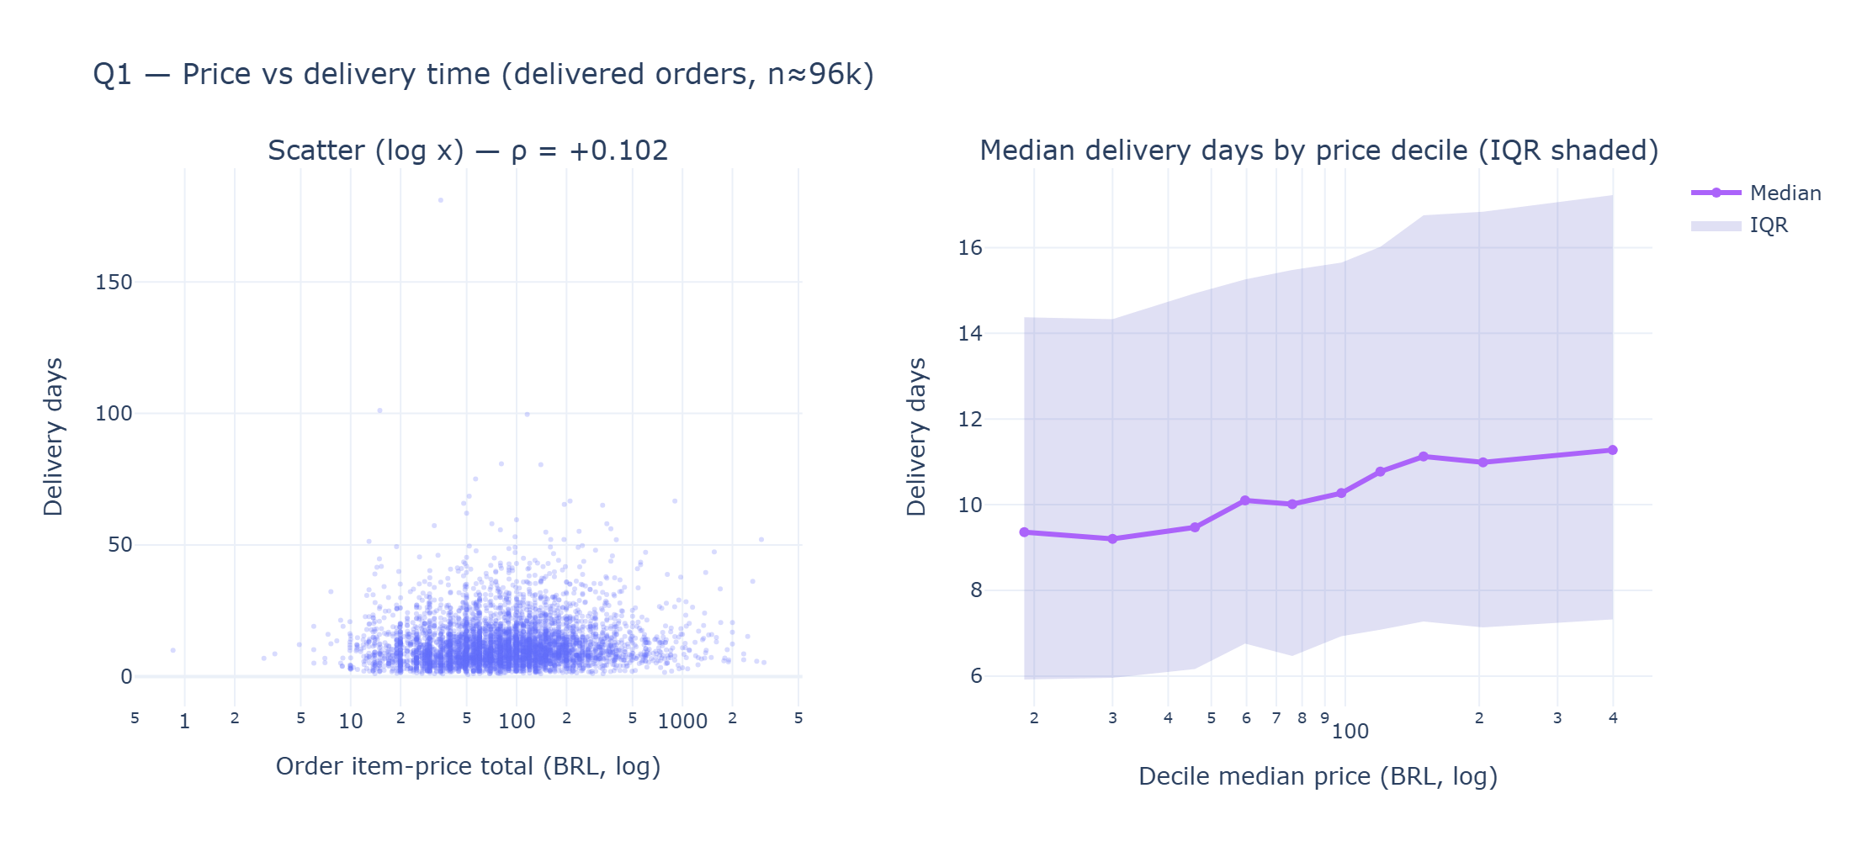
APPENDIX C
Q1 — Price vs delivery time (weak positive, ρ = +0.102)
Olist Analysis · Poi · April 2026
13 / 14

Slide 14
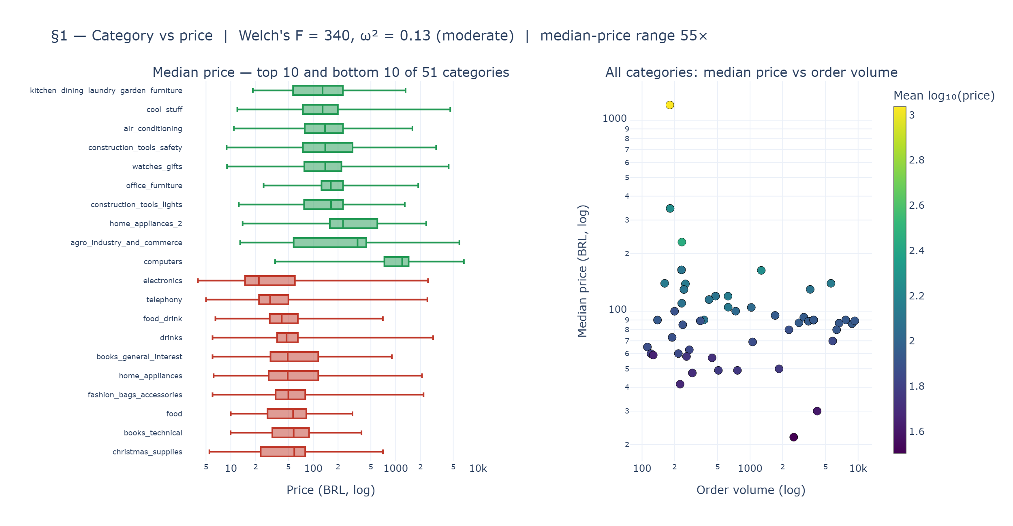
APPENDIX D
§1 — Category explains price (ω² = 0.129, moderate)
Olist Analysis · Poi · April 2026
14 / 14

