Slide 1
Overview
Formed in 2017, Future.Inc is a software technology company based in NewYork. Seeking $1million to develop Community software
01
02
03
04
05
We develop Community software to provide the support for investor
Provide the function to choosing an address
Depending on the information from the individual, give an effective advice
We will using our special algorithm to calculate
We will give customer a effective right report

Slide 2
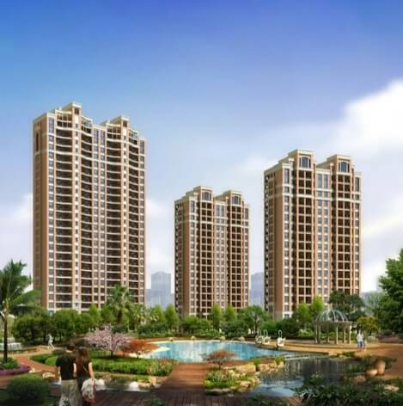
Opportunity
Effective
Help Founding Company
What I give is very effective advice , only need a little information from the customer
Help people to form a new career
●

Accurate
−

What we provide is very accurate ,because we receive all related information


Real Time
Becuase we use the information from the website ,so the information is new

Slide 3
Strategy/Solution
Searching for address
Searching for emplyee
Searching for type
Searching for block
Searching for fund
Submit for report

Slide 4
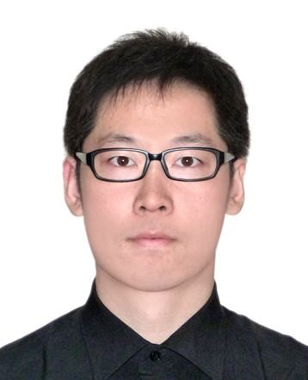
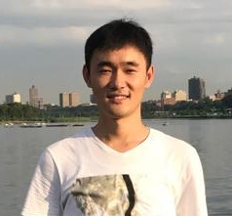
Management
Guohua Zhang,CEO
Zhenhua Cai CTO

Slide 5
Sources and Uses
01
Sources
Equities Capital $1,000,000
Total Sources $1.000.000
Uses
02
Uses
Sources
Marketing& Advertising $800,000
Satellite Office – NYC $75,000
Research& Development $50,000
Financing and Closing Costs $75,000
Total Uses $1,000,000

