Slide 1

Flight Reservation System database
Omar Madjitov, Aninda Ahsan, Joshua Pauldin

Slide 2
table of contents
01
02
03
04
05
Introduction
Requirement Analysis
Our data
Overview of database and real-world application
Describing data and functionality requirements. Reviewing ER/Relational Schema
Data Sources and Data Set Review
Functionalities
Conclusion
Summary and Questions
Implementation/Demo

Slide 3
01
Introduction

Slide 4
introduction
We created a database for a flight ticket reservation system that's easy to use. Our team designed an integrated solution that allows customers to search and book flights without any hassle. At the same time, travel agency employees can efficiently manage flight schedules and customer information.

Slide 5
02
Requirement analysis

Slide 6
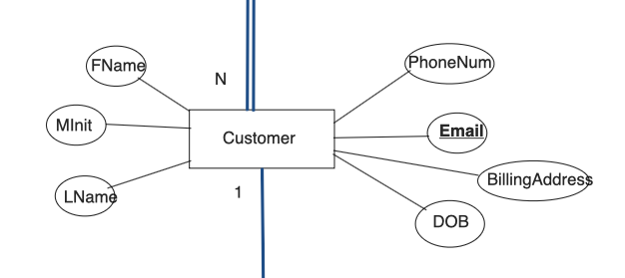
Entities and Relations
We have 10 entities: Airplane, Airport, Airline, Flight, Customer, Dependent, Travel Agency, Reservation, Employee, and Route
Each Customer has a unique email as well as first name, middle initial, last name, phone number, billing address, and DOB

Slide 7
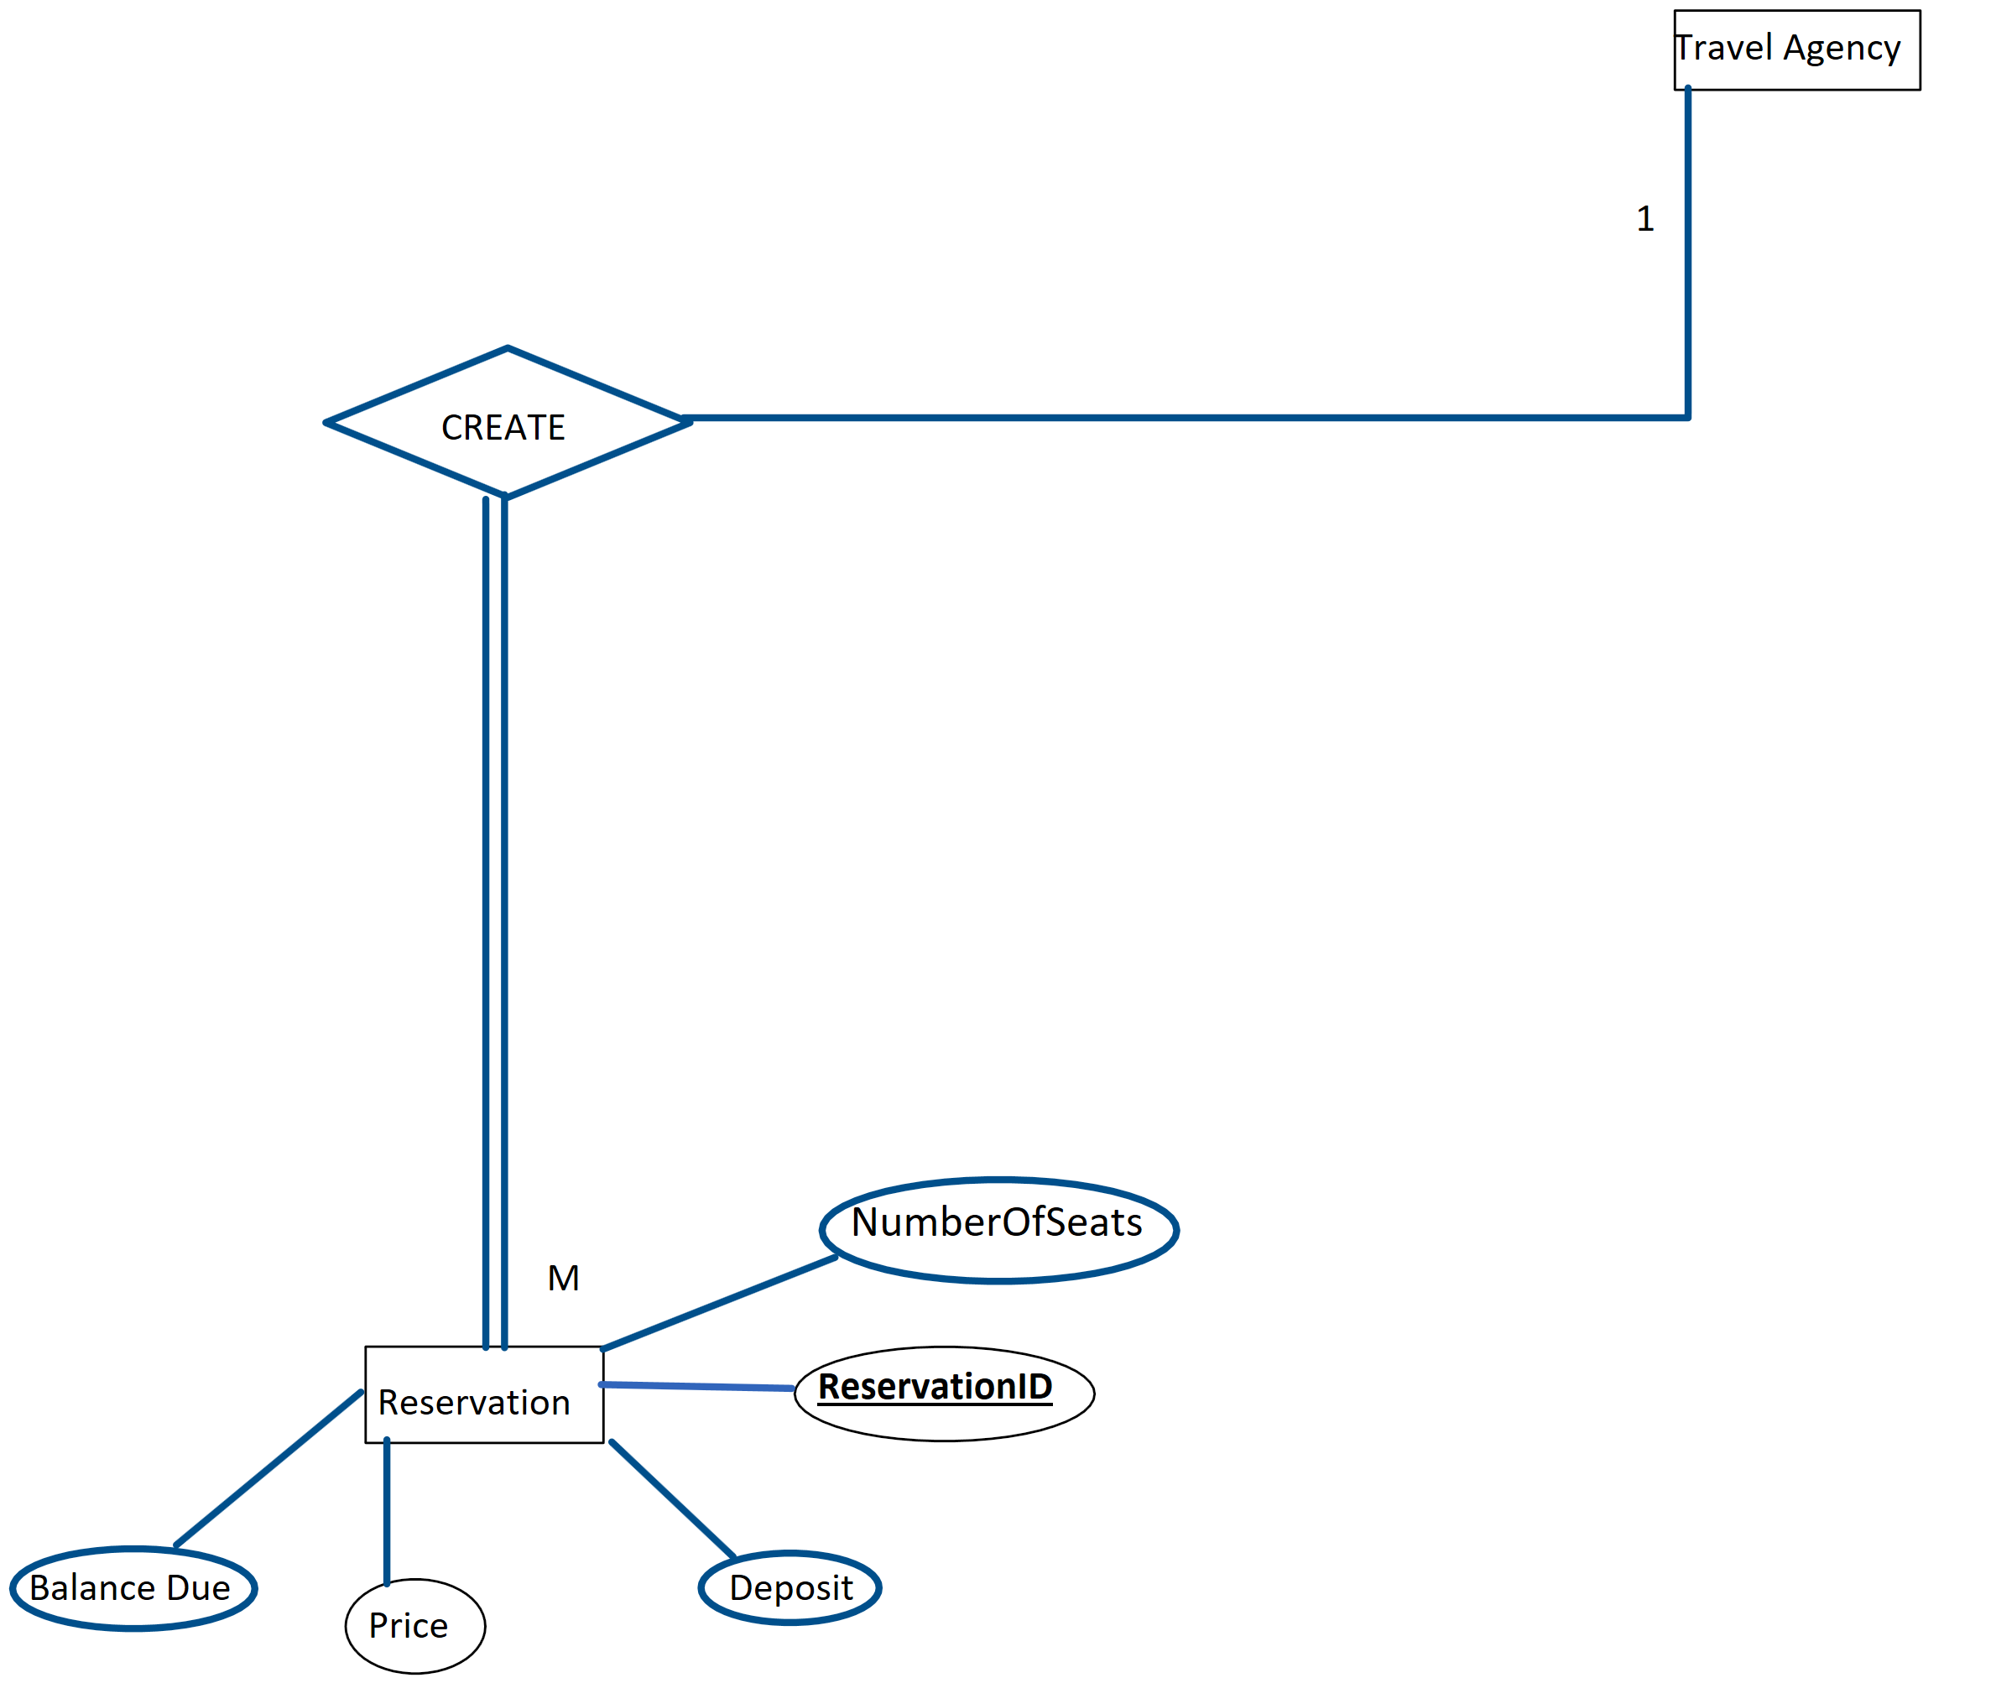
Entities and Relations
Each Travel Agency has a unique account number as well as name, country code, area code, and number
Each Reservation has a unique reservation id as well as balance, price, deposit, and number of seats. There is also a foreign key of account number (Travel Agency), flight number (Flight), and customer email (Customer)

Slide 8
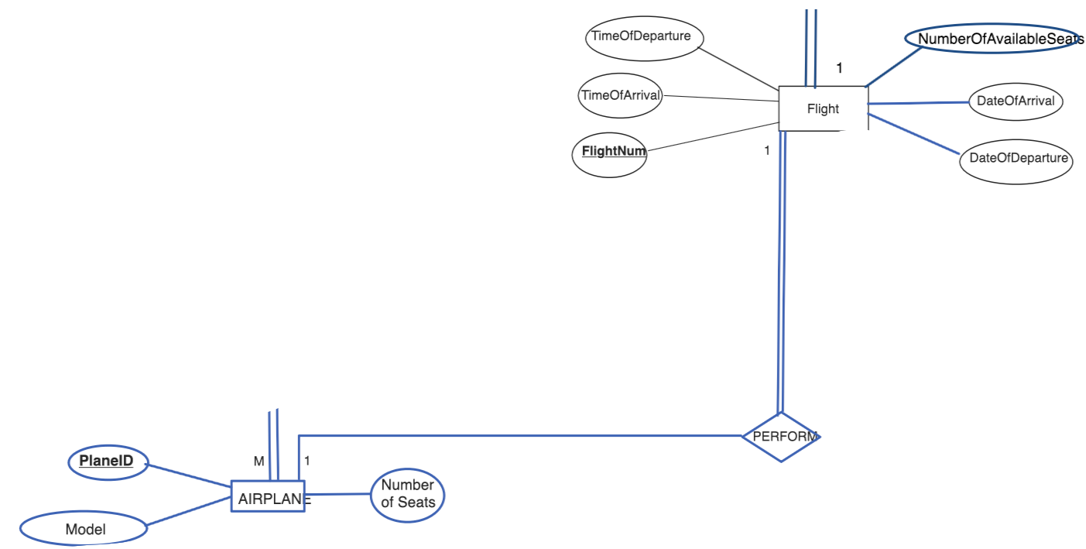
Entities and Relations
Each Flight has a unique flight id as well as time of arrival, time of departure, date of arrival, date of departure, number of seats available, and the price of the flight. Two foreign keys of plane id (Airplane) and route id (Route) are included as well.
Each Airplane has a unique plane id, as well as the model, number of seats available, and a foreign key of airline code (Airline)

Slide 9
Entities and Relations
Airports can be used by many airlines as well as many airplanes
Airlines can own many airplanes
Airplanes follow one flight and one route at a time
Any Customer can have multiple Dependents
Any Employee can only work for one travel agency
Travel Agencies can create multiple reservations

Slide 10


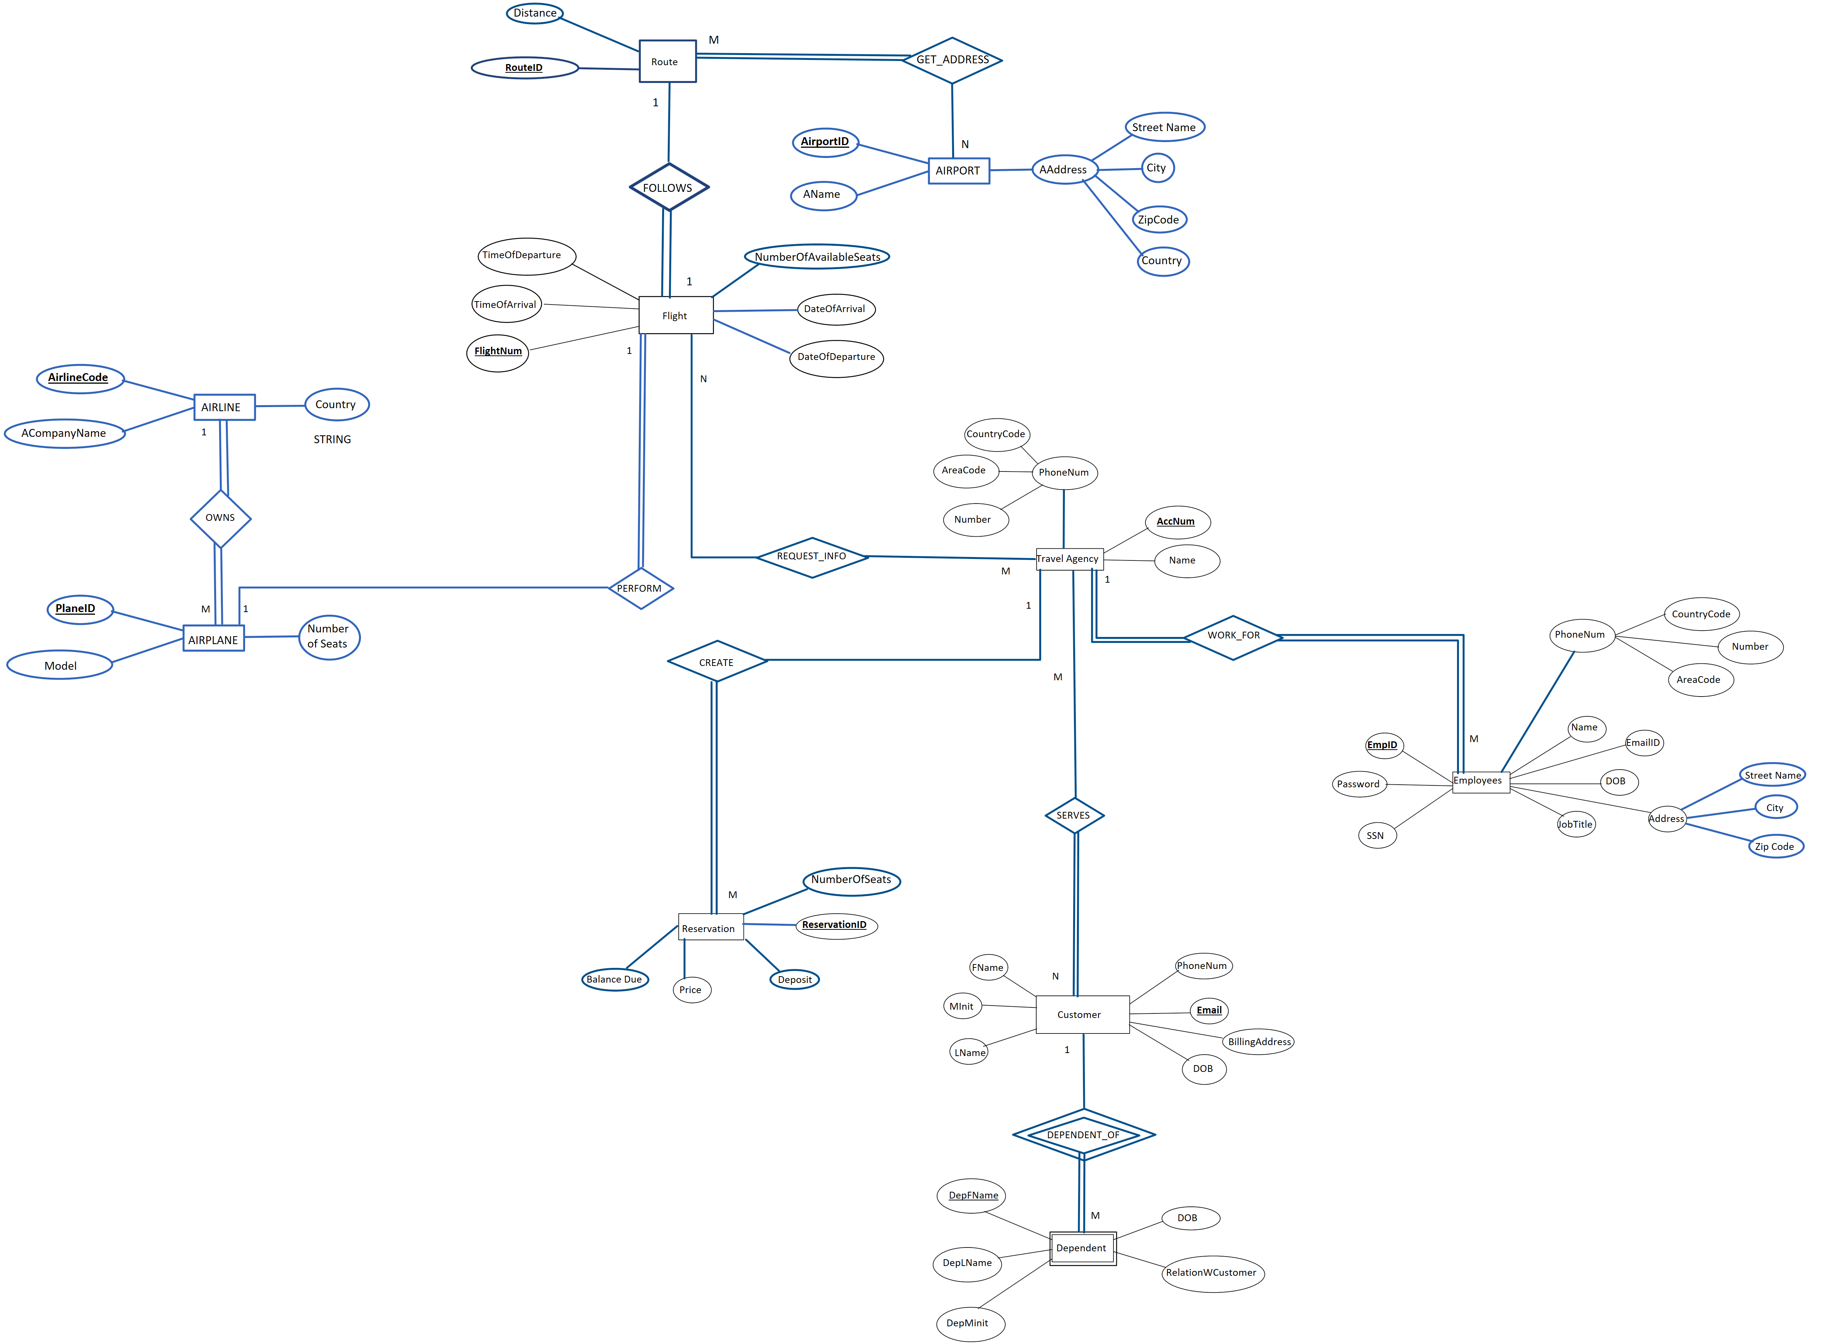
ER Model

Slide 11
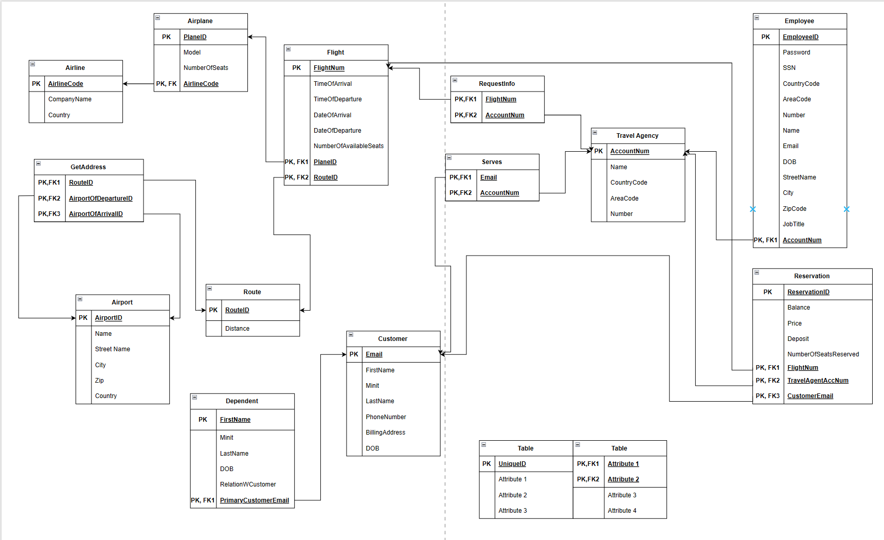
Relational Schema

Slide 12
03
Our Data

Slide 13
Data
To create our flight reservation system we analyzed established airline reservation systems like Delta, Spirit, and Frontier, to name a few. We also used ChatGPT to add relevant and diverse information to our dataset.

Slide 14
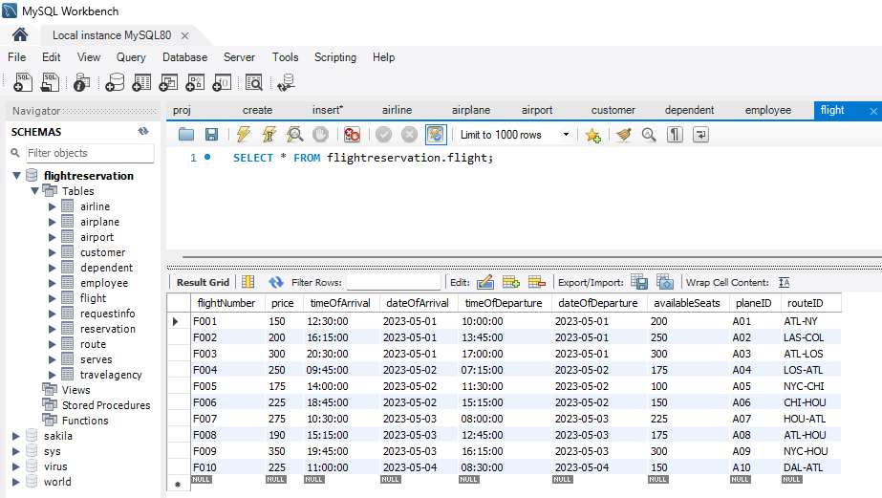
Data

Slide 15
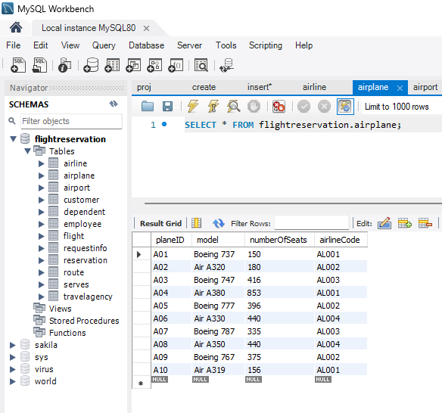
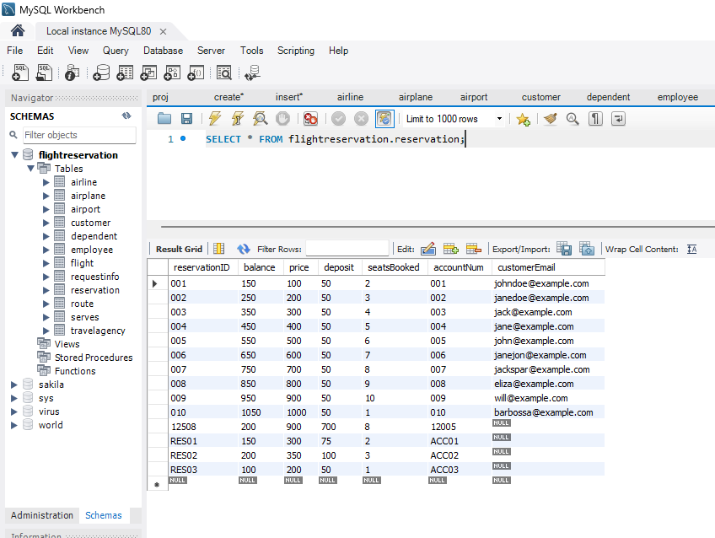
Data

Slide 16
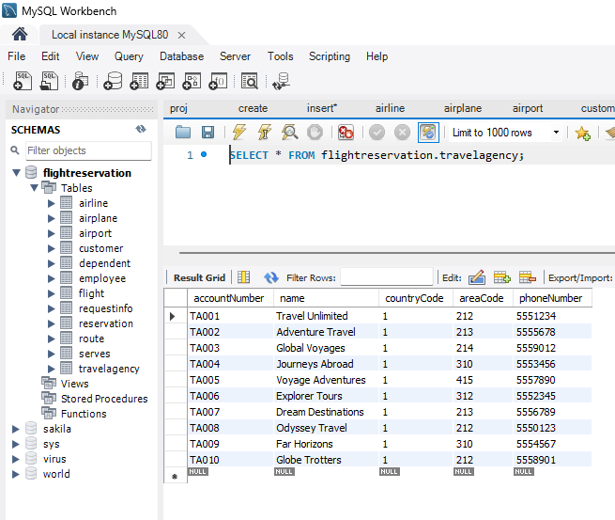
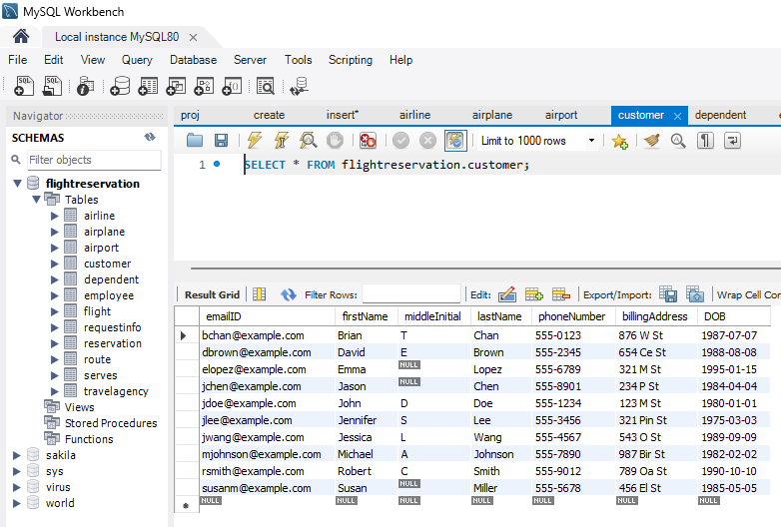
Data

Slide 17
04
Functionalities

Slide 18
Functional Requirements
Data Storage and Retrieval:
Store and Retrieve employee and customer information, including their dependents.
Insert customer reservations.
Data Insertion:
Various Flight Information from various Airports will be inserted and updated in the Database.
Enter customer information and dependents’ information
Reservation Creation using the Flight and Customer information.
Data Manipulation:
Filter and sort flight information by their price, duration and/or Airline companies.

Slide 19
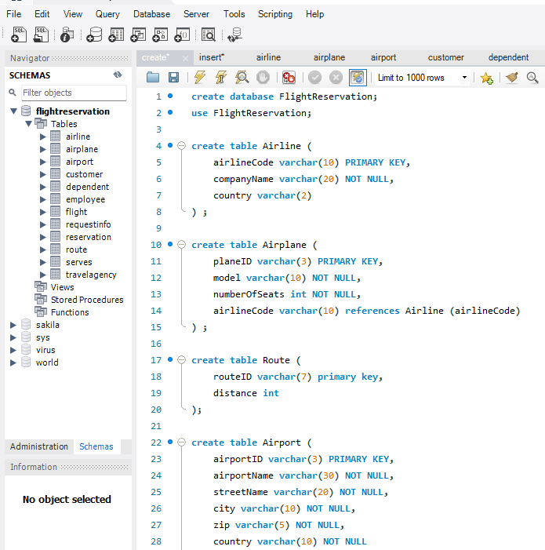
Functionalities

Slide 20
05
Conclusion

Slide 21
Summary
Our team has learned a lot about creating a highly functional and efficient database. We stayed focused and objective throughout the development process, carefully selecting key features and removing non-essential components. The hardest part was making sure our data was concise and not redundant during the normalization process. Going forward, we can easily integrate our optimized database structure into an application, making it more accessible and user-friendly for everyone.

Slide 22
Questions?

