Slide 1
Optimization towards Efficiency and Stateful of dispel4py
Liang Liang, Heting Zhang, Guang Yang, Thomas Heinis, Rosa Filgueira
Notes:
Hi everyone, I'm Liang, and I'm excited to present our paper on optimizing dispel4py for efficiency and supporting stateful applications.

Slide 2
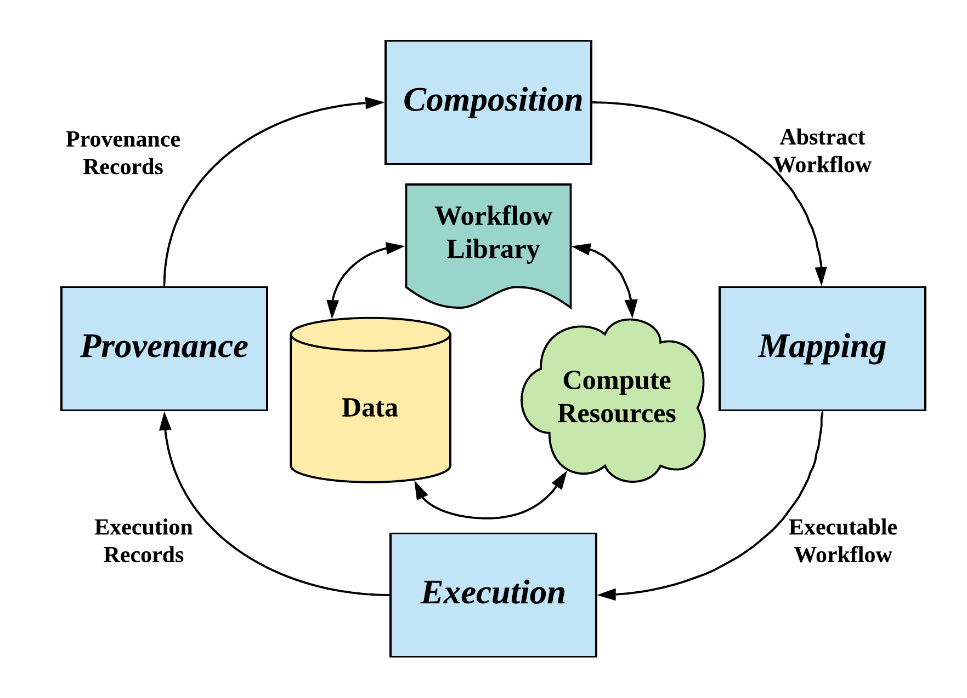
Stream-based Workflow System
A stream-based workflow system
Support efficient stream processing
Automatically handle low-level computing resources
Provide user-friendly programming framework
Life cycle of workflow system
Composition
Mapping
Execution
Provenance
Notes:
dispel4py is a stream-based workflow system designed to simplify complex data processing. It manages the nitty-gritty details of computing, allowing scientists to concentrate on their research within an efficient programming framework. The life cycle of dispel4py’s workflow encompasses four stages: composition, mapping, execution, and provenance monitoring.

Slide 3
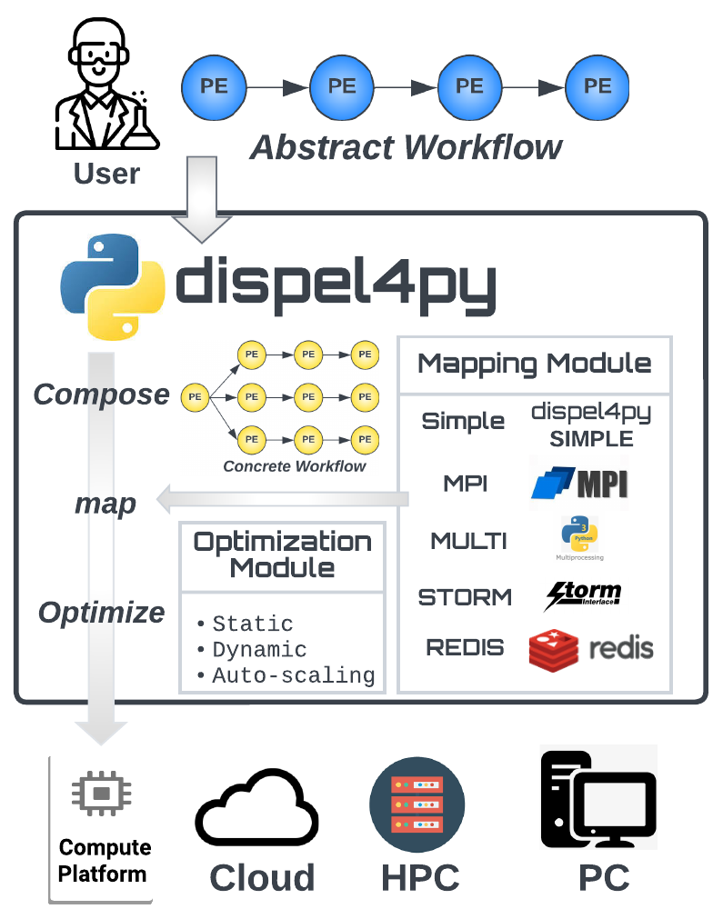
Overview of dispel4py
Composition
Compose concrete workflow based on an abstract workflow
Both workflows consists of Processing Elements (PEs)
Mapping
Simple, MPI, MULTI, STORM, REDIS
Execution
Could, HPC, PC
Provenance
Monitoring framework
Optimization
Static, Dynamic, Auto-scaling
Notes:
In the composition phase, users describe their workflow abstractly, which includes tasks and their dependencies. This abstract representation is then transformed into a concrete workflow, tailored to specific mapping methods. During execution, this concrete workflow is processed. Finally, in the provenance stage, we monitor the overall execution to ensure everything is on track.
dispel4py's composition stage involves translating user-defined abstract workflows into concrete ones. These workflows are executed on selected infrastructures through mapping. Processing elements (PEs), which represent computational activities or data transformations, are the core nodes in these workflows. We've introduced five mapping methods in dispel4py, including the newly added Redis.

Slide 4
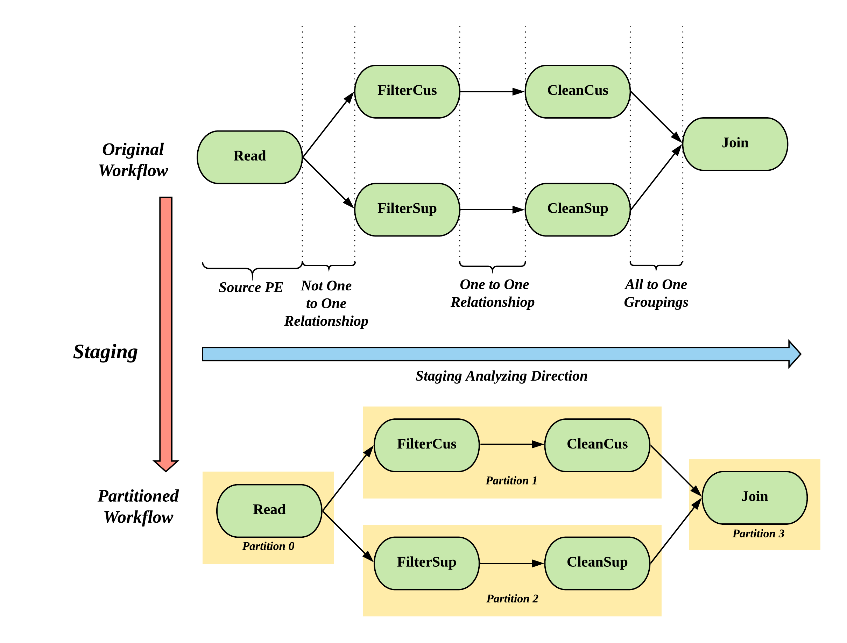
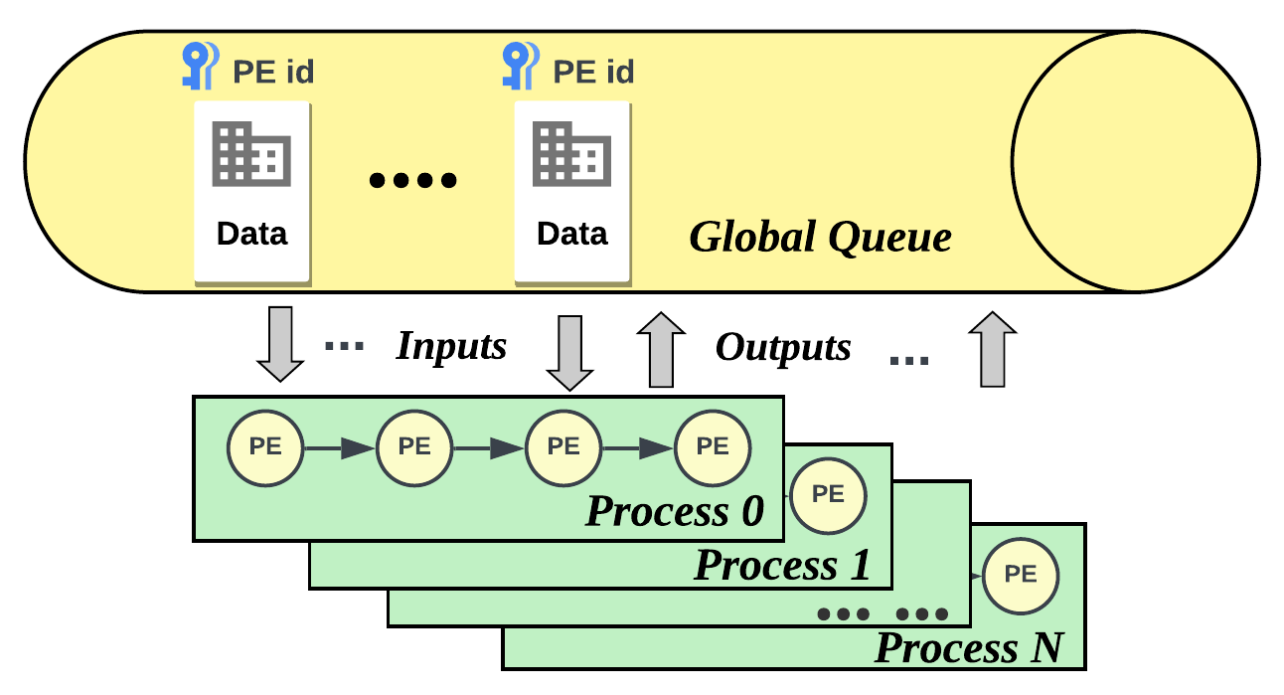
Existing Optimization
Static Optimization – allocating PEs into partition
Naive assignment
Staging
Dynamic Optimization – allocating the workflow to processes
From one-to-one PE-Process mapping to dynamic PE-Process mode
Communication via global queue
Effectively leveraging the resources
But fail to handle stateful applications
Notes:
Our optimization approaches can be classified into static and dynamic methods. Static methods, like naïve assignment and staging, focus on reducing communication costs and balancing workloads. The dynamic optimization, on the other hand, allows more flexibility, with tasks being distributed among processes from a global queue. However, this dynamism has its drawbacks, such as difficulties in supporting stateful applications.

Slide 5
Motivation
Stateful application
Stateful application need dispel4py to maintain consistent states across tasks
The nature of dynamic mapping only is to perform the random task and data selection from the queue
Green computing (Efficiency)
Efficient systems lead to significant energy savings and reduced carbon footprints
The dynamically map resources to tasks has shown its potential to adaptively mapping resources to the task
We could do one more thing – auto-scaling – for energy saving
Notes:
The project’s motivation hinges on two key aspects: enabling stateful applications and enhancing efficiency. The dynamic nature of task allocation in dispel4py necessitates mechanisms to maintain consistent states across tasks. Efficiency, defined as performance relative to cost, is crucial in green computing, as it demands energy conservation and carbon footprint reduction. Our solution is an auto-scaler that adjusts the number of active processes dynamically, contributing to energy savings.

Slide 6
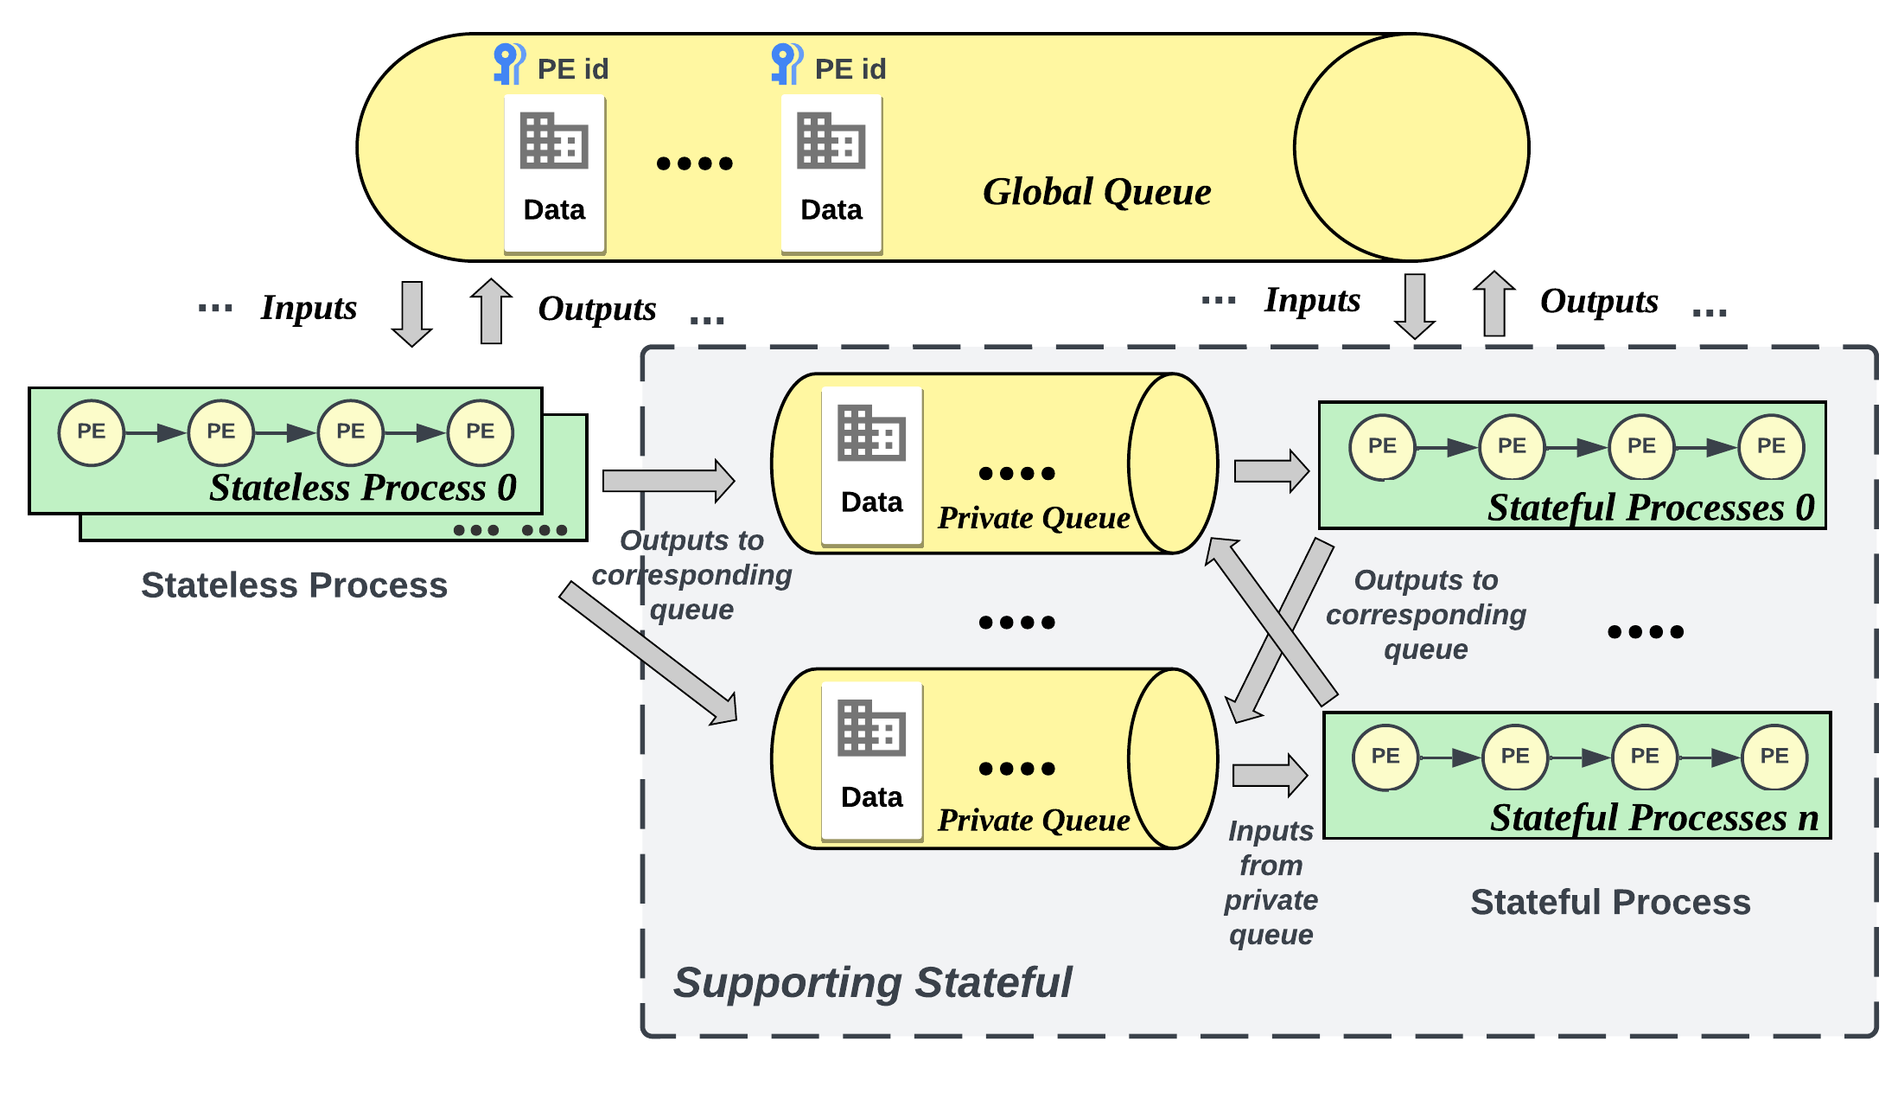
Introducing Redis Mappings
Redis
Effective data management
Redis stream supports real-time sequence.
Dynamic Redis mapping
Replace global queue with Redis Stream
Hybrid Redis mapping
Address the requirements of stateful applications
Integrate private queue and processes for stateful tasks
Notes:
We've incorporated Redis, an efficient open-source, in-memory database, into dispel4py. Redis Stream, a feature of Redis, enhances our system's dynamic capabilities, facilitating better management of data streams and aligning with our dynamic scheduling goals. We replaced the traditional multiprocessing queue with Redis Stream for more robust functionality. To support stateful applications, we introduced the Hybrid Redis Mapping. This approach assigns stateful PE instances to specific processes, maintaining local states and private task input queues. Outputs from these stateful PEs can be routed differently, reducing synchronization costs compared to traditional global state management. Stateless PEs, meanwhile, are handled by remaining processes in a manner akin to our dynamic approach, but they also interact with private queues depending on task dependencies.

Slide 7
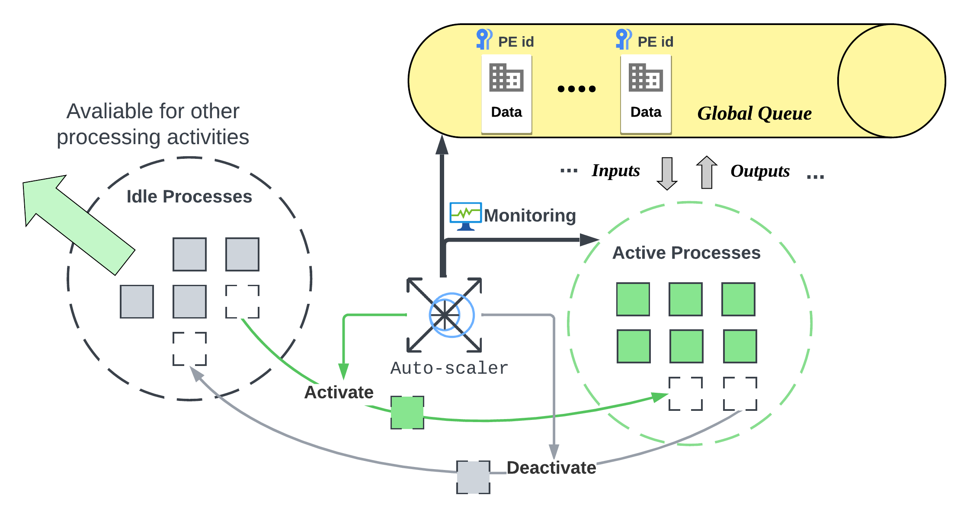
Introducing Auto-scaling Optimization
Auto-scaling optimization address the efficient allocation of resourcse
Auto-scaling in dispel4py
Works with both MULTI mapping and REDIS mapping
When to scale (Monitoring framework)
In MULTI mapping: monitoring the queue states and compare with the threshold.
In REDIS mapping: monitoring the idle time for active processes and compare with the threshold
How to scale (scaling strategy)
Naïve incremental strategy: incrementing the active size by 1 or -1.
Notes:
A key part of our improvements in dispel4py is the auto-scaling optimization. This feature smartly allocates computational resources based on how much work there is. It's particularly effective in handling sudden increases in workload and conserving resources when there is low demand. We've implemented this auto-scaling for both Multiprocessing and dynamic Redis mappings, focusing mainly on stateless workflows. Here's how it works: Processors in our system can switch between being active and idle. When active, they're fully engaged in processing tasks. When idle, they can be set to standby mode. This switching is controlled by our auto-scaler, which continuously assesses the workload and adjusts the number of active processors accordingly. For the Multiprocessing setup, the auto-scaler looks at the queue size. If it sees more tasks stacking up, it brings more processors online. If the workload decreases, it scales down, but always keeps a certain minimum number of processors active to avoid over-scaling. With Redis, we take a different approach. We monitor the average idle time of the consumer group. This metric gives us a direct measure of how busy or idle our processes are. If a process is idle longer than a certain threshold, indicating less demand, it's put into a standby mode. Scaling in both cases is done incrementally, either adding or removing one process at a time, based on these assessments.

Slide 8
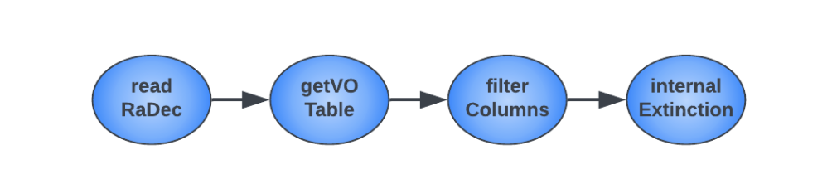
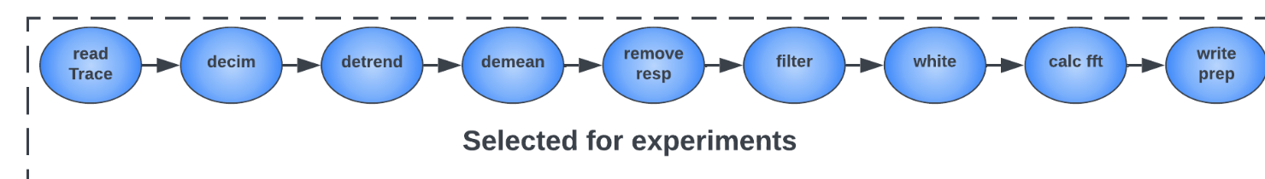
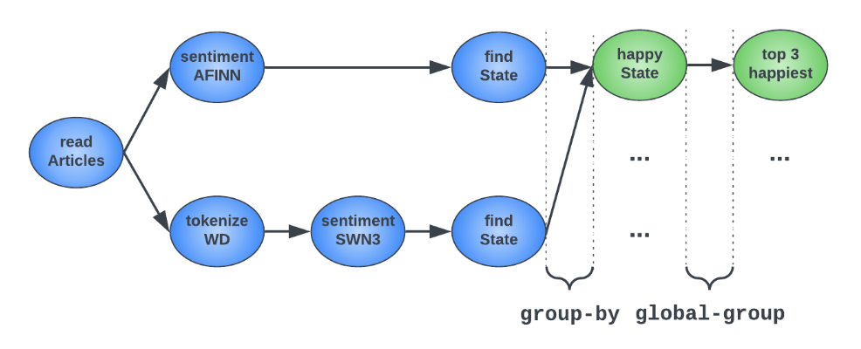
Use Cases
Internal Extinction
4 PEs with only one-to-one connection
Simple and short
Stateless
Seismic Cross-Correlation
9 PEs with only one-to-one connection
long
Stateless
Sentiment Analysis for News Articles
8 PEs with grouping and complex connection
Complex and long
Stateful
Notes:
To really put our system to the test, we used three scientific workflows. Each of these was selected to showcase different aspects of dispel4py's capabilities. First, we have the 'Internal Extinction' workflow. This is a relatively simple stateless process, involving only four processing elements, used to calculate the extinction metric within galaxies. Next, there's the 'Seismic Cross-Correlation' workflow, which is a bit more complex. This stateless workflow, consisting of nine processing elements, is designed to monitor and analyze geological waveforms. Lastly, we have the 'Sentiment Analysis for News Articles' workflow. This one is stateful and quite intricate, representing a more challenging and complex scenario.

Slide 9
Evaluation Setups
Tested techniques:
multi : Multiprocessing mapping (baseline)
dyn_multi : dynamic Multiprocessing mapping (baseline)
dyn_auto_multi : dynamic auto-scaling Multiprocessing mapping (newly introduced)
dyn_redis : dynamic Redis mapping (newly introduced)
dyn_auto_redis : dynamic auto-scaling Redis mapping (newly introduced)
hybrid_redis : hybrid Redis mapping (newly introduced)
Platforms:
Server : virtual server consists of 16-core with Intel E5-2690@2.60GHz processor paired with 64GB of RAM and runs on Ubuntu 14.04.
Could: Google Cloud Platform, It has 4 Intel(R) Xeon(R) CPU @ 2.20GHz (8vCPUs), and 16GB of RAM running Ubuntu 20.04
HPC: Imperial HPC cluster, we use the short class in which the CPU and OS mode are intel E5-2680 v3 @ 2.50GHz and Centos 8, respectively. We request up to 64 CPUs and 64 GB memory
Notes:
In our experiments, we compared six different methods: two baseline and four that we've developed. We tested these methods across various platforms, including standard servers, cloud environments, and HPC systems.

Slide 10
Evaluation Setups
Three workflows:
Internal Extinction
With 1X, 5X and 10X standard and skewed workload.
Seismic Cross-Correlation
Sentiment Analysis for News Articles
Metrics:
run time: represents the real-world execution time
Process time : accounts for all active process durations, reflecting overall efficiency
runtime and process time ratios : between methods to provide intuitive insights
Notes:
Our focus was on two key metrics: runtime and total process time. Runtime here refers to the actual time it takes for a workflow to be executed, while process time looks at the cumulative time that all active processes are engaged in work. This gives us a balanced view of both how fast the system is and how efficiently it uses its resources.

Slide 11
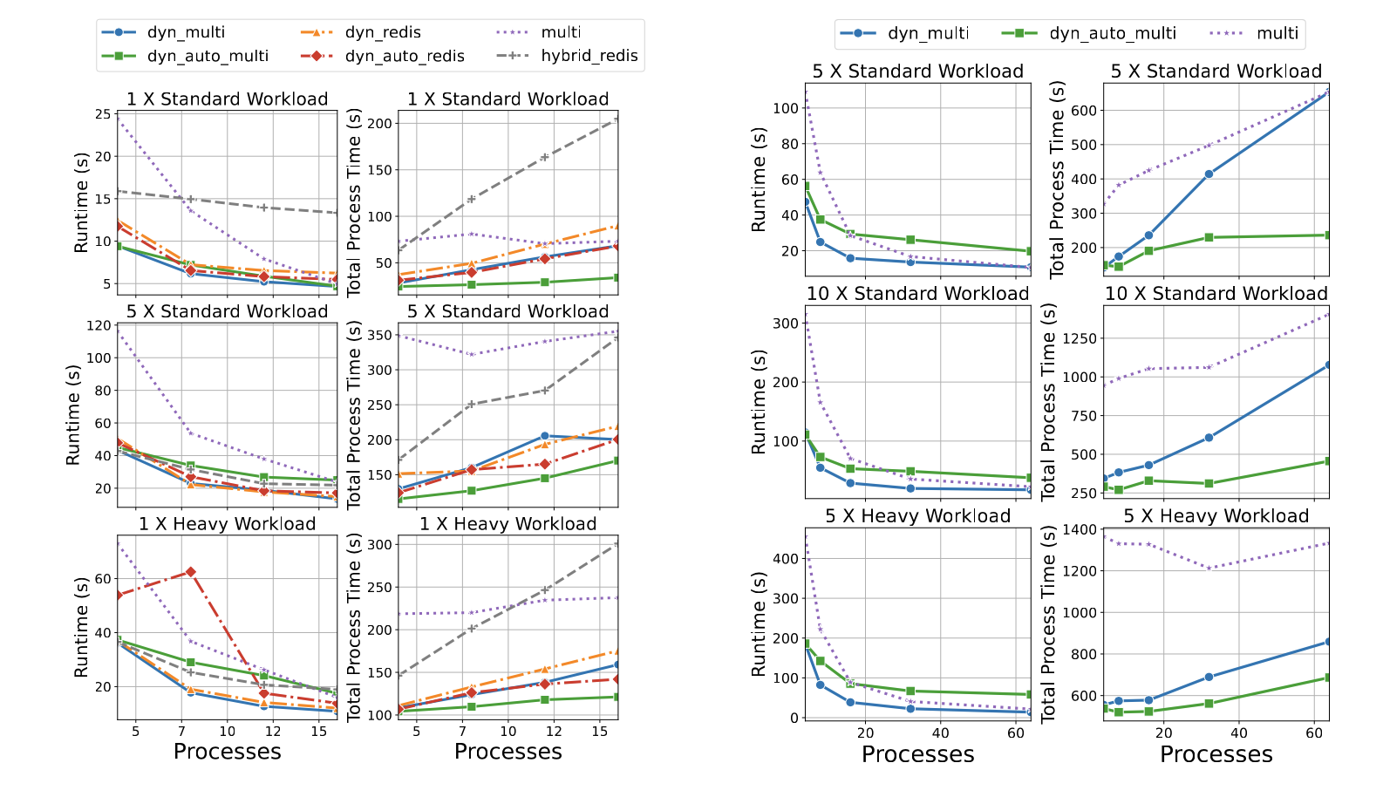
Ev. Internal Extinction of Galaxies
Observation:
Auto-scaling techniques improved runtime on lower workloads by reducing sync costs
multi mapping outperformed redis in lightweight tasks; redis was better for features like robust data persistence
Consistent performance trends across platforms show the experiments' reproducibility.
Auto-scaling showed significant efficiency gains, especially on hpc with more processes.
Notes:
Let's talk about the findings from each workflow: For Internal Extinction,
Auto-scaling significantly improved runtime, especially under lower workloads, by cutting down synchronization costs.
In simpler tasks, we found that our multi mapping technique actually outperformed Redis.
We observed consistent performance across different platforms, with notable efficiency gains in HPC environments due to auto-scaling.

Slide 12
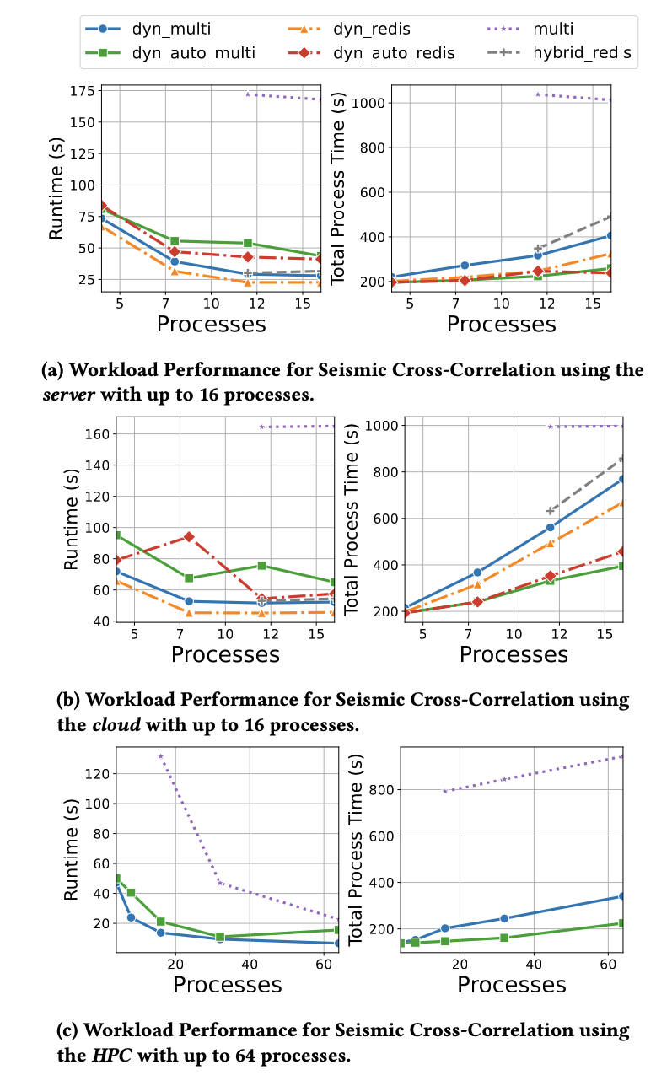
Ev. Seismic Cross-Correlation
Observation:
A decrease in runtime with more processes was observed across all techniques
Processing time increased with the number of processes
Better performance was noted on server compared to could
This workflow showed higher overall process time compared to Internal Extinction
The auto scaling optimization had challenges with runtime in complex workflows
Notes:
For Seismic Cross-Correlation,
A common trend was a decrease in runtime with an increase in the number of processes.
However, as the number of processes increased, so did the processing time. This posed challenges for auto-scaling in longer workflows.

Slide 13
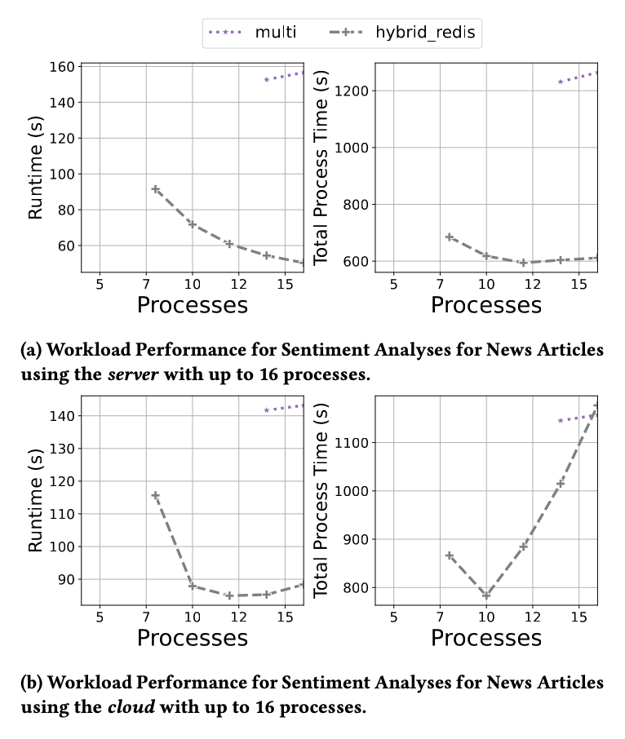
Ev. Sentiment Analyses for News Articles
Observation:
hybrid_redis showed superior runtime performance
As the number of processes increased, hybrid_redis continued to improve due to more efficient handling of stateless tasks
The trend for processing time unexpectedly mirrored the run time
On the cloud, the limited cores highlighted the inefficiencies of over-allocating processes, but hybrid_redis still outperforms multi .
Notes:
In the case of the Sentiment Analysis workflow, which was key for testing stateful methods, the Hybrid Redis approach showed remarkable runtime performance. But, we also noticed inefficiencies when there are over-allocating processes.

Slide 14
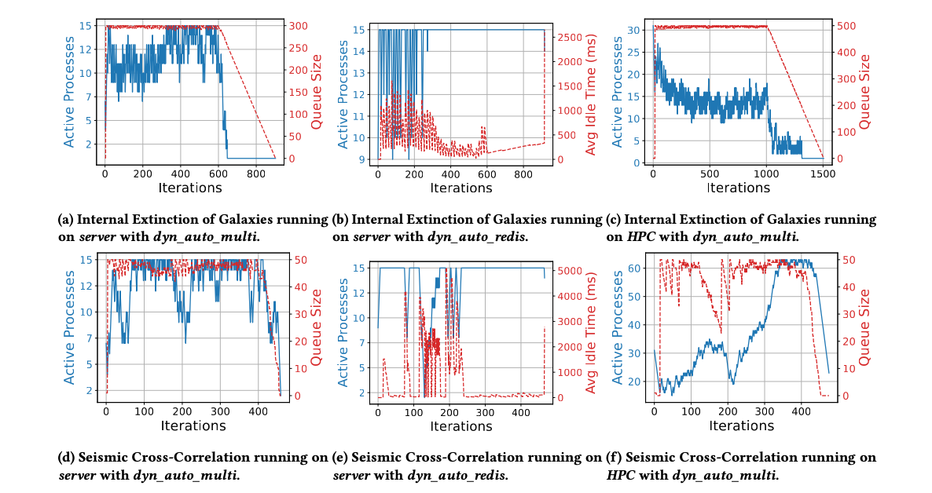
Analysis on auto-scaling
Observation:
For dyn_auto_multi , a clear positive correlation between queue size and active processes was observed
For dyn_auto_redis, an inverse relationship was seen between active process count and average idle time, suggesting a reactive scaling down during low workloads
On the HPC, dyn_auto_multi did not always maximize the process count despite high queue sizes
Findings:
The auto-scaler's adjustments were reactive rather than predictive, with active process numbers not always aligning promptly with workload changes.
Notes:
In our experiments with auto-scaling, the results largely aligned with our expectations. For instance, we observed that as the idle time increased, the number of active processes decreased, which is a sign of efficient resource management. However, our auto-scaler's responses were more reactive than predictive. This meant that the adjustments in the number of active processes didn't always sync up quickly with the changes in workload. This lag indicates a potential area for improvement, where a more predictive approach could optimize resource allocation.

Slide 15
Key Insights and Conclusion
Key Insights
Consistent auto-scaling efficiency
Complex workflow challenges
Stateful mapping superiority
Conclusion
Enhanced optimization for dispel4py
Attempt to intergrate auto-scaling into stream-based workflow systems
Yet, better auto-scaling strategies are requried
Notes:
To summarize our key findings: In most scenarios, auto-scaling proved to be efficient, handling varying workloads effectively. However, we did encounter challenges when dealing with complex workflows. Specifically, for stateful applications, our Hybrid Redis approach showed a significant advantage over the traditional multi-mapping method. In some cases, it reduced runtime by as much as 32%.
Concluding, we've successfully optimized dispel4py for both efficiency and stateful application support, demonstrating strong performance across diverse platforms and use cases. However, our study also uncovered some limitations of auto-scaling in complex workflows. This highlights the need for more adaptive and predictive auto-scaling strategies, which will be a focus in our future work.
Thank you for your attention, and I'm open to any questions or discussions.

