Slide 1
Distributed Data Locality-Aware Job Allocation
Presenter: Ana Markovic
Authors: Ana Markovic, Dimitris Kolovos, Leandro Soares Indrusiak

Slide 2
Outline
Example
Data-locality scheduler approaches
Proposed approach: Bidding scheduler
Evaluation
Conclusion & Future work

Slide 3
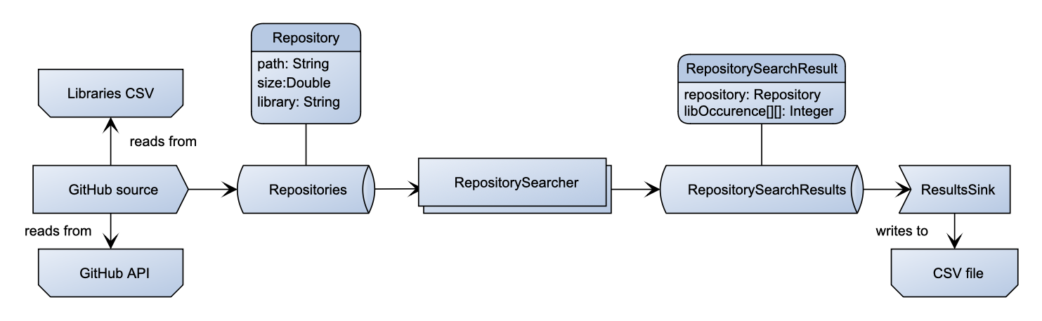
Example Mining software repositories
Examining co-occurrences of popular JavaScript libraries in large scale GitHub projects

Slide 4
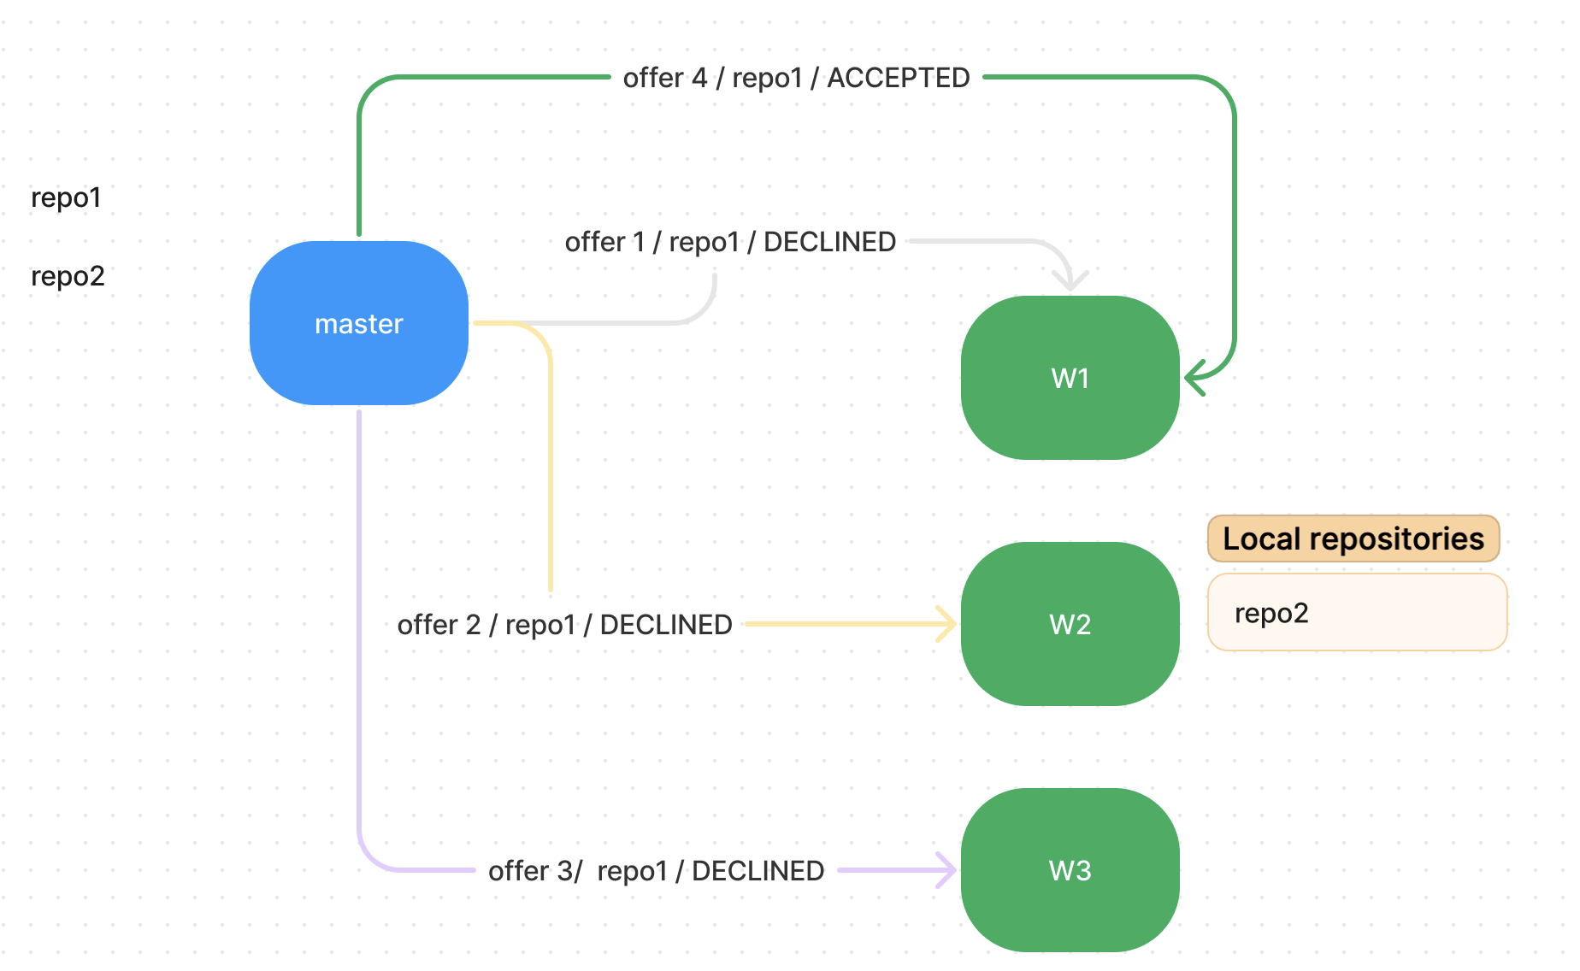
Data-locality scheduler approaches
Delayed scheduling
delays job assignment until an appropriate node is available or the allocation will be postponed
Matchmaking for MapReduce
when a node is available will it try to pull a task for which it has data locally
the node can remain idle for a single heartbeat before it is bound to accept a “non-local” task
Crossflow scheduler
Relies on opinionated nodes which can accept an incoming task or decline it a fixed number of times if the necessary data is not local

Slide 5
Proposed approach: Bidding scheduler
Master opens a bidding contest for each incoming job
Workers submit their bids, ie. estimates of how long they anticipate it would take to complete the job
Worker with the lowest bid wins the job
Currently, we wait for all workers to submit their bids within a threshold period of time
Estimates include data transfer time, processing time, and estimates for previously won jobs
Workers are involved in the job-allocation process
Benefits:
Optimizing the end-to-end execution time
even if it means less data-locality
All workers are almost equally used
even if there are numerous jobs involving the same data
Worker differences (CPU/Memory) are considered in job allocation
and not only the local data
Adaptable in volatile environments
workers’ speed/memory can change over time, and job allocation will take it into account

Slide 6
Evaluation
Metrics:
end-to-end execution time
data load
cache misses
Cloud infrastructure setup
distributed AWS infrastructure using t3.micro instances
total of 7 instances
5 workers
1 master
1 for the messaging infrastructure
instances are geographically distributed (randomly determined during configuration startup)
Simulation configurations
4 worker configurations (including fast/slow workers)
5 job configurations
Real deployment experiments
network bandwidth and read/write speed determined by the AWS infrastructure

Slide 7
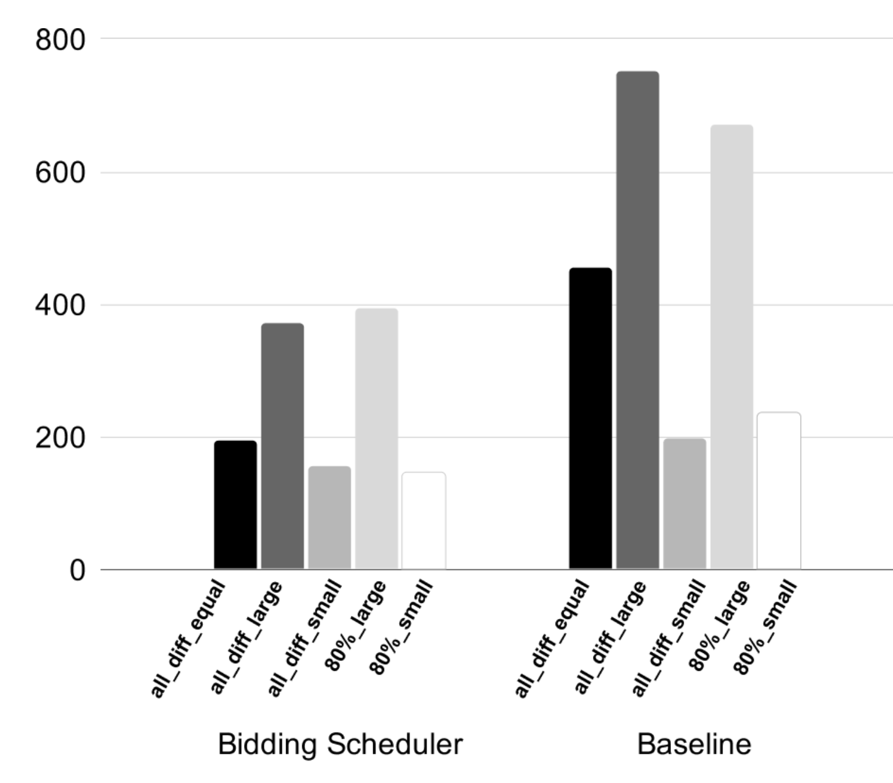
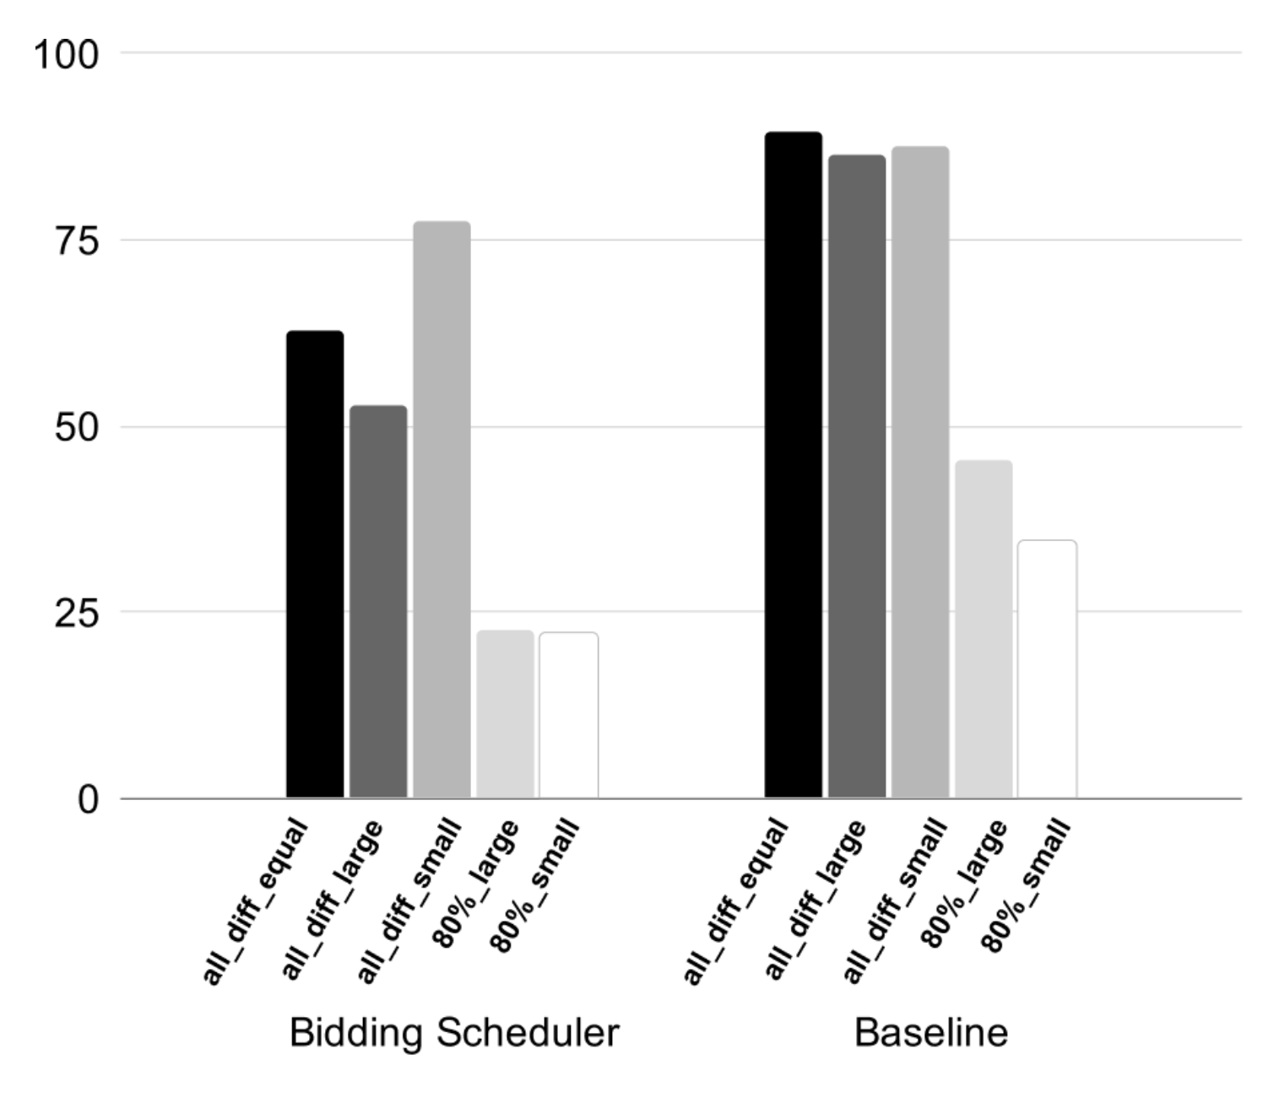
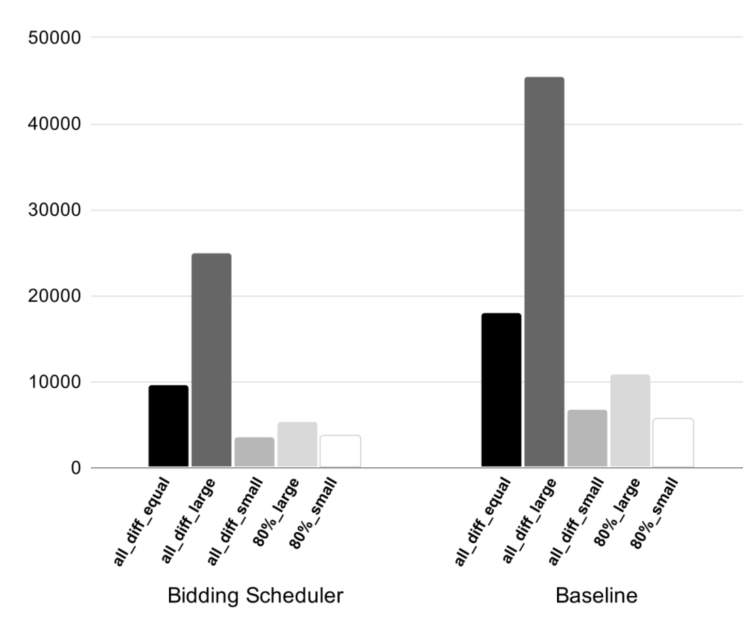
Evaluation Simulation results
1
2
Bidding Scheduler achieves a speedup of approximately 24.5% compared to the Baseline.
Bidding Scheduler demonstrates improvements in local data utilization, with approximately 49% fewer cache misses and approximately 45.3% reduction in data load per workflow run.
3
Average total execution time per workload
Average cache miss count per workload
Average data load per workload

Slide 8
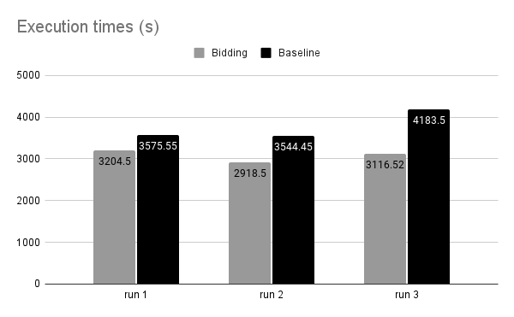
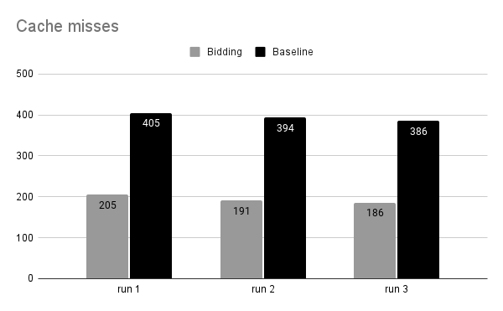
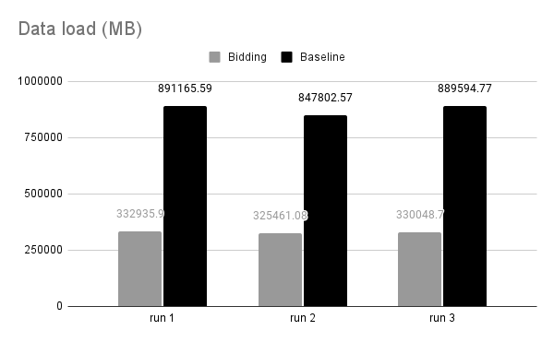
Evaluation real deployment results
The Bidding Scheduler completes the execution with a 10.3%-25.5% reduction in time compared to the Baseline, together with ~50% less cache misses resulting in ~60% less MB downloaded.

Slide 9
Conclusion & Future work
Conclusion
- effective for large resources and long-running workflows
- for small resources or short workflows, competing for jobs unnecessarily prolongs the execution
Future work
Larger-scale evaluation (e.g. comparing with other scheduling techniques such as Matchmaking)
Additional worker intelligence
introduce worker’s ability to learn from estimates’ errors and correct their future bids

