Slide 1





Scaling on Frontier: Uncertainty Quantification Workflow Applications using ExaWorks to Enable Full System Utilization
Mikhail Titov¹, Robert Carson², Matthew Rolchigo³, John Coleman³, James Belak², Matthew Bement³, Daniel Laney², Matteo Turilli^{1,4}, Shantenu Jha^{1,4}
¹ Brookhaven National Laboratory, Upton, NY
² Lawrence Livermore National Laboratory Livermore, Livermore, CA
³ Oak Ridge National Laboratory Oak Ridge, Oak Ridge, TN
⁴ Rutgers University, New Brunswick, NJ

Slide 2
Motivation
Scientific discovery increasingly requires “... assembling multiple components (e.g., modsim applications, post-processing), into higher-level parallel patterns and motifs (e.g., ensembles, steer, optimization), consisting of multiple stages, leveraging multiple compute resources and facilities”.
Workflows are the new applications!
Notes:
Think beyond a single task performance!

Slide 3
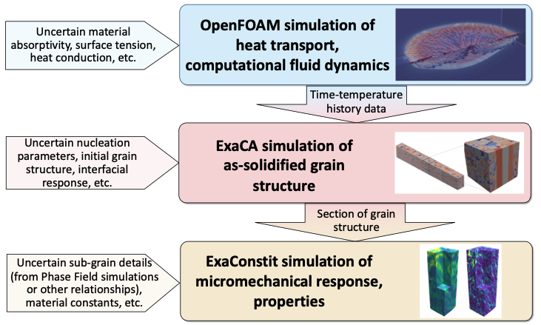
ExaAM | Introduction
The DOE ECP Exascale Additive Manufacturing project (ExaAM) has developed a suite of exascale-ready computational tools to model the process-to-structure-to-properties (PSP) relationship for additively manufactured (AM) metal components.
ExaAM built an uncertainty quantification (UQ) pipeline (aka campaign) to quantify the effect that uncertainty has on local mechanical responses in processing conditions.
Schematic of the workflow associated with AdditiveFOAM / OpenFOAM modeling
of AM processing, ExaCA modeling of microstructure, and ExaConstit modeling of
properties as part of the ExaAM project, noting sources of uncertainty in model inputs.
Rolchigo, M., Carson, R., Belak, J., Understanding Uncertainty in Microstructure Evolution and Constitutive Properties in Additive Process Modeling (2022) DOI:10.3390/met12020324
Turner, J., et al., ExaAM: Metal additive manufacturing simulation at the fidelity of the microstructure (2022) DOI:10.1177/10943420211042558

Slide 4
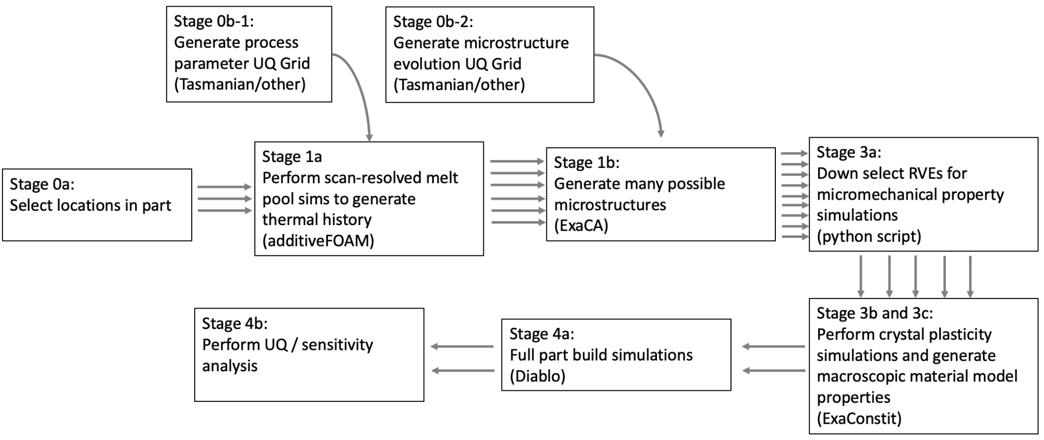
ExaAM | Uncertainty Quantification Campaign
Workflow Applications

Slide 5
UQ Campaign | Requirements for Ensemble Management
Ability to coordinate an ensemble of pipelines (aka campaign):
Each pipeline progresses at different rates of progress.
Each campaign stage is a different workflow, with different workload properties:
Diverse resource management and scheduling requirements.
Support different heterogeneous tasks and high-performance computing platforms:
Complex spatio-temporal properties (STP) of the workload.
Fault-tolerance of the tools and executing processes:
Manage and recover from failures at large-scale.
Notes:
Control different resource requirements (e.g., either having one large batch job for all workflows or setting a workflow per batch job with the different numbers of acquired compute nodes and runtime).

Slide 6

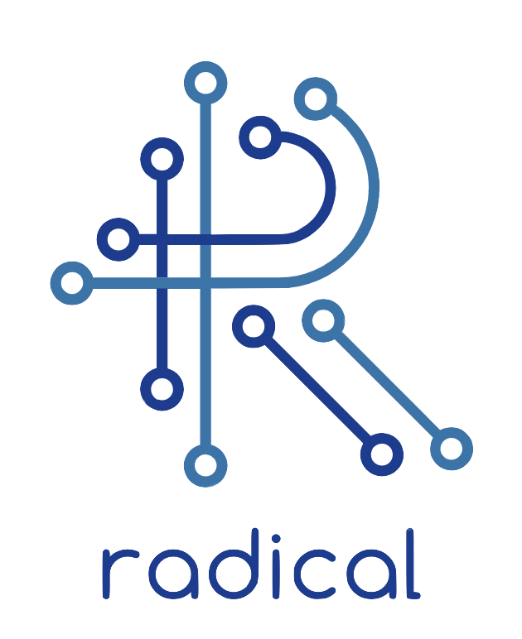
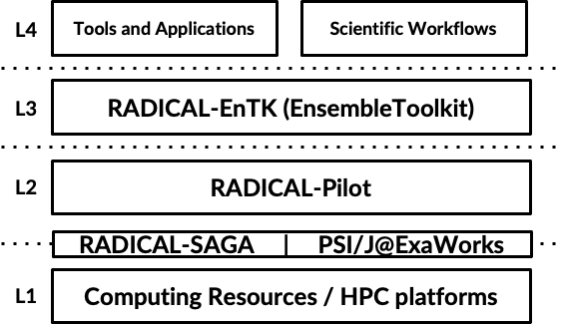
RADICAL-Cybertools (RCT) | Middleware Building Blocks
Workflow middleware building blocks: integrate with existing software ecosystem; implemented in Python; designed for performance on Leadership Computing Facility (LCF) platforms. ExaWorks – a DOE ECP project – integrates independent middleware to enable the execution of scientific workflows on HPC.
https://radical-cybertools.github.io
RADICAL-EnTK (Ensemble-ToolKit) provides first-order support for:
Ensemble of Tasks;
Ensemble Learning, Ensemble Models (coming).
RADICAL-Pilot:
Workload and task execution management.
Workflow middleware building blocks with the layered view of the distributed infrastructure.
Turilli, M., et al., Middleware Building Blocks for Workflow Systems (2019) DOI:10.1109/MCSE.2019.2920048
Alsaadi, A., et al., ExaWorks: Workflows for Exascale (2021) DOI:10.1109/WORKS54523.2021.00012

Slide 7
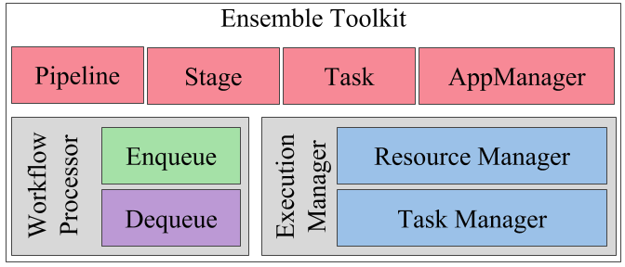
RADICAL-EnTK | Overview
Pipeline 1
Pipeline 2
Stage 1.1
Stage 2.1
EnTK (Ensemble Toolkit) promotes ensembles to a high-level programming abstraction, providing specific interfaces and execution models for ensemble-based applications:
Pipeline - sequence of stages;
Stage - set of tasks;
Task - self-contained process.
(*) Sequences and sets formally define dependences among tasks, stages and pipelines - the PST model.
Workflow management components compose a special purpose management system, which manages resources and task execution via a runtime system (general purpose).
Stage 1.2
. . .
Stage 2.2
. .
Stage 1.3
Stage 2.3
Example of the EnTK PST model.
EnTK core components.

Slide 8
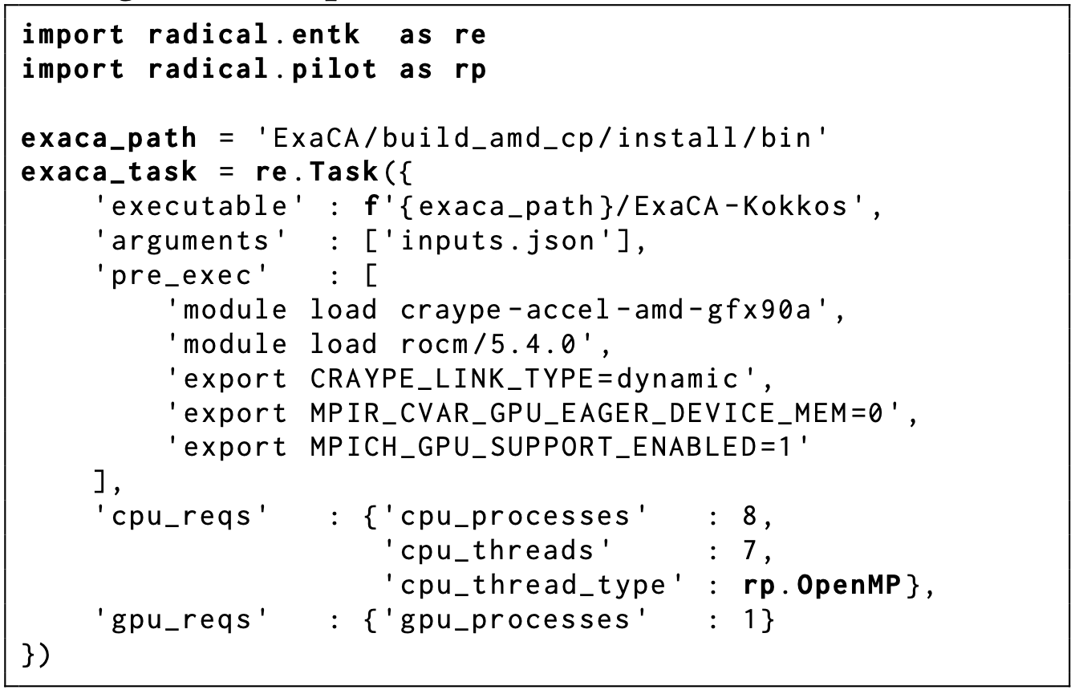
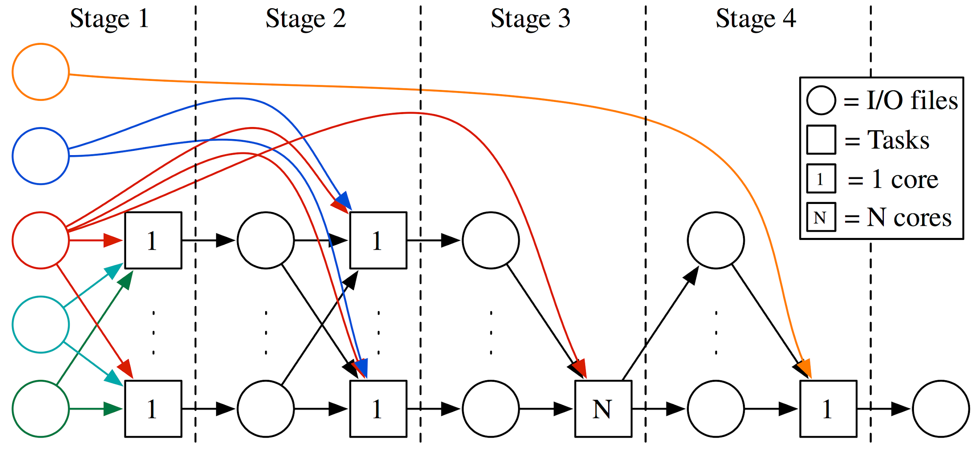
RADICAL-EnTK | Workflow Management
The UQ campaign is implemented as a set of EnTK workflow applications, where each UQ stage corresponds to the EnTK application (with a single EnTK pipeline) and consists of one or more EnTK stages.
https://github.com/ExascaleAM/Workflows
Example of workflows and workloads.
Code listing of the EnTK task from the ExaCA workflow application.

Slide 9
Runs on Frontier @OLCF/ORNL
AdditiveFOAM / OpenFOAM workflow:
Utilized 40 compute nodes for up to 2 hours;
Each task requires 4 nodes with 56 cores per node;
ExaCA workflow:
Utilized 125 compute nodes for up to 4 hours;
Each task requires 1 node and utilizes 8 MPI ranks with 7CPUs-1GPU decomposition;
ExaConstit workflow:
Utilized 8000 compute nodes (85% of Frontier’s nodes) for up to 3.3 hours;
Total 7875 tasks;
Each task requires 8 nodes with 8 MPI ranks per node with the typical 7CPUs-1GPU decomposition and runtime ∼10-25 min.

Slide 10
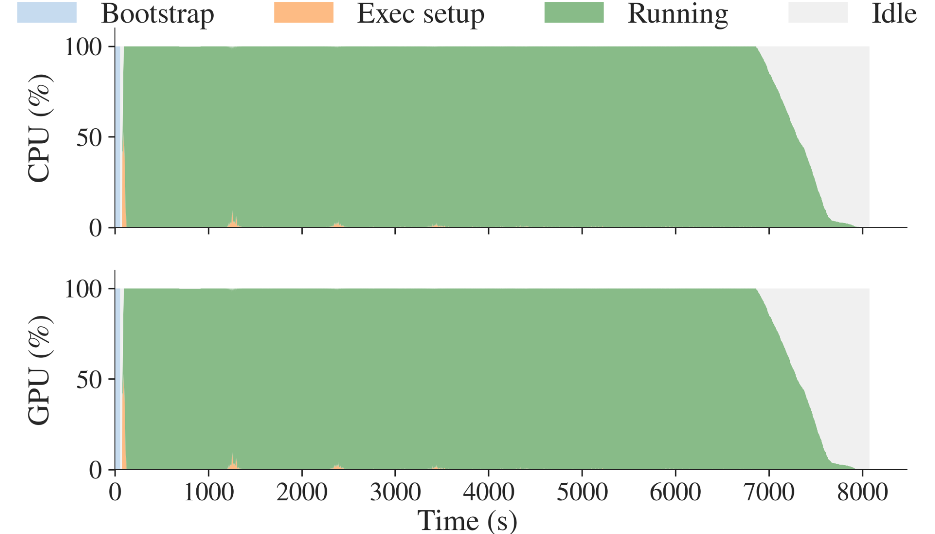
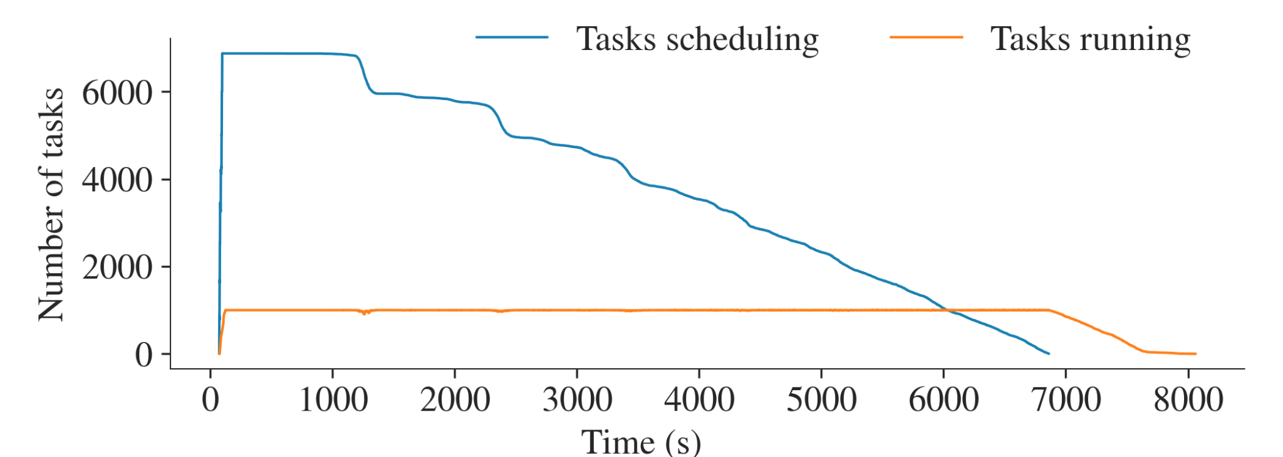
Frontier Run of the EnTK Workflow Application for ExaConstit
Concurrency of 7875 EnTK tasks in scheduling and running* (execution) states.
(*) 1000 tasks were running concurrently.
Resource utilization*: 100% corresponds to 448,000 CPU cores (not considering 8 cores per node reserved for system processes) and 64,000 GPUs.
(*) Achieved total resource utilization is 90%.

Slide 11
Summary
Workflows are the new applications; future of scientific work and discovery:
Workflows are the highest-level of execution, parallelism, and programming.
Support “new applications” via innovation at higher levels of the workflows stack:
Collective performance of heterogeneous workflows, not just single tasks.
RADICAL-Cybertools: building blocks for campaigns and workflows applications:
Share common components and reduce development, testing, maintenance, etc. costs and enhance portability;
Build upon robust capabilities, e.g., advanced workflow runtime systems to efficiently utilize 8000 and more nodes on Frontier (OLCF/ORNL).
HPC for UQ workflows:
UQ for HPC workflows is important!

Slide 12
Acknowledgements
This research used resources of OLCF at the Oak Ridge National Laboratory, which is supported by the Office of Science of the U.S. Department of Energy under Contract No. DE-AC05-00OR22725. This research was supported by the Exascale Computing Project (17-SC-20-SC), a collaborative effort of the U.S. DOE Office of Science and the NNSA, by the ECP ExaWorks project under DOE Contract No. DE-SC0012704, and under the auspices of the U.S. DOE by Lawrence Livermore National Laboratory under Contract No. DE- AC52-07NA27344. We also acknowledge DOE INCITE awards for allocations on Summit, Crusher, Frontier (OLCF/ORNL).

