Slide 1
Laminar: A New Serverless Stream-based Framework with Semantic Code Search and Code Completion
Zaynab Zahra, Zihao Li, Rosa Filgueira
University of St. Andrews

Slide 2

Introduction
Serverless Computing: scalability, cost-effectiveness, and simplicity in deploying applications.
Challenges in Current Serverless Frameworks:
Handling continuous data streams and stateful computations
Latency issues and inefficiencies in data processing
Searches of functions / computing tasks in registries
Significance of Laminar:
Seamlessly addresses data stream handling and stateful computations
Innovates serverless architecture with deep learning code search facilities

Slide 3
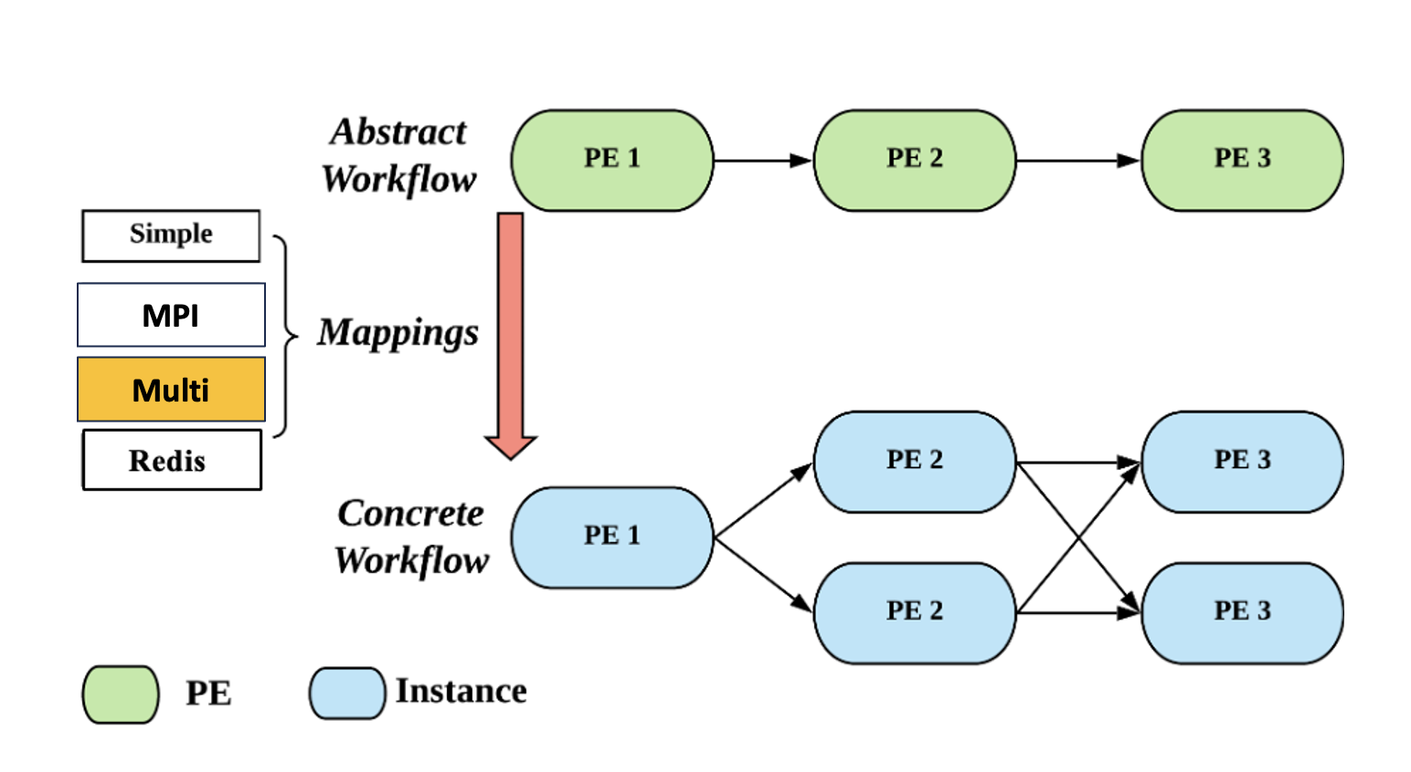
dispel4py - Background
Laminar serverless framework based on dispel4py - parallel stream-based dataflow library
PE (Processing Element): Core unit for computational tasks, linked via inputs/outputs.
Instance: Represents PE execution
Abstract Workflow: Logical connections between PEs.
Concrete Workflow: Automatically generated - parallel execution based on the abstract workflow.
Connection: Data flow rates between PEs.
Mappings: Map workflows to execution engines for sequential/ parallel processing.
Grouping: Specifies communication behavior between PEs, e.g., 'group-by’ ~ to 'MapReduce’.

Slide 4
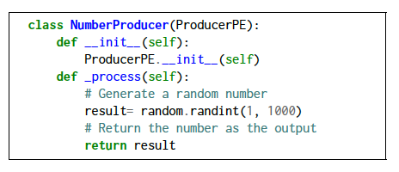
dispel4py - Background
Laminar serverless framework based on dispel4py - parallel stream-based dataflow library
NumberProducer stateless PE

Slide 5
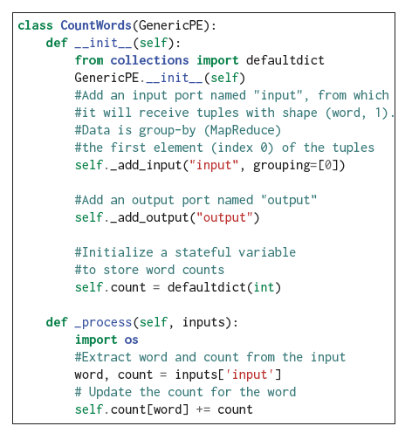
dispel4py - Background
Laminar serverless framework based on dispel4py - parallel stream-based dataflow library
CountWords stateful PE

Slide 6
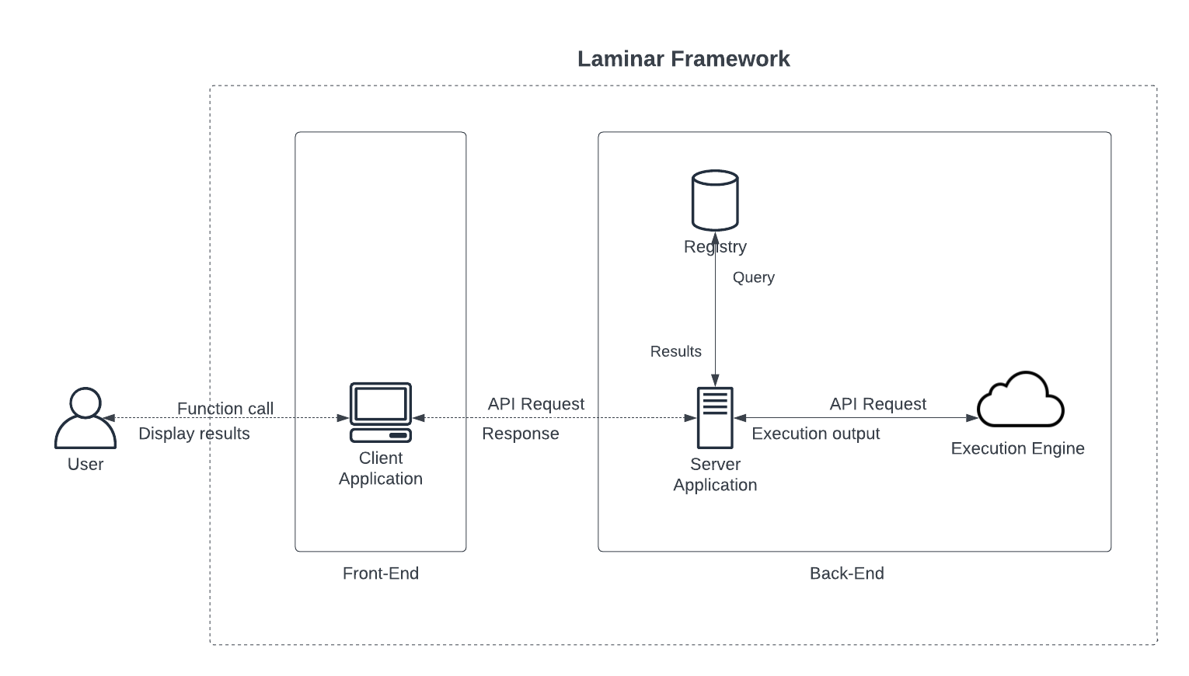
Laminar: Serverless Stream-based Framework with Deep Learning Features
Stream-based serverless framework based on dispel4py
It manages streaming data, data-pipelines
Accommodates stateless and stateful computations
Deep Learning Features
-

Slide 7
Laminar: Serverless Stream-based Framework with Deep Learning Features
Four main components:
Registry: Stores users/PEs/workflow information
Server: Coordinates system functionality
Execution Engine: Serverless workflow execution
Client: Interacts with server and users' requests
-

Slide 8
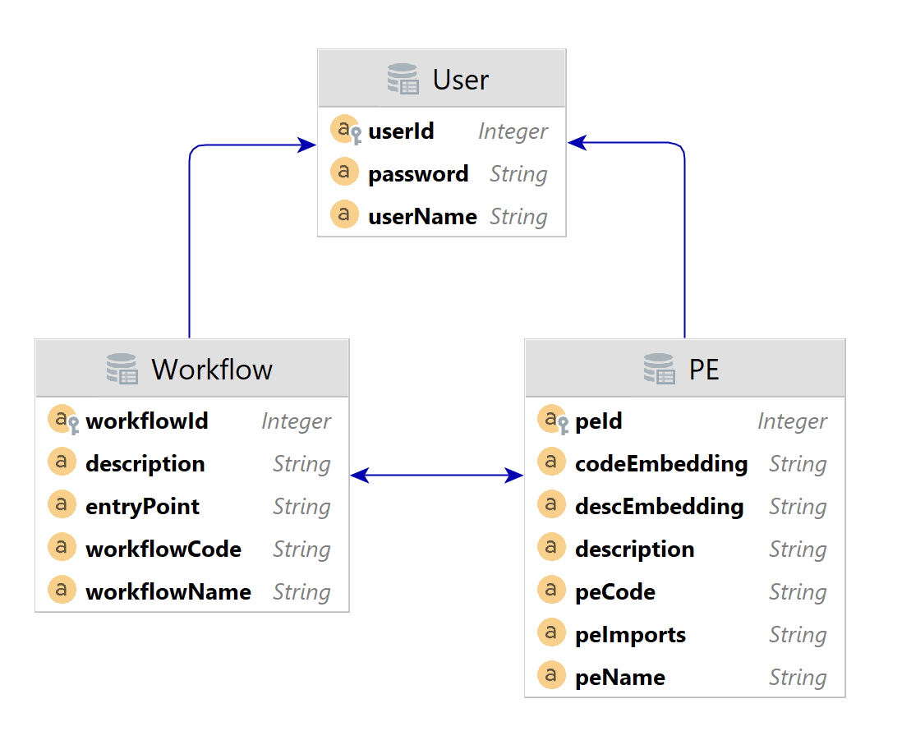
Laminar: Registry Overview
Central Repository:
Web-based storage for user, PE, and workflow details.
Association Structure:
Maintains many-to-many links between users, PEs, and workflows
Ensures privacy and prevents data duplication.
Unified Ownership:
Establishes 'owners' of PEs and workflows
eliminating individual registries.
Efficient Associations:
Allows multiple connections between PEs and workflows,
simplifying data retrieval.
Benefits:
Reduces data duplication, enhances query efficiency
and streamlines user interactions with the system's API.
Registry with Semantic Code Features

Slide 9
Laminar: Registry with Semantic Code Features
PE Summarizations:
Generated by the Laminar Client if users don't provide PE descriptions
Utilizes CodeT5 Language LLM model → PE description
Code and Description Embeddings:
Stored in the Registry for both PE code and descriptions.
Created during PE registration by the Client
UniXcoder-code-search description embeddings → PE descEmbeddings
ReACC-py-retriever code embeddings → PE codeEmbeddings
Enhanced Performance:
Re-use of embeddings for efficient semantic code searches
and completions – Bi-enconders approach

Slide 10
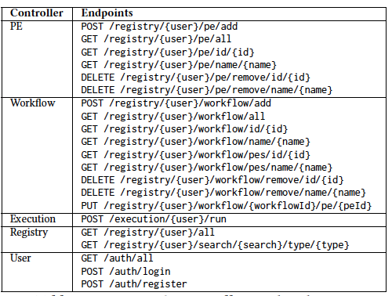
Laminar: Server
Core logic foundation for Laminar system
Manages client-server interactions
Hosts business logic and data storage
Implements a structured, layered architecture
Essential for system operation and stability
Laminar API controllers
Handle specific functions
Facilitate communication between the client
and server

Slide 11
Laminar: Execution Engine
Remote Workflow/PE Execution:
Single API endpoint for initiating executions (/execution/{user}/run) – workflows or a single PE
Streamlined Environment:
dispel4py + conda for seamless execution -- without user environment management
Auto-import Mechanism:
Analyses the varied import dependencies of streaming workflows
Creating an all-inclusive requirement list transmitted to the Execution Engine.
It autonomously imports necessary prerequisites - eliminating the need for user installations
Enhanced Capabilities:
Facilitates parallel execution and diverse mappings via dispel4py for improved performance
Additional resources – ‘resources’ directory

Slide 12
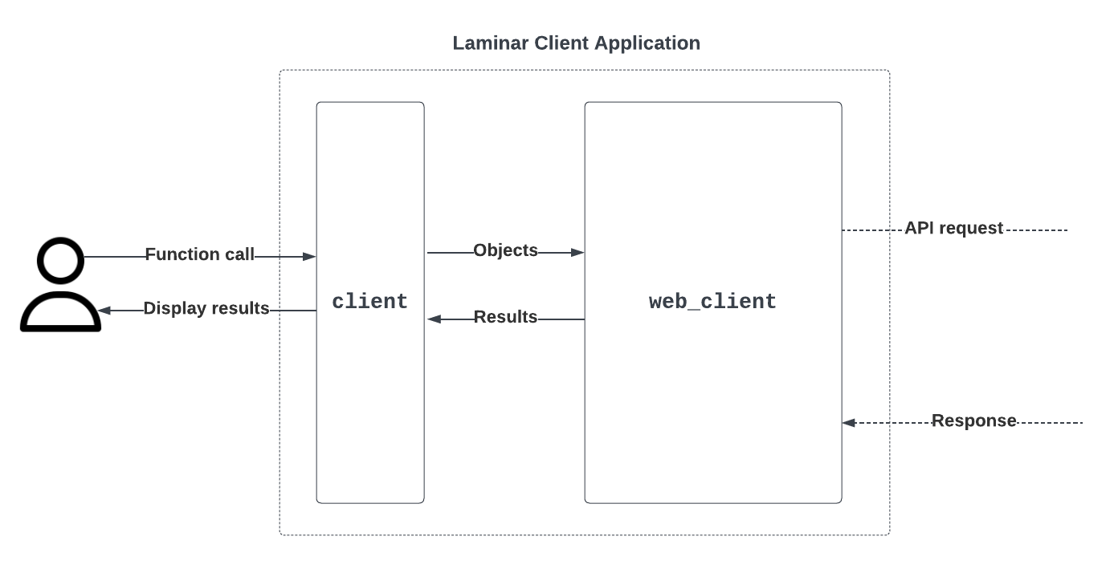
Laminar: Client Layer
A user-friendly Python application
Dual-layer structure:
Client layer : user-accessible functions
Registering PEs/ workflows
workflow execution
Web_client layer: between client and server

Slide 13
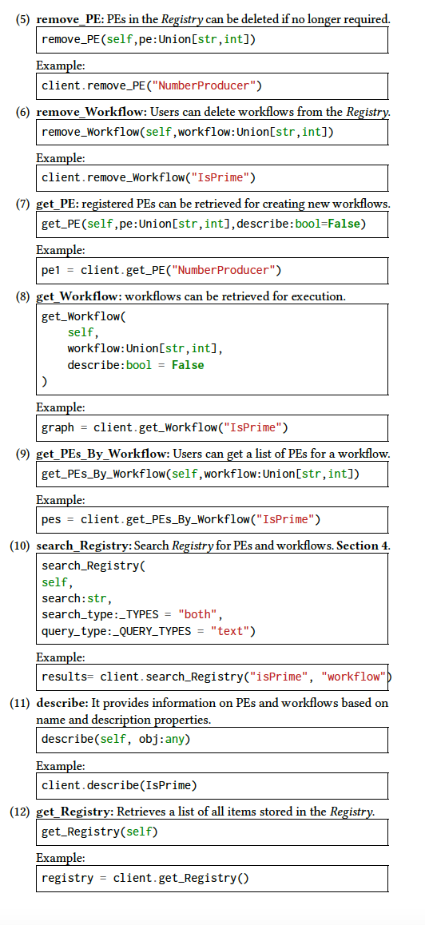
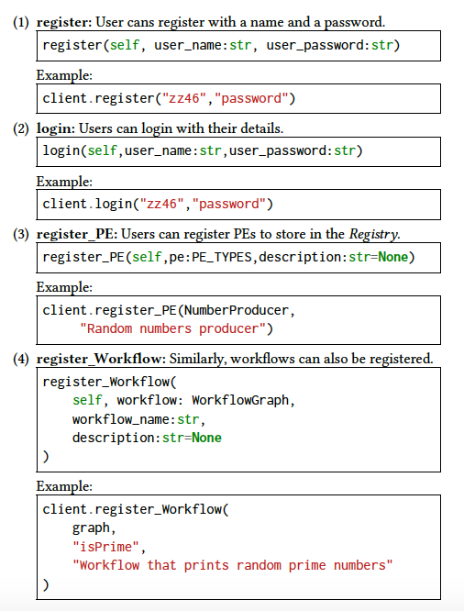
Laminar: Client

Slide 14
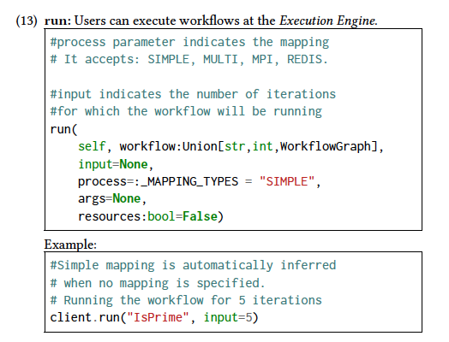
Laminar: Client

Slide 15
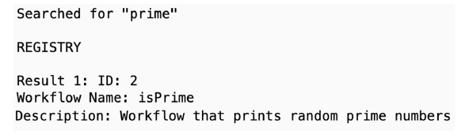

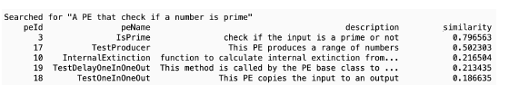
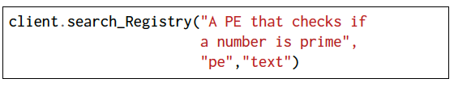
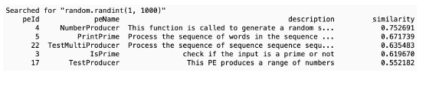

Laminar: Text and Semantic Searches
Text-based Search
Semantic PE Code Search
UniXcoder-code-search
Automatic Code Completion
ReACC-py-retriever

Slide 16
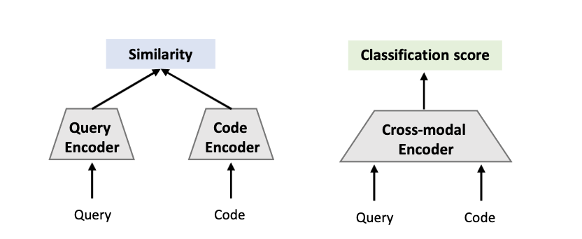
Semantic Search: Bi-Encoder vs Cross-Encoder
Bi-encoder
Cross-encoder
Bi-encoders compare things separately. Map each input into a dense vector space /embedding
Cross-encoders compare things by
looking at both the items together
Bi-encoder models are fast as the embeddings can be pre-calculated offline -- but less accurate
Cross-encoder models perform full-attention over the input pair of query and code -- more information & slow
Semantic Searches: based in their PE code & descriptions→ registry might contain large number of PEs → selected the Bi-encoder paradigm

Slide 17


Laminar: Semantic Searches
Registry
Candidates
Embeddings
Search or Code Completion
Query
Retrieval Bi-Encoders Embeddings
Cosine Similarity
Ranked Hits
Query
Embeddings
Generate
Query
Embedding

Slide 18
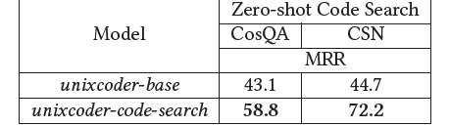
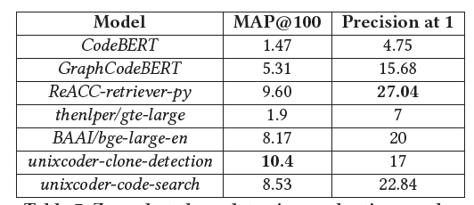
Evaluation: Deep Learning Models
Semantic Code Search Evaluation
Code Completion Evaluation
Text-2-code evaluations
Mean Reciprocal Rank (MRR) metric: How quickly the system finds the most relevant result on average
Zero-shot clone detection evaluation
Assessing a models’ ability to retrieve similar code segments from a dataset using partial queries:
MAP@100 (Mean Average Precision at 100):
Average precision of the top 100 retrieved items for each query
Precision at 1:
Accuracy in retrieving the most relevant item as the top recommendation

Slide 19
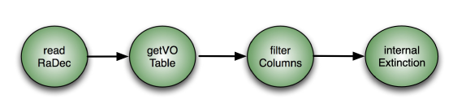
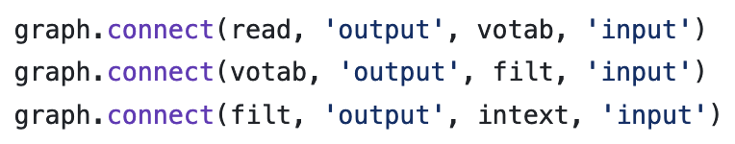
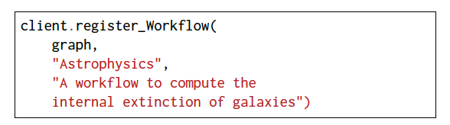

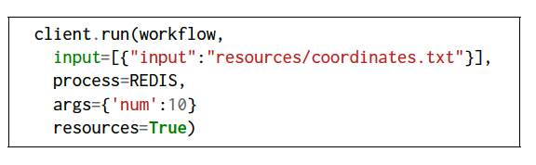
Use Case: Astrophysics workflow: Internal Extinction
Streaming workflow for calculating the internal extinction of galaxies

Slide 20
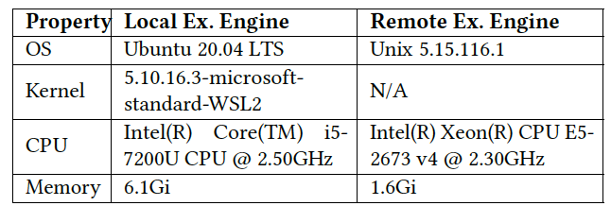
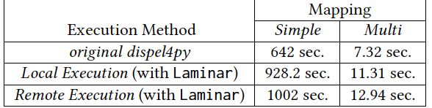
Evaluation: Deep Learning Models
Execution Engines Configuration
Execution times of the Internal Extinction

Slide 21
Conclusions
Laminar enables and provides:
Novel serverless stream-based framework with integrated deep learning search features
Efficient handling of data streams and stateful computations – uses dispel4py
User-friendly interfaces and streamlined server-client architecture
Serverless principles for automatic resource provisioning and management
Advanced deep learning models for enhanced code search and analysis
Currently working on:
Applying semantic facilities to workflows
Improving Laminar end-points
Exploring new LLM
Registering multiple Execution Engines for user convenience and efficiency
Improving client – even more user friendly

Slide 22
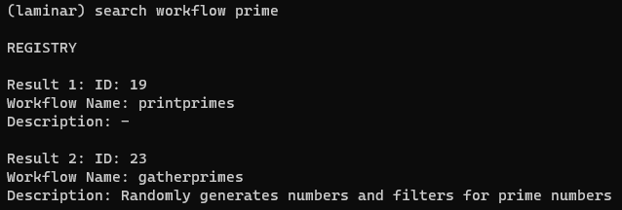
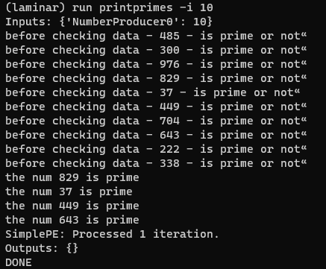
Current Works – Improving Client

