Slide 1
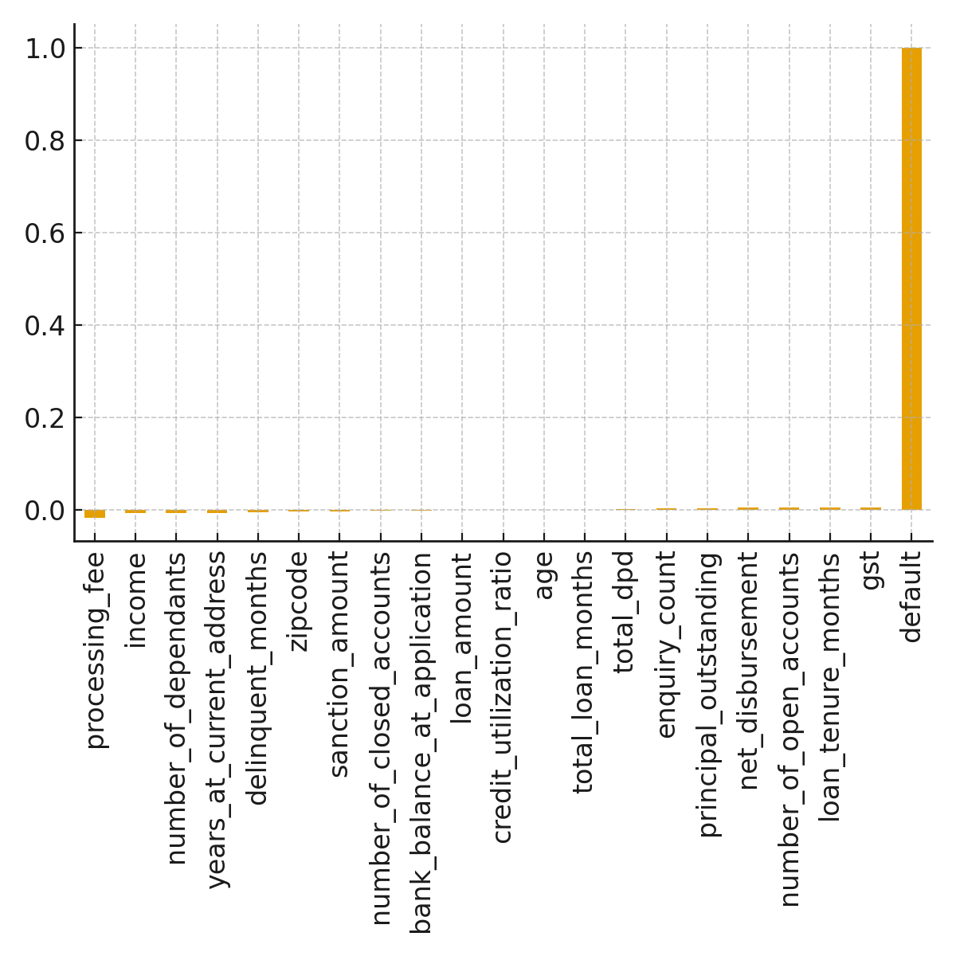
What Drives Credit Risk
- High number of open accounts
- High outstanding principal
- More credit enquiries
- Longer loan tenures
- Lower income & stability

Slide 2
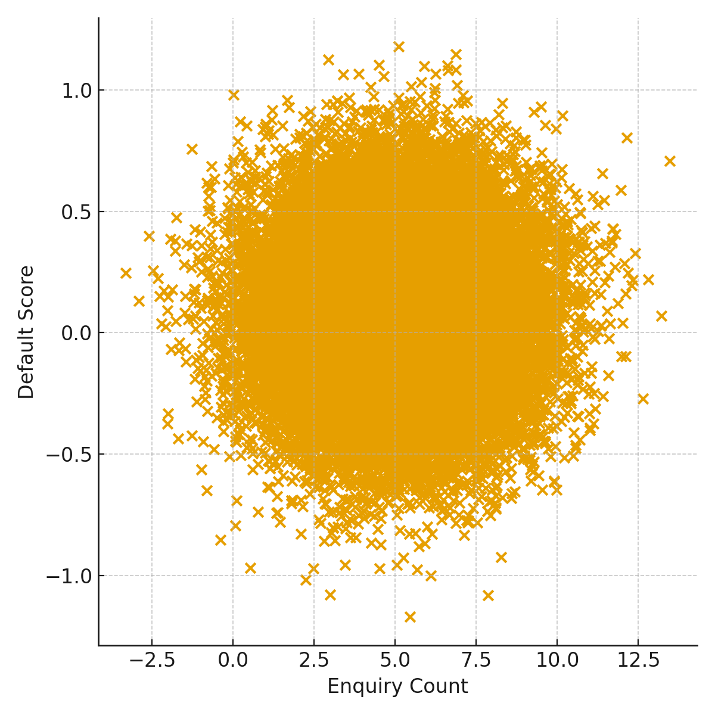
Patterns Discovered
- Borrowers with many open accounts show higher risk
- Enquiry spikes predict future stress
- Outstanding principal matters more than sanction amount
- Younger borrowers show slightly higher risk

Slide 3
Actions Pragati FinCorp Should Take
- Integrate enquiry & open-account signals
- Tighten checks on thin-file borrowers
- Monitor rising outstanding balances
- Flag rising DPD for intervention

Slide 4
Q1: Features Correlating With Repayment Issues
- Open accounts, principal outstanding, enquiries
- Lower income correlates with higher risk

Slide 5
Q2: High-Risk Borrower Segments
- Highly leveraged borrowers
- Young borrowers with short histories
- High enquiry-count customers

Slide 6
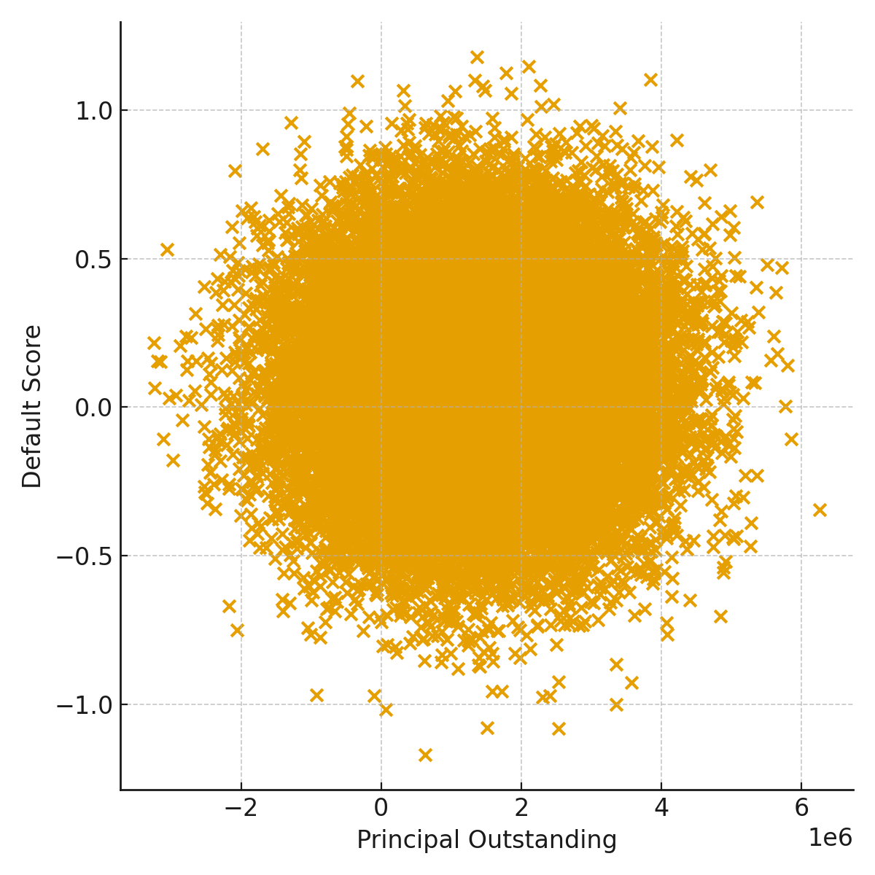
Q3: Interaction of Loan & Bureau History
- High utilization + many open accounts = rising risk
- Outstanding principal predicts default more than EMI
- DPD drift indicates early stress

Slide 7
Q4: Early Warning Signs
- Rising enquiries
- Increasing outstanding principal
- Growth in open accounts
- DPD spikes

