Slide 1
CHAPTER ONE
Introduction to Database Systems
By Aster A.
1

Slide 2
Introduction
A database is a collection of related data.
  Data is a known facts that can be recorded and that have implicit meaning. E.g. consider the names, telephone numbers, and addresses of the people you know.
  You may have recorded this data in an indexed address book or stored it on a hard drive, using a personal computer and software such as Microsoft Access or Excel.
This collection of related data with an implicit meaning is a database.

Slide 3
Introduction…
A database has the following implicit properties:
  A database represents some aspect of the real world, sometimes called the miniworld or the universe of discourse (UoD).
    Changes to the miniworld are reflected in the database.
  A database is logically coherent collection of data with some inherent meaning.
    A random assortment of data cannot correctly be referred to as a database.
A database is designed, built, and populated with data for a specific purpose.
  It has an intended group of users and some preconceived applications in which these users are interested.

Slide 4
Introduction…
A database may be generated and maintained manually or it may be computerized.
For example, a library card catalog is a database that may be created and maintained manually.
A computerized database may be created and maintained either by a group of application programs written specifically for that task or by a database management system.

Slide 5
DBMS (Database Management System)
A Database Management System (DBMS):
is a software package designed to store and manage databases.
is a collection of programs that enables users to create and maintain a database.
is a general-purpose software system that facilitates the processes of defining, constructing, manipulating, and sharing databases among various users and applications.
Example: Access, My-SQL, SQL, Oracle etc.

Slide 6
DBMS (Database Management System)…
The DBMS also protect the database and maintaining it over a long period of time.
Protection includes system protection against hardware or software malfunction (or crashes) and security protection against unauthorized or malicious access.

Slide 7
DBMS (Database Management System)…
A typical large database may have a life cycle of many years, so the DBMS must be able to maintain the database system by allowing the system to evolve as requirements change over time.
It is not absolutely necessary to use general-purpose DBMS software to implement a computerized database.
We could write our own set of programs to create and maintain the database, in effect creating our own special-purpose DBMS software

Slide 8
DBMS (Database Management System)…
In either case whether we use a general-purpose DBMS or not—we usually have to deploy a considerable amount of complex software.
In fact, most DBMSs are very complex software systems.
The database and DBMS software together a Database System.
The DB Application is simply a program that interacts with the DB at some point in its execution.

Slide 9
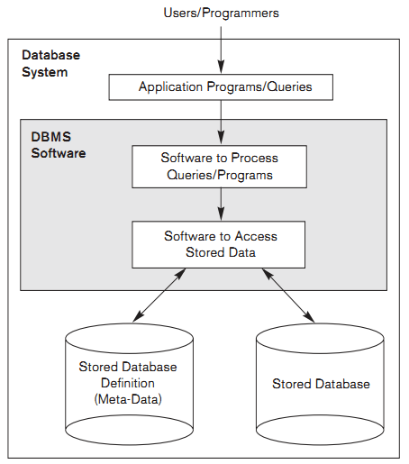
A simplified Database System Environment.

Slide 10
Data Management Approaches
Data Management (keeping your data records)can be done:
    Manual Approach
    File-Based Approach
    Database Approach
  Currently, all methods of data handling are in use to some extent.

Slide 11
1. Manual File Handling Systems
The primitive and traditional way of information handling where cards and papers are used for the purpose. This approach:
  requires intensive human labour
  Events and objects are written on files (paper)
  Files are labeled and stored in one or more cabinets.
  The cabinets could be kept in safe places for security purpose.
  Insertion and retrieval is done by searching first for the right cabinet then for the right file, then the information.
  One could have indexing system to facilitate access to the data.

Slide 12
Example , Personal Calendar
We might start by building a file with the following structure:
What Day Time with_whom Where
Lunch 10/24 1pm Abebe Bole
Shop 10/26 9am Ayele Piassa
Dinner 10/26 6PM Elfinesh Café
This calendar is easy to deal with.

Slide 13
Let us also build our address book
  Abebe A. 0911164743
  Seble K. 0912150844
  Ayele L. 0913170841
  Elfinesh W. 0911169673
  Ermias H. 0912151043
  Worku A. 0911199904
  Worku D. 0912620410
  Abebe D. 0914556768

Slide 14
Limitations of Manual File Handling
A) Problem of Data Organization
  Suppose we want to cancel one of our appointments.
  Two conceptual “entities” -- address and calendar -- with a relationship between them, linking people in the calendar to their contact information.
B) Problem of Efficiency
Size of your personal address book is probably less than one hundred entries, but there are things we'd like to do quickly and efficiently.
  “Give me all appointments on 10/28”
  “When am I next meeting Dr. Dawit?”
What would happen if you were using a business calendar with hundreds of thousands of entries?

Slide 15
Limitations of Manual File Handling …
      C) Prone to error
      D) Difficult to update, retrieve, integrate
      E) You have the data but it is difficult to compile the information
      F) Significant amount of duplication of data
      G) Cross referencing is difficult
What is the solution to overcome the problems or difficulties inherited in the Manual File Handling Approaches:
Two computerized approaches evolved to overcome this limitations
  File Based Approach → Decentralised
  Database Approach→ Centralised

Slide 16
2. File-Based Approach
  File based systems were an early attempt to computerize the manual filing system.
  This approach is a decentralized computerized data handling method - to develop a program or a number of programs for each different application.
  Since every application defines and manages its own data, the system is subjected to serious data duplication problem

Slide 17
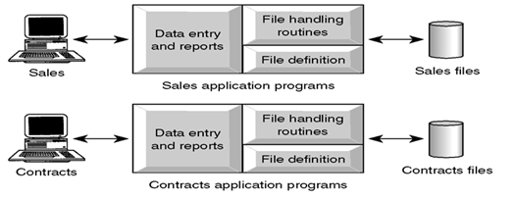
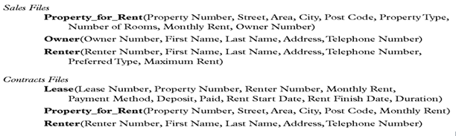

Slide 18
Limitations of File-Based systems
Data Redundancy (Duplication of data)
  Same data is held by different programs
  Wasted space (Uncontrolled duplication of data)
Separation and isolation of data
  Each program maintains its own set of data.
  Users of one program may be unaware of potentially useful data held by other programs.
  Limited data sharing
  Special codes for different queries

Slide 19
Limitations of File-Based systems…
Data Inconsistency and confusion
    Eg. Consider an organization
    Personnel Department stores details relating to each member.
    Payroll Department stores salaries of each staff
There are potentially different values and/or different formats for the same item.
Consider the duplication of data between the payroll and personnel departments.
If an employee moves house and the change of address is communicated only to personnel and not to payroll, the person’s pay slip will be sent to the wrong address.

Slide 20
Limitations of File-Based systems…
Data Dependence
  File structure is defined in the program code and is dependent on the application programming language.
  Each application program must have its own processing routines for reading, inserting, updating and deleting data.
Incompatible file formats (Lack of Data Sharing and Availability)
  Programs are written in different languages, and so cannot easily access each others files.
    Eg. personnel writes in C
    payroll writes in COBOL

Slide 21
Limitations of File-Based systems…
Suppose payroll wants to know when a certain employee will be on pension.
It is difficult to share this information unless we have another application programmer to write software to convert the files to some common format.
Poor Security and Administration
Unauthorized people may access the data.
Anomalies
Modification Anomalies:
A problem experienced when one or more data value is modified on one application program but not one others containing the same data set.
2) Deletion Anomalies:
A problem encountered where one record set is deleted from one application but remain untouched in other application programs.
3) Insertion Anomalies:
A problem experienced whenever there is a new data item to be recorded, and the recording is not made in all the applications.

Slide 22
3. Database Approach
The limitation of the file based can be attributed to two factors:
  Definition of data is embedded in the application programs, rather than being stored separately and independently.
  There is no control over the access and manipulation of data beyond that imposed by the application programs.
To become more effective, a new approach was required by the name Database Approach.
  What emerged were the database and database management systems.
  A single repository of data is maintained

Slide 23
3. Database Approach…
A Database is a shared collection of logically related data designed to meet the information needs of an organization- (Centralized System).
  Logically related data comprises entities, attributes, and relationships of an organization's information.
System Catalog (Data Dictionary or Metadata) provides the description of the data to enable program–data independence.
The database contains not only the database itself but also a complete definition or description of the database.

Slide 24
3. Database Approach…
This definition is stored in the system catalog, which contains information such as the structure of each file, type and storage format of each data item and various constraints on the data..
The information stored is called metadata and it describes the structure of the primary database.

Slide 25
DBMS Functions
A DBMS performs several important functions that guarantee the integrity and consistency of the data in the database.
Most of those functions are transparent to end users, and most can be achieved only through the use of a DBMS.

Slide 26
DBMS Functions…
They include:
Data Dictionary Management
Data Storage Management
Data Transformation and Presentation
Security Management
Multiuser Access Control
Backup and Recovery Management
Data Integrity Management
Database Access Languages and Application Programming Interfaces
Database Communication Interfaces

Slide 27
1. Data Dictionary Management
The DBMS stores definitions of the data elements and their relationships (metadata) in a data dictionary.
In turn, all programs that access the data in the database work through the DBMS.
The DBMS uses the data dictionary to look up the required data component structures and relationships.
Additionally, any changes made in a database structure are automatically recorded in the data dictionary.
In other words, the DBMS provides data abstraction, and it removes structural and data dependence from the system.

Slide 28
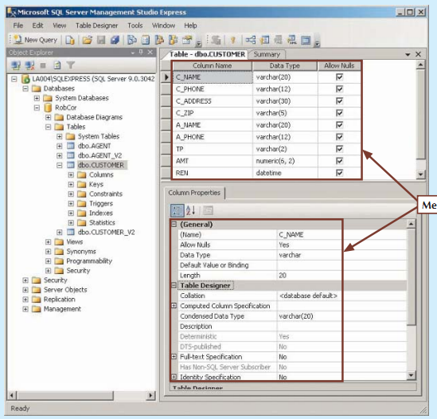
Meta Data
Fig: Illustrating metadata with Microsoft SQL Server Express

Slide 29
  A useful data dictionary system should store and manage the following types of information:
  Descriptions of the schemas of the database system.
  Detailed information on physical database design, such as storage structures, access paths, and file and record sizes.
  Descriptions of the types of database users, their responsibilities, and their access rights.
  High-level descriptions of the database transactions and applications and of the relationships of users to transactions.
  The relationship between database transactions and the data items referenced by them.
  Usage statistics such as frequencies of queries and transactions and access counts to different portions of the database.

Slide 30
2. Data Storage Management
The DBMS creates and manages the complex structures required for data storage.
A modern DBMS provides storage not only for the data, but also for related data entry forms or screen definitions, report definitions, data validation rules, procedural code, structures to handle video and picture formats, and so on.
Data storage management is also important for database performance tuning.

Slide 31
2. Data Storage Management…
Performance tuning relates to the activities that make the database perform more efficiently in terms of storage and access speed.
Although the user sees the database as a single data storage unit, the DBMS actually stores the database in multiple physical data files.
See the following figure. Such data files may even be stored on different storage media.
Therefore, the DBMS doesn’t have to wait for one disk request to finish before the next one starts.
In other words, the DBMS can fulfill database requests concurrently.

Slide 32
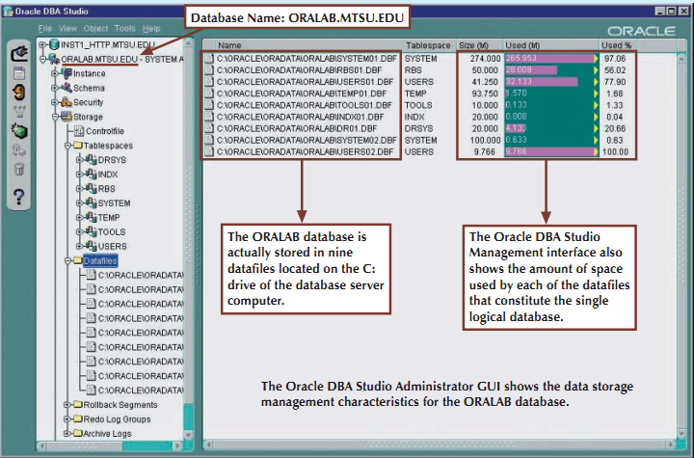
Illustrating data storage management with Oracle

Slide 33
3. Multiuser Access Control
To provide data integrity and data consistency, the DBMS uses sophisticated algorithms to ensure that multiple users can access the database concurrently without compromising the integrity of the database.

Slide 34
4. Backup and Recovery Management
The DBMS provides backup and data recovery to ensure data safety and integrity.
Current DBMS systems provide special utilities that allow the DBA to perform routine and special backup and restore procedures.
Recovery Management deals with the recovery of the database after a failure, such as a bad sector in the disk or a power failure.
Such capability is critical to preserving the database’s integrity.

Slide 35
5. Data Integrity Management
The DBMS promotes and enforces integrity rules, thus minimizing data redundancy and maximizing data consistency.
The data relationships stored in the data dictionary are used to enforce data integrity.
Ensuring data integrity is especially important in transaction-oriented database systems.

Slide 36
6. Database Access Languages and Application Programming Interfaces …
The DBMS provides data access through a query language.
A query language is a nonprocedural language—one that lets the user specify what must be done without having to specify how it is to be done.
Structured Query Language (SQL) is the de facto query language and data access standard supported by the majority of DBMS vendors.

Slide 37
The DBMS also provides application programming interfaces to procedural languages such as COBOL, C, Java, Visual Basic.NET, and C#.
The DBMS also provides administrative utilities used by the DBA and the database designer to create, implement, monitor, and maintain the database.

Slide 38
6. Database Communication Interfaces
Current-generation DBMSs accept end-user requests via multiple, different network environments.
For example, the DBMS might provide access to the database via the Internet through the use of Web browsers such as Mozilla Firefox or Microsoft Internet Explorer.

Slide 39
In this environment, communications can be accomplished in several ways:
End users can generate answers to queries by filling in screen forms through their preferred Web browser.
The DBMS can automatically publish predefined reports on a Website.
The DBMS can connect to third-party systems to distribute information via e-mail or other productivity applications.

Slide 40
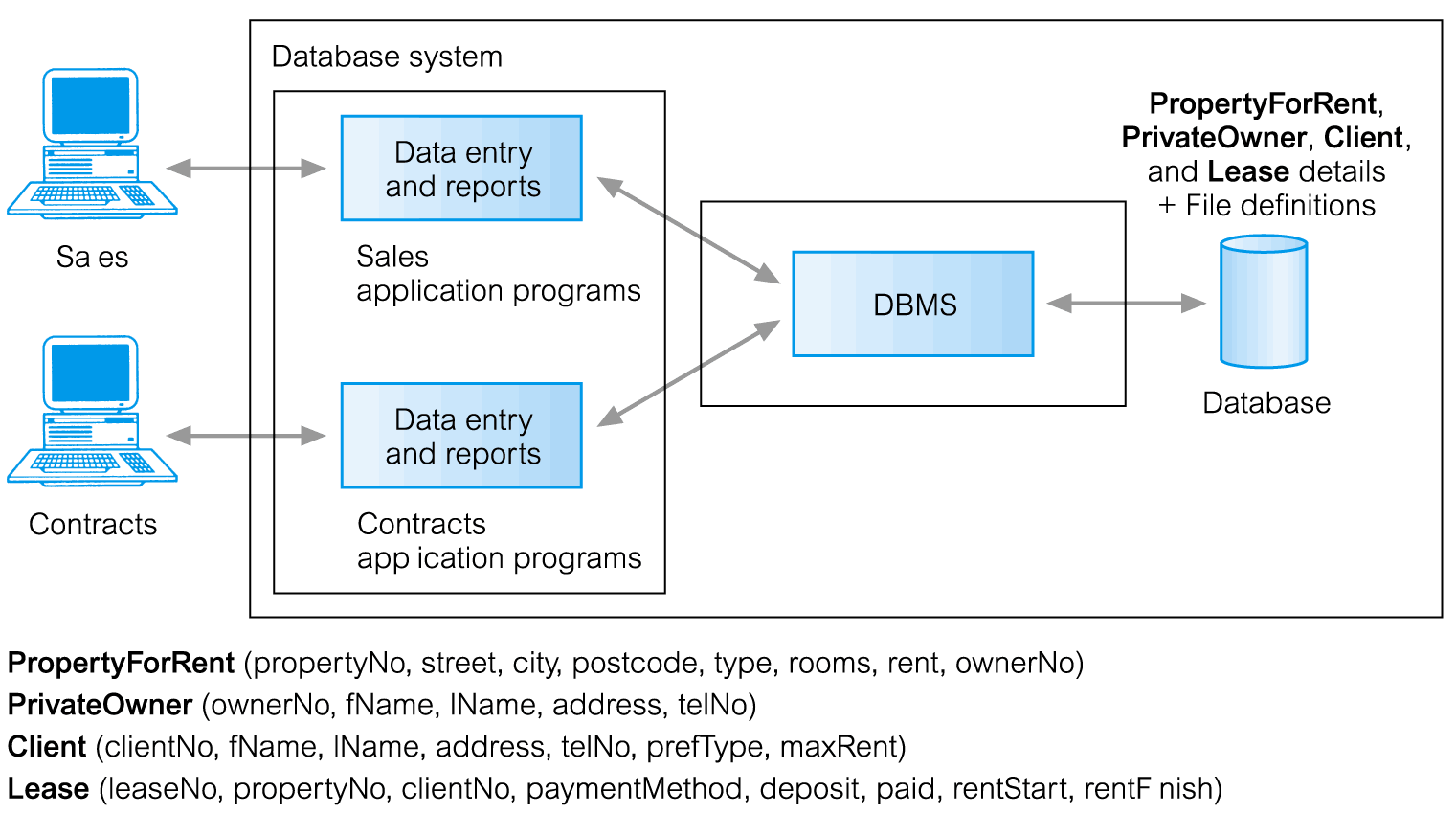
Figure: Database Approach

Slide 41
Advantages of Database Systems
  Data can be shared: two or more users can access and use same data instead of storing data in redundant manner for each user
  Improved Data Accessibility - By using structured query languages, the users can easily access data without programming experience.
  Redundancy can be reduced: Isolated data is integrated in database to decrease the redundant data stored at different applications
  Quality data can be maintained: the different integrity constraints in the database approach will maintain the quality leading to better decision making.
  Inconsistency can be avoided: controlled data redundancy will avoid inconsistency of the data in the database to some extent.

Slide 42
Advantages of Database Systems…
  Transaction support can be provided: basic demands of any transaction support systems are implanted in a full scale DBMS.
  Integrity can be maintained: Data at different applications will be integrated together with additional constraints to facilitate shared data resource
Security measures can be enforced: the shared data can be secured by having different levels of clearance and other data security mechanisms.
Improved decision support: the database will provide information useful for decision making
Standards can be enforced: the different ways of using and dealing with data by different units of the organization can be balanced and standardized by using database approach.

Slide 43
Advantages of Database Systems…
Less Labor: Unlike the other data handling methods, data maintenance will not demand much resource
Centralized information control: Since relevant data in the organization will be stored at one repository, it can be controlled and managed at the central level.
Data Independence - Applications insulated from how data is structured and stored

Slide 44
Limitations and Risk of DB Approach
Although the database system yields considerable advantages over previous data management approaches, database systems do carry significant disadvantages. For example:
Increased Costs.
Database systems require sophisticated hardware and software and highly skilled personnel.
The cost of maintaining the hardware, software, and personnel required to operate and manage a database system can be substantial.
Training, licensing, and regulation compliance costs are often overlooked when database systems are implemented.

Slide 45
Limitations and Risk of DB Approach…
2) Management Complexity.
Database systems interface with many different technologies and have a significant impact on a company’s resources and culture.
The changes introduced by the adoption of a database system must be properly managed to ensure that they help advance the company’s objectives.
Given the fact that database systems hold crucial company data that are accessed from multiple sources, security issues must be assessed constantly.

Slide 46
Limitations and Risk of DB Approach…
3) Maintaining Currency
To maximize the efficiency of the database system, you must keep your system current.
Therefore, you must perform frequent updates and apply the latest patches and security measures to all components.
Because database technology advances rapidly, personnel training costs tend to be significant.
4) Vendor Dependence
Given the heavy investment in technology and personnel training, companies might be reluctant to change database vendors.

Slide 47
As a consequence, vendors are less likely to offer pricing point advantages to existing customers, and those customers might be limited in their choice of database system components.
5) Frequent Upgrade/Replacement Cycles
DBMS vendors frequently upgrade their products by adding new functionality.
Such new features often come bundled in new upgrade versions of the software.
Some of these versions require hardware upgrades.
Not only do the upgrades themselves cost money, but it also costs money to train database users and administrators to properly use and manage the new features.

Slide 48
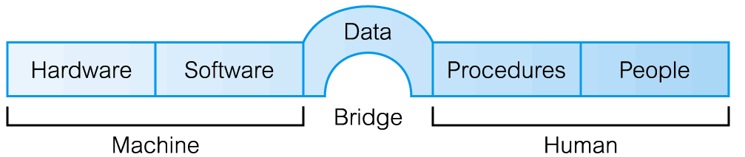
Database System Environment
The term database system refers to an organization of components that define and regulate the collection, storage, management, and use of data within a database environment.
From a general management point of view, the database system is composed of the five major parts: hardware, software, people, procedures, and data.

Slide 49
Database System Environment…
Hardware
Hardware refers to all of the system’s physical devices; for example, computers (PCs, workstations, servers, and supercomputers), storage devices, printers, network devices (hubs, switches, routers, fiber optics), and other devices (automated teller machines, ID readers, and so on).

Slide 50
Database System Environment…
2) Software
Although the most readily identified software is the DBMS itself, to make the database system function fully, three types of software are needed: operating system software, DBMS software, and application programs and utilities.
Operating system software manages all hardware components and makes it possible for all other software to run on the computers.
Examples of operating system software include Microsoft Windows, Linux, Mac OS, UNIX, and MVS.
DBMS software manages the database within the database system.

Slide 51
Database System Environment…
Some examples of DBMS software include Microsoft’s SQL Server, Oracle Corporation’s Oracle, Sun’s MySQL, and IBM’s DB2.
Application programs and utility software are used to access and manipulate data in the DBMS and to manage the computer environment in which data access and manipulation take place.
Application programs are most commonly used to access data found within the database to generate reports, tabulations, and other information to facilitate decision making.
Utilities are the software tools used to help manage the database system’s computer components.

Slide 52
Database System Environment…
3) People
This component includes all users of the database system.
On the basis of primary job functions, five types of users can be identified in a database system:
System Administrators
Database Administrators
Database Designers
System Analysts and Programmers
End Users
Each user type, described below, performs both unique and complementary functions.

Slide 53
Database System Environment…
3.1 System Administrators oversee the database system’s general operations.
3.2 Database Administrators, also known as DBAs, manage the DBMS and ensure that the database is functioning properly.
  In a database environment, the primary resource is the database itself, and the secondary resource is the DBMS and related software.

Slide 54
Database System Environment…
  Administering these resources is the responsibility of the database administrator (DBA).
  The DBA is responsible for:
  Authorizing access to the database,
  Coordinating and monitoring its use, and
  Acquiring software and hardware resources as needed.
  The DBA is accountable for problems such as
  Security breaches and poor system response time

Slide 55
Database System Environment…
3.3 Database Designers design the database structure.
They are, in effect, the database architects.
If the database design is poor, even the best application programmers and the most dedicated DBAs cannot produce a useful database environment.
Because organizations strive to optimize their data resources, the database designer’s job description has expanded to cover new dimensions and growing responsibilities.

Slide 56
Database System Environment…
A) Logical Designers
  Concerned with identifying the data, entities and attributes, relationships and constraints
  Need a complete knowledge of the organization's data and business rules
B) Physical Designers
  Decide how the logical database design is to be physically realized
  Map the logical database design into a set of tables
  Select specific storage structures and access methods
  Design security measures

Slide 57
Database System Environment…
3.4 System Analysts and Programmers design and implement the application programs.
Design and create the data entry screens, reports, and procedures through which end users access and manipulate the database’s data.
For example work based on the requirement specified by the system analyst.
Each program contains statements that request the DBMS to perform some operation on the database – retrieving, inserting, updating and deleting data

Slide 58
Database System Environment…
3.5 End users are the people who use the application programs to run the organization’s daily operations.
For example, salesclerks, supervisors, managers, and directors are all classified as end users.
High-level end users employ the information obtained from the database to make tactical and strategic business decisions.
End users are differentiated by the way they expect to interact with the system.

Slide 59
Database System Environment…
End Users can be either Native users or Sophisticated users
Naive Users
  Unaware of the DBMS and the DB
  Depend on the simplicity of the GUI
Sophisticated Users
  Familiar with the structure of the database and the facilities of the DBMS
  May use high-level query languages (SQL) to perform the required operation
  May even write application program for their own use

Slide 60
Database System Environment…
4) Procedures
Procedures are the instructions and rules that govern the design and use of the database system.
Procedures are a critical, although occasionally forgotten, component of the system.
Procedures play an important role in a company because they enforce the standards by which business is conducted within the organization and with customers.
Procedures are also used to ensure that there is an organized way to monitor and audit both the data that enter the database and the information that is generated through the use of those data.

Slide 61
Database System Environment…
5. Data
The word data covers the collection of facts stored in the database.
Because data are the raw material from which information is generated, the determination of what data are to be entered into the database and how those data are to be organized is a vital part of the database designer’s job.

Slide 62
Reading Assignment
Read about Database development life cycle and phases

