Slide 1
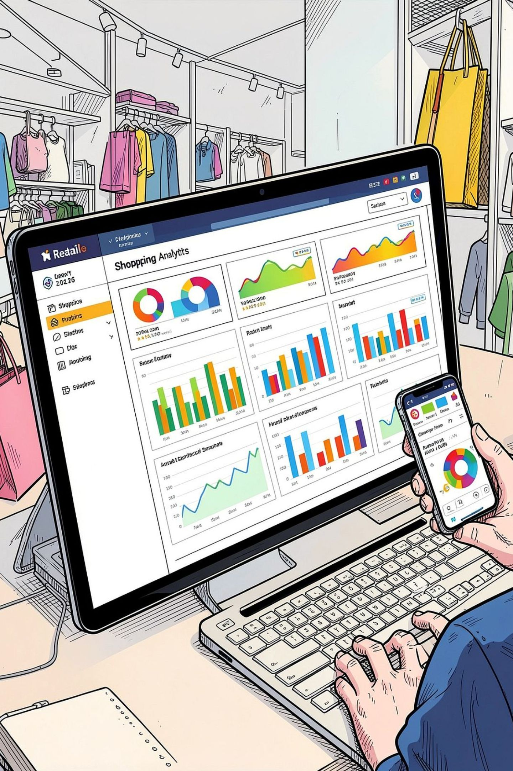
Customer Shopping Behavior Analysis
Uncovering insights from 3,900 transactions across product categories — spending patterns, customer segments, and subscription behavior to guide strategic business decisions.

Slide 2
Dataset at a Glance
3,900
18
Total Purchases
Features
Transactional records analyzed
Demographics, purchases & behavior
$59.76
37
Avg. Purchase
Missing Values
Mean spend per transaction
In Review Rating column only
Key features include customer demographics (age, gender, location, subscription status), purchase details (category, amount, season), and shopping behavior (discount applied, frequency, review rating, shipping type).

Slide 3




Data Preparation in Python
Cleaning & Standardization
Loaded via pandas, explored with df.info() and .describe(). Missing Review Ratings imputed using median by category. Columns renamed to snake_case.
Feature Engineering
Created age_group (binned ages) and purchase_frequency_days. Dropped redundant promo_code_used after checking against discount_applied.
Database Integration
Cleaned DataFrame loaded into Mysql for structured SQL analysis.

Slide 4
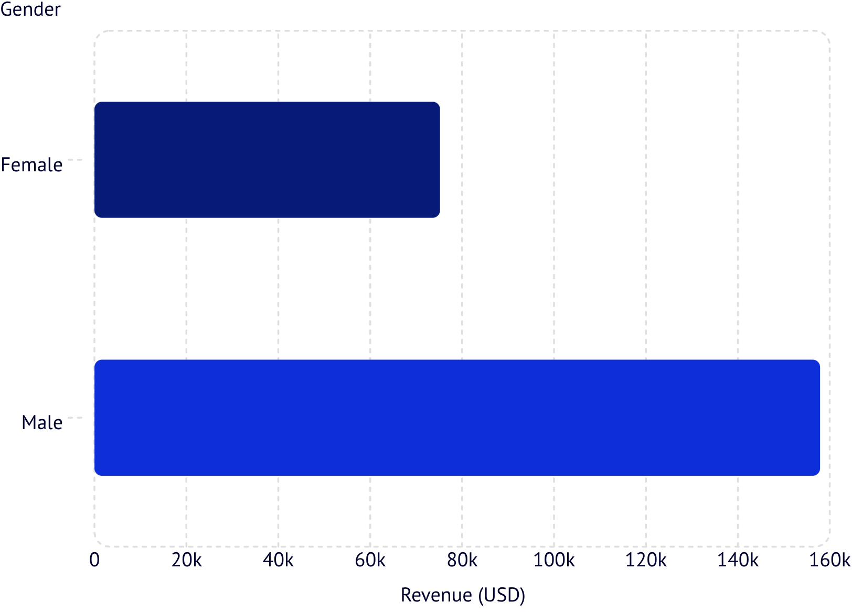
Revenue & Spending Insights
Revenue by Gender
Male customers generated 2.1× more revenue than female customers ($157,890 vs. $75,191).
High-Spending Discount Users
839 customers used discounts yet still spent above the average purchase amount — indicating strong deal-seeking behavior among high-value buyers.

Slide 5

Top Products & Shipping Behavior
Top 5 Products by Rating
Shipping Type Comparison
Express shipping averages $60.48 vs. $58.46 for Standard — a modest $2.02 premium.
Product | Avg Rating
Gloves | 3.86
Sandals | 3.84
Boots | 3.82
Hat | 3.80
Skirt | 3.78
Discount-Dependent Products
Hats, Sneakers, and Coats show the highest discount rates (49–50%), suggesting these categories rely heavily on promotions to drive sales.
Revenue by Gender
High-Spending Deals
Male revenue 2.1× female
Top Rated Products
Shipping Comparison
839 discount users high spend
Gloves, Sandals, Boots, Hat, Skirt
Discount-Dependent Items
Express $60.48 vs Standard $58.46
Hats, Sneakers, Coats ~49–50%

Slide 6
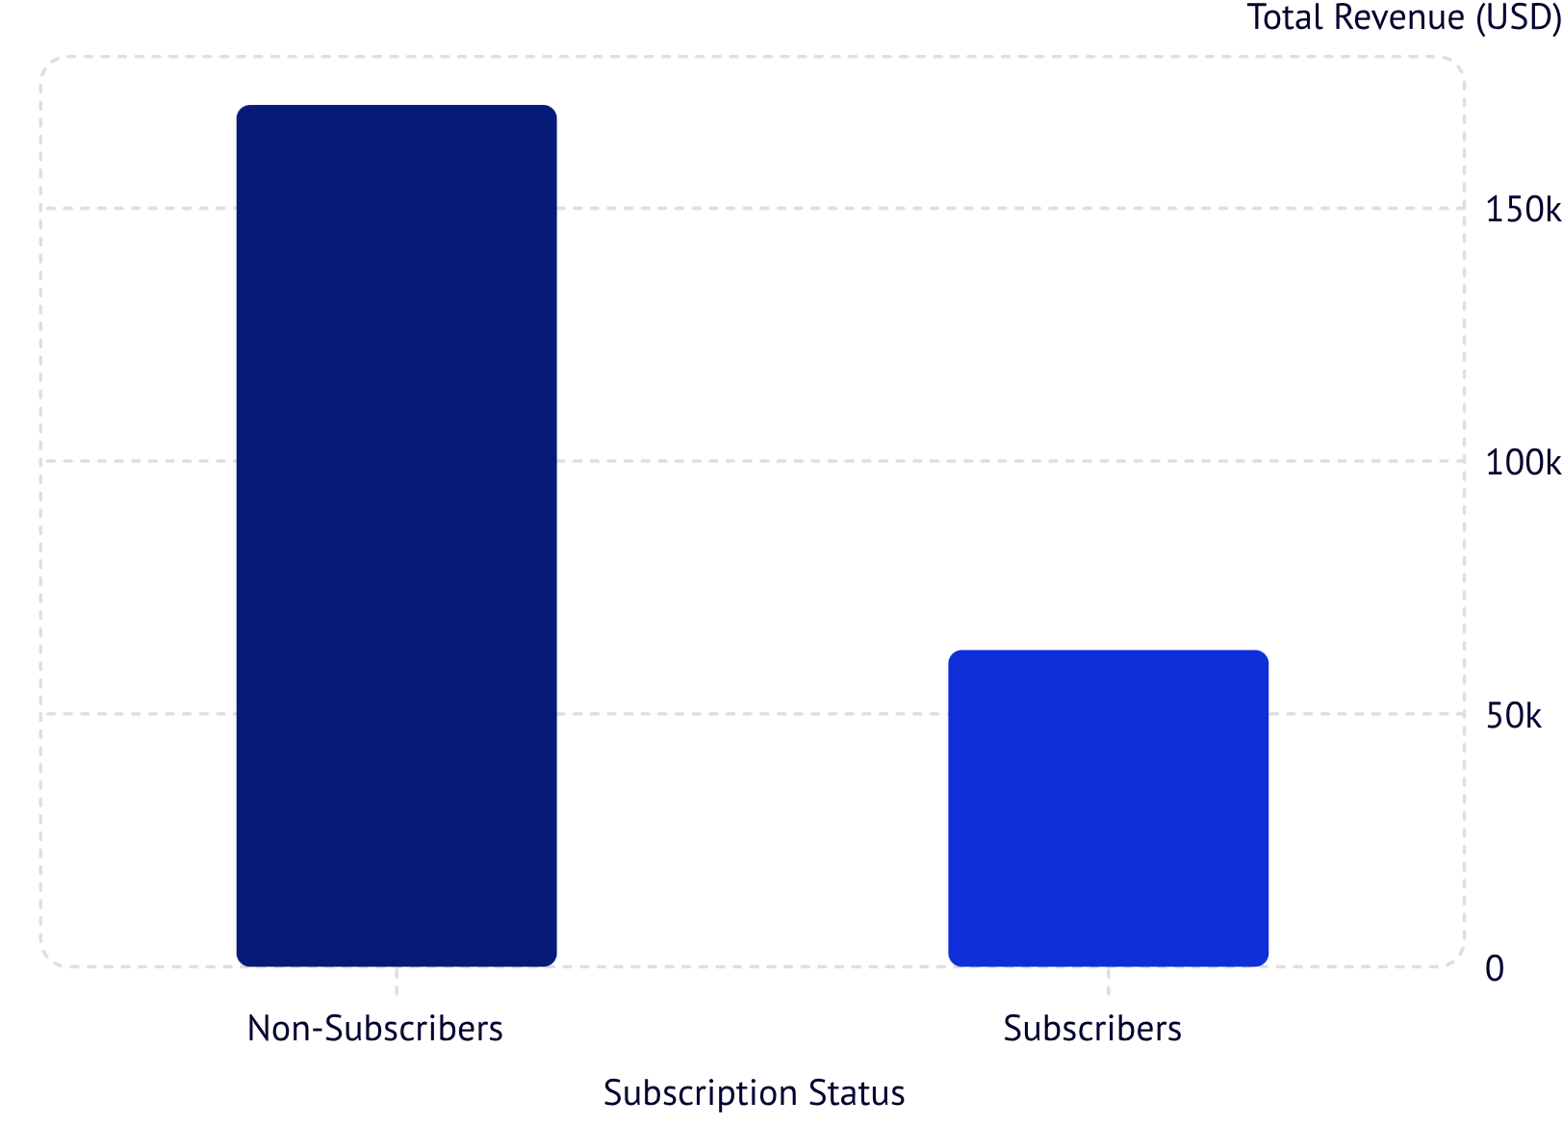
Subscription Behavior
Subscribers vs. Non-Subscribers
Non-subscribers drive 73% of total revenue (2,847 customers) vs. subscribers at 27% (1,053 customers). Average spend is nearly identical: $59.87 vs. $59.49.
Repeat Buyers & Subscriptions
Among customers with 5+ purchases, 958 are subscribers and 2,518 are not — indicating repeat buying alone doesn't guarantee subscription conversion.

Slide 7
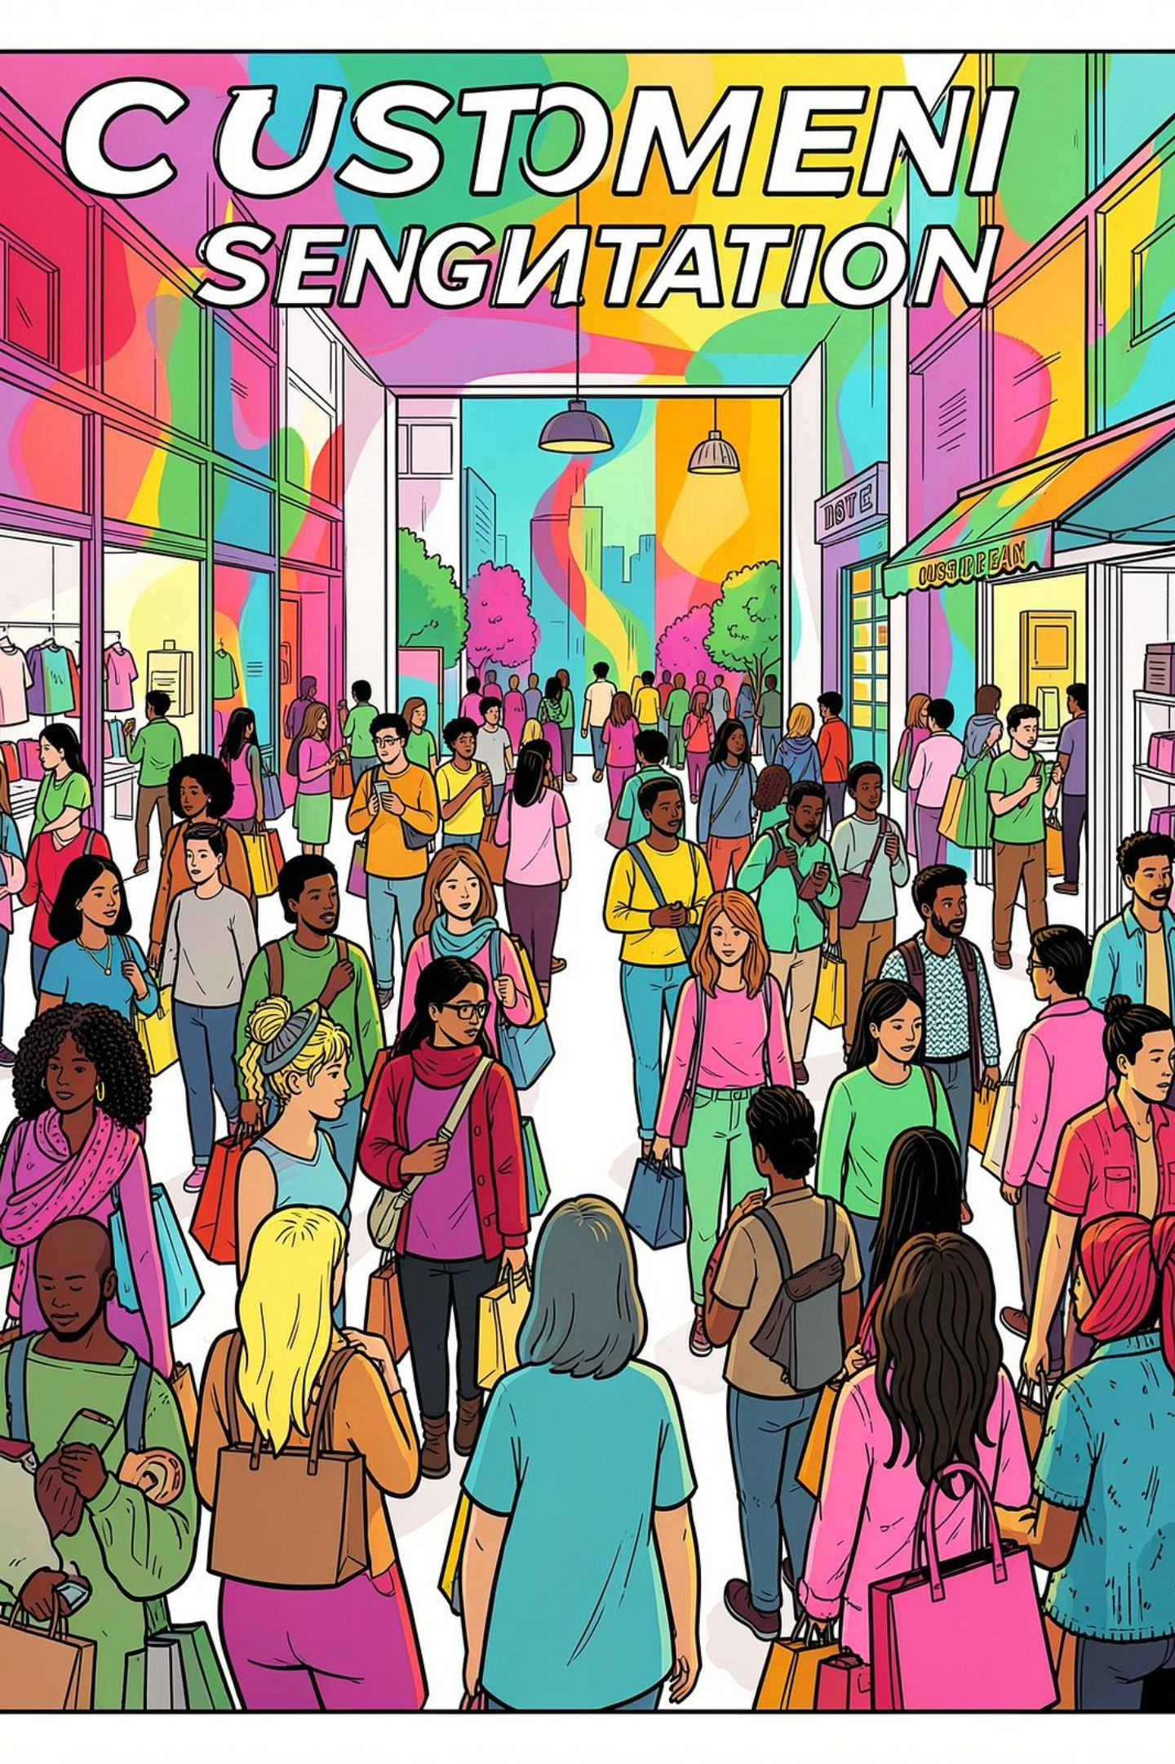
Customer Segmentation
🏆 Loyal
🔄 Returning
3,116 customers — the dominant segment, representing the vast majority of the customer base.
701 customers — engaged shoppers with potential to convert to loyal status.
🆕 New
83 customers — the smallest segment, representing growth opportunity.

Slide 8
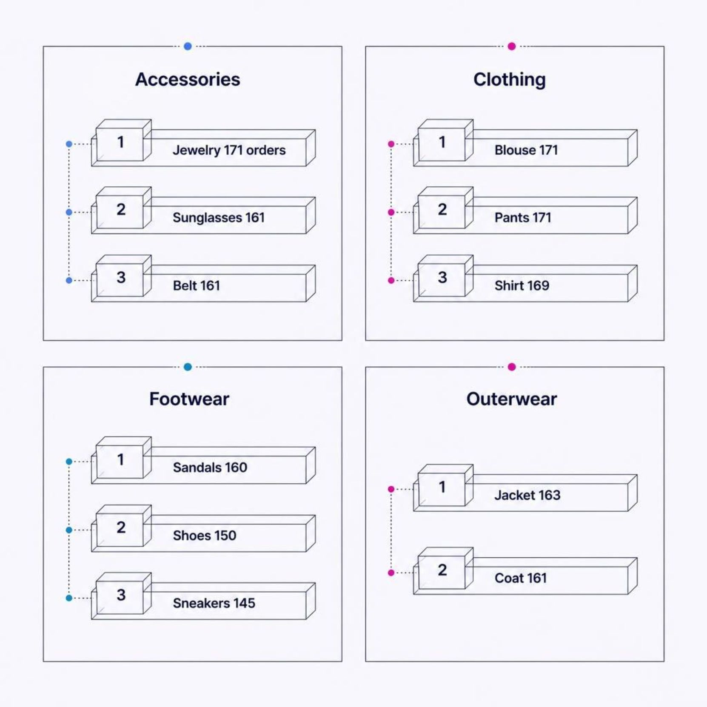

Top Products by Category
Best-Sellers Across Categories
Clothing leads in volume with Blouse, Pants, and Shirt each at ~170 orders. Outerwear shows strong performance with Jacket and Coat. Footwear is led by Sandals at 160 orders.
Jewelry is the top accessory with 171 orders, tied with Blouse and Pants as the highest-ordered individual products overall.

Slide 9
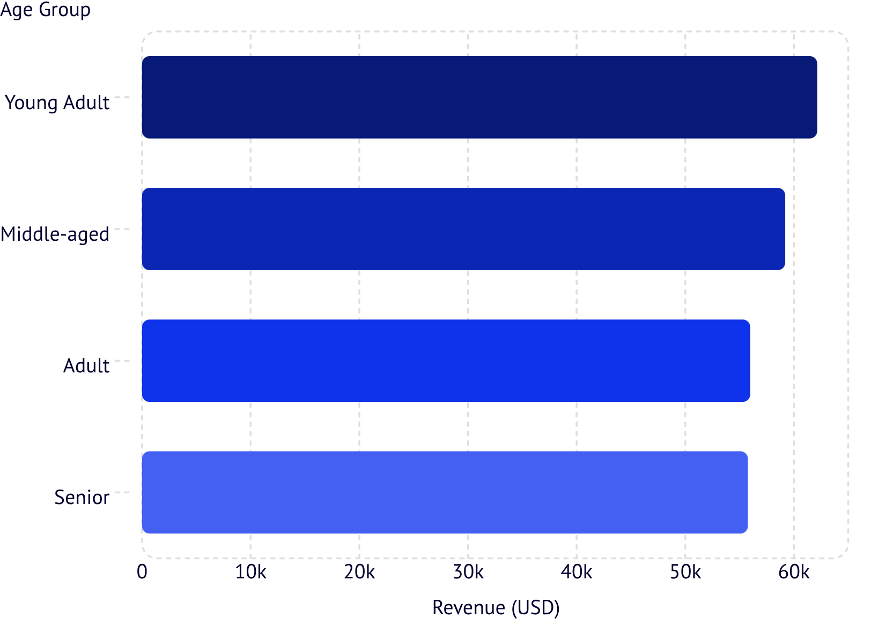
Revenue by Age Group
Age Group Revenue Contribution
Young Adults lead revenue at $62,143, followed closely by Middle-aged ($59,197). Revenue is relatively evenly distributed across all four age groups, suggesting broad market appeal.
Age range in dataset: 18–70 years, with a mean age of 44.

Slide 10




Dashboard & Business Recommendations
An interactive Power BI dashboard visualizes all key metrics: 3.9K customers, $59.76 avg. purchase, 3.75 avg. rating — with filters for subscription, gender, category, and shipping.
Boost Subscriptions
Promote exclusive benefits to convert the 73% non-subscriber base.
Loyalty Programs
Reward repeat buyers to grow the Loyal segment (currently 3,116).
Review Discount Policy
Balance sales boosts with margin control — 50% of Hat purchases use discounts.
Targeted Marketing
Focus on Young Adults and express-shipping users for highest ROI.

