Slide 1
Network optimization
case study: Lima, Peru –

Slide 2
Questions to answer
Project context
The Ministry of Health of Peru is preparing an investment program that aims to contribute to the provision of timely, appropriate, efficient and high-quality services in primary health care facilities owned by MINSA and the regional governments. The ultimate goals of the program are to improve the health of the Peruvian population that does not have access to health services through social security or private insurance, and to strengthen the health sector's governance, efficiency, and equity.
To deliver health services to the population, policy makers need to make strategic decisions about placement of health facilities, considering the spatial distribution of the target population, the needs of beneficiaries, and the supply capacity of health systems.
These network optimization tools use operations research modeling and analysis to solve facility location problems. The results are then used to inform the decision-making process.
What areas are not well covered by the facility network?
What areas have redundant and over-coverage?
Which are the most important hospitals that should be kept open, dependent on the average travel time between households and facilities?

Slide 3
STEP 2B: Optimization analysis
WORKFLOW
Types of Analysis
Optimization
modeler
(julia)
P-Median Problem
Solver
(CbC, CPLEX, or Gurobi)
Partial Set-Covering Problem
Maximal Covering Location Problem (MCLP)
STEP 3: Post-Processing, visualization, and interpreting results
STEP 1: Pre-Processing
STEP 2A: Accessibility analysis
Inputs
Visualization & Mapping
Origins
weight
Origin – Destination (OD) Matrix
Jupyter notebooks
Inputs:
Destinations
GOSTnets
(python)
-travel time (driving, walking)
-travel distance
-weighted (optional)
Selected optimal facilities
weight
Step 1 & step 2 input data
GIS software
(ArcGIS or QGIS)
Mapping network node back to original facility points
Additional parameters
Road Network OSM
speed limits
Potentially adjust model and repeat step 2

Slide 4
STEP 2 Detailed Workflow: Accessibility analysis
Origins
weight
Python / Jupyter Notebook
Destinations
Step1 – Extract road network from OpenStreetMap
weight
Step2 – Transform road network into routable network
Road Network
speed limits
speed limits
Step3 – Data preparation for OD matrix computation
Step4 – Map accessibility results back to shapefile
Implementation
GOSTnets
ArcGIS/QGIS
Origin – Destination Matrix (OD)
Geospatial data manipulation and visualization
-travel time (driving, walking)
-travel distance
-weighted (optional)

Slide 5
STEP 2 Detailed Workflow: Optimization analysis
Inputs
Origin – Destination (OD) Matrix
Types of Analysis
P-Median Problem
Optimization
modeler
(JuMP/julia)
Solver
(CbC, CPLEX, or Gurobi)
Outputs
-travel time (driving, walking)
-travel distance
-weighted (optional)
Partial Set-Covering Problem
Selected optimal facilities
Maximal Covering Location Problem (MCLP)
Additional parameters
JuMP is a domain-specific modeling language for mathematical optimization embedded in Julia. Using JuMP/Julia for our location optimization problems is currently under development. We are planning to complete three mixed-integer programming location science models for the first phase. The input to these models are the OD Matrix and additional parameters depending on the type of analysis. Solvers are the only binary dependencies. JuMP currently supports a number of open-source and commercial solvers.
Installing and using an open-source solver such as CbC would be appropriate for problems of a smaller size. To be able to solve larger problems and to increase performance a commercial solver such as CPLEX or Gurobi is recommended.

Slide 6
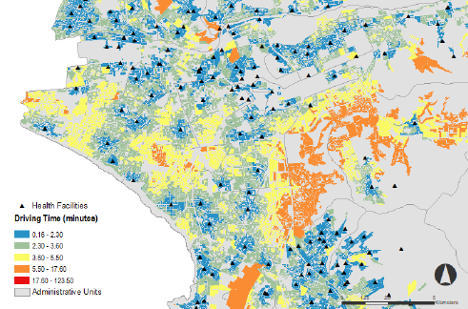
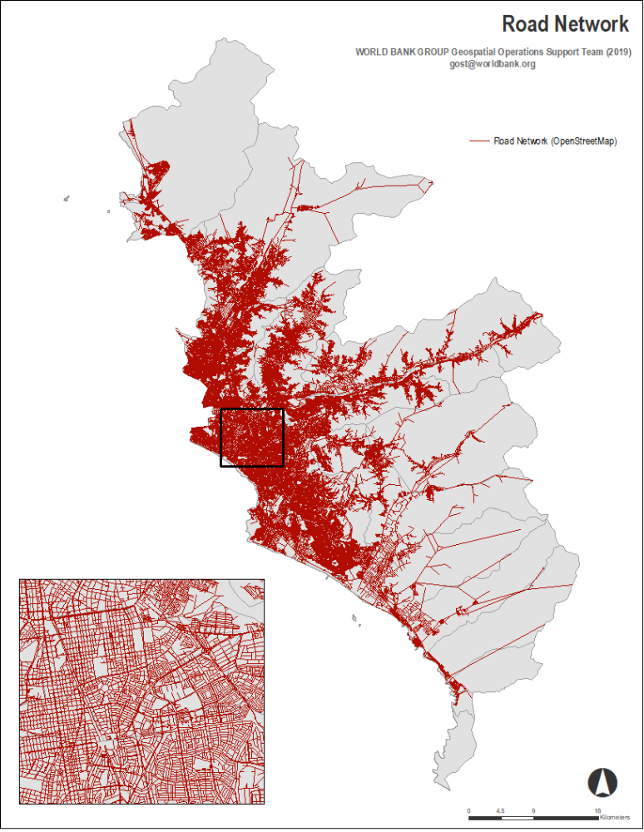
Spatial Data: Apartment Blocks
-constitutes the origins of the access analysis
Quantitative Data: Population information at block level (census)
-will represent the weight of each block in the access analysis
Spatial Data: Health Facilities
-constitutes the destinations of the access analysis
GOSTnets library
Compute the Origin Destination Matrix
Output: access to health facilities
Quantitative Data: Capacity of each facility (personnel, number of beds)
-will represent the weight of each facility in the optimization analysis
Spatial Data: Road Network
-to compute travel time and travel distance from each origin to each destination
Quantitative Data: Speed limits for each road segment
-will influence the travel time between each origin and destination

Slide 7
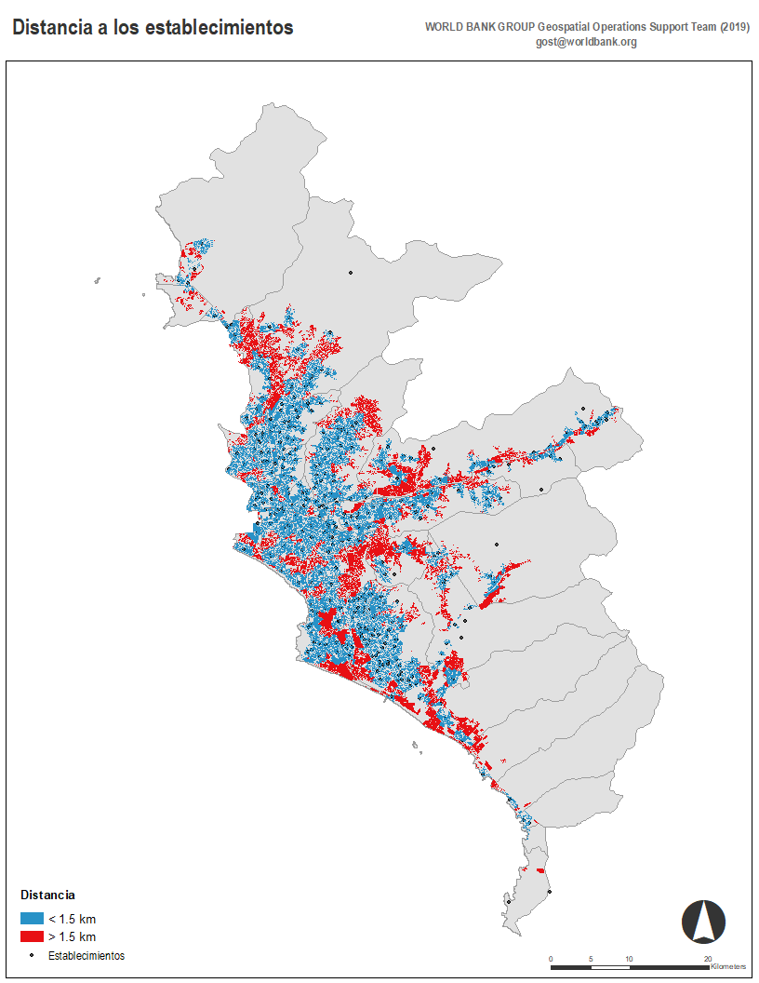
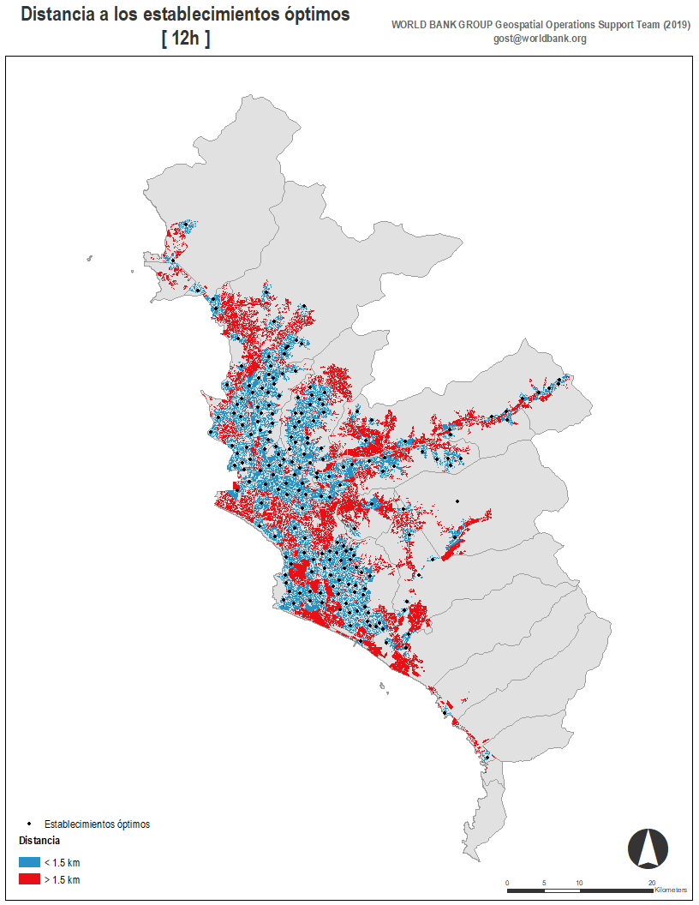
Before: 289 facilities
After: 210 facilities

