Slide 1
A Very Short Intro to
Git and Github

Slide 2
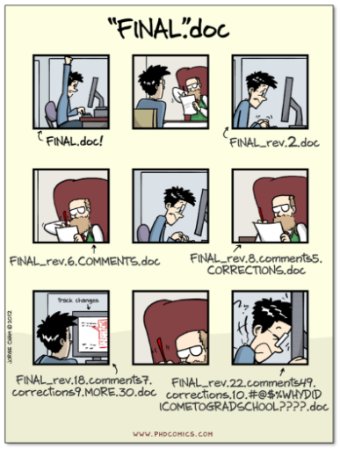

Slide 3
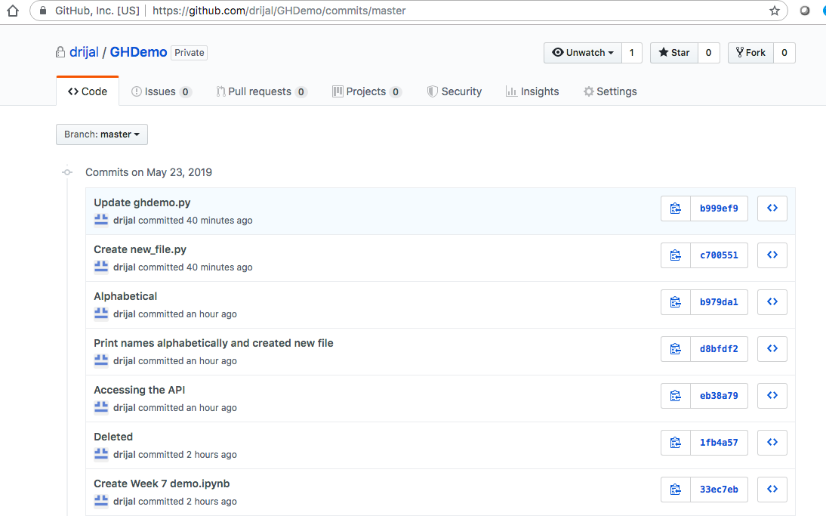
Git
Tracks and manages project versions
Each version is called a “commit,” which is a snapshot of the entire working directory
Branches make it possible to have multiple living versions of project.
Allows for comparison/merging of different versions

Slide 4
git commands
  git help
  git status
  git add .
  git commit –m “comment”
  git push
  git pull
  git checkout <branch_name>
  git merge <branch_name>
  git resources: https://git-scm.com/doc

Slide 5
GitHub
A code-sharing platform
Helps organize and manage contributions to your project (data, code, instructions for use)
Great for collaboration!
GitHub Desktop: Graphical User Interface (GUI) that allows us to use most features of git

Slide 6
Setup and Explore
STEP 1: Create a GitHub.com account if you don’t have one already
STEP 2: Download and Install GitHub Desktop from: https://desktop.github.com/
STEP 3: Log in using GitHub.com account
STEP 4: Clone an existing repository or create a new one
STEP 5: Explore how to: commit changes, push, pull, compare differences between branches, merge, etc.
GitHub Desktop documentation: https://help.github.com/en/desktop/contributing-to-projects

