Slide 1
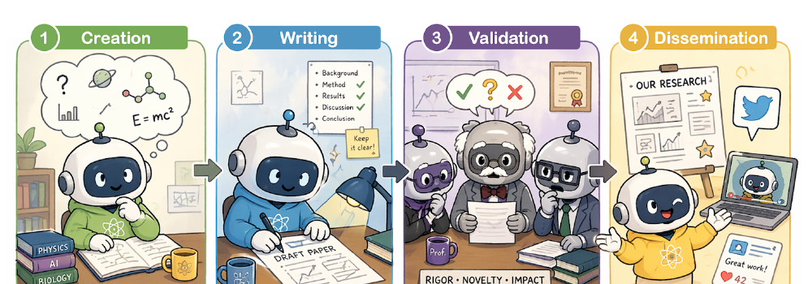
AI for Auto-Research
A Survey of AI Across the Complete Academic Research Lifecycle
From local assistance to lifecycle-level research automation.
Core framing of the survey
4
8
5
50+
phases
stages
method families
benchmarks
Paper focus: capability, reliability, and governance boundaries for AI-assisted research.
AI for Auto-Research: A Survey
1

Slide 2
Why this survey now?
AI systems are moving from single-task assistants to autonomous research workflows.
Cost frontier
$15 papers
Long horizon agents
End-to-end systems
Automated pipelines can generate complete research-like artifacts at very low cost.
Agents can run for many hours, execute experiments, draft manuscripts, and simulate critique.
Tools now span ideation, retrieval, coding, writing, review, rebuttal, and Paper2X.
The field lacks a unified analysis of reliability across the complete lifecycle.
The bottleneck is no longer whether AI can produce research-like artifacts; it is whether AI can preserve evidence, judgment, provenance, and accountability.
Motivation
AI for Auto-Research: A Survey
2

Slide 3
Central thesis
Generation has outpaced scientific verification.
What AI is increasingly good at
What remains fragile
Producing fluent artifacts
Following templates and rubrics
Retrieval-grounded synthesis
Tool-mediated execution
Fast iteration and formatting
Novelty and research promise
Semantic correctness of experiments
Faithful claim-evidence links
Review judgment and robustness
Accountability across phases
Reliable deployment = human-governed collaboration
AI for Auto-Research: A Survey
3

Slide 4
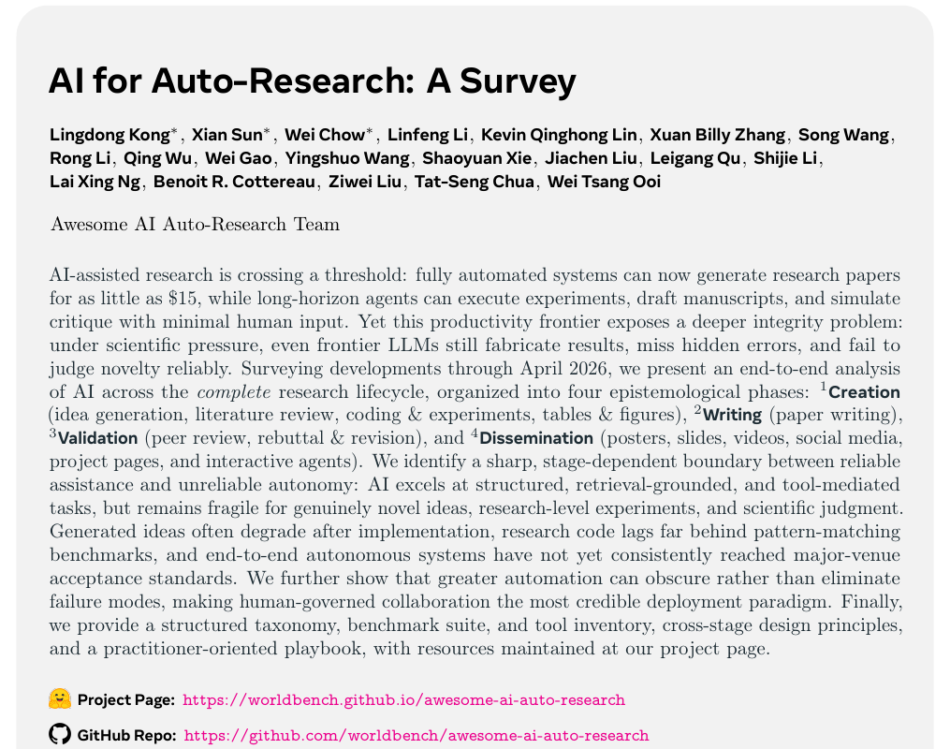
Scope and corpus
The survey covers public systems, tools, and benchmarks through April 2026.
Coverage
Collection strategy
Inclusion criteria
Academic research workflows in computer science and machine learning, including cross-disciplinary systems when they support research tasks.
Keyword search, citation snowballing, community repositories, open-source projects, and benchmark leaderboards.
Targets a lifecycle stage, is publicly accessible, and provides enough method or evaluation detail for critical analysis.
AI for Auto-Research: A Survey
4

Slide 5
Lifecycle framework
Four epistemological phases organize the full research process.
1
2
3
4
Creation
Writing
Validation
Dissemination
Produce ideas, evidence, code, tables, and figures
Organize evidence into scholarly arguments and manuscripts
Subject claims to review, critique, rebuttal, and revision
Translate papers into posters, slides, videos, pages, and agents
The lifecycle is not strictly linear: review can trigger new experiments, and dissemination can reveal ambiguities that require rewriting.
Feedback loops are first-class objects
AI for Auto-Research: A Survey
5

Slide 6
Eight stages
The taxonomy separates different AI capabilities and risk profiles.
1
Idea Generation
2
Literature Review
3
Coding & Experiments
4
Tables & Figures
Hypotheses, research questions, candidate directions
Retrieval, synthesis, citation support, deep research
Code generation, paper-to-code, orchestration
Plots, method diagrams, formulas, pseudocode
5
Paper Writing
6
Peer Review
7
Rebuttal & Revision
8
Paper2X
Drafting, editing, citation-aware manuscript construction
Review drafting, meta-review support, reviewer matching
Comment analysis, response writing, revision planning
Posters, slides, videos, social media, project pages, agents
Each stage has different grounding signals, evaluation protocols, and failure modes.
AI for Auto-Research: A Survey
6

Slide 7
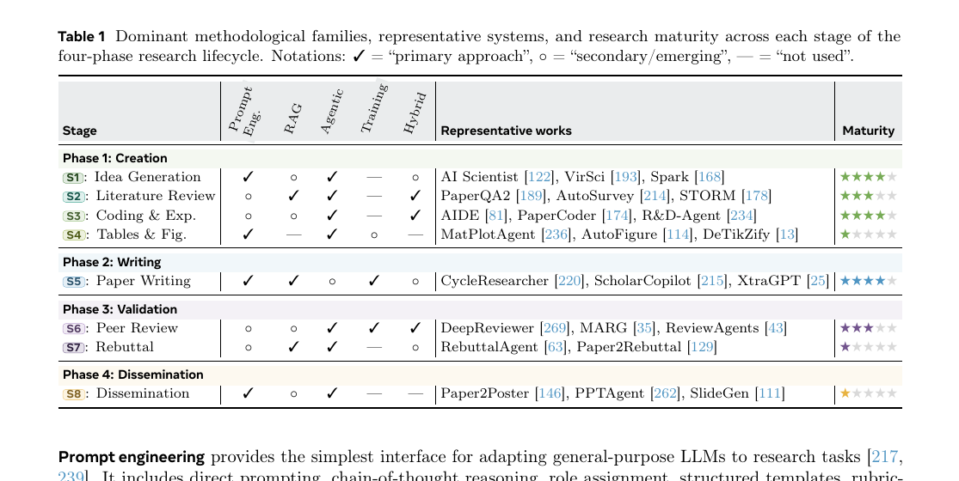
Methodological families
Most systems combine a small set of recurring design patterns.
Prompting
RAG
Agentic
Training
Hybrid
Templates, roles, rubrics, CoT
Grounding in papers, code, logs, graphs
Planning, tools, memory, self-reflection
SFT, preference, RL, domain adaptation
Coupled orchestration with grounding and scoring
AI for Auto-Research: A Survey
7

Slide 8
Development timeline
The field shifted from local assistance to multi-stage orchestration.
Before 2024
2024
2025-2026
Single-stage assistants: literature QA, coding, domain-specific workflows
Early end-to-end agents: idea -> experiment -> paper -> review-style evaluation
Specialized agents and benchmarks for nearly every lifecycle stage
This trajectory makes orchestration, evaluation, reliability, and governance as important as model scale.
Timeline implication
AI for Auto-Research: A Survey
8

Slide 9
P1
Creation: producing research artifacts
The richest current ecosystem, but uneven maturity
Core question: what is the contribution and what evidence supports it?
Four stages: ideation, literature review, coding/experiments, tables/figures
Creation
Writing
Validation
Dissemination
Ideas, evidence, artifacts
Argument and manuscript
Critique and revision
Paper2X communication
AI for Auto-Research: A Survey
9

Slide 10
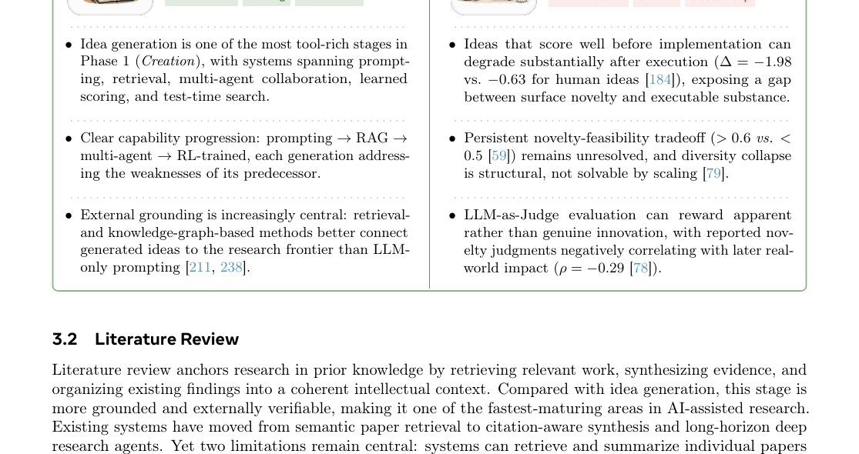
S1 - Idea generation
High apparent novelty, but persistent execution and feasibility gaps.
Approaches
Progress
Main limitation
Direct prompting; retrieval- and knowledge-graph-grounded generation; multi-agent debate; learned scoring; test-time search.
Systems increasingly connect generated ideas to literature, trends, and structured scientific knowledge.
Ideas often look novel before implementation but degrade after execution; LLM judges may overvalue surface novelty.
AI for Auto-Research: A Survey
10

Slide 11
S2 - Literature review
One of the fastest-maturing areas because it is externally grounded.
Retrieval
Synthesis
Dense retrieval, citation graphs, agentic multi-step search
Survey generation, outline planning, topic organization
Deep research agents
Evaluation
Plan -> retrieve -> read -> update -> synthesize
Citation accuracy, coverage completeness, coherence, grounding
Literature review insight
Key bottleneck: generating plausible related-work text is easier than grounding each claim in the correct source.
AI for Auto-Research: A Survey
11

Slide 12
S3 - Coding and experiments
Executable code is not enough: research code must implement the intended algorithm.
Capability progression
Code generation
Paper-to-code
Experiment agents
Analysis
local code tasks
reproduce methods
orchestrate runs
interpret results
Where AI helps
Where AI struggles
Boilerplate, debugging, small code modifications, benchmark harnesses, logs, and experiment scheduling.
Novel research implementation, hidden assumptions, semantic mismatches, reproducibility, and experiment design.
AI for Auto-Research: A Survey
12

Slide 13
S4 - Tables and figures
Visual plausibility can hide scientific inaccuracies.
What is generated
Assessment axes
Open issue
Plots, comparison tables, method diagrams, algorithms, equations, and LaTeX/TikZ figures.
Visual fidelity, data correctness, notation consistency, comparison structure, and scientific meaning.
A figure may look publication-ready while misrepresenting data, symbols, or causal relationships.
Takeaway: scientific visualization requires both design quality and evidence preservation.
AI for Auto-Research: A Survey
13

Slide 14
P2
Writing: organizing evidence into argument
Paper writing is not just formatting
It requires rhetorical structure, citation grounding, and claim-evidence alignment
Full-paper generation remains much less reliable than section-level assistance
Creation
Writing
Validation
Dissemination
Ideas, evidence, artifacts
Argument and manuscript
Critique and revision
Paper2X communication
AI for Auto-Research: A Survey
14

Slide 15
S5 - Paper writing
Mature tool support, but the hardest parts are argumentation and evidence control.
Reliable assistance
Unreliable autonomy
Best deployment
Grammar polishing, restructuring, section drafting, consistency checks, LaTeX assistance, and style transfer.
Unsupported claims, shallow framing, hallucinated citations, weak novelty positioning, and rhetorical overclaiming.
Human-led writing with AI as a drafting, editing, retrieval, and revision assistant.
Writing converts artifacts into claims; this is where evidence, narrative, and responsibility must stay aligned.
AI for Auto-Research: A Survey
15

Slide 16
P3
Validation: external critique and revision
Validation is where scientific claims are challenged
AI can assist review, meta-review, rebuttal, and revision planning
But judgment, fairness, and accountability cannot be delegated safely
Creation
Writing
Validation
Dissemination
Ideas, evidence, artifacts
Argument and manuscript
Critique and revision
Paper2X communication
AI for Auto-Research: A Survey
16

Slide 17
S6 - Peer review
Automated reviews can be coherent yet lenient, biased, or manipulable.
Review generation
Meta-review support
Reviewer matching
Evaluation risks
Structured critique, summaries, strengths, weaknesses, scores
Aggregation, conflict detection, decision rationales
Expertise retrieval and topic-author matching
Bias, robustness, grounding, score calibration, manipulation
Review fluency is not the same as scientific scrutiny; the evaluation target must be grounded, robust judgment.
Peer review insight
AI for Auto-Research: A Survey
17

Slide 18
S7 - Rebuttal and revision
The key question is whether responses lead to fulfilled, verifiable revisions.
Review comments
Analysis
Response draft
Revision
Verification
Concerns and requests
Group issues, detect evidence gaps
Answer, commit, clarify
Run experiments, edit manuscript
Check commitments are fulfilled
Potential benefit
Main risk
AI can cluster reviewer concerns, map them to required evidence, and improve clarity of responses.
AI-generated rebuttals may promise changes that the final manuscript does not actually fulfill.
AI for Auto-Research: A Survey
18

Slide 19
P4
Dissemination: Paper2X communication
Dissemination artifacts increasingly shape how research is understood
Posters, slides, videos, project pages, demos, and agents need fidelity constraints
Audience adaptation must not become evidence distortion
Creation
Writing
Validation
Dissemination
Ideas, evidence, artifacts
Argument and manuscript
Critique and revision
Paper2X communication
AI for Auto-Research: A Survey
19

Slide 20
S8 - Paper2X dissemination
Communicating research requires compression without overstatement.
Poster
Slides
Video/Talk
Social Media
Project Page/Agent
visual hierarchy, concise story
narrative arc, audience pacing
script, timing, visual demonstration
visibility, framing, accessible summary
interactive access and adoption
Evaluation should focus on fidelity, usability, and audience adaptation - because dissemination artifacts can circulate independently from the paper.
Dissemination insight
AI for Auto-Research: A Survey
20

Slide 21
Cross-phase research systems
End-to-end agents expose the limits of autonomy.
Sequential pipelines
Search/self-improvement
Fixed stage-by-stage workflows
Generate, evaluate, iterate
Skill/tool integrated
Multi-agent systems
Specialized tools and execution environments
Role specialization and simulated critique
Cross-phase implication
End-to-end coverage increases the importance of provenance, checkpoints, and phase-boundary verification.
AI for Auto-Research: A Survey
21

Slide 22
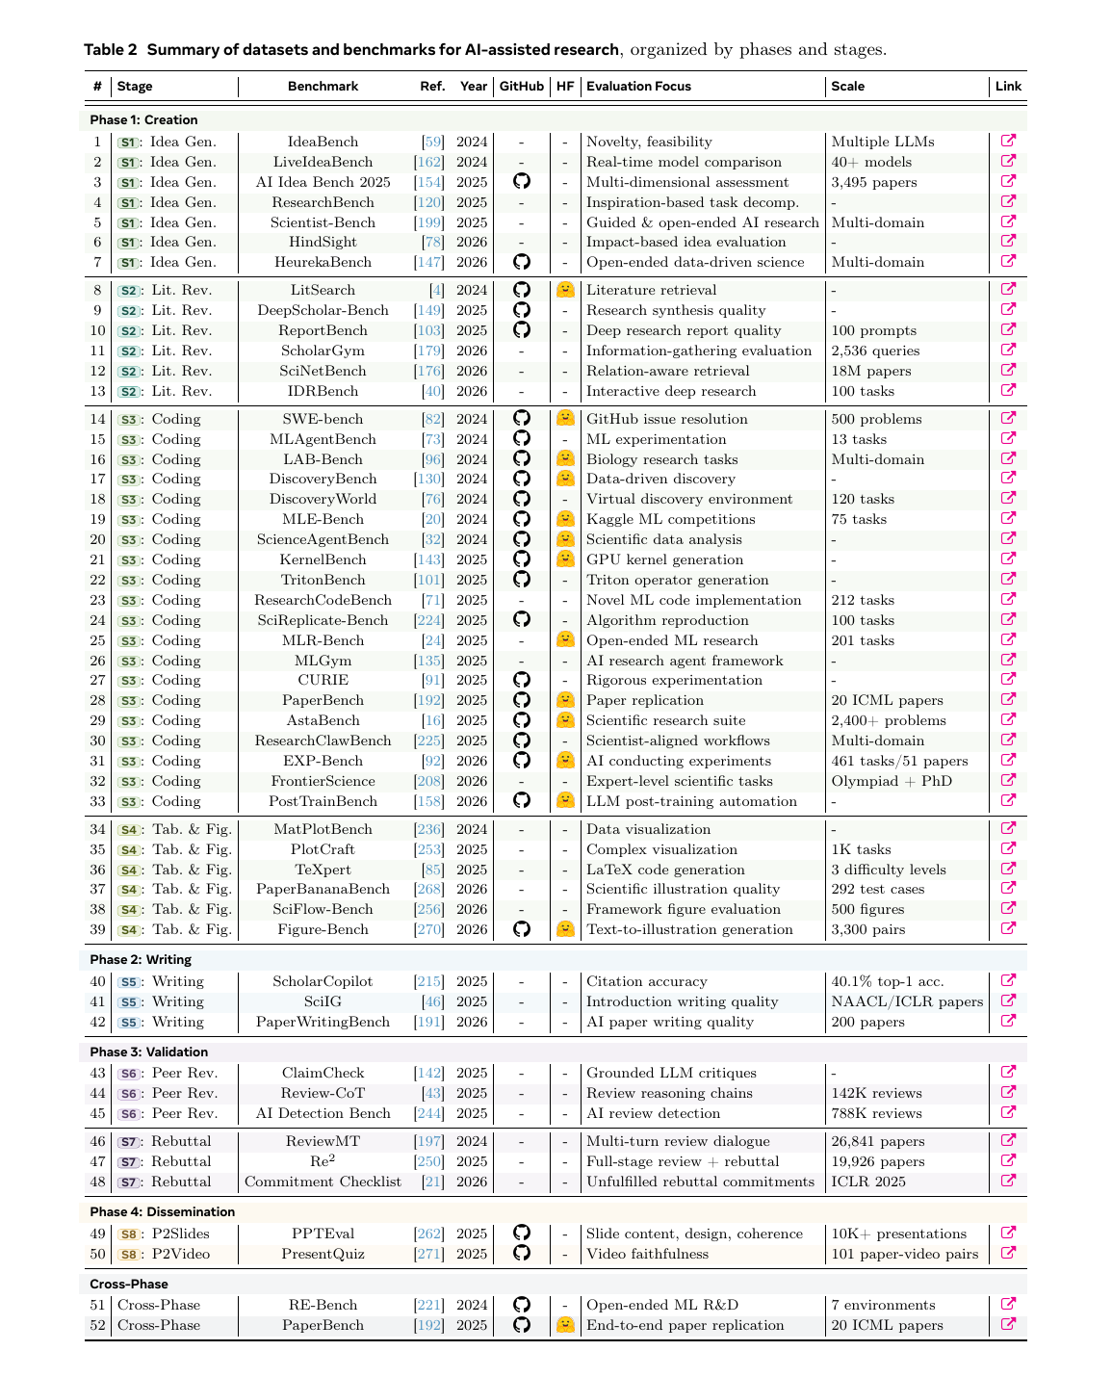
Benchmark landscape
Benchmarks are becoming stage-specific, domain-aware, and workflow-aware.
Evaluation trend
From isolated proxy metrics toward stage-specific, multi-axis assessment.
Remaining gap
Benchmark performance can still diverge from real research value.
AI for Auto-Research: A Survey
22

Slide 23
Capability boundary
Reliability depends on structure, grounding, and external checkability.
More reliable
Less reliable
Structured tasks
Grounded retrieval
Tool-mediated execution
Clear rubrics
External verification
Open-ended novelty
Implicit field judgment
Long-horizon research design
Unsupported claims
Opaque autonomy
AI excels as a collaborator, not a scientist-in-the-loop replacement.
AI for Auto-Research: A Survey
23

Slide 24
Failure propagation
Errors introduced early can be amplified downstream.
Idea
Experiment
Manuscript
Review/Rebuttal
Dissemination
shallow novelty
wrong implementation
unsupported claim
missed flaw or empty promise
overstated summary
The lifecycle view exposes hidden dependency chains: AI outputs must carry evidence, provenance, and verification signals across phase boundaries.
Why the taxonomy matters
AI for Auto-Research: A Survey
24

Slide 25
Design principles for reliable AI-assisted research
From artifact generators to trustworthy research collaborators.
1. Provenance across the lifecycle
2. Grounding over self-judgment
Link ideas, evidence, code, figures, claims, reviews, rebuttals, and dissemination artifacts
Use retrieval and execution signals rather than purely textual self-evaluation
3. Human checkpoints
4. Transparent AI involvement
Place expert review at phase boundaries where errors propagate
Make assistance visible for readers, reviewers, and institutions
AI for Auto-Research: A Survey
25

Slide 26
Practitioner playbook
How to use AI across the lifecycle without outsourcing scientific judgment.
Use AI for
Do not outsource
Search, summarization, and first-pass synthesis
Novelty claims without literature verification
Boilerplate code and debugging support
Research-level implementation semantics
Drafting, polishing, and restructuring
Argumentation and claim-evidence alignment
Review/rebuttal scaffolding
Final judgment, commitments, and responsibility
Poster/slide/social-media drafts
Fidelity to paper evidence and limitations
AI for Auto-Research: A Survey
26

Slide 27
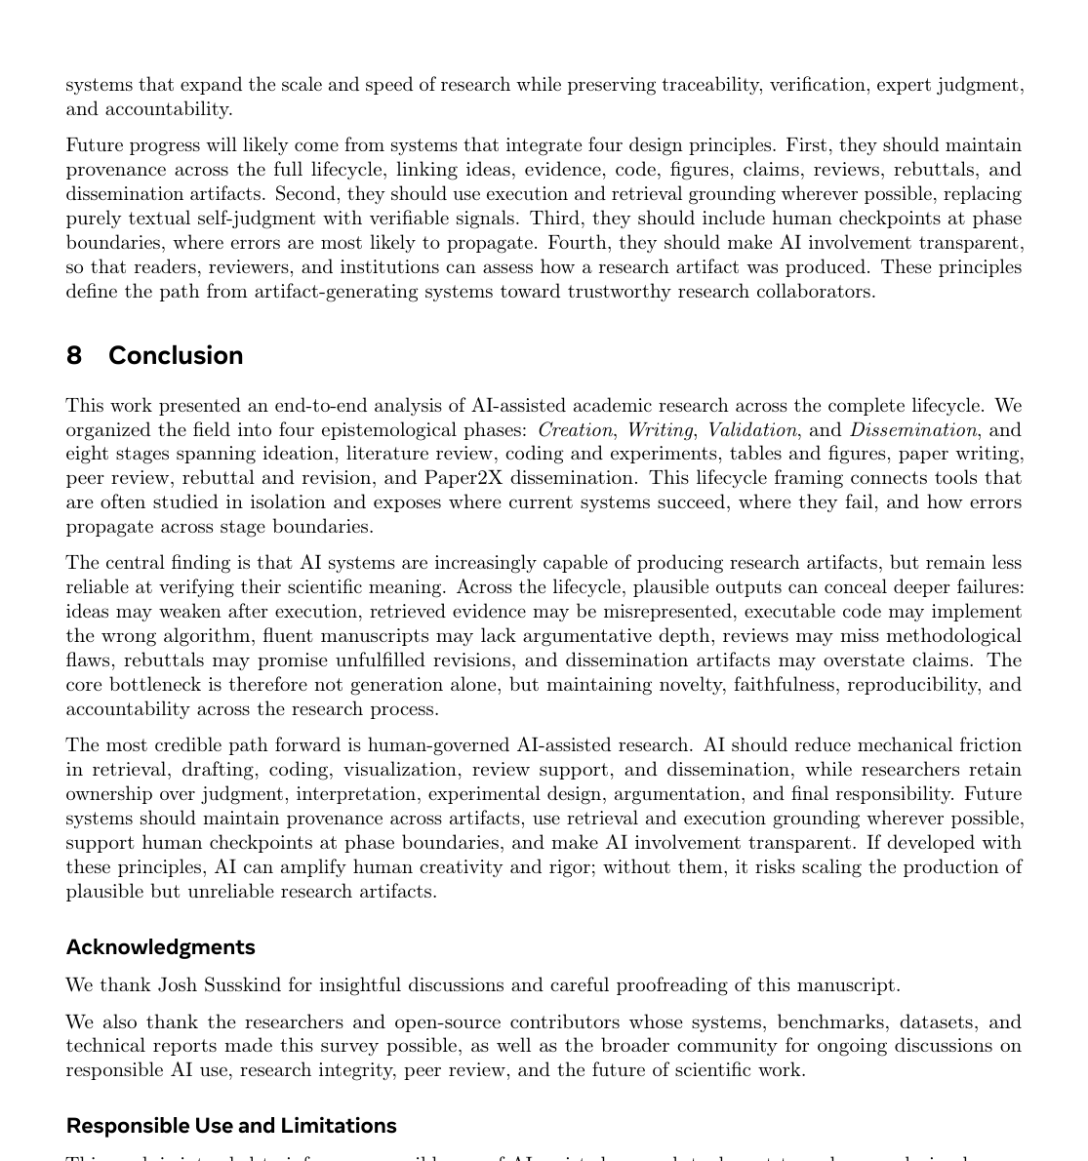
Responsible use and limitations
The paper argues for reliable human-governed automation, not full replacement.
Responsible use
Human responsibility
Limitations
AI should assist retrieval, drafting, coding, visualization, review support, and dissemination.
Researchers retain ownership of novelty, interpretation, verification, authorship, and accountability.
The field evolves quickly; this survey is a structured snapshot through the search cutoff.
AI for Auto-Research: A Survey
27

Slide 28
Final takeaway
AI can amplify research, but only if verification scales with generation.
The credible future is not fully autonomous science, but human-governed AI-assisted research with provenance, grounding, checkpoints, and transparent responsibility.
Main message
Generation
Verification
Governance
fast, fluent, scalable
hard, slow, expert-dependent
the missing control layer
Project: worldbench.github.io/awesome-ai-auto-research | GitHub: github.com/worldbench/awesome-ai-auto-research
AI for Auto-Research: A Survey
28

