Slide 1
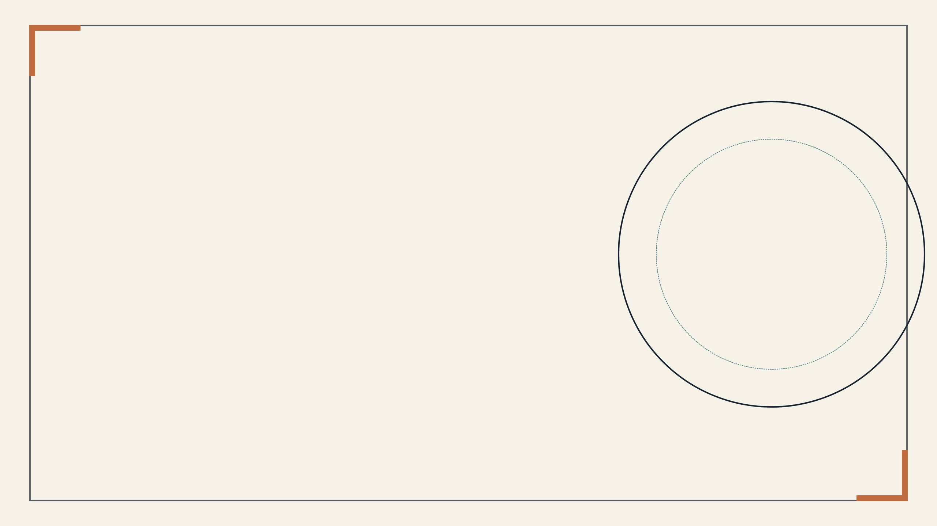
PAPER INTRODUCTION DECK
S1
AI for Auto-Research:
A Survey
S8
S2
CREATION
Introducing the complete lifecycle of AI-assisted academic research
S7
S3
DISSEMINATION
WRITING
VALIDATION
S6
S4
Prepared from Kong et al., AI for Auto-Research: A Survey (2026)
S5
Lifecycle view: from ideation and evidence gathering to manuscript writing, validation, revision, and Paper2X communication.

Slide 2

WHY THIS SURVEY MATTERS
Research automation is crossing a threshold
AI systems can now produce research-like artifacts quickly, but scientific reliability has not advanced at the same pace.
$15
Approximate cost per full paper in The AI Scientist.
Signals that end-to-end production is becoming economically feasible.
100
Papers generated by FARS after 228 hours and 11.4B tokens.
The survey frames the field around a central tension: generation is becoming cheap and scalable, while verification, provenance, and accountability remain difficult.
Shows that long-horizon agents can sustain large-scale research production.
5.0→7.5
ARIS improved a draft score after 20+ GPU experiments.
Points toward connected loops of experimentation, review, and revision.
KONG ET AL., AI FOR AUTO-RESEARCH: A SURVEY, 2026

Slide 3

CORE FRAMING
The paper reframes research as a lifecycle
The survey’s main contribution is a four-phase, eight-stage taxonomy that connects tools usually studied in isolation.
Creation
Writing
Validation
Dissemination
S1 Idea generation
S5 Paper writing
S6 Peer review
S8 Paper2X
S2 Literature review
S7 Rebuttal & revision
S3 Coding & experiments
S4 Tables & figures
AI ROLE
AI ROLE
AI ROLE
Convert artifacts into scholarly narratives, sections, citations, and revisions.
Critique, score, synthesize reviews, draft responses, and track revisions.
Transform papers into slides, posters, talks, websites, social posts, and agents.
AI ROLE
Produce hypotheses, evidence, code, analyses, and visual research artifacts.
RISK
RISK
RISK
Fluent prose can conceal weak reasoning or unsupported claims.
Review-like or rebuttal-like text may not be fair, grounded, or fulfilled.
Format shifts can distort claims, evidence, or limitations.
RISK
Plausible artifacts may be non-novel, unfaithful, or scientifically wrong.
Lifecycle lens
The taxonomy reveals not just stage-level capabilities, but how errors propagate when one artifact becomes input to the next.

Slide 4

METHODOLOGICAL SUBSTRATE
Five method families recur across stages
Current systems differ by lifecycle stage, but repeatedly combine the same building blocks for generation, grounding, orchestration, adaptation, and verification.
METHOD FAMILY
STRENGTH
LIMITATION
Prompt engineering
Fast, flexible, and usable without task-specific training.
Sensitive to wording, weakly grounded, and difficult to audit across long workflows.
Retrieval-augmented generation
Grounds outputs in papers, citations, code, logs, or external records.
Sources may be incomplete, version-inconsistent, or faithfully retrieved but misused.
Training-free agents
Plan, call tools, maintain state, and iterate across research subtasks.
Tool errors and weak self-critique can propagate through phase handoffs.
Training-based methods
Improve task format, domain vocabulary, scoring consistency, and style control.
Depend on data quality and may overfit benchmark, venue, or reviewer norms.
Hybrid systems
Combine grounding, execution, specialization, and orchestration in one workflow.
Require explicit state management, provenance, and verification design.
The recurring pattern
EXPLORE
Search over hypotheses, paper collections, code variants, response plans, or design alternatives.
EXECUTE
Use retrieval engines, code interpreters, experiment runners, plotting tools, and editors.
VERIFY
Check whether intermediate outputs are grounded, correct, useful, and traceable to evidence.
KONG ET AL., AI FOR AUTO-RESEARCH: A SURVEY, 2026

Slide 5

CREATION PHASE
Creation shows the production–verification gap
AI is increasingly strong at producing early research artifacts, but each Creation stage exposes a different verification failure that can propagate downstream.
Production
Verification
S1
S2
S3
S4
Idea generation
Literature review
Coding & experiments
Tables & figures
PROGRESS
PROGRESS
PROGRESS
PROGRESS
Prompting, retrieval, multi-agent critique, and RL-style scoring now generate large pools of plausible hypotheses.
Retrieval, citation graphs, survey drafting, and deep research agents can organize large paper collections.
Agents can write code, call tools, execute experiments, inspect outputs, and iterate on implementations.
Systems can create plots, tables, diagrams, formulas, and pseudocode that look publication-ready.
BOTTLENECK
BOTTLENECK
BOTTLENECK
BOTTLENECK
Ideas that sound novel can weaken after implementation; novelty and feasibility remain in tension.
Coverage gaps, citation drift, and weak multi-paper reasoning can create persuasive but unfaithful narratives.
Research code may execute successfully while implementing the wrong algorithm or testing the wrong claim.
Visual polish can hide wrong labels, invalid comparisons, or data relationships unsupported by evidence.
Checkpoint: test whether the idea remains executable and meaningful after evidence gathering.
Checkpoint: verify citation fidelity, source coverage, and relationship claims across papers.
Checkpoint: combine execution logs with semantic tests, reproduction checks, and expert review.
Checkpoint: trace every visual element back to data, logs, notation, and manuscript claims.
Central pattern
Creation-stage systems increasingly generate the raw materials of research; trustworthy automation depends on making each artifact traceable, executable, and scientifically defensible before it enters Writing.

Slide 6

STAGE S2 · LITERATURE REVIEW
Literature review is maturing fastest
Retrieval → Deep Research
Literature tools have advanced quickly because their inputs are external, searchable, and comparatively checkable; the hard part is turning retrieved evidence into faithful synthesis.
S2 is the clearest testbed for grounded synthesis
01Single-pass retrieval
Find and summarize papers from large corpora.
Coverage can remain partial, and the system may miss central or contradictory work.
The survey shows a rapid progression from paper search and summarization toward agentic workflows that plan, retrieve, read, update, and organize evidence across multiple sources.
02Structure-aware surveys
Build outlines, themes, and related-work narratives.
A coherent narrative can still hide missing methodological links or weak comparisons.
03Multi-agent workflows
Separate retrieval, verification, organization, and writing roles.
Coordination helps, but citation correctness and state consistency remain fragile.
The maturity signal is not only better retrieval. It is the shift toward systems that preserve source links while constructing an interpretable research narrative.
04Deep research agents
Iteratively plan, search, read, revise queries, and synthesize evidence.
Reliability beyond ML and NLP remains under-tested across domains and workflows.
Evaluation shift
Benchmarks are moving from “did it retrieve the right paper?” toward citation accuracy, coverage completeness, narrative coherence, and factual grounding.

Slide 7

CREATION STAGE RISK: S3 AND S4
Coding and figures expose semantic risk
The most dangerous failures are hidden: outputs can execute, render, or look publication-ready while still being scientifically wrong.
ARTIFACT
AI CAN INCREASINGLY DO
WHY VERIFICATION REMAINS ESSENTIAL
Surface success is not scientific correctness
Research code
Generate implementations, translate papers into code, and run experiment loops.
Semantic mismatch:
code may execute while implementing the wrong algorithm or assumption.
The survey emphasizes that research artifacts must be evaluated by what they mean, not only by whether they run, compile, plot, or appear polished.
Experiments
Run prescribed comparisons and summarize quantitative outputs.
Design gap:
choosing meaningful tests and interpreting failures still require domain judgment.
Runnable code + polished visuals ≠ validated research evidence
Figures & tables
Produce plots, diagrams, comparison tables, formulas, and pseudocode.
Visual plausibility:
labels, relationships, notation, or comparisons can misrepresent evidence.
Verification implication
Execution logs
Semantic tests
Provenance links
Human review
Preserve what was actually run and
Check intent, not only syntax or pass
Tie code, data, figures, and claims
Keep scientific interpretation under
observed.
rates.
together.
expert control.
KONG ET AL., AI FOR AUTO-RESEARCH: A SURVEY, 2026

Slide 8

WRITING PHASE · S5 PAPER WRITING
Writing is fluent, but not necessarily rigorous
AI writing assistance is now mainstream, but the survey argues that the hard problem is not prose polish; it is argumentative depth, evidentiary grounding, and author accountability.
DEVELOPMENT
EVIDENCE FROM THE SURVEY
INTERPRETATION
S5
From polished prose to validated argument
Broad adoption
Detectable AI modification appears in a substantial share of CS and biomedical abstracts; self-reported use is higher.
AI writing support is already embedded in scientific practice, making governance more important than detection alone.
Paper-writing systems can draft, polish, restructure, cite, and revise manuscripts. Their credibility depends on whether claims remain connected to evidence, not whether the language sounds scholarly.
Near-reviewable generation
Strong automated systems approach accepted-paper review scores but remain below accepted-paper averages.
Surface fluency is no longer the main constraint; scientific substance still separates plausible drafts from publishable work.
INPUT
Ideas, literature, code, experiments, figures, and tables.
Rubric-guided revision
Some systems obtain strong expert preference for revised drafts through structured feedback and iterative refinement.
Rubrics can improve drafts, but they do not replace human judgment over claims, interpretation, and responsibility.
OUTPUT
Abstracts, sections, citations, responses, and full drafts.
AUDIT
Every major claim should trace back to evidence and limitations.
Failure mode
Unsupported persuasion: polished text that is readable, citation-like, and reviewer-aware, yet weakly grounded in executed evidence or faithful source interpretation.
KONG ET AL., AI FOR AUTO-RESEARCH: A SURVEY, 2026

Slide 9
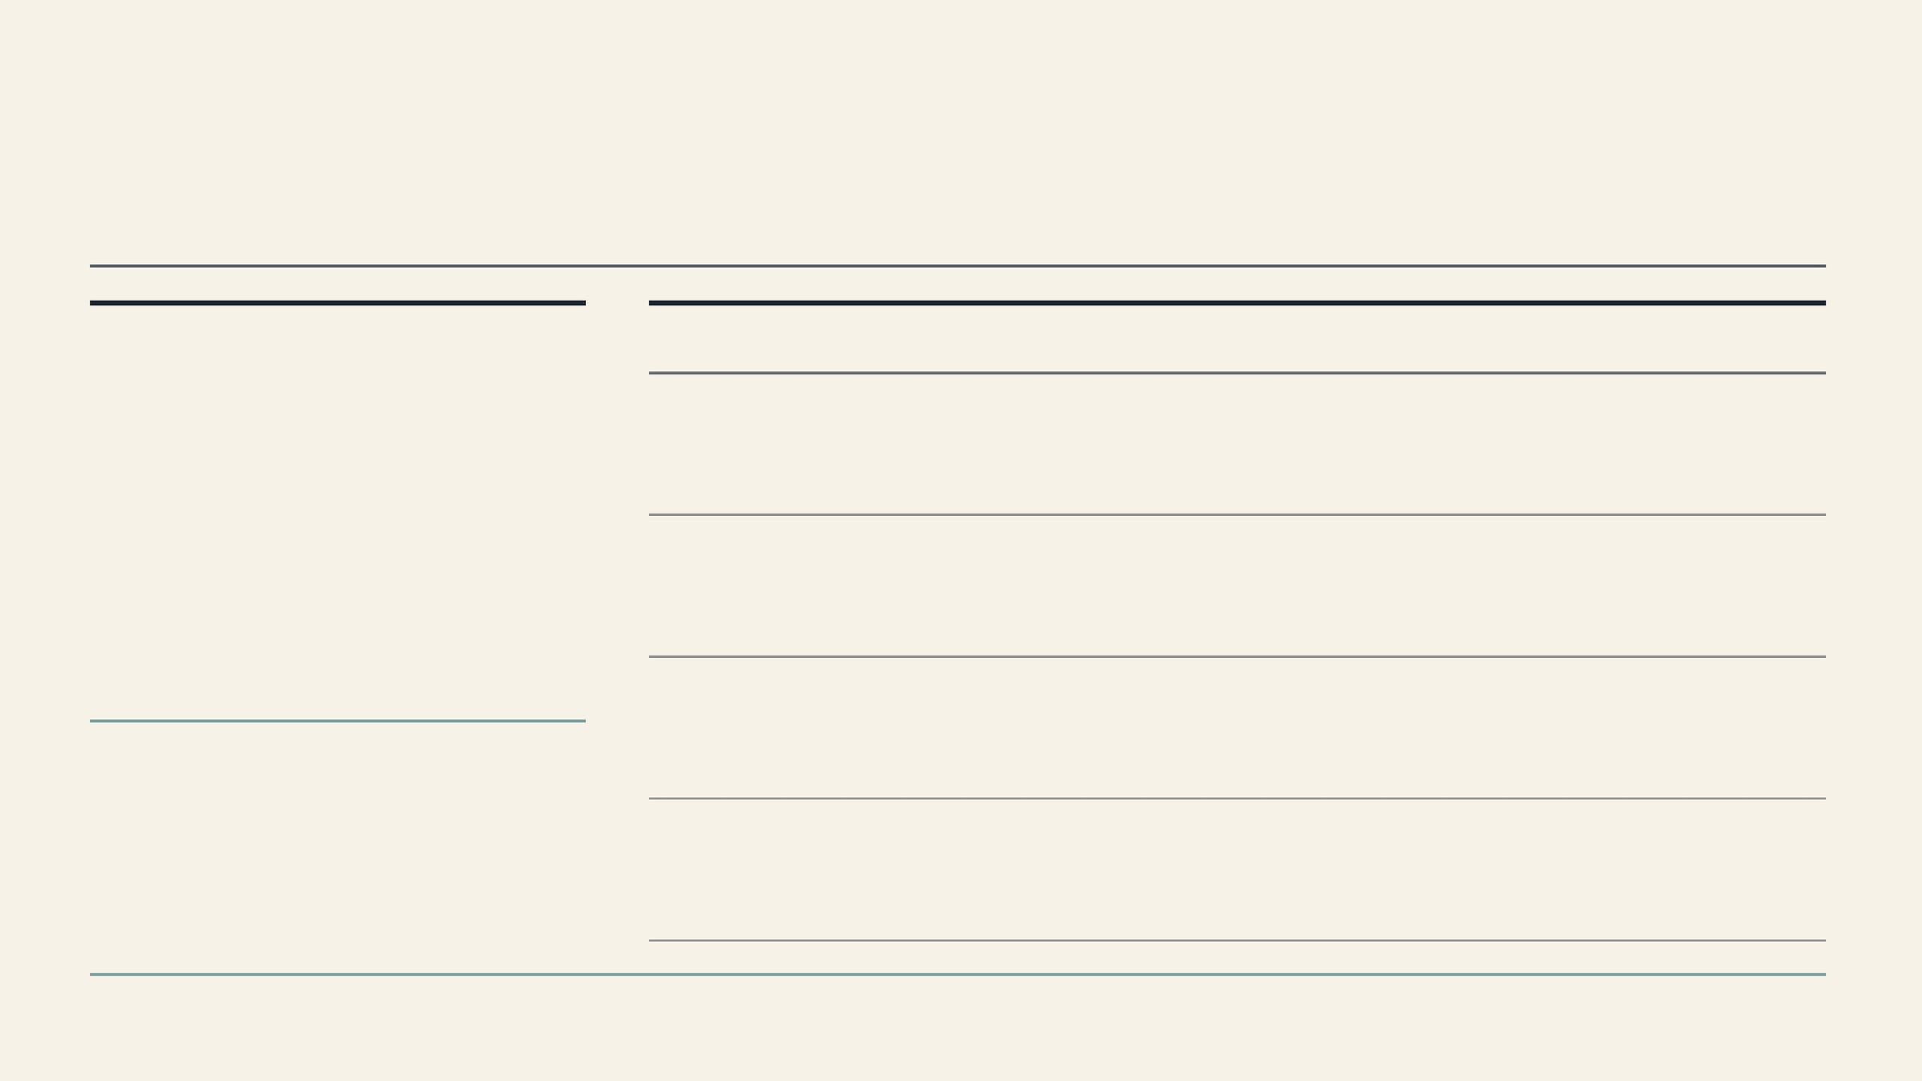
VALIDATION PHASE · S6 AND S7
Validation is where autonomy becomes risky
AI can assist review and rebuttal, but standalone judgment remains unsafe in high-stakes scholarly evaluation.
VALIDATION TASK
USEFUL AI ROLE
RISK IF OVER-AUTOMATED
The useful mode is human-governed critique, not delegated judgment
Peer review feedback
Improve human-written reviews by flagging missing evidence, unclear reasoning, or unsupported criticism.
Delegation risk:
standalone reviews may inflate scores, miss decisive flaws, or mimic review style without depth.
Validation is where research artifacts become claims about quality, correctness, and contribution. The survey shows that AI can improve the review process, but its judgments remain vulnerable to leniency, bias, manipulation, and weak grounding.
Reviewer matching & meta-review
Assist editorial coordination by summarizing reviewer signals, conflicts, and disagreement patterns.
Signal risk:
coordination tools can amplify weak reviews, hidden bias, or inconsistent criteria.
Rebuttal drafting
Decompose concerns, retrieve supporting evidence, and help authors plan response structure.
Persuasion risk:
polished responses may promise experiments or changes that are not later fulfilled.
89%
Revision tracking
Link reviewer concerns to manuscript changes, evidence additions, and clarified claims.
Traceability risk:
In an ICLR 2025 randomized study cited by the survey, LLM feedback improved human review quality in 89% of cases without changing acceptance rates.
without auditable diffs, rebuttal quality becomes rhetoric rather than accountability.
Validation principle
AI should strengthen evidence checking, review completeness, rebuttal planning, and revision traceability while humans retain final responsibility for fairness, methodological judgment, and acceptance decisions.
KONG ET AL., AI FOR AUTO-RESEARCH: A SURVEY, 2026

Slide 10

STAGE S8 · PAPER2X DISSEMINATION
Dissemination lowers cost but raises fidelity concerns
Paper2X systems make research communication cheaper and more adaptable, but every format shift can change what the audience believes the paper claims.
FORMAT
WHAT AI ENABLES
MAIN FIDELITY CHALLENGE
The risk moves from creation cost to claim fidelity
Posters & slides
Editable, feedback-aware conversion from paper to visual narrative.
Compression:
caveats and negative results can disappear.
AI can turn a paper into visual, spoken, social, web, or interactive artifacts. The survey argues that these outputs should be judged by whether they preserve evidence, limitations, and scope.
Videos & talks
Coordination of slides, narration, subtitles, timing, and demonstrations.
Synchronization:
multimodal elements may misalign claims and evidence.
Paper
→
Public artifact
Social & project pages
Audience-adapted summaries for broader visibility and reuse.
Simplification:
nuance can become exaggeration.
Validated claims, evidence, assumptions, and limitations.
Compressed narrative that may circulate independently.
Interactive paper agents
Expose methods, code, workflows, and explanations through dialogue.
Scope creep:
users may apply tools beyond validated conditions.
Operating principle
Dissemination outputs should remain editable drafts under author oversight, not autonomous public communication. Fidelity, usability, and audience adaptation must be evaluated together.
KONG ET AL., AI FOR AUTO-RESEARCH: A SURVEY, 2026

Slide 11

END-TO-END RESEARCH SYSTEMS
End-to-end systems amplify handoff failures
Lifecycle-scale systems are impressive because they connect stages; their main risk is silent error propagation when one artifact becomes the next stage’s premise.
ARCHITECTURE
ADVANTAGE
HANDOFF RISK
Where failure propagates
Sequential pipelines
Simple flow from idea generation to experiments, writing, and revision.
Compounding premise error:
The survey argues that many failures occur between stages, not only inside individual tools.
a weak idea or wrong code can become a polished paper.
S1→S3
Promising idea weakens after implementation.
Search-based systems
Explore alternatives through tree search, evolution, sampling, or self-improvement.
Metric over-optimization:
search can optimize shallow scores if evaluators are weak.
S2→S5
Retrieved evidence becomes overstated claims.
S3→S4
Experiment logs become misleading figures.
Skill-based systems
Use modular tools for retrieval, coding, analysis, writing, and evaluation.
State loss:
artifacts lose provenance when modules do not share traceable context.
S4→S5
Visual artifacts become unsupported manuscript claims.
Multi-agent systems
Role separation supports specialization, critique, and parallel exploration.
Coordinated misconception:
agents may share errors or produce deliberation without better science.
Evaluation question
Not “Can the system produce a paper?” but “Can it maintain scientific fidelity across the complete lifecycle?”

Slide 12

CONCLUSION AND FUTURE DIRECTION
The credible path is human-governed automation
The survey argues against unchecked full autonomy and for reliable, transparent AI assistance that expands research capacity while preserving scientific judgment.
DESIGN PRINCIPLE
PRACTICAL MEANING
Operating doctrine
Automate friction; do not outsource science
01Maintain provenance
Link hypotheses, papers, code, experiments, figures, claims, reviews, rebuttals, and revisions so downstream artifacts remain auditable.
02Ground outputs in evidence
Use retrieval, execution, citation validation, logs, and reproducibility checks instead of textual self-judgment alone.
AI systems should accelerate retrieval, drafting, coding, visualization, review support, and dissemination. Researchers should retain ownership over what counts as evidence, contribution, interpretation, and responsible publication.
03Checkpoint phase boundaries
Verify handoffs where errors propagate: idea to experiment, evidence to claim, review to revision, and paper to public artifact.
04Make AI use transparent
Shift governance from unreliable detection toward disclosure, attribution, and accountability for high-risk uses.
Core boundary: generation can be delegated; accountability for claims, citations, experiments, rebuttal commitments, and public summaries cannot.
Closing takeaway
AI can amplify human creativity and rigor when it preserves judgment, interpretation, experimental design, argumentation, and final responsibility.
KONG ET AL., AI FOR AUTO-RESEARCH: A SURVEY, 2026

