Slide 1
DEVELOP A SEO TOOL TO ANALYZE A LIVE WEB PAGE

Slide 2
ABSTRACT
This project aims to utilize web scraping techniques in Python to extract and analyze data from Forbes' annual list of the world's highest-paid celebrities.
Forbes publishes this list to showcase the earnings and influence of celebrities from various industries, providing valuable insights for fans, industry professionals, and marketers interested in understanding the financial aspects of the celebrity world
The extracted data will include the celebrity's name, earnings for the year, and their ranking on the list.
This data will be stored in a CSV file for further analysis

Slide 3
OBJECTIVE
The project aims to develop a sophisticated SEO tool specifically tailored to analyze and optimize the online presence of the world's highest-paid celebrities.
The tool will encompass a range of features designed to provide comprehensive insights
And actionable recommendations for improving search engine rankings and visibility

Slide 4
INTRODUCTION
In the era of digital media and entertainment, celebrity earnings serve as a significant indicator of their influence and success.
Forbes, renowned for its lists ranking the wealthiest individuals, annually publishes a list of the world's highest-paid celebrities.
This project aims to develop a robust web scraping tool using Python to automate the extraction of data from Forbes' website, specifically targeting the highest-paid celebrity list

Slide 5
EXISTING SYSTEM
This dynamic environment poses a challenge for web scraping projects, as it requires continuous monitoring and adaptation of scraping scripts to ensure their effectiveness.
Furthermore, some websites deploy measures such as CAPTCHAs, rate limiting, or IP blocking to hinder scraping activities, complicating the data retrieval process further.
As a result, web scrapers must implement robust error-handling mechanisms and employ techniques like rotating proxies, user-agent spoofing, or headless browsing to bypass these obstacles and maintain data integrity

Slide 6
DISADVANTAGE
Frequent changes in website layout and anti-scraping defences
Maintaining data accuracy is challenging due to dynamic content and evolving scraping restrictions.
Legal and ethical considerations pose risks regarding compliance with website terms and potential consequences for unauthorized data extraction

Slide 7
PROPOSED SYSTEM
The proposed system will feature a modular architecture designed for flexibility and scalability, allowing for seamless integration of additional functionalities and customization options.
The proposed system aims to set a new standard for web scraping solutions, offering unparalleled adaptability, reliability, and efficiency in data extraction from dynamic websites while ensuring compliance with legal and ethical standards.

Slide 8
ADVANTAGE
Improved data integrity maintenance through proactive error-handling mechanisms
Enhanced adaptability to changes in website structures and anti-scraping measures
Ensuring consistent data extraction

Slide 9
SYSTEM REQUIREMENT
HARDWARE REQUIREMENT
Processor : Dual core processor 2.6.0 GHZ
RAM : 4 GB
Hard disk : 320 GB
Compact Disk : 650 Mb
Keyboard : Standard keyboard
Monitor : 15 inch color monitor
SOFTWARE REQUIREMENT
Operating system : Windows OS
Front End : Python
Back End : MySQL SERVER
IDLE : Python 2.7 IDLE

Slide 10
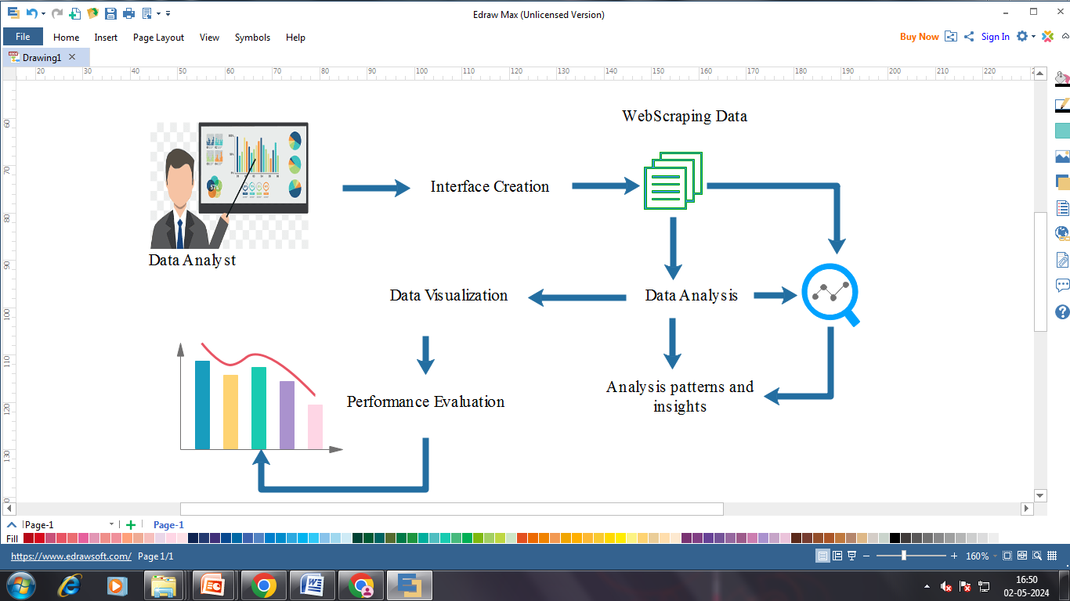
ARCHITECTURE DIAGRAM

Slide 11
USECASE DIAGRAM

Slide 12
MODULES
Interface Creation
Web Scrapping
Data Analysis
Reporting and Visualization

Slide 13
MODULE DESCRIPTION
Interface Creation
This module refers that developing a user interface for visualizing the world's highest-paid celebrities using Python, import library such as BeautifulSoup.
The system gathers data from Forbes' website and applies data analysis techniques to generate meaningful insights from the collected data.
The data including information about the highest paid celebrities such as their names, ranking, earnings, age and category

Slide 14
MODULE DESCRIPTION
Web Scrapping
The "Web Scraping Module" serves as the foundational component responsible for extracting vital data from Forbes' website, particularly focusing on the highest-paid celebrities.
Leveraging libraries like BeautifulSoup and requests, it navigates through webpage structures to parse HTML content and retrieve relevant information such as celebrity names, earnings, and rankings.
This module meticulously handles dynamic webpage elements and anti-scraping measures, ensuring accurate and consistent data extraction

Slide 15
MODULE DESCRIPTION
Data Analysis
This module conducts in-depth data analysis tasks to discern trends, patterns, and insights within the highest-paid celebrity data.
Furthermore, it calculates various SEO metrics, including keyword frequency, analysis, and content optimization scores, providing actionable insights to enhance website ranking and performance.

Slide 16
MODULE DESCRIPTION
Reporting and Visualization
The "Reporting and Visualization Module" plays a pivotal role in summarizing and presenting the analyzed data and SEO metrics in a visually comprehensible format.
It generates comprehensive reports enriched with charts, graphs, and tables, facilitating easy interpretation of insights.
Moreover, the module offers actionable recommendations for optimizing website content, refining keyword targeting strategies, and boosting overall SEO performance based on the analysis results

Slide 17
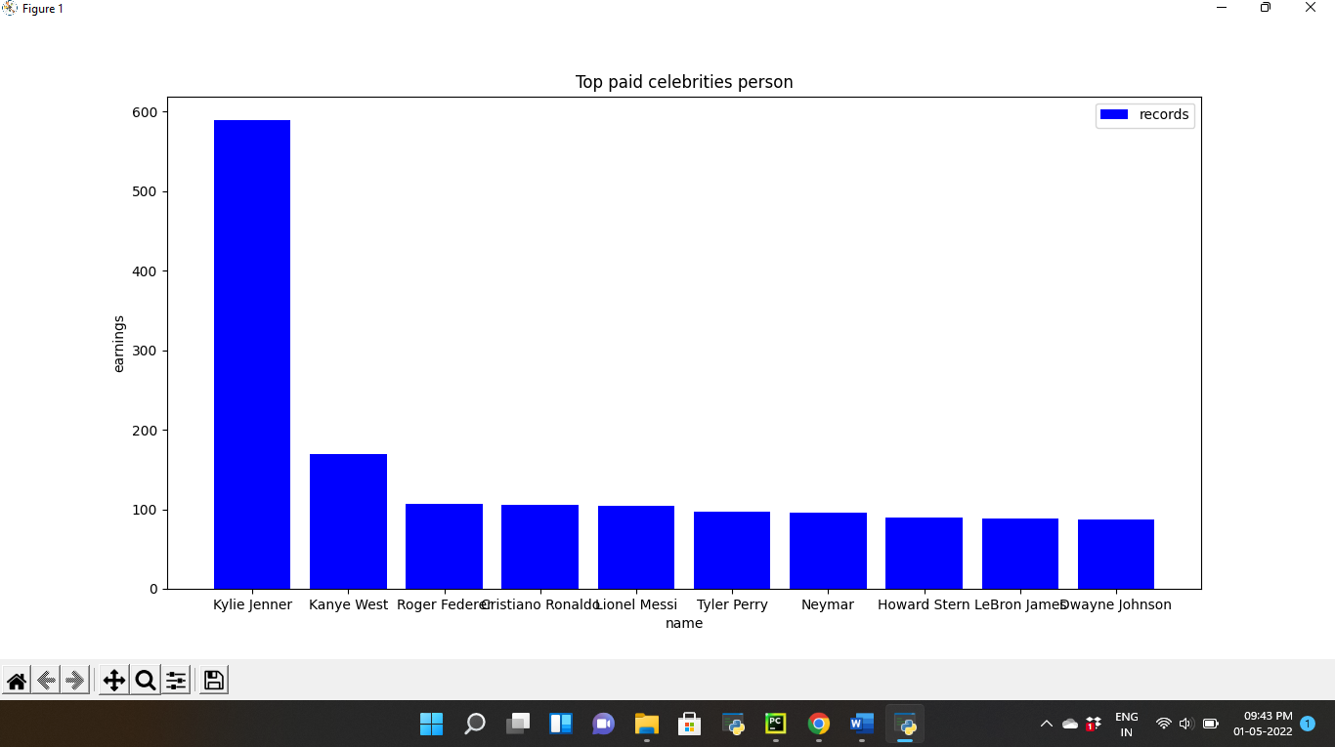
SAMPLE SCREENSHOT

Slide 18
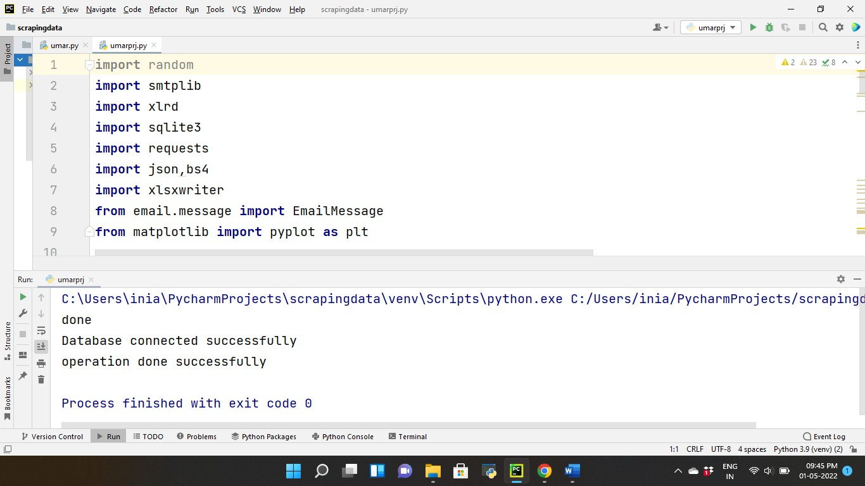

Slide 19
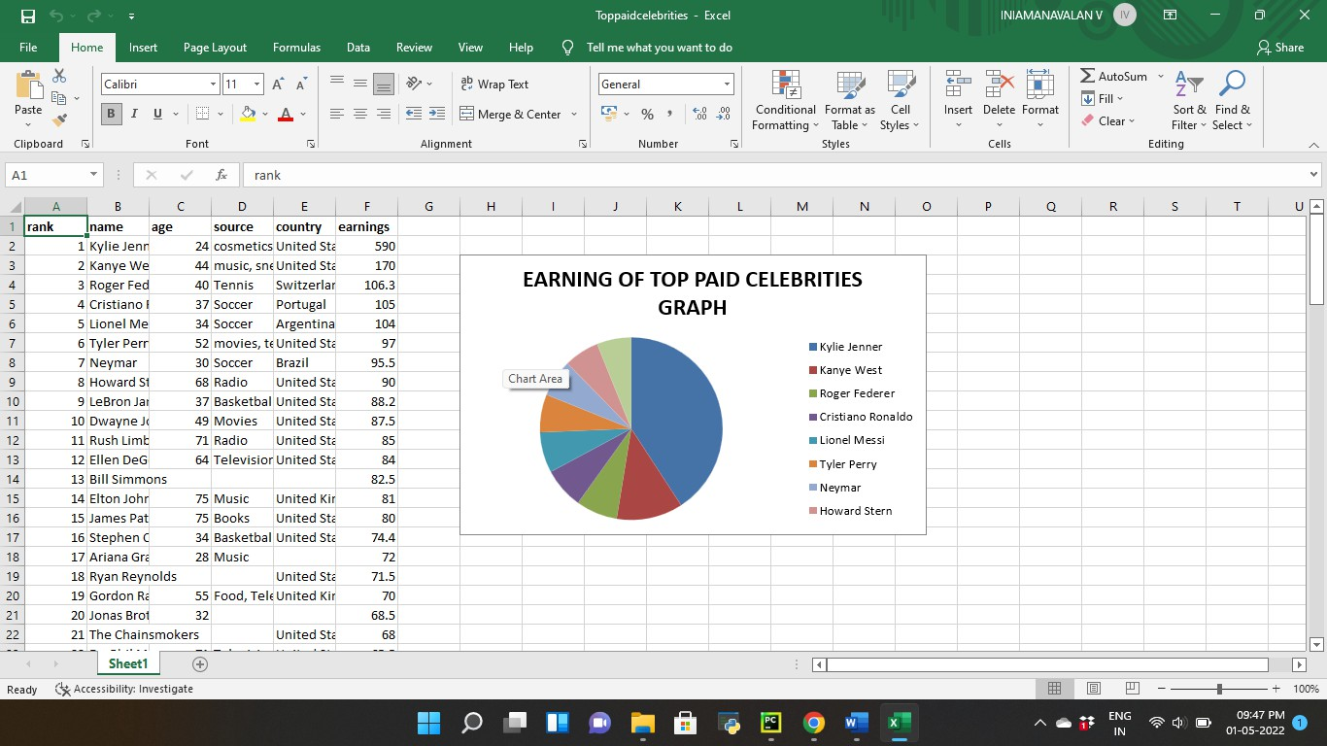

Slide 20
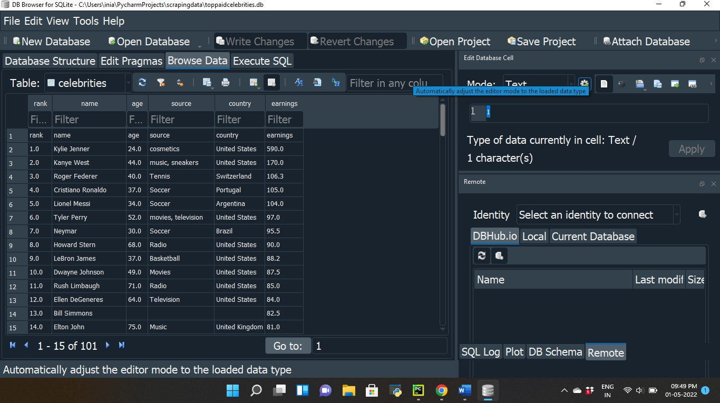

Slide 21
CONCLUSION
In conclusion, web scraping has emerged as a powerful tool for gathering valuable data from online sources, offering numerous applications across various industries.
Through the development of sophisticated scraping techniques and the utilization of robust libraries like BeautifulSoup and requests, researchers and businesses can access timely and relevant information for analysis, decision-making, and strategic planning.
However, as web content evolves and anti-scraping measures become more sophisticated, future enhancements in web scraping technology will be crucial to ensure its effectiveness and sustainability

Slide 22
FUTURE ENHANCEMENT
In future web scraping can explore the integration of machine learning and natural language processing techniques to enhance data extraction and analysis capabilities.
By leveraging these technologies, scraping tools can automatically identify relevant information, extract structured data from unstructured sources, and provide deeper insights into the collected data

