Slide 1
▶
YOUTUBE
✦
PRODUCT CASE STUDY • SEARCH & DISCOVERY
Answer Mode
Turning YouTube search into an answer engine — matching a viewer’s question to the exact moment that answers it.
Prepared for YouTube Search Leadership Review
2026

Slide 2
THE PROBLEM
Search finds the video. It rarely finds the moment.
Long-form tutorials and podcasts bury the single answer a viewer actually came for — forcing them to guess, scrub, and rewatch.
1
2
3
One question, one moment
Buried in long-form
Manual scrubbing
Most searches on long videos map to a single, specific question — not the whole runtime.
The answer often sits minutes into a 20–45 minute video, with no signal of where.
Viewers drag the seek bar, rewatch chunks, and frequently give up before finding it.
ANSWER MODE
02 / 11

Slide 3
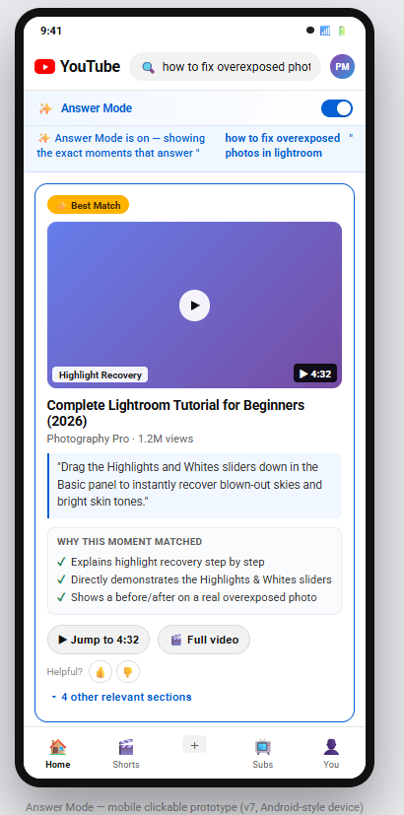
THE SOLUTION
Answer Mode turns results into direct answers
An opt-in layer on Search that ranks and explains the exact moments in a video most likely to answer a query — then gets the viewer there in one tap.
1
Match the moment
AI ranks moments as Best Match, Highly Relevant, or Relevant to the query.
2
Explain the match
Every result shows its own “why this moment matched” reasoning — no black box.
3
One-tap jump
Jump straight to the timestamp, or fall back to the full video anytime.
ANSWER MODE
03 / 11

Slide 4
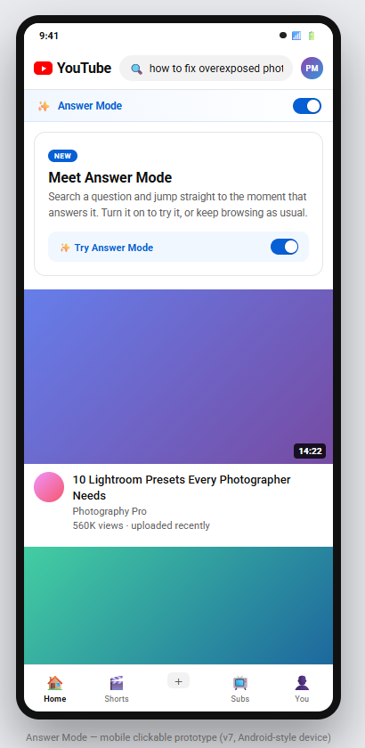
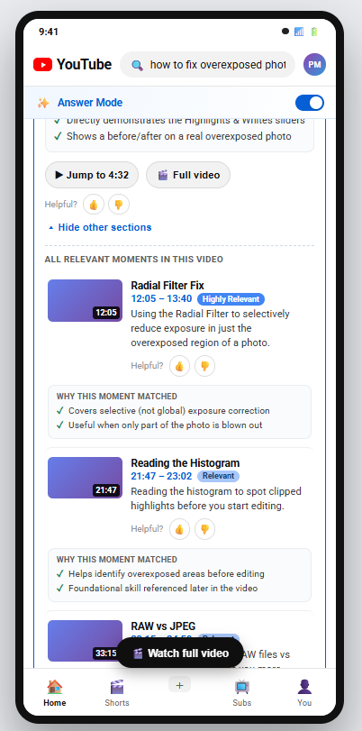
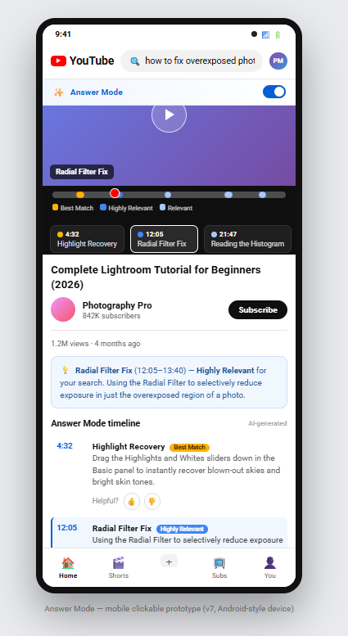
USER JOURNEY
From question to answer in four steps
1
2
3
4
›
›
›
Discover
Ask
Match
Watch
Toggle on from Home
Search a real question
See ranked, explained moments
Jump straight to the moment
ANSWER MODE
04 / 11

Slide 5
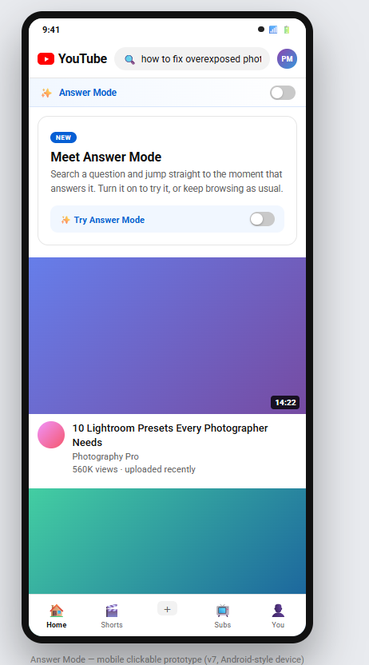
ENTRY POINT
A visible, optional toggle on the Home feed
BEFORE
AFTER
TOP-NAV TOGGLE
Persistent switch — Answer Mode stays off until the viewer opts in.
“NEW” BADGE
Surfaces the feature without interrupting normal browsing.
INLINE EXPLAINER CARD
One line of copy + a second toggle — zero learning curve to try it.
Answer Mode off
Answer Mode on
ANSWER MODE
05 / 11

Slide 6
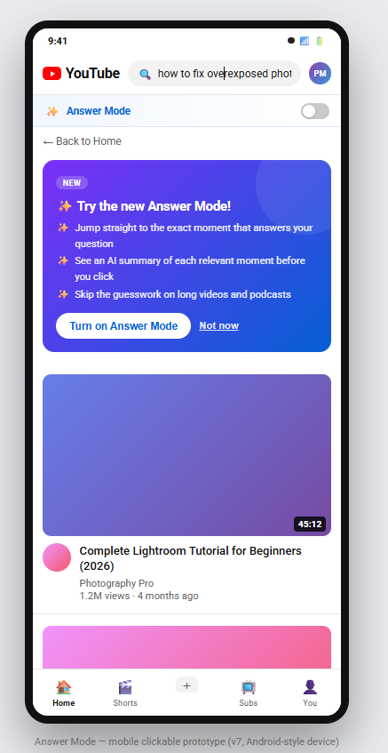
FEATURE DISCOVERY
A prompt to try Answer Mode, right in search results
“NEW” PROMPT CARD
Surfaces only when Answer Mode is off and the query reads like a question — not on every search.
THREE-LINE VALUE PROP
Jump to the moment, get an AI summary, skip the guesswork — the pitch in one glance.
“TURN ON ANSWER MODE”
One tap opts in and instantly re-runs the same query with Answer Mode results.
“NOT NOW”
Always dismissible — the prompt never blocks or gates the normal results.
GRACEFUL FALLBACK
Standard video results still render underneath — nothing is hidden while the viewer decides.
ANSWER MODE
06 / 11

Slide 7
CORE EXPERIENCE
Search results become direct answers
BEST MATCH BADGE
Confidence tier shown at a glance — Best Match, Highly Relevant, or Relevant.
AI-GENERATED SUMMARY
A short, quoted summary of what happens at this exact moment.
“WHY THIS MOMENT MATCHED”
Transparent, per-result reasoning — explainability builds trust in the ranking.
JUMP TO TIMESTAMP
One tap to the moment, or “Full video” to watch normally — never a dead end.
OTHER RELEVANT SECTIONS
Expands to every relevant moment in the video, not just the top result.
ANSWER MODE
07 / 11

Slide 8
CORE EXPERIENCE
The player keeps explaining as you watch
RELEVANCE-DOT SCRUBBER
The seek bar itself is annotated — amber, blue, and gray dots mark Best Match, Highly Relevant, and Relevant moments along the timeline.
JUMP CHIPS
Tappable chips for each ranked moment, with timestamp and label, sit right under the scrubber.
AI-GENERATED TIMELINE
Below the fold, the full “Answer Mode timeline” lists every matched moment with its own explanation.
ANSWER MODE
08 / 11

Slide 9
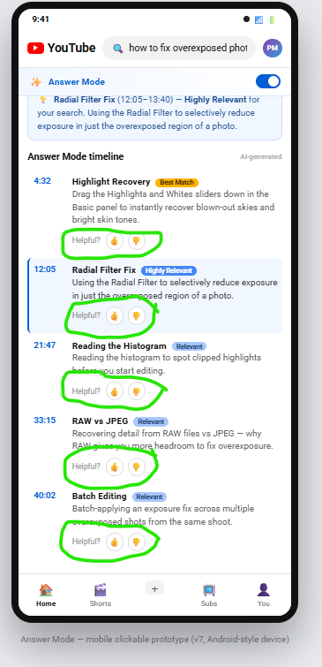
FEEDBACK LOOP
Every match asks a simple question back
HELPFUL / NOT HELPFUL
A thumbs up-or-down sits under every single matched moment, not just the top result.
WHY IT MATTERS
Trains ranking
Signal feeds back into the relevance model — Best Match improves per-query over time.
Per-moment, not per-video
Granular feedback isolates exactly which explanation or timestamp missed, not just “bad video.”
Low-friction
One tap, no forms — designed to be answered by a meaningful share of viewers, not skipped.
ANSWER MODE
09 / 11

Slide 10
ROADMAP
MVP today, a smarter answer engine next
MVP — SHIPPED
NEXT — ROADMAP
What’s live now
Where it goes next
Opt-in toggle on Home and Search
Personalize ranking using feedback + watch-history signal
Best Match / Highly Relevant / Relevant ranking tiers
Extend from search results into related-video recommendations
AI-generated summary + “why this matched” per moment
Multi-video answers — stitch moments across a whole playlist
One-tap jump to timestamp, with full-video fallback
Creator-side insights: which moments viewers say “actually answered it”
Annotated player scrubber + Answer Mode timeline
Answer Mode for live streams and Shorts
Per-moment helpful / not-helpful feedback
Voice and multi-turn follow-up queries (“what about JPEGs?”)
ANSWER MODE
10 / 11

Slide 11
✦
CLOSING VISION
Every video becomes searchable
at the moment level.
Answer Mode is the first step toward YouTube Search that understands intent, not just keywords — turning hours of video into an answer, in seconds.
INTERACTIVE PROTOTYPE
claude.ai/public/artifacts/72535428-7de1-4141-bb98-f633c92ec44d
Thank you
ANSWER MODE
11 / 11

