Slide 1

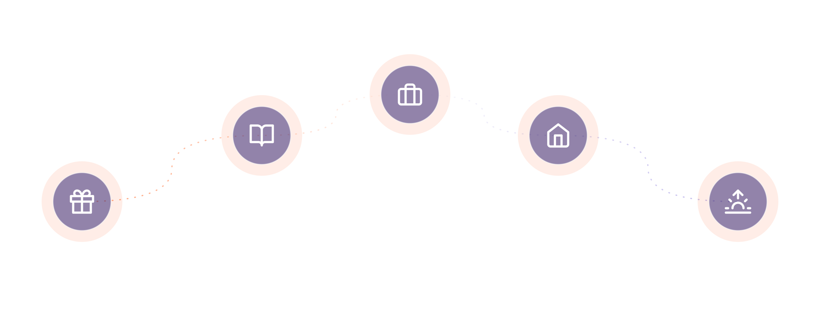
COMPANION AI
Companion AI
An emotionally intelligent AI that grows with you
through every stage of life.
Technology that doesn’t just answer your questions. It remembers your story.

Slide 2




THE PROBLEM, CONCRETELY
Meet Sarah.
“
Sarah, 24
Remote software designer
She isn’t looking for answers.
She’s looking for someone
who remembers her.
Moved to Bangalore. Her parents live 1,500 km away.
Works remotely, mostly alone, most of the day.
People don’t just need information.
They need understanding.
Talks to ChatGPT every evening — because she has no one else to talk to.
Sarah isn’t rare. She’s typical — and she has nowhere else to turn.
02

Slide 3





THE PROBLEM, SYSTEMICALLY
And today’s AI can’t give her that.
It only remembers conversations.
TODAY’S AI
HUMAN RELATIONSHIPS
User
Memory
Question
Trust
Answer
Shared experiences
Conversation ends
Emotional continuity
03

Slide 4






WHY NOW
Why couldn’t this be built five years ago?
Low-latency
voice AI
Frontier
LLMs
Long-context
memory
Affordable
inference
Realistic speech
synthesis
For the first time, a lifelong AI companion is technologically feasible.
04

Slide 5



USER INSIGHTS
What people are really asking for
“
“
“
“
“
Someone who listens
Someone who remembers
Someone who understands
Someone who doesn’t judge
Someone who grows with them
The real emotional need isn’t conversation. It’s feeling understood.
05

Slide 6



INTRODUCING
The first AI designed not to maximize engagement —
but to maximize
personal growth.
Meet Companion AI — a lifelong companion. Not another chatbot, assistant, or therapist.
Voice-First
Long-Term Memory
Emotional Intelligence
Natural, spoken conversation that feels human.
Remembers your story, not just your last message.
Understands feelings, not just words.
Adaptive Personality
Growth-Oriented
Relationship-Driven
Personalizes tone and style to fit you.
Helps you become your best self.
Optimized for connection, not just answers.
06

Slide 7


THE ARCHITECTURE
A system built for relationship — not just response.
Voice
Emotion
Relationship
Engine
Memory
Planning
LLM
The loop repeats — continuously feeding back into Voice, deepening with every conversation.
Six systems, working as one relationship.
07

Slide 8




THE JOURNEY
The companion grows because you grow.
Child
Student
Professional
Parent
Older Adult
Storyteller
Mentor
Coach
Support system
Memory companion
Learning buddy
Study partner
Friend
Reflection partner
Legacy companion
08

Slide 9



WHY WE WIN
Our moat isn’t the model. It’s Relationship Intelligence.
Anyone can ship a better model next month. No one can copy years of remembered relationship.
Conversation
Every exchange, captured
Memory
What matters, retained
Relationship Graph
How people & moments connect
Life Timeline
Your story, in sequence
Personalization
Tone, pace, and style — tuned to you
Growth Engine
Turns memory into momentum
Each layer compounds with time — that’s what makes it hard to copy.
09

Slide 10

MVP STRATEGY
One user. One problem. One job to be done.
CORE MVP FEATURES
Voice conversations
Persistent memory
Rahul, 26
Daily reflections
Goal tracking
Software Engineer · Lives alone
Feels overwhelmed most evenings
Proactive check-ins
Natural avatar
Talks to ChatGPT nightly — but it forgets everything the next day
Needs someone who remembers his goals
Rahul is our first user. If Companion AI matters to him, it will matter to millions like him.
10

Slide 11


BUSINESS MODEL
A simple path to scale
Initial User
Subscription
Network Effects
Expansion
One relationship, deeply valued
Priced for daily habitual use
Trust spreads through word of mouth
New personas, new relationships
BUSINESS MODEL
GO-TO-MARKET
Freemium entry → premium subscription, priced for a daily habit — not a one-off task.
Start with young professionals → expand through emotional trust and word of mouth into every relationship.
11

Slide 12
LONG-TERM VISION
From one companion to a life companion platform
Life Companion
Platform
Family
Ecosystem
Relationship
Support
Multiple
Personas
One
Companion
EXPANDING TO EVERY RELATIONSHIP THAT MATTERS
Children
Students
Professionals
Couples
Parents
Families
12

Slide 13



FOUNDATIONS
Trust is the foundation of the product
Privacy-first
Transparent memory
User controls
Healthy boundaries
Supports — never replaces — human relationships
Never manipulates users
This is a companion, not a replacement for human connection.
13

Slide 14
A LIFETIME OF MEMORY
8
18
28
40
72
“I’m scared of school.”
“I got into university.”
“I’m getting married.”
“My daughter started school today.”
“Do you remember
my first day?”
“Do you remember when I was scared on my first day?”
“I do. And I remember how proud you were when your daughter
walked into school with that same smile.”
COMPANION AI
Technology that doesn’t just answer your questions. It remembers your story.

