Slide 1
EXAMPLE OF MULTISCALAR SPATIAL ANALYSIS target variable : Peaks of population density
V2
A peak of population density appears when the density is higher in local neighbourhood V1 than in global neighbourhood V2
In this case, it is possible to define the spatial concentration as the quantity of population P which should move from V1 to V2 in order to obtain an equilibrium of population density in V1 and V2
V1
. i
V2
V1
. i

Slide 2
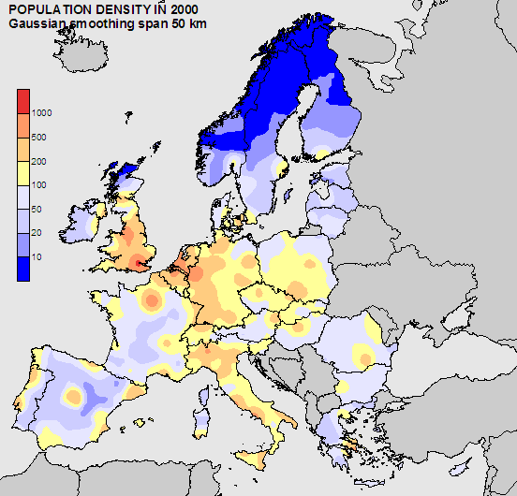
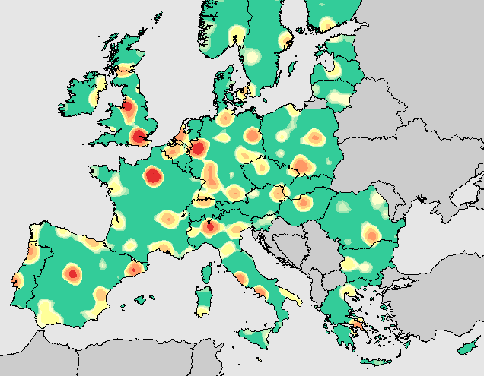
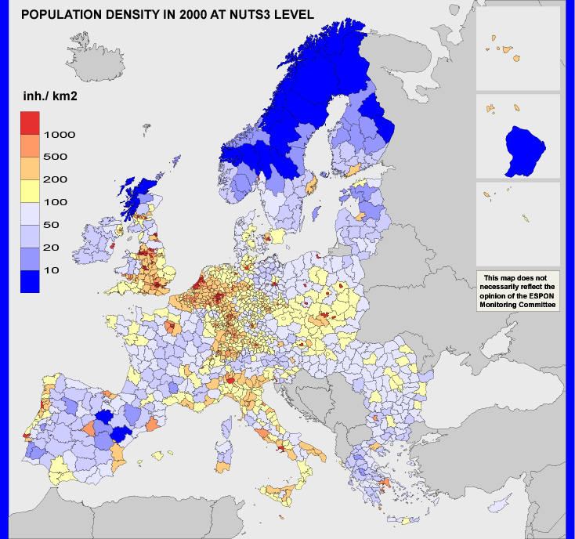
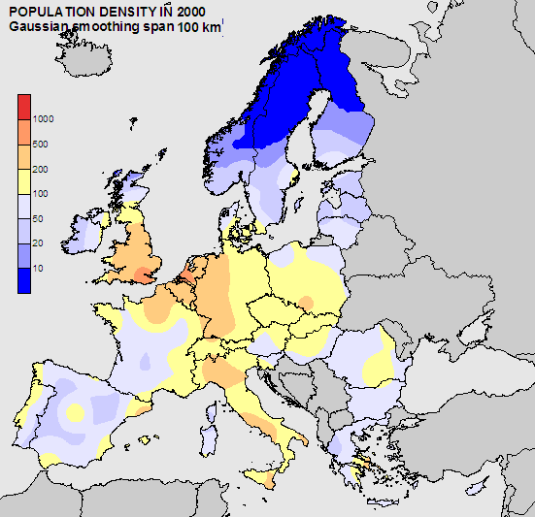
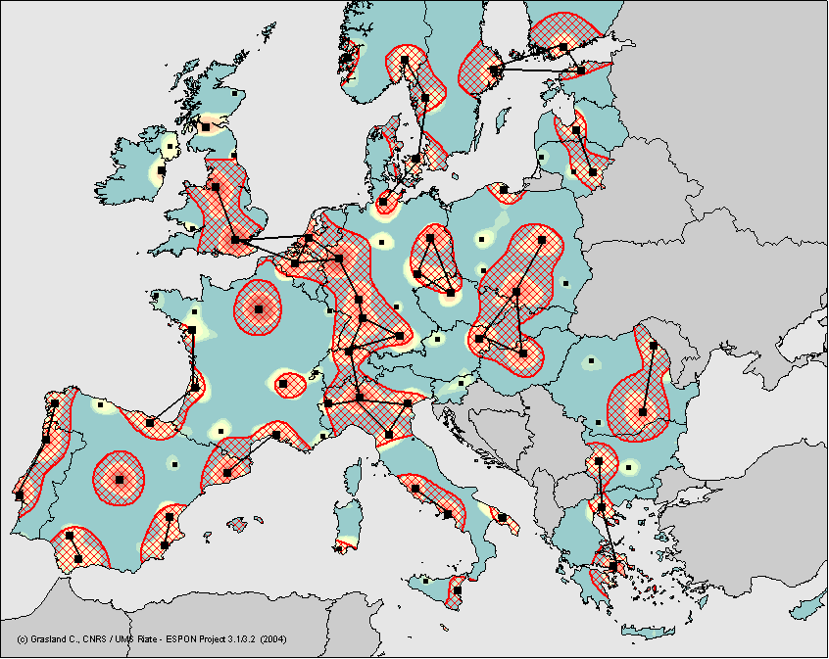
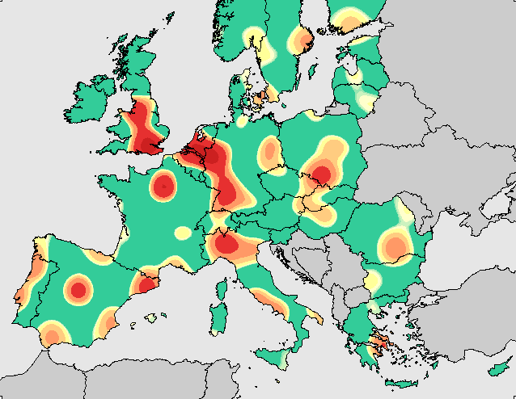
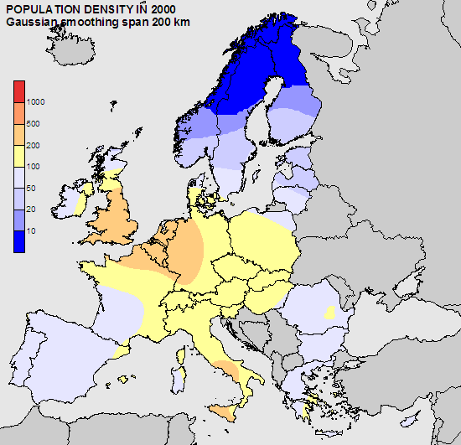
EXAMPLE OF MULTISCALAR SPATIAL ANALYSIS Summary of the scale transformations

Slide 3

EXAMPLE OF MULTISCALAR SPATIAL ANALYSIS Population density in a gaussian neighbourhood span 50 km

Slide 4
EXAMPLE OF MULTISCALAR SPATIAL ANALYSIS Population density in a gaussian neighbourhood span 50 km

Slide 5
EXAMPLE OF MULTISCALAR SPATIAL ANALYSIS Population density in a gaussian neighbourhood span 100 km

Slide 6
EXAMPLE OF MULTISCALAR SPATIAL ANALYSIS Population density in a gaussian neighbourhood span 100 km

Slide 7

EXAMPLE OF MULTISCALAR SPATIAL ANALYSIS Population density in a gaussian neighbourhood span 200 km

Slide 8
EXAMPLE OF MULTISCALAR SPATIAL ANALYSIS Population density in a gaussian neighbourhood span 200 km

Slide 9
EXAMPLE OF MULTISCALAR SPATIAL ANALYSIS Peaks of population for neighbourhoods of 50-100 km

Slide 10
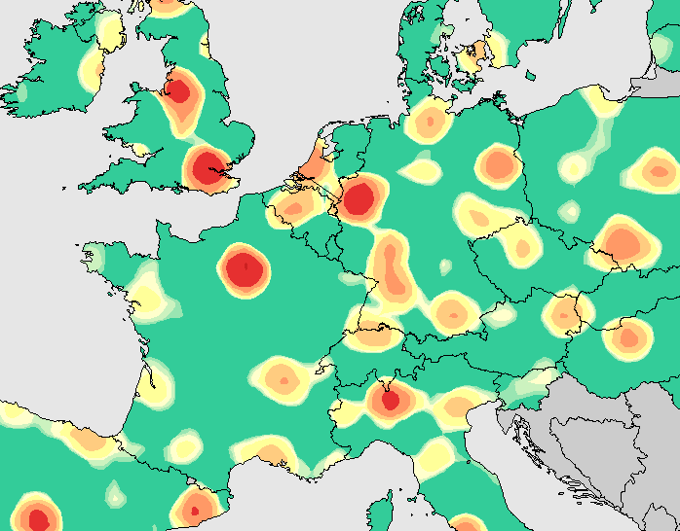
EXAMPLE OF MULTISCALAR SPATIAL ANALYSIS Peaks of population for neighbourhoods of 50-100 km (zoom)

Slide 11
EXAMPLE OF MULTISCALAR SPATIAL ANALYSIS Peaks of population for neighbourhoods of 100-200 km

Slide 12
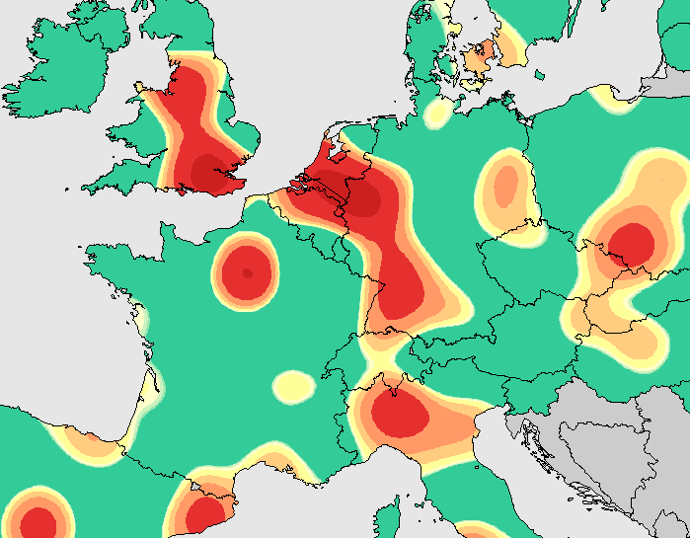
EXAMPLE OF MULTISCALAR SPATIAL ANALYSIS Peaks of population for neighbourhoods of 100-200 km (zoom)

Slide 13
EXAMPLE OF MULTISCALAR SPATIAL ANALYSIS Delimitation of polycentric area of population concentration

Slide 14
CONCLUSION
The evaluation of the potential of european regions should not be based only on their internal situation according to NUTS.
The situation of neighbouring regions should be taken into account by appropriate spatial analysis tools (discontinuities, smoothing methods, …).
The fact that political action takes place in NUTS2 and NUTS3 units does not necessary mean that the scientific diagnosis should be realised in this territorial framework.

