Slide 1
CSPD6

Slide 2
CSPRn

Slide 3
CBL

Slide 4
CBM

Slide 5
Mish

Slide 6
SPP

Slide 7
MaxPooling

Slide 8
Average
Pooling

Slide 9
Dense blk

Slide 10
Zero
Padding

Slide 11
ZCRn

Slide 12
CSPRn

Slide 13
Up
Sample

Slide 14
Down
Sample

Slide 15




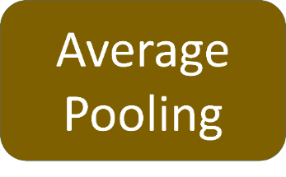
Shortconv
add

Slide 16

Shortconv
add

Slide 17
SPP
MaxPooling
Concat
SPP
MaxPooling
MaxPooling

Slide 18



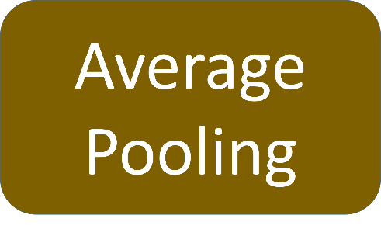
Transition blk
Transition blk

Slide 19

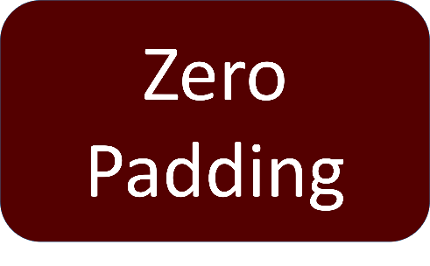
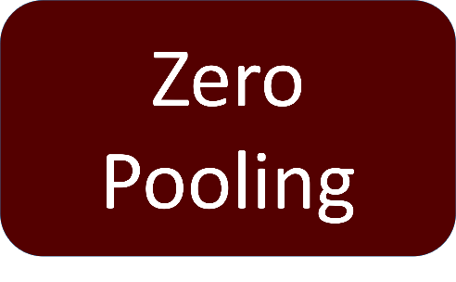

ZCRn

Slide 20


CSPDn
Part One
Concat
Part Two
Transition blk
*n

Slide 21


CSPRn
Concat
Part One
Part Two

Slide 22




CBL

Slide 23

CBM
Mish

Slide 24
Dense blk

Slide 25





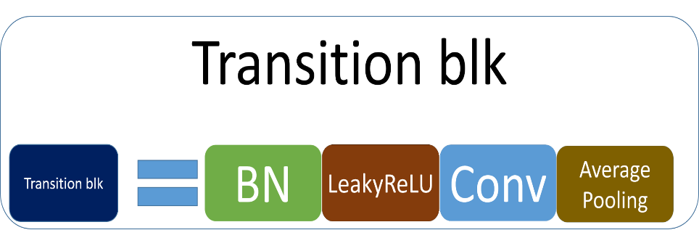
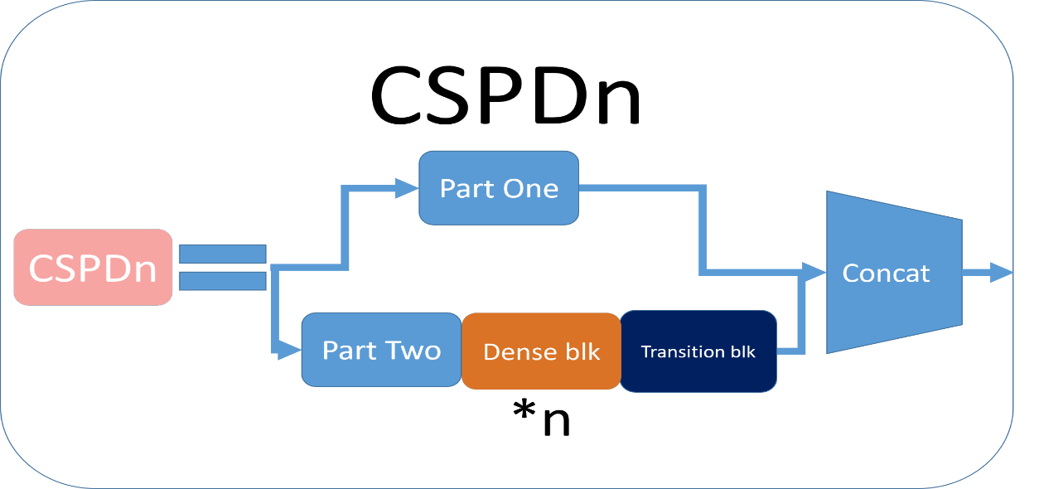
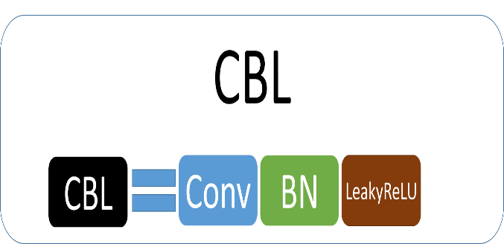
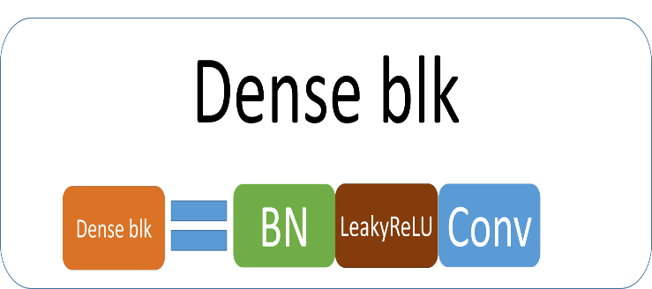
Backbone
Neck
Head
(CSPDensenet121)
(YOLOV3_Head)
CBL*5
13x13 / 1024
CSPD
6
CSPD
16
CSPD
24
Concat
YOLO_Loss
CBL*5
26x26 / 1024
Concat
CBL*5
52x52/ 512

Slide 26






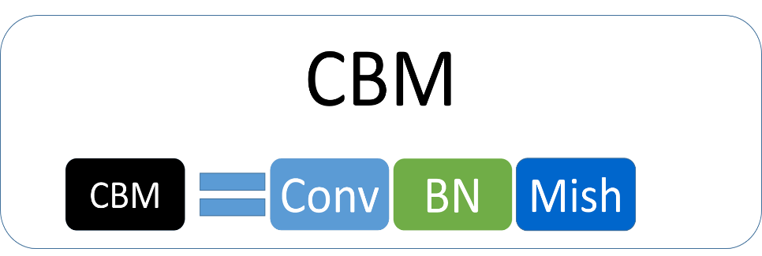
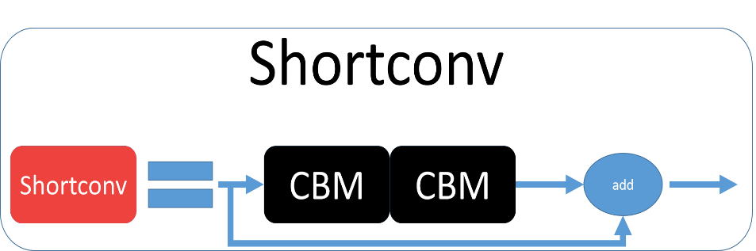
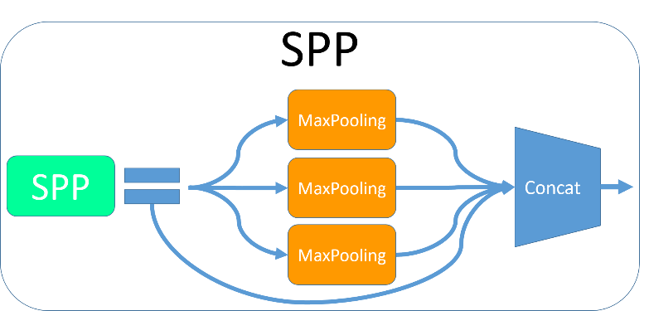
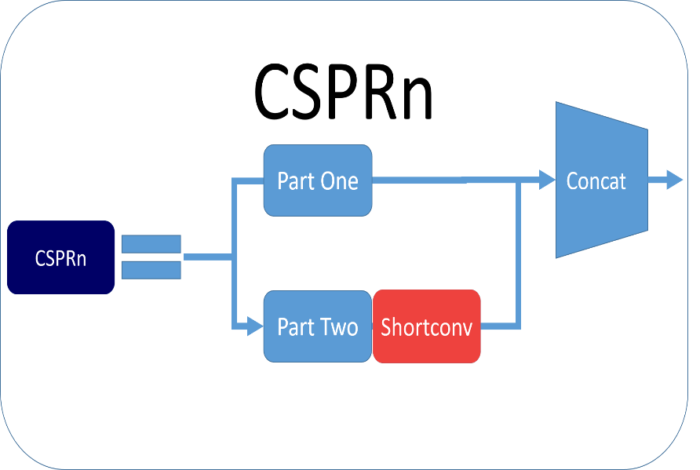
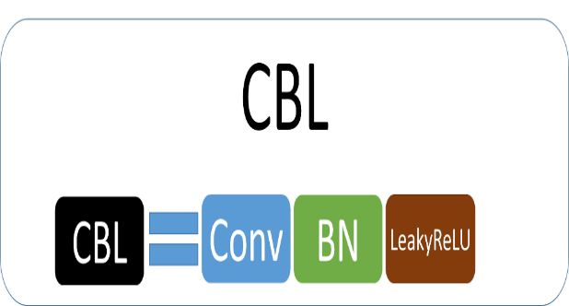
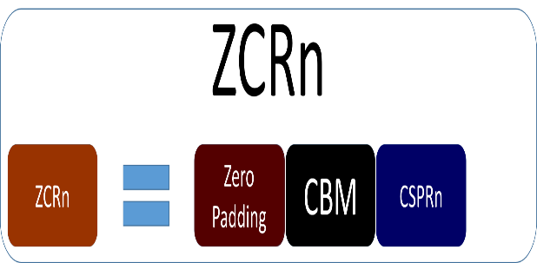
Backbone
Neck
Head
(CSPDarknet)
(YOLOV3_Head)
SPP
CBL*4
CBL*3
Concat
CBM*5
19x19/ 1024
608x608
Concat
Concat
YOLOv4
Loss
CBL*5
CBM*5
38x38 / 512
Concat
CBL*5
76x76/ 256

Slide 27
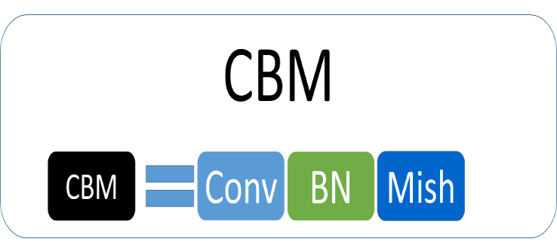
Backbone
Neck
Head
(CSPDensenet121)
(YOLOV3_Head)
CBL*6
Concat
CBM*5
13x13/ 1024
416x416
Concat
Concat
YOLOv4
Loss
CSPD
6
CSPD
16
CSPD
24
CBL*5
CBM*5
26x26 / 1024
Concat
CBL*5
52x52/ 512

Slide 28
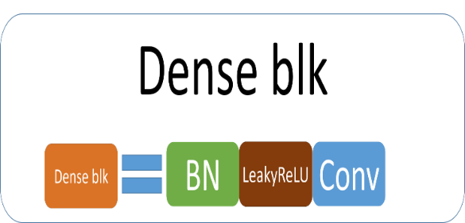


Backbone
Neck
Head
(CSPDensenet121)
(YOLOV3_Head)
SPP
CBL*3
CBL*3
52x52/ 512
CSPD
6
CSPD
16
CSPD
24
Concat
YOLO_Loss
CBL*5
26x26 / 1024
Concat
CBL*5
13x13 / 1024

Slide 29

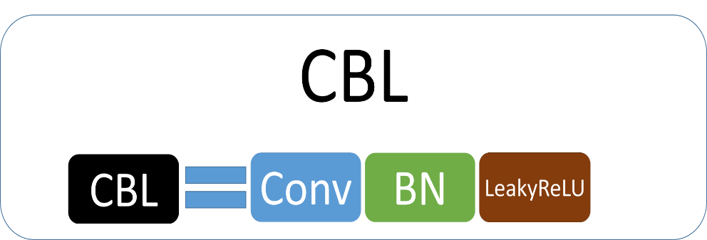
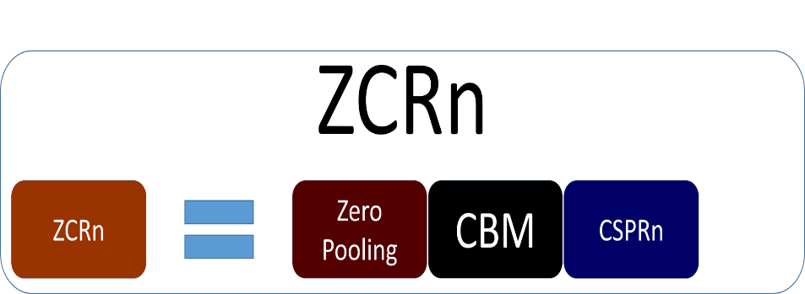
Backbone
Neck
Head
(CSPDarknet)
(YOLOV3_Head)
CBL*5
Concat
CBM*5
13x13/ 1024
Concat
Concat
YOLOv4
Loss
CBL*5
CBM*5
26x26 / 1024
Concat
CBL*5
52x52/ 512

