Slide 1








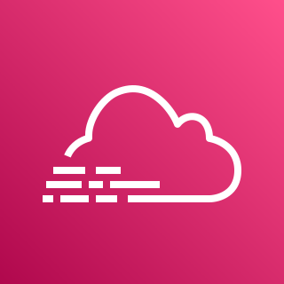


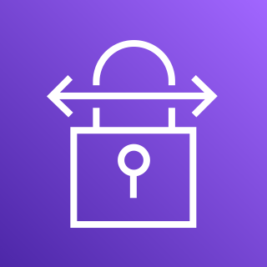



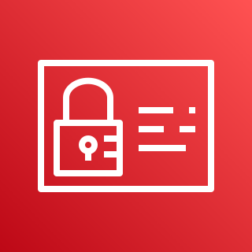
AWS Cloud
Internet gateway
Logging and audit controls
Management VPC
Production VPC
Development VPC
Availability Zone 1
Availability Zone 2
Availability Zone 1
Availability Zone 2
Availability Zone 1
Availability Zone 2
CloudWatch
S3
Public subnet
Public subnet
AWS Config
S3
NAT gateway
NAT gateway
Private subnet
Private subnet
Private subnet
Private subnet
Private subnet
Private subnet
CloudTrail
S3
Customer connectivity
Flow logs
Flow logs
Flow logs
AWS Site-to-Site VPN
All flow logs
AWS Direct Connect
AWS Transit Gateway
Access control and alerting
SNS
IAM

Slide 2
AWS Cloud
Development VPC
Logging and audit controls
Management VPC
All flow logs
Flow logs
CloudWatch
S3
NAT gateway
Customer connectivity
AWS Config
S3
Internet gateway
Flow logs
AWS Transit Gateway
AWS Site-to-Site VPN
CloudTrail
S3
Access control and alerting
Production VPC
NAT gateway
AWS Direct Connect
Amazon SNS
Flow logs
AIM

Slide 3
Logging and audit controls
All flow logs
CloudWatch
AWS Config
CloudTrail
S3
S3
S3

