Slide 1

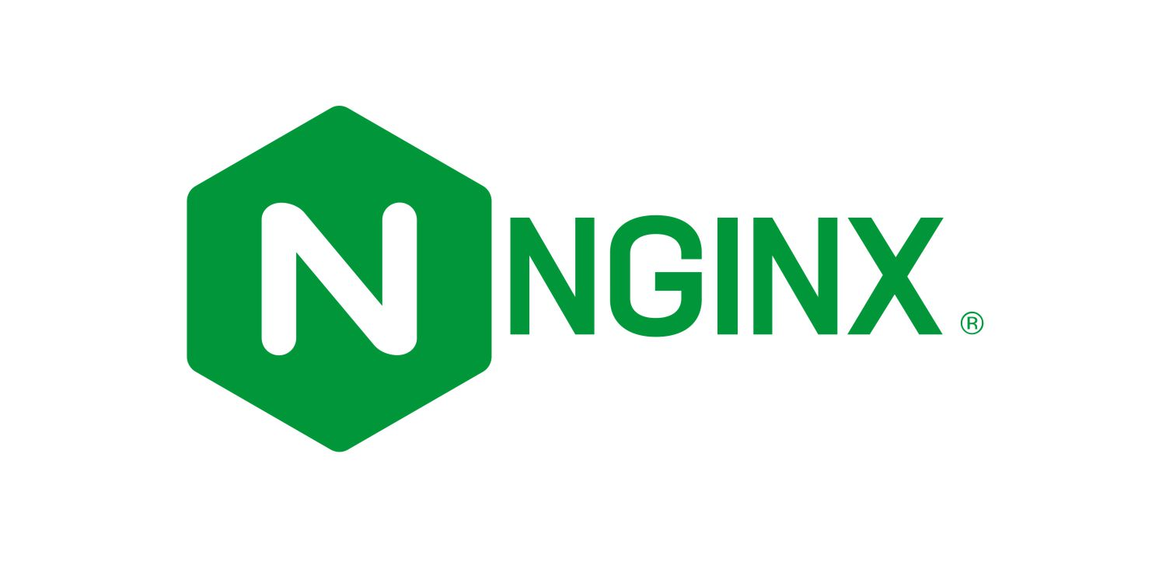
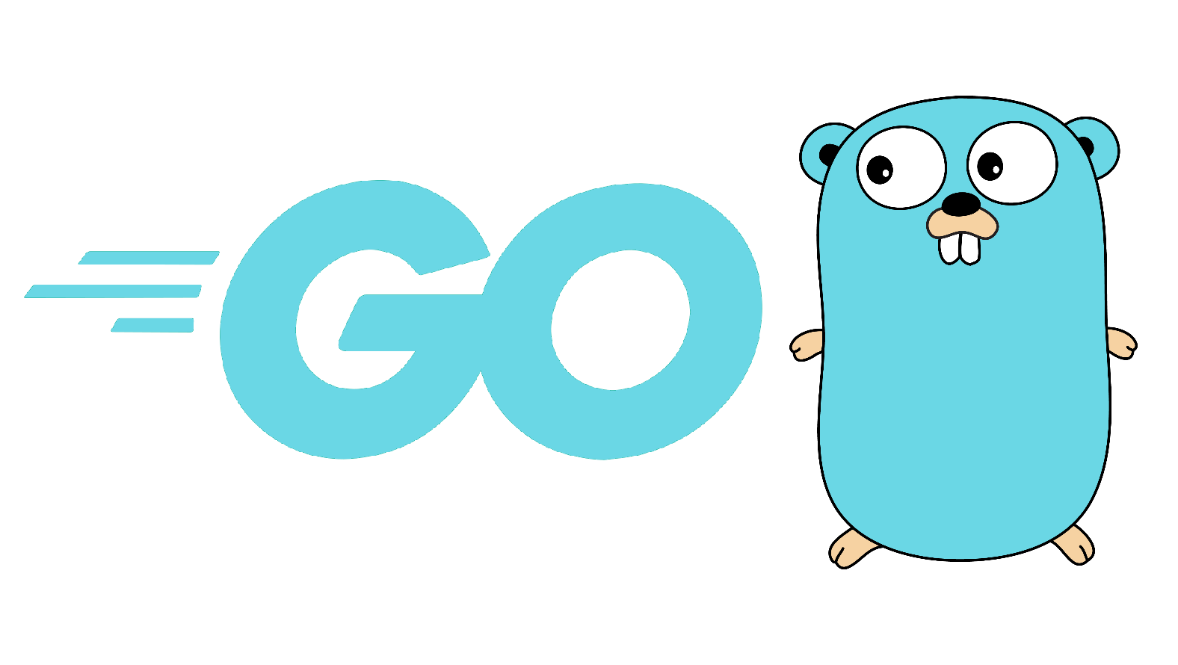





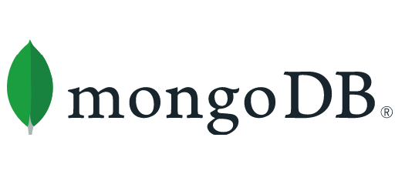
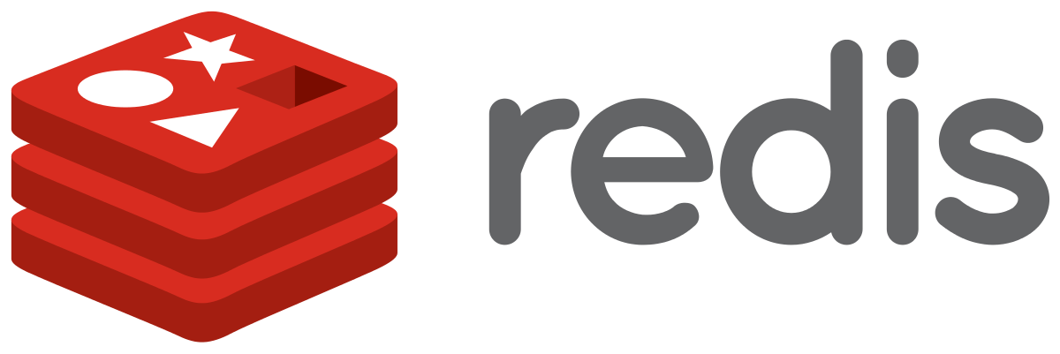
Docker Image
MongoDB Access
Axios Req/Resp.
Redis (JWT Token) Access
Nginx Proxy

Slide 2
Client
(A) Authorization Grant
Authorization Server
(B) Access Token & Refresh Token
(C) Access Token
Resource Server
(D) Protected Resource
(E) Access Token
(F) Invalid Token Error
(G) Refresh Token
(H) Access Token

