Slide 1


Labatt Blue Promotional Research
By Brian Worrall

Slide 2

Company Information
Labatt Brewing Company Ltd. was founded in 1847 by John Kinder Labatt in London, Ontario, Canada
Largest brewer in Canada
Is now owned by Belgian company InBev
Has over 3200 employees
Part-owner of The Beer Store, which takes over 90% of Ontario beer sales

Slide 3
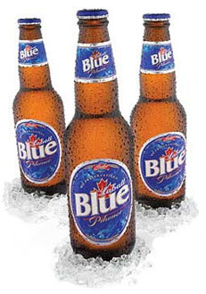
Canadian Products
Labatt produces beer under the names Blue, Blue Light, Bleue Dry, Crystal, Extra Dry, 50, Genuine, Ice, Lite, Nordic, Wildcat, Wildcat Strong, and Sterling
Labatt also markets its Canadian products under the names Oland, Schooner, Alexander Keith’s, Columbia, Kokanee, Kootenay, Club, and Blue Star

Slide 4
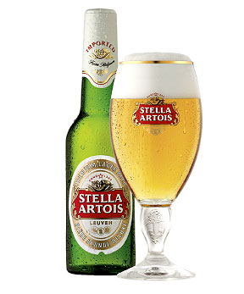
Associated Products
Labatt also is associated with marketing beer with such names as Budweiser, Guinness, Stella Artois, Hoegaarden, Leffe Blonde, Belle-Vue Kriek, Bass Pale Ale, Boddingtons, and Cristal around the world

Slide 5
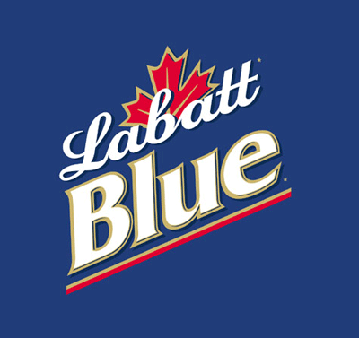
Labatt Blue
First brewed in 1951 and marketed as Pilsener Lager
Nicknamed “Blue” after the colour of its label and the company’s support of the Winnipeg Blue Bombers
Most popular beer in the world, based on worldwide sales

Slide 6
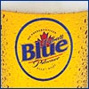
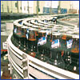
Labatt Blue - Composition
Best served between 35.60°F and 37.60°F
4.7% Alcohol Content by volume
153 calories per 12-ounce serving
Good balance, fruity character, and a slightly sweet taste

Slide 7
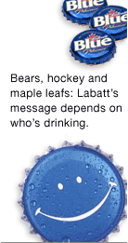
Marketing
Slogan: “Best When Enjoyed Responsibly”
Like most beer, Labatt Blue is associated with professional hockey, and hence promotions usually have a hockey theme

Slide 8

Promotions
The promotion of putting something FREE inside the beer case with the beer bottles is a strategy that many other beer companies use
Labatt is also Canadian in origin, so it is also marketed using Canadian content, such as putting Canadian music FREE inside the beer case

Slide 9

Promotional Timeline (1)
April 2003 - LaBatt Blue temporary 15 pack Cup Crazy promotion. During the months of April and May, consumers will find one limited edition NHL original bottle inside specially marked 15 bottle packs of LaBatt Blue (six collectible bottles in total)
June 2003 - LaBatt Blue Hometown Bash. During the month of June, consumers will have a chance to win an exclusive trip to the LaBatt Blue Hometown Bash, London, Ontario by finding the specially marked bottle that says, “ You win”. The prize trip includes air-fare, 3 nights accommodations, $400 spending money, backstage passes and 2 tickets to the Hometown Bash. Promo in support of LaBatt Blue 12

Slide 10
Promotional Timeline (2)
April 2004 - During the months of April and May, consumers will find a Scratch N Win game card inside every specially marked package of Labatt Blue 15 packs. Each game card is potentially a winning card and prizes include the NHL themed X box, X box NHL games and more
July 2004 - LaBatt Blue 24 pack promotion. Inside specially marked cases of LaBatt Blue 24's, consumers will receive free 1 of 4 “collectible” CD’s : Our Lady Peace, The Tragically Hip, Sum 41 and Jet.

Slide 11
Promotional Timeline (3)
April 2005 - During the months of April & May, with every purchase of Labatt Blue 15's @ $19.99, consumers will have a chance to win an exciting trip for 4 to Las Vegas or 1 of 100 Labatt Blue insulated beer dispensing poker tables (Labatt Blue 15 pack temporary listing). A Labatt Blue poker chip has been inserted inside each specially marked 15 bottle case of Labatt Blue. Scratch the chip to see if you have won.
July 2005 - With every purchase of specially marked Labatt Blue 24's consumers will find 1 or 2 collectible Labatt Blue t-shirts (July only)
March 2006 - Labatt Blue 12 pack and Blue Light 12 pack both reduced from $18.80 to $17.80

Slide 12
Promotional Timeline (4)
April 2006 - During the month of April, Labatt Blue 12's and Blue Light 12's will be available at a special price of $16.80.
June 2006 - Purchase either a LaBatt Blue 12 or a Blue Light 12 and receive a free Blue quart while supplies last
July 2006 - During the month of July, with every purchase of Blue 12's and Blue Light 12's, consumers will receive a free quart of LaBatt Blue ( while supplies last)
September 2006 - LaBatt Blue 16 pack promotion. During the months of September and October, consumers will receive a free LaBatt Blue quart with the purchase of a LaBatts Blue 16 pack which will sell for $21.99

Slide 13
Promotional Timeline (5)
October 2006 - LaBatt Blue 16 pack promotion continues thru to end October. Purchase a LaBatt Blue 16 pack @ $21.99 and receive a free LaBatt Blue Quart
November 2006 - During the months of October and November with every purchase of Bud Light 24 bottle pack, consumers will find in case , a LaBatt Blue themed cap
January 2007 - During the month of January, consumers can purchase LaBatt Blue 12's @ a special $17.30, $2.00 off regular price

Slide 14
Promotional Timeline (6)
July 2007 - Labatt Blue 16 pack @ $20.99. In addition, with every purchase consumers will have a chance to win $25,000 ( 1- $25,000 draw for July; 1- $25,000 for August)
August 2007 - LaBatts Blue 16 pack Temporary Listing promotion continues throughout August. Purchase a 16 pack of LaBatts Blue @ $20.99 and consumer has a chance to win $25,000

Slide 15
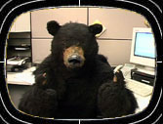
References
http://www.labattblue.com/main.jsp
http://en.wikipedia.org/wiki/Labatt_Brewing_Company
http://www.labatt.ca/
http://www.peilcc.ca/index.php3?number=71361

